Slide 1
Women in European History
A Review of People and Principles Renaissance to Present

Slide 2
Late Middle Ages and Renaissance Women
Witch hunts common throughout 1400s-1600s
In the Renaissance, women often gained power/prominence by becoming patrons
Very few published authors/artists
Christine de Pisan, Laura Cerata, Isabella d’Este most important
Renaissance merchant class women held powerful position in the family, helping to run the family business, often controlling the bookkeeping
Overall, still a patriarchal society

Slide 3
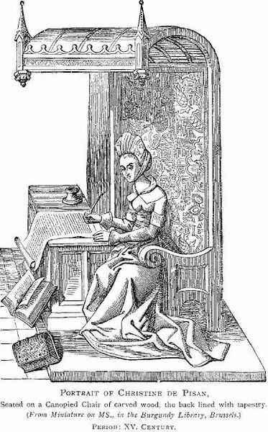
Christine de Pisan 1364-1430 Author and Teacher of the Late Middle Ages

Slide 4
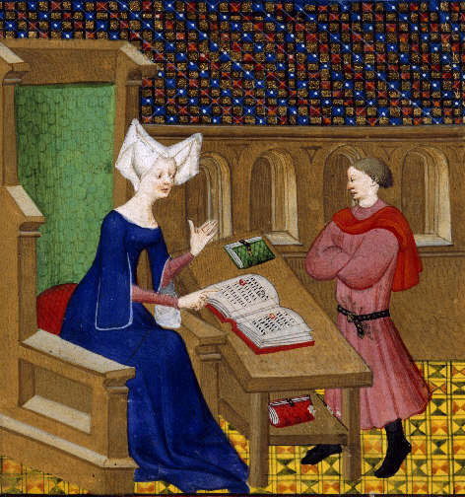
Pisan instructing her son

Slide 5
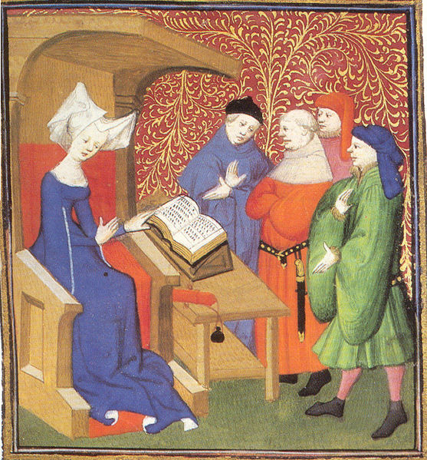
Pisan Instructing a Group of Men

Slide 6
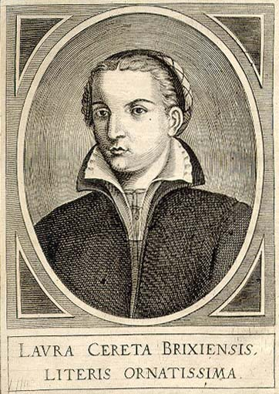
Laura Cereta 1469-1499 Well-Accepted among Male Writers until she tried to Publish her works; accused of Plagiarism

Slide 7
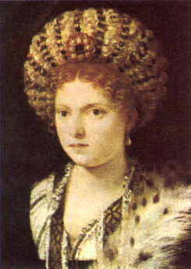
Isabella d’Este 1474-1539 Most Famous of the Female Patrons

Slide 8
Reformation Women
In the Protestant Reformation, women gained power in the new churches
allowed to speak, sometimes even hold positions
In the Catholic Reformation, women led reform movements

Slide 9
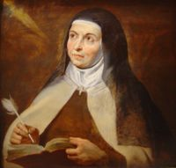
St. Teresa of Avila (1515-1582) Spanish Mystic of the Catholic Reformation

Slide 10
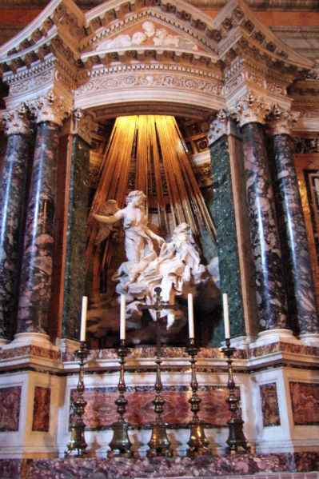
The Ecstasy of Saint Teresa of Avila by Bernini

Slide 11
Royal Women
Women often played major roles whether they were queen, regent to their son, or the influential wife of a king

Slide 12
Catherine de Médicis 1519-1589 Mother to and Regent of Francis II, Charles IX, Henry III of France During French Wars of Religion

Slide 13
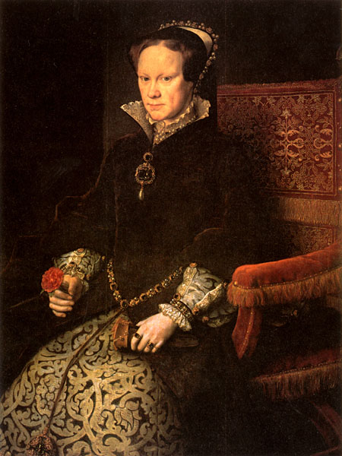
Mary I of England Mary Tudor r. 1553-1558 Nicknamed “Bloody Mary” for her Protestant Persecution after the death of her brother Edward VI

Slide 14
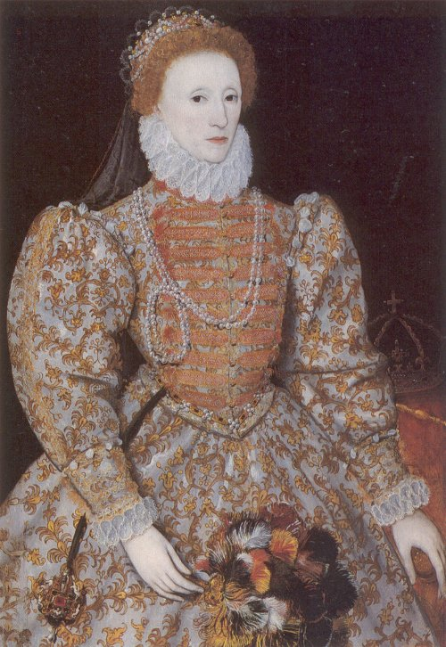
Elizabeth I of England r. 1558-1603 Reign is Known for Rise in English Power over Spain, prosperity, golden age of the Arts

Slide 15
Marie de Médicis 1575-1642 Wife of Henry IV (Navarre) and and Regent for Son Louis XIII of France

Slide 16
Mary II of Orange r. 1689-1694 Protestant daughter of Stuart King James II; Part of the “Glorious Revolution” Duo

Slide 17
Marie Thérèse 1638-1683 Wife of Louis XIV Wars of Devolution and Spanish Succession Based on her Ties to Land Holdings

Slide 18
Holy Roman Empress Maria Theresa r. 1740-1780 First Female HRE Due to Pragmatic Sanction

Slide 19
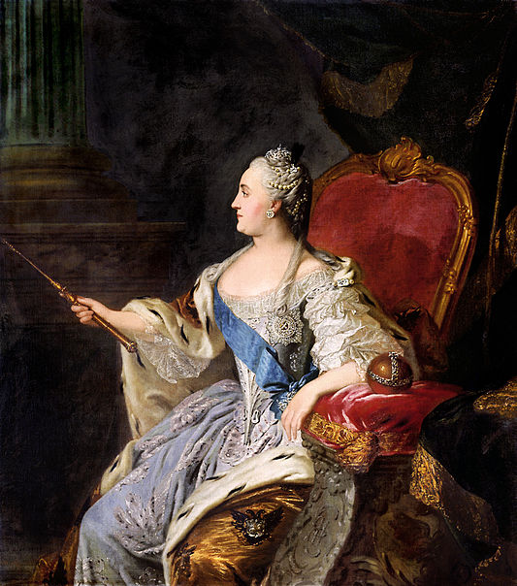
Catherine the Great of Russia r. 1762-1796 German Princess Turned First Czarina, “Englightened” Despot, partioner of Poland

Slide 20
Queen Victoria Era known for Peace and Prosperity, and moral and behavioral standards r. 1837-1901

Slide 21
Czarina Alexandra 1872-1918 Wife of Czar Nicolas II who Allowed Rasputin to make political decisions after he “saved” her son

Slide 22
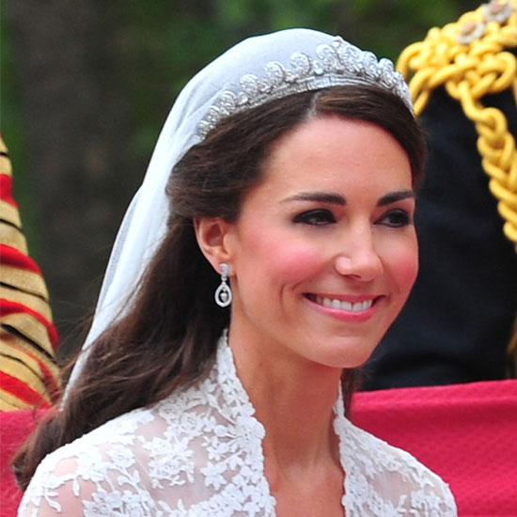
What will she do?

Slide 23
Women of the Enlightenment and French Revolution
Became more outspoken as society began embracing change only to find that their kind of change wasn’t wanted!
Rousseau said women should always be subordinate to men
Montesquieu feared equality would cause problems in society (even though he supported it)
Women often gained power by hosting salons instead of trying to publish their own writings
During the Revolution, women were active participants early (march on Versailles) but were persecuted during the Reign of Terror (de Gouges)

Slide 24
The Salon of Madame Geoffrin

Slide 25
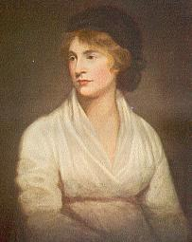
Mary Wollstonecraft 1759-1797 Battled Rousseau over women’s rights, said Equality of Education the Key to gaining equal rights

Slide 26
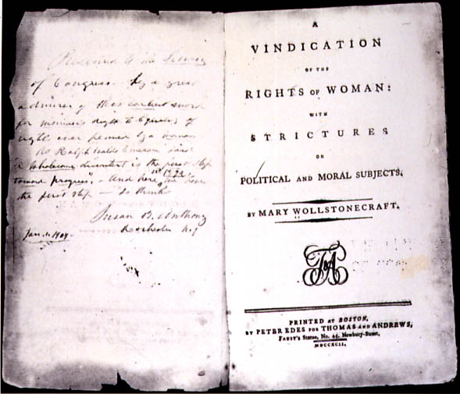
A Vindication of the Rights of Women

Slide 27
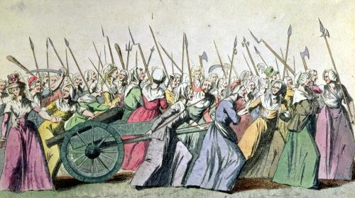
The Women March on Versailles

Slide 28
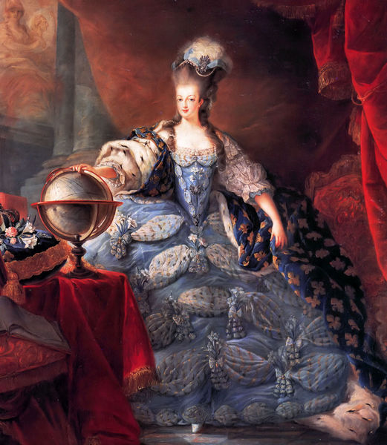
Marie Antoinette 1774-1792 Wife of Louis XVI Executed During French Revolution

Slide 29
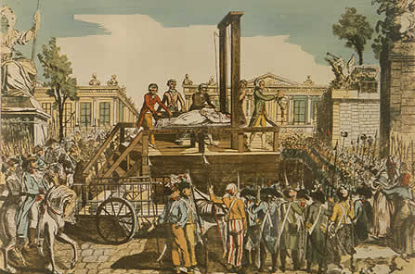
Execution of Marie Antoinette

Slide 30
Olympe de Gouges 1748-1793 Declaration of the rights of women and Citizen Executed during reign of terror

Slide 31
Women and the Industrial Revolution
Factories replaced putting-out system so many turned to cottage industries
Women hired for same positions in factories for less pay; also hired for their size and dexterity
Women still required to do most of child-rearing and household management even if working full time
With greater participation in economy, however, came increasing demand for voting rights, better conditions (especially by the late industrial period)
Series of mid-late 1800s English Factory Acts led to better conditions, hours, pay for women

Slide 32
Factory Workers

Slide 33
John Stuart Mill 1806 - 1873 Utilitarian, Utopian Socialist, and Supporter of Women’s Equality

Slide 34
Women of Science and Medicine
Early scientists not well-accepted by colleagues
Needed male research partners when publishing
Began breaking gender boundaries in the early 20th century

Slide 35
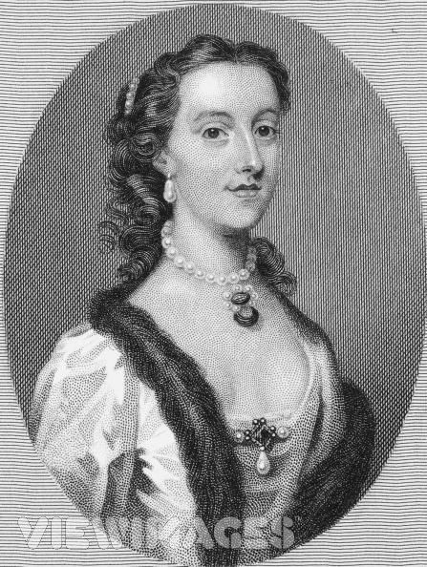
Margaret Cavendish 1623-1673 Scientific Revolution First woman allowed to attend Royal Society of London Meetings

Slide 36
Florence Nightingale 1820-1910 Set Cleanliness Standards in field Hospitals during Crimean War then founded first school of Nursing in England

Slide 37
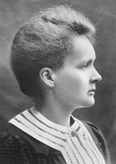
Marie Curie 1867-1934 Worked with her husband in Atomic radiation

Slide 38
19th and 20th Century Accomplishments
Voting rights!! Britain – 1918, France – after WWII
Women also a large part of temperance and abolitionist movements before the suffrage movement
Needed for “Total War” efforts of WWI and WWII
Mostly on home front in Allied West
Replaced men in factory jobs
Worked in secretarial, nursing positions in the army
Fascists/Nazis/Stalin praised motherhood and women’s ability to add to the population and keep it pure
Begin making higher wages although often still less than men in same position
Have taken a great role in elected positions (as opposed to positions by birth)

Slide 39
Male Reaction to Female Abolitionists
“For ladies to meet, to publish, to go from house to house stirring up petitions - these appear to me proceedings unsuited to the female character as delineated in Scripture. I fear its tendency would be to mix them in all the multiform warfare of political life.”
William Wilberforce
Leading English Abolitionist

Slide 40
Emmeline Pankhurst 1858-1928 leader of Radical British Women’s suffrage Movement

Slide 41
Chalking

Slide 42
Chaining

Slide 43
More Chaining

Slide 45
Hunger Strikes and Forced Feeding

Slide 46
Margaret Thatcher First Female British PM 1979-1990

Slide 47
Wrap-Up
Generally speaking, women have moved from less to more
Less pay to more pay
Less rights to more rights
Less important roles in society to more important
Some of the biggest things to impact women’s lives:
Birth control
Voting and divorce rights
Equal access to education

