Slide 1
Romanov Russia
A Review of the People and Principles

Slide 2
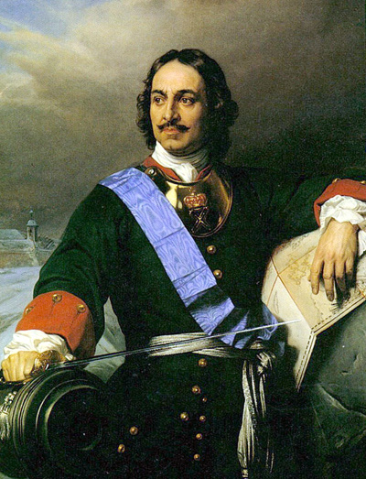
Peter I “The Great” of Russia r. 1682-1725

Slide 3
Particulars about PTG
Most important of the early czars due to his impact on his country, even though many changes died with him
First responsible for “rise of Russia,” especially in the realm of Europe
Major impacts:
Westernization – wanted acceptance of Europe through
emulation
Dress and appearance (Boyars especially), army training, legal
code, increase in local authority’s power
Increase in size of Russia
Fought Sweden in Great Northern War and gained Baltic lands
Fought Ottoman Turks for lands along the Black Sea
land was lost later but regained by Catherine the Great

Slide 4
Russian Boyars

Slide 5
Peter Cutting the Beard of a Boyar

Slide 6
Peter Cutting the Sleeves of the Boyars

Slide 7
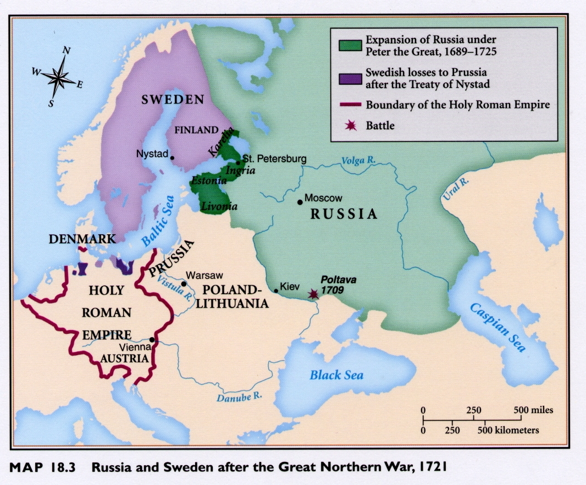

Slide 8
Catherine the Great of Russia r. 1762-1796

Slide 9
Particulars about CTG
Next important czar due to her lasting impact on Russia
Major impacts:
First female czar
German princess who embraced Russian language, Russian
Orthodox Church and got rid of crazy husband so accepted
Also accepted b/c awarded local nobility with increased power
over serfs if they complied with her wishes
“Enlightened Despot” due to readings, correspondence
with Enlightenment leaders but didn’t apply ideas
Continued to organize/codify Russian law
Increase in size of Russia to largest country in the world
Partitioned Poland along with Austria and Prussia
avoided war between the three but poor, poor Poland – gone until 1919
Fought Ottoman Turks for lands along the Black Sea
land was retained this time

Slide 10
Peter III of Russia Lover of Prussia r. 6 months in 1762 Likely murdered by Catherine the Great

Slide 11
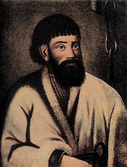
Pugachev’s Rebellion One of the major challenges posed by peasants Along with French Revolution, made Catherine withdraw support for Enlightenment ideals

Slide 12
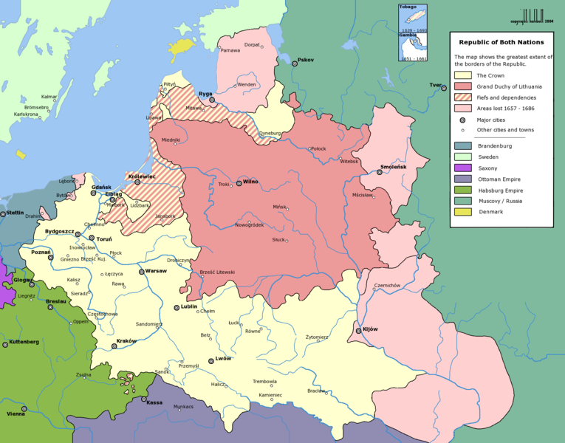
Poland-Lithuanian at its Greatest Extent

Slide 13
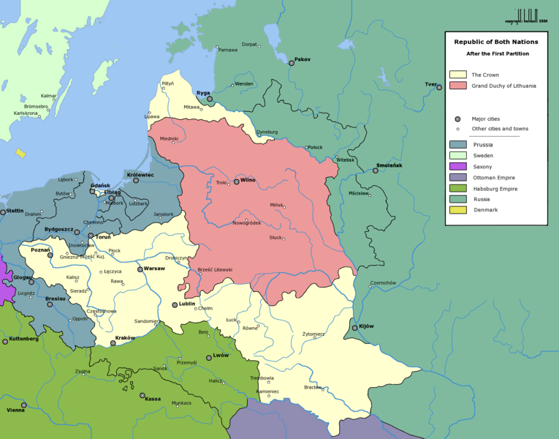
The 1st Partition of Poland, 1772

Slide 14
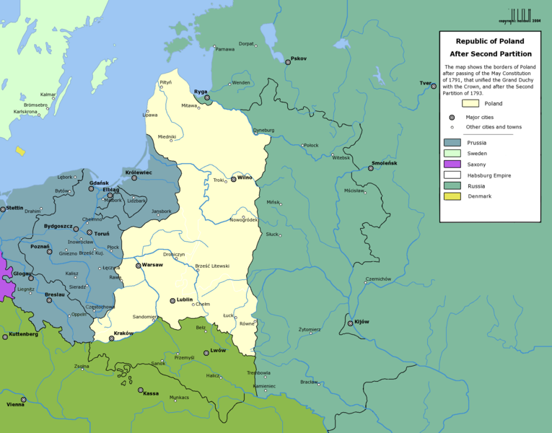
The 2nd Partition of Poland, 1793

Slide 15
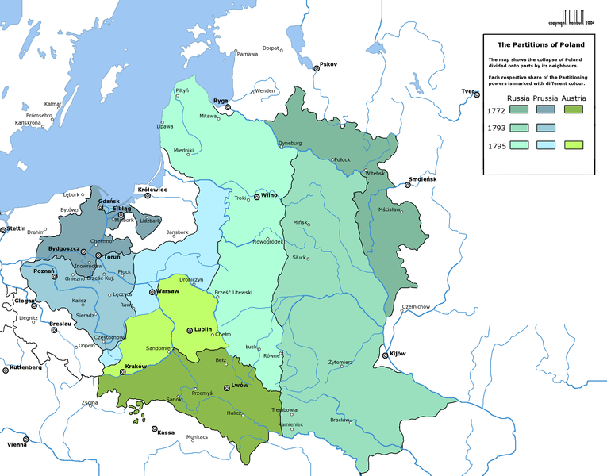
The Aftermath of Poland’s Partition

Slide 16
Involvement during the French Revolution, Napoleonic Era, and Congress of Vienna
Most important czar of the era – Alexander I
Major impacts:
Continued to fight France during Napoleonic Wars
Coaltion Wars had started before his reign ag. Rev. France
He loss to Nap. in 1807 and signed Treaty of Tilsit, giving up
land
Joined in Continental System then withdrew, making Nap. Go to war against Russia in its ill-fated invasions
Finally won ag. Nap. in Grand Coaltion (Leipzig) & then Quadruple Alliance – (Battle of Waterloo)
Represented Russia at Congress of Vienna
Signed Holy Alliance with other European Leaders

Slide 17
Czar Alexander I of Russia r. 1801-1825

Slide 18
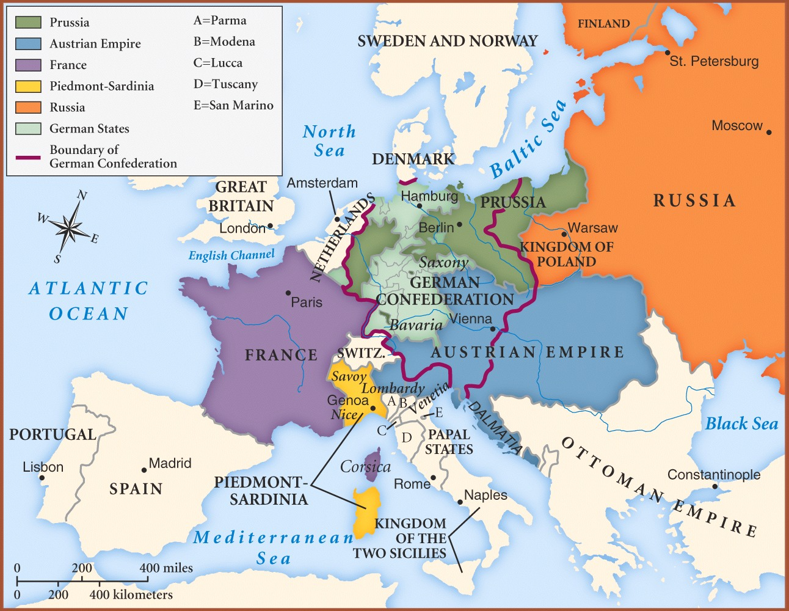
Europe in 1815

Slide 19
Middle to Late 1800’s Russia

Slide 20
Czar Nicholas I
Successor to Alexander I – impact:
Dealt with Decembrist Revolt at outset of reign
Revolt in response to Napoleonic Code ideals introduced in invasion; led by his army officers – failed coup but major impact
responded to revolt with program called Official Nationality
Orthodoxy, Nationalism, Autocracy
Continued and completed codification of Russian Law

Slide 21
Czar Nicholas I r. 1825-1855

Slide 22
Czar Alexander II
Successor to Nicholas I
Impact
Known as “Czar Emancipator” for ending serfdom
lives of serfs still not good because they couldn’t afford land so turned into tenant farmers
Allowed greater freedom and reduced censorship
backfired b/c new terrorist political groups emerged (People’s Will); eventually succeeded in assassinating him
Expanded Russia further to Sea of Japan

Slide 23
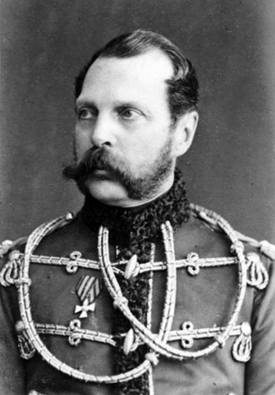
Czar Alexander II r. 1855 - 1881

Slide 24
Czar Alexander III
Successor to Alexander II
Impact
Reactionary against Alexander II’s allowance of more social freedoms
went back to Nicholas I’s oppression

Slide 25
Czar Alexander III r. 1881-1894

Slide 26
Czar Nicholas II
Last Romanov Czar
Impact
Helped usher in Industrial Revolution in late 1800s (FINALLY) but still far behind Europe
Lost Russo-Japanese War – long-lasting problems ensued
showed industrialism still not good
inspired march of protest led by Father Gapon
Nicholas ordered army to fire on peaceful marchers
resulted in Revolution of 1905 – ultimately failed
People revolted, Nicholas II allowed Duma to meet, dissolved it
until he was happy with its lack of Liberalism (advised by
Stolypin)
Family imprisoned/executed during Russian Revolution

Slide 27
Czar Nicholas II r. 1894-1917

Slide 28
Father George Gapon 1870-1906

Slide 29
Vladimir Ulyanov Lenin 1870-1924 Began his political criticisms under Nicholas II

Slide 30
Poster from 1929 Commemorating Bloody Sunday and the Revolution of 1905

Slide 31
Peter Stolypin PM 1906-1911

