Slide 1
Islam: Its Rise, Spread, and Impact on the World
AP Exam Review

Slide 2
Part I: Rise of Islam through Fall of the Abbasid Caliphate
AP Exam Review

Slide 3
The Pre-Islamic Arab World
Arab peninsula was a nomadic land on periphery of major civilizations – had contact but it was limited by geography
Bedouins – nomadic clans based on camel and goat-herding who lived along caravan routes in mobile tent encampments
Towns grew up around oases & agricultural kingdoms in S. along Arabian sea (better farmland); most like Mecca/Medina founded by former Bedouins turned settled merchants
People linked by kinship, focus on clan and family, clan identities of great importance leading to rivalries
Kin-related clans group with others to make tribes which would only congregate for war or in a severe crisis

Slide 4
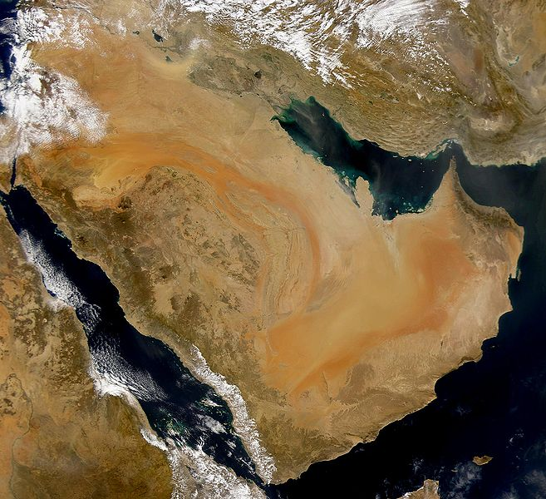

Slide 5
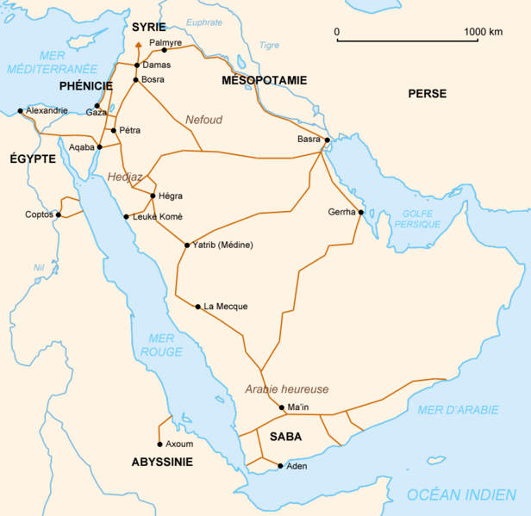
Bedouin Caravan Routes

Slide 6
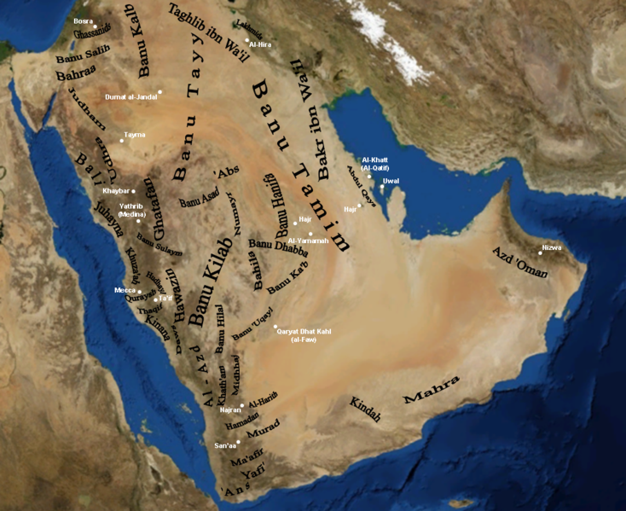
Tribes

Slide 7
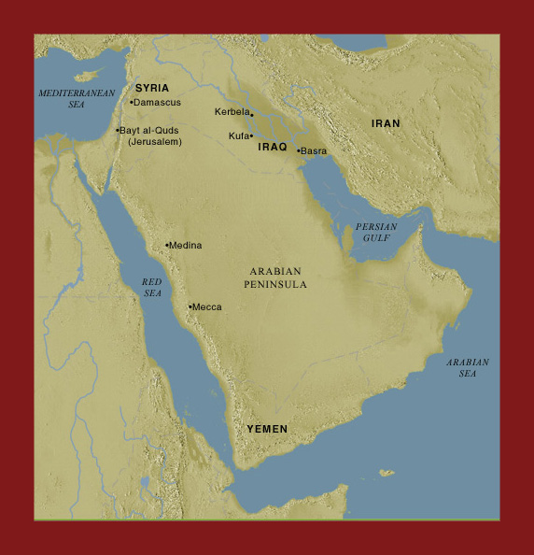

Slide 8
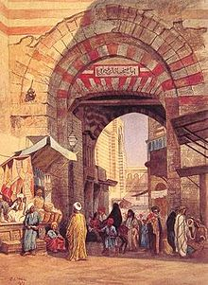
Bazaar

Slide 9
The Pre-Islamic Arab World
Shaykhs – leaders of the tribe/clan who had large herds, several wives, many children/retainers
Town of Mecca dominates in south – controlled by Umayyad clan of Quraysh tribe
Has Ka’ba – important pre-Islamic religious shrine and the focus of bazaars
Medina – to the north – Unlike Mecca, run by five competing families – 2 Bedouin, 3 Jewish clans which would later help with formation of Islam
Pre-Islamic women had greater freedom; had important economic roles of milking camel, weaving cloth, raising children; not veiled/secluded like Persian neighbors; polygamy ok; lineage matrilineal; women in cities experience greater stratification
Bedouin religion – usually polytheistic/animistic but Quraysh believed one god was supreme - named Allah (but not prayed to initially)

Slide 10
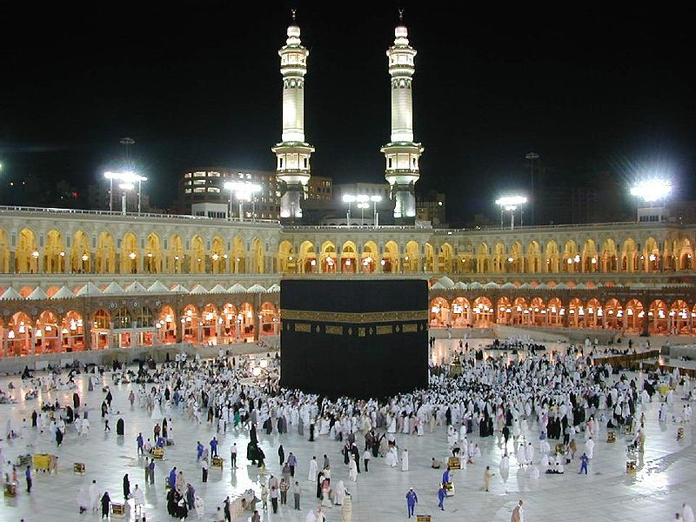
The Ka’ba at Mecca

Slide 11
Rise of Islam and the life of Muhammad
Muhammad born into prominent clan of Quraysh tribe c. 570 in Mecca, orphaned and raised by uncle and prominent grandfather (merchants)
Caravan trips exposed him to Christian/Jewish faiths, esp. in Jerusalem
Worked as a trader for Khadijah – later wife – and saw inequity of classes, class rivalries, tension between clans as some, Umayyads, got rich through commerce; Similar to Siddhartha Gautama (Buddha), Jesus
610 – first revelation of many from angel Gabriel (Same as in Old Testament); wrote Allah’s words in Qur’an

Slide 12
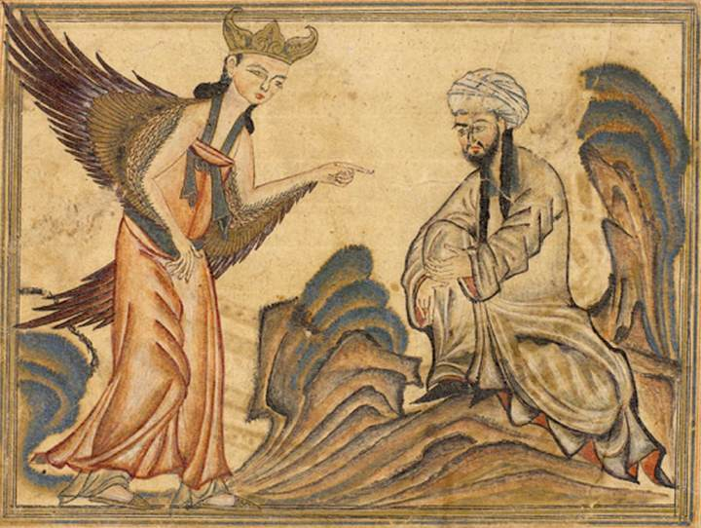
Muhammad Receives the Message from Gabriel

Slide 13
Rise of Islam and the life of Muhammad
Seen as threat to wealth/power by the Umayyad in Mecca b/c of growing following; threatened Ka’ba role which brought in money from visitors
Clansmen Ali sneaks him out to Medina in 622; ideal location b/c caught up in clan conflict and almost a civil war; Muh. invited to resolve disputes
Negations win him many converts (now called Muslims)
Quraysh send out attacks on Muh. but he proves himself a strong military leader leading to surrender of Umayyad/Quraysh 628
629 – 10K converts enter city, destroy idols, Mecca inhabitants (including Umayyads/ Quraysh convert to Islam (can’t beat ‘em, so join ‘em)
Muh’s hadiths – traditions/actions – play a huge role in Islamic law, ritual
Muh. died 632 leading many to wonder if it would fall apart…

Slide 14
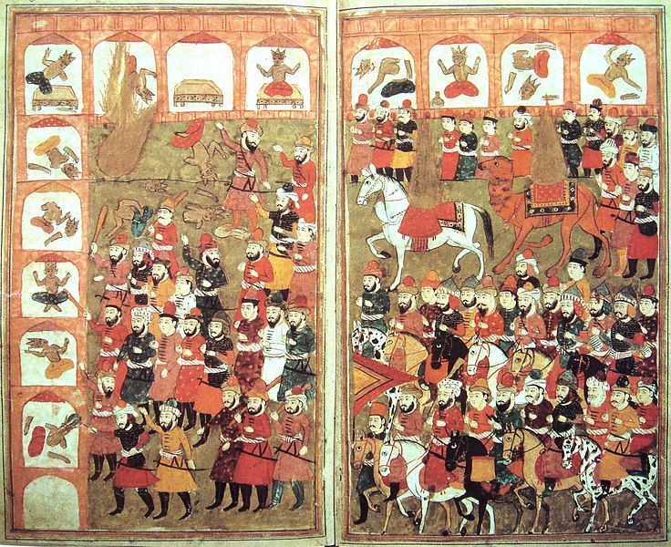
Muhammad’s Entry into Mecca and Destruction of the Idols

Slide 15
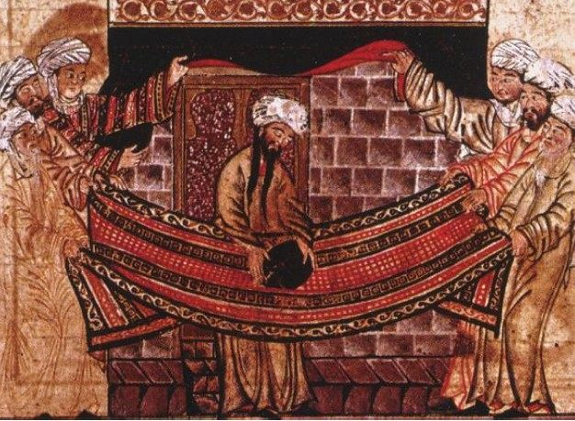
Muhammad Resetting the Black Stone in the Ka’ba

Slide 16
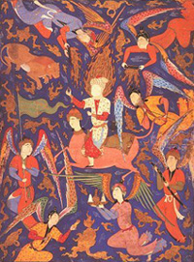
“Ascent of the Prophet to Heaven” C. 1550

Slide 17
Islam’s Appeal and Theology
Islam belonged to no single tribe which offered an end to vendettas, feuds and united the Bedouin
Created an umma – community of the faithful – which transcended tribal boundaries
Grew quickly = in strength to other Semitic monotheistic faiths (Judaism, Christianity)
Allowed no intermediaries – priests, saints – so even more monotheistic than Christianity; gave Bedouins a single authority
Turned wars against selves into wars against others – conquered much of known world (Christians will do this later w/ Crusades)

Slide 18
Islam’s Appeal and Theology
Provided an ethical system to keep law and order w/ Shari’a law; life regulated to prepare for Judgment Day (like Christianity)
Seen by outside converts as a fulfillment to Judaism, Christianity
Universal Elements in Islam – called Five Pillars
1. Confession of Faith: “There is no God but Allah, and Muh. is his prophet” – no other gods
2. Pray five times a day facing Mecca
3. Fast sunup to sundown during Ramadan – holy month
4. Zakat (charity tax) for those in need
5. Hajj - pilgrimage to Ka’ba to worship Allah

Slide 19
Islam’s Early Years and Conquest
After Muh’s death, some renounced faith, argued over succession
However, others lead foreign expeditions, easily beat neighbors due to military prowess, religious zeal, border empire weakness
New lands/people ruled by small Arab warrior elite
Muh. gave no procedure for appointing successor but eventually, leader known as caliph (dynasties were caliphates)
Ali – cousin/son-in-law said to be too young so Abu Bakr – earliest follower, closest friend named caliph (632-634)

Slide 20
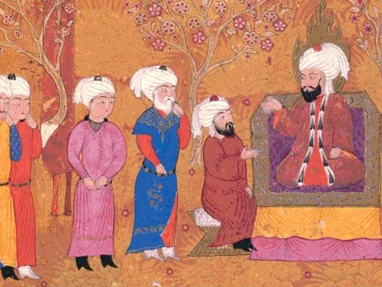
Ali (Ali ibn Abi Talib) 600-661 CE

Slide 21
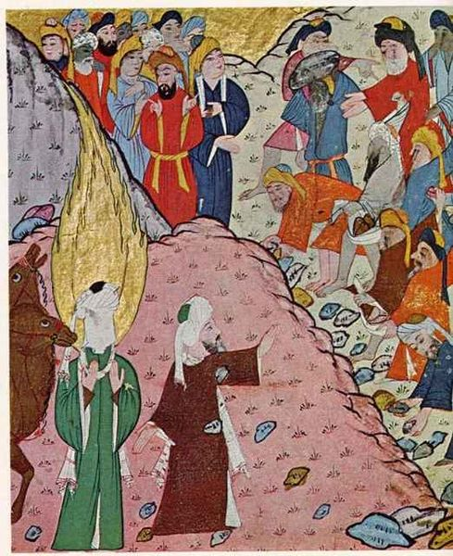
Abu Bakr 1st Caliph c. 573 – c. 634 CE

Slide 22
Islam’s Early Years and Conquest
Ridda Wars – successfully fought to defeat Bedouin tribes who refused to embrace Islam; success made Abu Bakr push north into Fertile Crescent, Byzantine & Persian empires
Initially just raided for spoils but raids showed weakness of empires; also many residents annoyed w/ Byz./Persial leaders so helped Muslims
Not driven by desire to win converts – even avoided mass conversions b/c wanted tax money (jizya) for non-Muslims (can’t tax Muslims)
Early wars not jihads - holy wars to spread Muslim faith

Slide 23
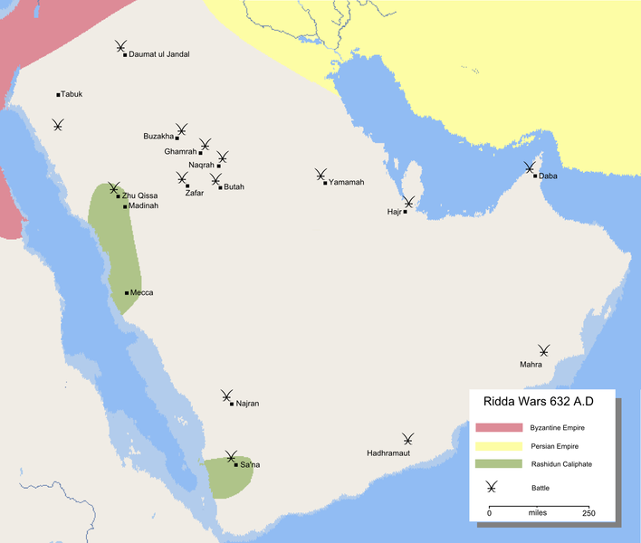
Ridda Wars

Slide 24
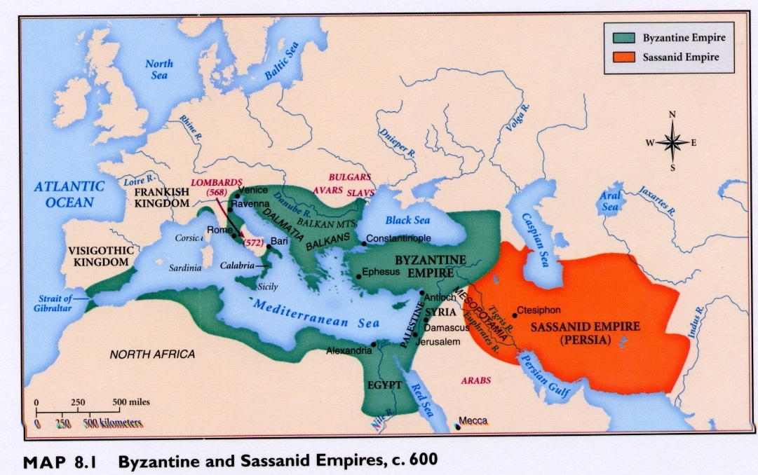
Neighboring Empires

Slide 25
The Sunni-Shi’a Split
Old clan rivalries still under the surface
Spark: murder of third caliph Uthman in 656 (2nd was Umar who ruled fairly peacefully) – Abu Bakr, Umar, Uthman called early caliphs
Ali (son-in-law/cousin) regains throne and doesn’t punish assassins of Uthman, an Umayyad – now the war is on w/ Umayyads
Ali’s forces were winning, but he decides on mediation at Battle of Siffin which makes him look weak and leads to Mu’awiya in 660 (Umayyad) claim he is new caliph from Jerusalem

Slide 26
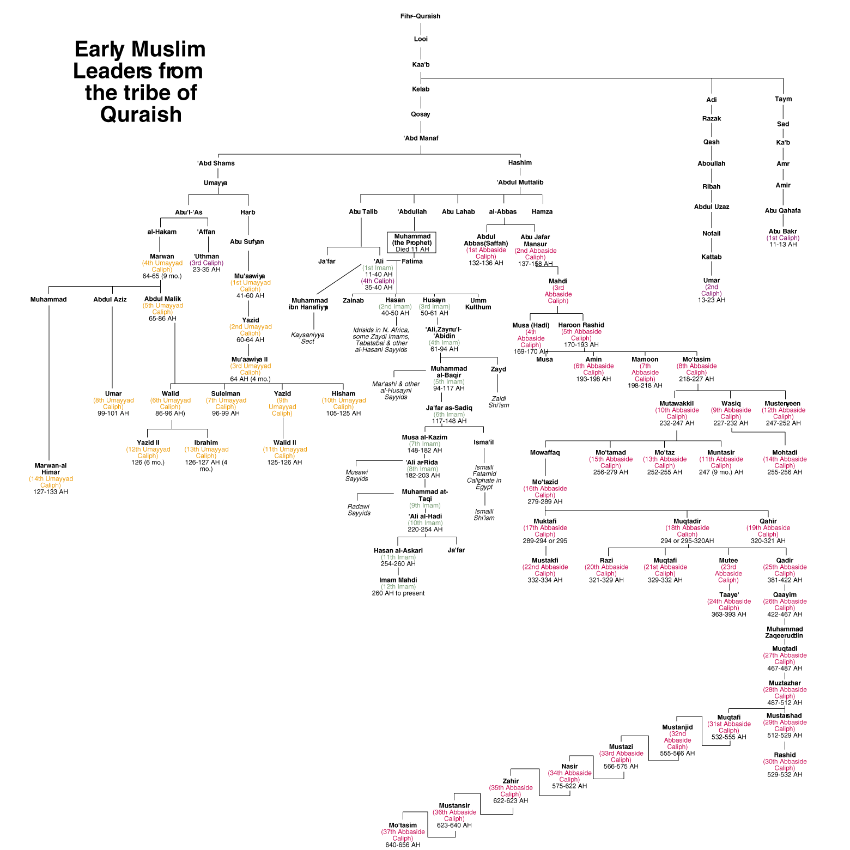
Imams
Abbasids
Umayyads

Slide 27
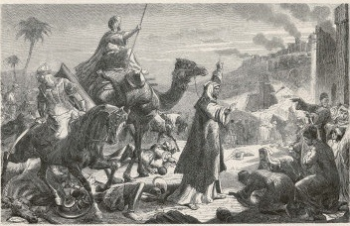
Umar 2nd Caliph c. 584-644 AD

Slide 28
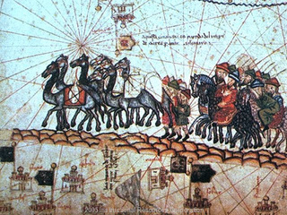
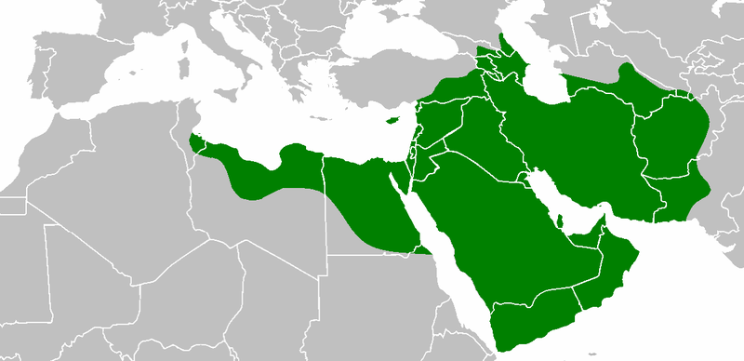
Uthman 3rd Caliph c. 579-656 AD

Slide 29
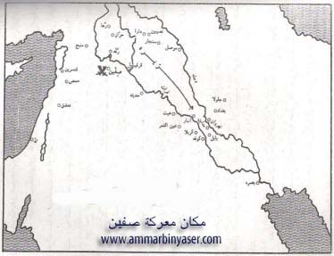
Battle of Siffin 657 AD

Slide 30
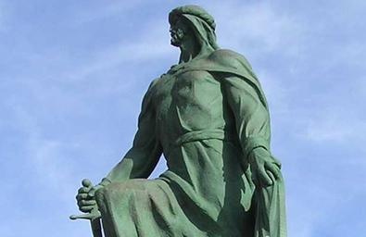
Muawiyah I – 1st of the Umayyad Caliphate 602-680 AD

Slide 31
The Sunni-Shi’a Split
Ali assassinated; 1st son has to renounce claim to throne, 2nd son killed (Husayn)
And now we have a feud
Backers of Umayyads/Caliphs in Power (Sunni) vs. backers of Ali (Shi’a)
Sunni Caliph goes through dominant clan vs. Shi’a caliph goes through descendants of Muhammad (called imams)

Slide 32
Ali (Ali ibn Abi Talib) 600-661 CE

Slide 33
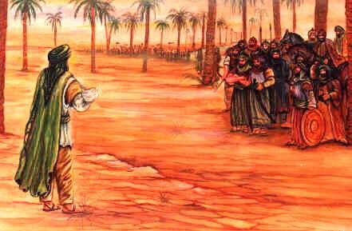
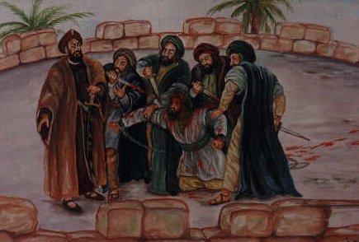
Hussayn, son of Ali Grandson of Muhammad 625-669 AD

Slide 34
Expansion, Decline and Fall of the Umayyad Caliphate
Umayyad Caliphs begin building an east/west empire; runs into conflict w/ Buddhism in east after spreads across India & goes into Spain in West but eventually stopped by Charles Martel (Franks) at Poitiers 732
By late 700s empire stretches from Spain to steppes and Indus River valley; capital moved from Mecca to Damascus, Syria – Arab/Muslim aristocracy ruled over non-Arabs/Muslims
Non-Muslims do convert but considered Mawali, still taxed
Jews, Christians (later Hindus, Buddhists) were considered Dhimmi (People of the Book) allowed to continue to worship given religions so there weren’t many conversions under Umayyads

Slide 35
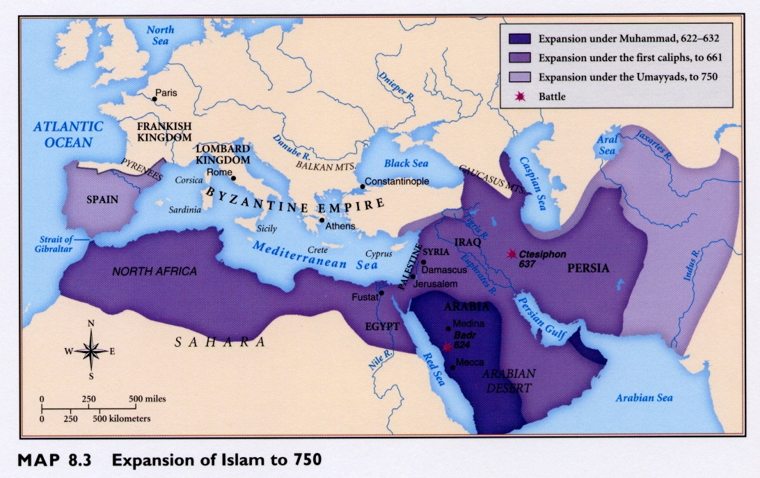
Expansion of Islam to 750 C.E.

Slide 36
Expansion, Decline and Fall of the Umayyad Caliphate
Umayyad caliph’s had a growing addiction to luxury and soft living by mid 700s; stopped fighting wars, built palaces
Revolts start around empire at their signs of weakness
The Abbasid Revolt is their undoing
Abbasids (descendants of Muh’s uncle) formed a coalition: 50K Muslim warriors in Merv (part of Persia, rarely given share of spoils so annoyed at distant Umayyad elite) + mawali (annoyed at taxes) + Shi’a
Coalition defeated Umayyad caliph at Battle on the River Zab
Invited the rest of the Umayyad family to a fake peace-making dinner but wrapped them in carpets and slaughtered them; hunted down the rest
One guy made it out – established Caliphate of Cordoba where he and his successors lived in exile in Spain until 1400s kicked out

Slide 37
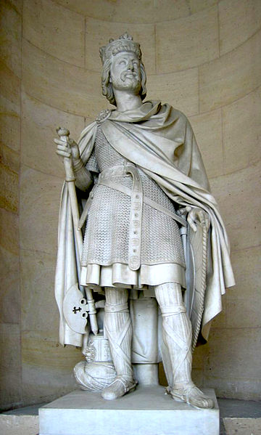
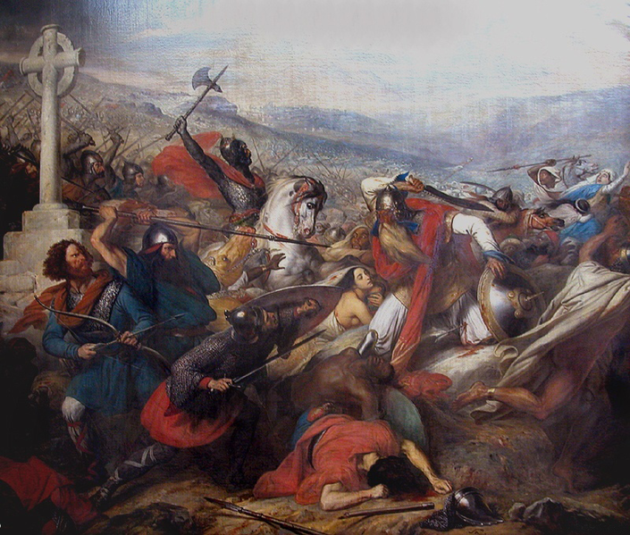
Charles Martel and the Battle of Poitiers, 732

Slide 38
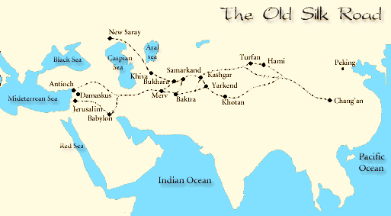
Merv

Slide 39
The Abbasid Caliphate
Abbasids less tolerant of Shi’a sects (they were Sunnis)
Shi’a and mawali supporters of Abbasids should have seen it coming (feast murders and all…)
Pushed for centralized, absolutist imperial order; moved capital to Baghdad; had jeweled thrones
Expanded number of bureaucrats – sound like China? Appointed a wazir – chief administrator to help run empire
Under Abbasids, mawali given equal footing to Arab Muslims so no longer have to pay head tax (jizya) for being non-Muslim

Slide 40
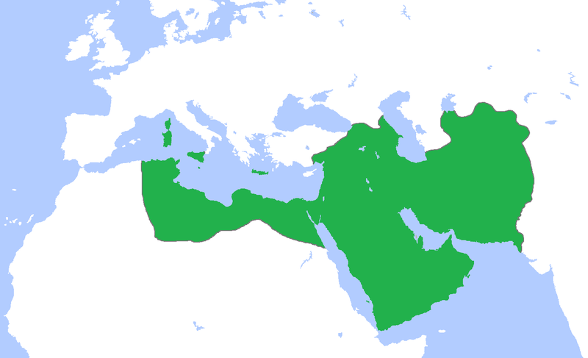
Abbasid Caliphate at its Greatest Extent

Slide 41
Trade under the Abbasids
BTW: all of this while Eur. struggling after fall of W. Roman empire
Merchant class wealth and social status improves, trade becomes a priority under Abbasids
Afro-Eurasian trading resumes after Rome/ Han China let it die (b/c they die!)
But now, mostly through Asian Sea Trade Used
Dhows – Arab ships w/ lateen (triangular) sails used monsoon winds
Products – luxury products for elites
Money reinvested in companies, share given to charity
Also used in patronage of the arts, beautification, infrastructure
Built beautiful mosques, religious schools, baths, hospitals, rest houses w/ trade $ to facilitate movement across empire
Exports: furniture, glassware, jewelry, tapestries/carpets
Landed elite emerges – ayan
Traded goods but also ideas

Slide 42
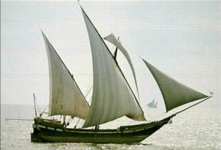
Arab Dhow with Lateen Sails

Slide 43
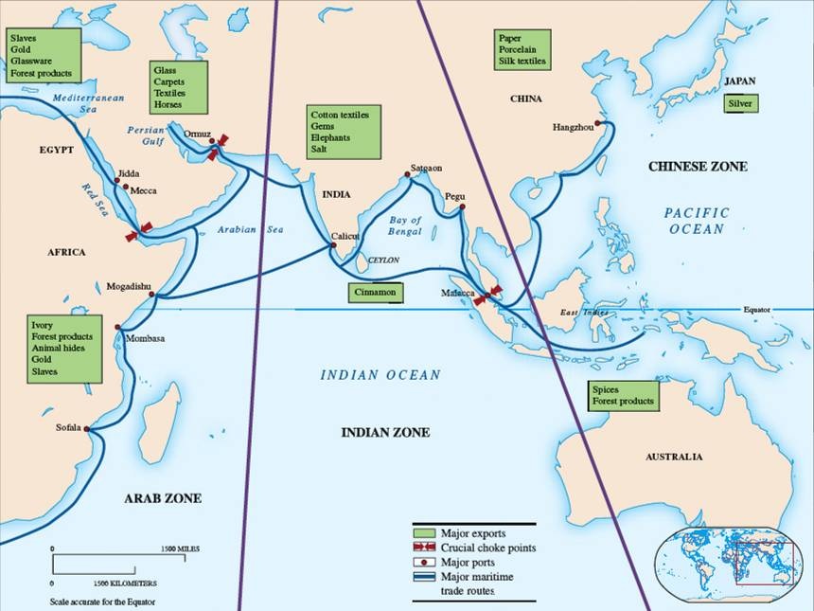

Slide 44
Arts, Culture, and Science in the Abbasid Era
Political divisions did not hold Abbasids & rest of Muslim world back artistically/technologically; one of great ages in human ingenuity and creativity
Preserved classical texts of Greece, Mediterranean, Middle East, India; without Muslim and Jewish scholars much of classical knowledge would be lost
Architecture – the mosque; borrowed from classical architecture, sometimes even used materials from destroyed churches/temples
Had repeating geometric designs, arabesque, and Arabic calligraphy
Expansion of professional classes under Abbasids – doctors, scholars, legal/religious experts; also artisans (made rugs, furniture, textiles, pottery etc.

Slide 45
Arts, Culture, and Science in the Abbasid Era
When Abbasids moved capital to Baghdad, came under major Persian influence
Persian language = high culture; used in literature, poetry, rhetoric
Epic Poem – Shah-Nama (Book of Kings)– written in 10th/11th centuries
Sciences: Arabic remained the language of science, law, established religion
Math – Made corrections to Greek algebra, geometry, trigonometry
Used objective experimentation, created classification system of animal, vegetable, mineral; best astronomy in the world
Health/Medicine: best hospitals – doctors were required to pass formal examinations, optics/bladder ailments were a specialty
Other inventions: trade w/China led to papermaking, silk-weaving, ceramics
Cartography: best maps in the world

Slide 46
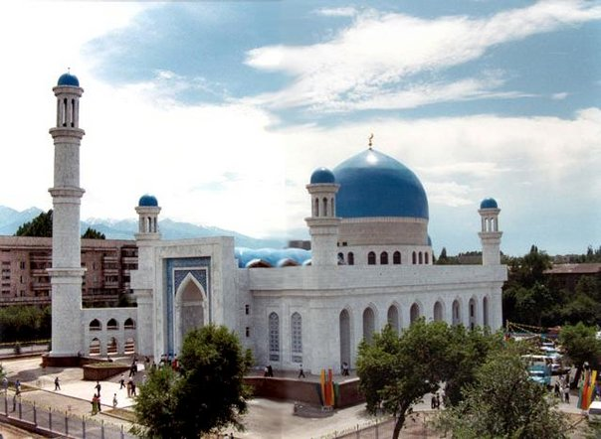
The Mosque

Slide 47
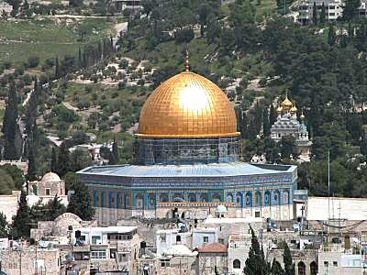

Slide 48
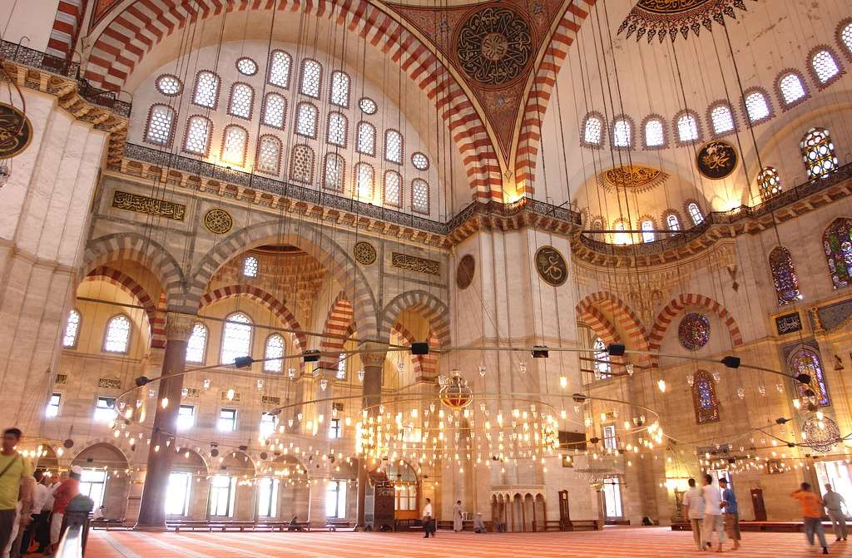

Slide 49
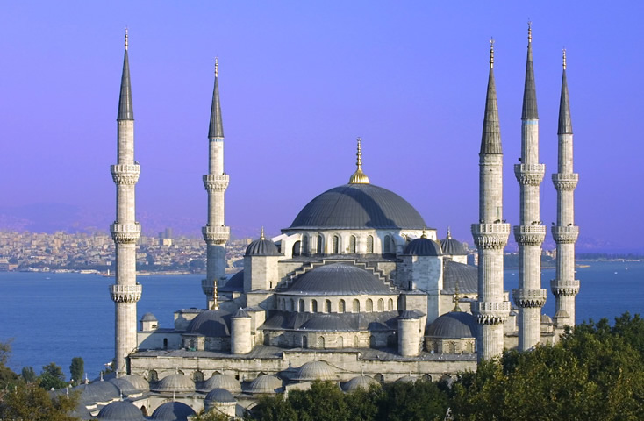

Slide 50
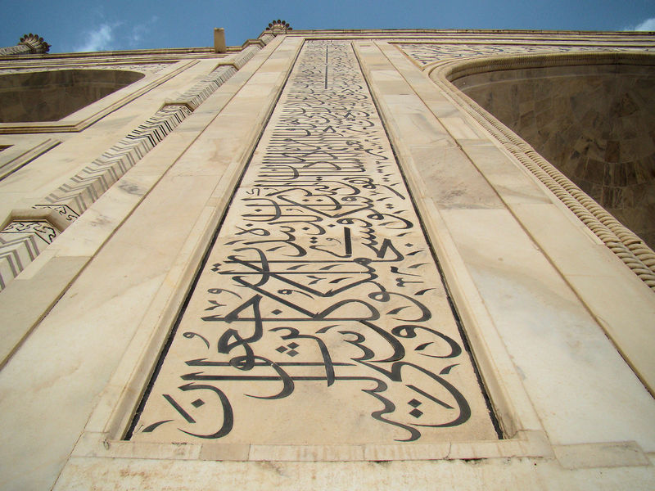
Calligraphy

Slide 51
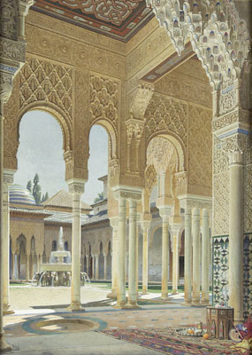
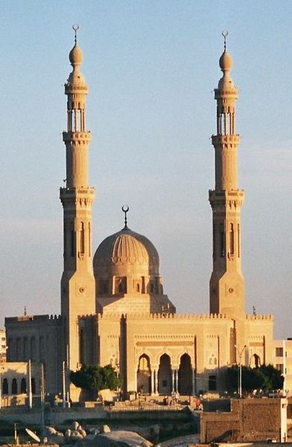
Arabesque and Minaret

Slide 52
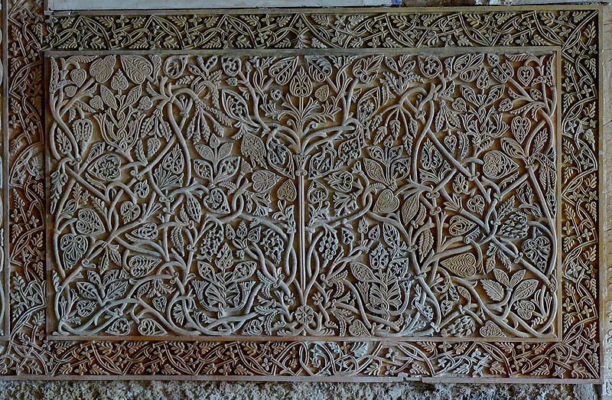
More Arabesque

Slide 53
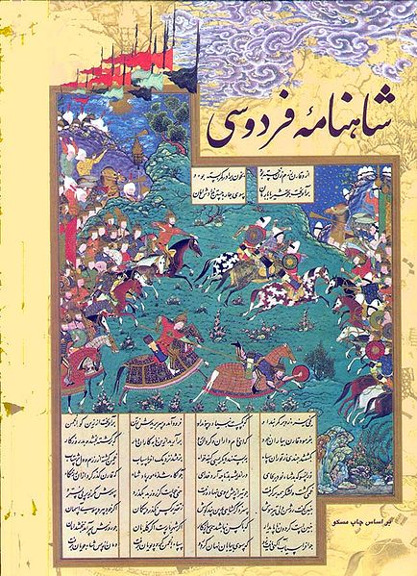
Pages from the Shah-Nama

Slide 54
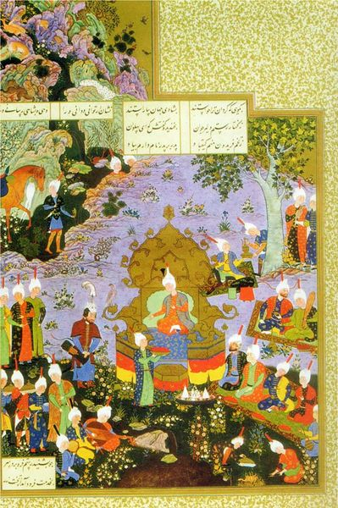

Slide 55
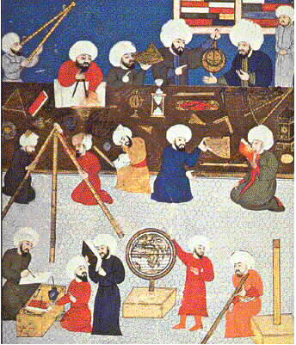
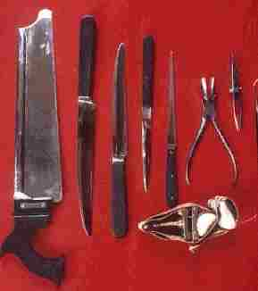
Muslim Science

Slide 56
Impact of the Crusades
First Crusade 1096-1099 – most successful for Europeans
element of surprise, took advantage of Muslim political divisions
Europeans killed Muslim and Jewish inhabitants of Jerusalem
Followed by 200 years of battle – but had little effect on Muslim world
Saladin – Salah-ud-Din – reconquered most of lost territory by end of 12th century after uniting Muslims under a strong leader
Impact much greater on Christian Europe

Slide 57
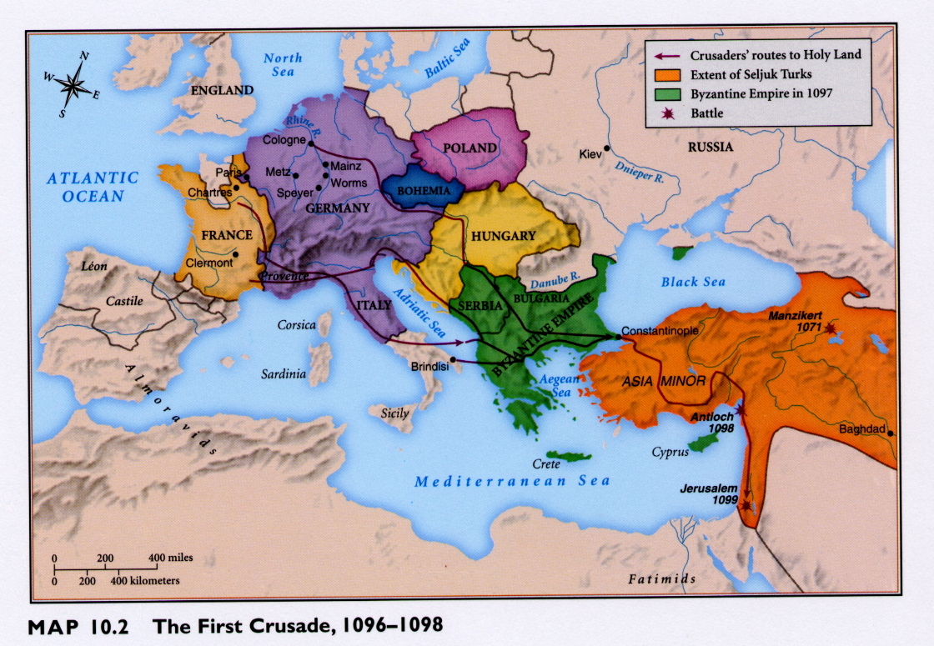

Slide 58
Impact of the Crusades
Examples of European cultural borrowing
weapons – damascene sword (from Damascus) & fortifications
science/medicine – many Europeans preferred Muslim doctors
recovered Greek learning – brought it back to Europe, eventually leads to Renaissance
mastered Arabic (former Indian) numerals
Middle Eastern rugs/textiles popular; new names for cloths – taffeta, muslin develop
Games & Music: Chess (also originally Indian), troubadours/ballads
Food – dates, coffee, yogurt

Slide 59
Class, Gender, and Religion in the Abbasid Era
Women in decline in Abb. Era although Islam had been egalitarian at start
Harems develop – women kept in seclusion – was a creation of Abbasid court, much due to Persian influence
Slave women could win their freedom/gain power by bearing healthy sons; could be educated & had more freedom w/ no veils, robes, seclusion
Religious scholars called ulama develop and embrace orthodoxy
Orthodox Muslims gained power after Crusades (b/c Western learning )
Ulama suspicious of Greek learning b/c based on questioning
threatened ulama’s authority and people’s devotion to Qur’an
said Qur’an was final, perfect, a complete revelation

Slide 60
Class, Gender, and Religion in the Abbasid Era
Al-Ghazali tried to fuse Greek/Arab traditions; greatest Islamic theologian
Ideas usually rejected by orthodox Muslims
Sufis/Sufist movement – more mystical; reaction to orthodoxy
Wanted a personal union with Allah
Became wandering mystical healers; some led militant bands to forcibly convert
some used bodily denial, asceticism to find Allah in their lives
some used meditation, songs, drugs, dancing (whirling dervishes)
helped expand religion by whirling their way all the way to SE Asia!

Slide 61
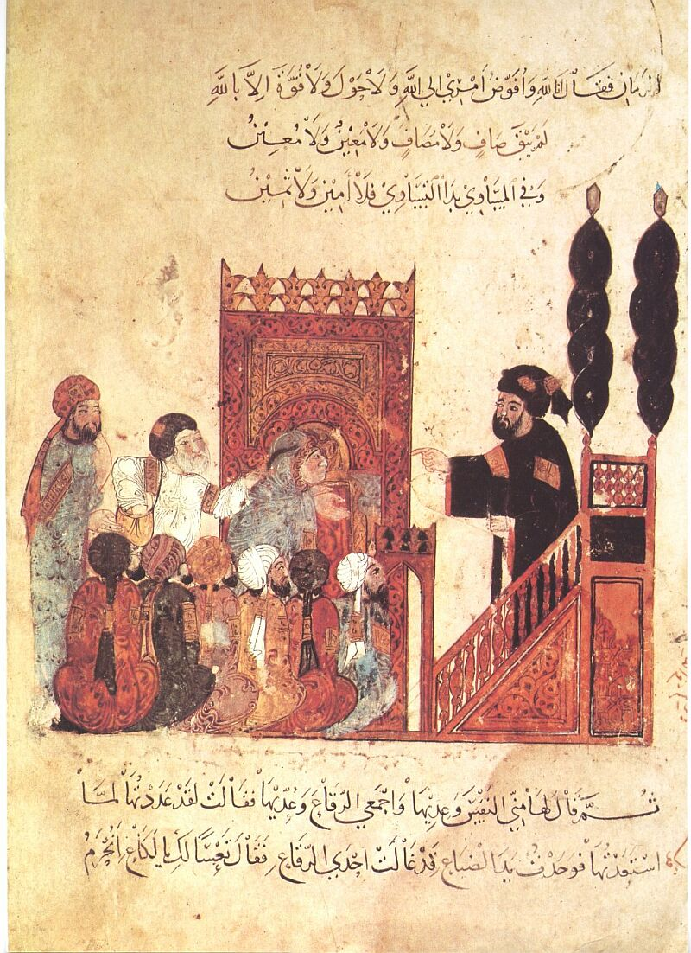
Ulama Instructing Religious Learners

Slide 62
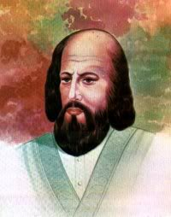
Al-Ghazali 1058-1111

Slide 63
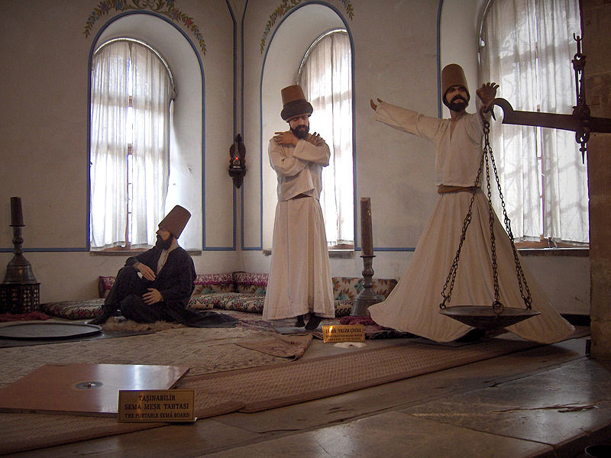
Modern Sufis

Slide 64
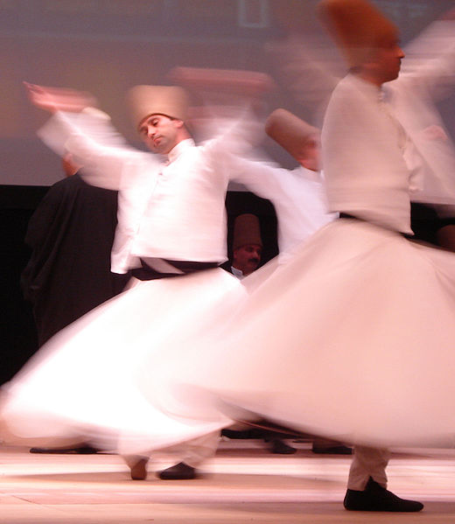
Whirling Dervish

Slide 65
Abbasid Decline and Fall
3rd Abbasid caliph, al-Mahdi – displayed common problems (Ibn Khaldun article); financial drain w/ courtly excesses, luxury, monumental buildings
Problem of succession: al-Mahdi wouldn’t name a successor; son Harun al-Rashid (786-809) poisoned him, became most influential Abbasid ruler
Rashid’s Caliphate – Extravagance amazed visitors like Charlemagne
The Thousand and One Nights describe this well
Persian advisors grew in power which signaled shift – court advisors now more important than caliphs sometimes
His death led to civil war; winner had huge army & started precedent of having mercenary forces could reach 70K; power now shifted to military

Slide 66
Abbasid Decline and Fall
Caliphs try to move capitals away from Baghdad – kind of like Versailles
Cost of new palaces/capitals plus mercenary force = high taxes
Peasant revolts due to taxation, Shi’a “encouragement”
Nomadic invasions begin as they realized Abb. Empire’s internal weakness
945 Buyids invade, capture Baghdad; took name of sultan – “victorious” & controlled Abbasid caliphs as puppets
1055 Seljuk Turks (Sunnis) replaced Buyids, purged Shi’a
Mongols under Chinggis’s grandson Hulegu overthrows Baghdad in 1258 & last (27th ) Abb. Caliph
Cairo and Istanbul became dominant Muslim cities instead

Slide 67
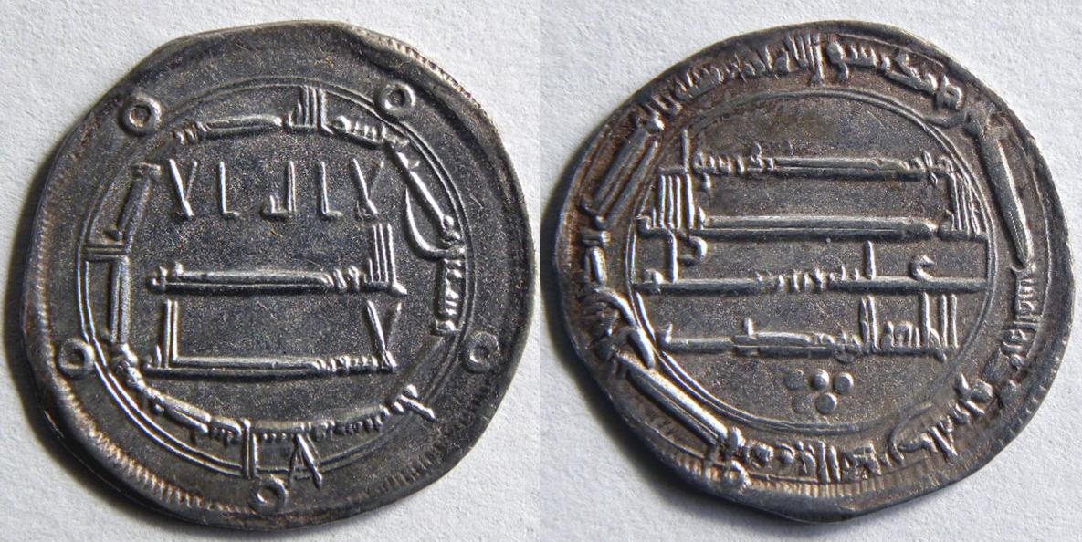
Coins from Abbasid Ruler al-Mahdi’s Caliphate

Slide 68
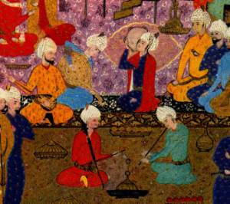
Abbasid Court Life

Slide 69
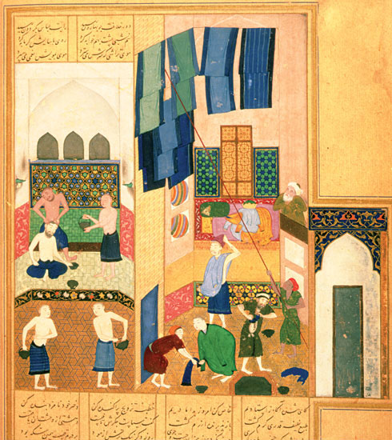

Slide 70
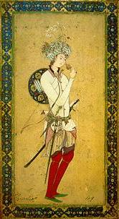
Huran al-Rashid Abbasid Caliph 786-809

Slide 71
Huran al-Rashid receiving a delegation of Charlemagne

Slide 73
Chinggis Khan r. 1206–1227

Slide 74
Hulegu Khan

