Slide 1
Important Wars and Treaties from European History

Slide 2
Part 2: During and After the French Revolution

Slide 3
The French Revolutionary Wars
1792-1802

Slide 4
These were a series of major conflicts fought between the French Republic government (starting under Legislative Assembly) and Austria, Prussia, and Great Britain
French Revolutionary Armies defeated a number of opposing coalitions; resulted in expanded French control to the Low Countries, Italy, and the Rhineland; success was due to high numbers of soldiers recruited by mass conscription and revolutionary fervor
The French Revolutionary Wars are usually divided between those of the First Coalition and the Second Coalition

Slide 5
War of the First Coalition
1792–1797

Slide 6
In 1791, Leopold II of Austria (and HRE and Marie Antoinette’s brother) joined with Fredrick William II of Prussia to issue Declaration of Pilnitz which promised to intervene in France to protect royal family and preserve the monarchy
The next spring (1792), the Legislative Assembly beat them to it and declared war on both Austria & Prussia; had grown more radical under direction of Jacobins, specifically the Girondists
Prussia invaded, the royal family was seized from the Tuileries (Sept. Massacres) & imprisoned; the French Army pushed Prussian forces out
Elections were held for the new National Convention, the monarchy was abolished & Louis XVI was put on trial as Louis Capet and executed in 1793 (begins Reign of Terr)

Slide 7
Nat’l Convention took an even greater radical turn under a new group of Jacobins, the Mountain (Montagnards) who expanded war in 1793 to include Britain, Holland, and Spain; invaded Austrian Netherlands
The First Coalition: Austria, Prussia, GB, Holland, Spain
Fall of 1793: to improve size/condition of the French Army, Nat’l Convention issued Levee en Masse which required society’s complete support of the war efforts
After the end of the Reign of Terror and fall of Robespierre, the Directory was established which signed the Treaty of Basel in 1795, ending war with Prussia and Spain but not GB, Holland or Austria

Slide 8
Role of Napoleon During the War of the First Coalition
Napoleon began his rise to military fame in the Austrian Netherlands in 1792 and quickly rose through the ranks of the French Army
After the Treaty of Basel, the Directory came to rely heavily on the army since it was still at war with Austria, GB, and the Netherlands & put Napoleon in charge of fighting Austrian forces in northern Italy
Napoleon gained war hero status w/ Italian Campaign as he crushed Austrian and Sardinian forces in 1797; Austria signed the Treaty of Campo Formio, ending the War of the First Coalition (technically France remained at war w/ Netherlands and GB but fighting subsided for a while)

Slide 9
What happened between the First and Second Coalition Wars
Directory asked Napoleon to continue fighting the British which he did in Egyptian Campaign (wanted to avoid an invasion of England proper)
Land invasion of Egypt went well but English Admiral Lord Horatio Nelson destroyed much of the French fleet in the Mediterranean (1798) & Napoleon had to return to France
Later in 1798, the much of Europe rejoins forces in the Second Coalition which included the Ottoman Turks, England, Austria and Russia (T.E.A.R.)

Slide 10
War of the Second Coalition
1799-1802

Slide 11
Second Coalition got off to a good start, winning battles against the French and causing major discontent back home with the Directory
This provided an opportunity for Napoleon to lead a coup d'état of the Directory in 1799, establishing the Consulate and his role as First Consul
Napoleon continued War of Second Coalition while serving as First Consul and the tide turned
By 1800, Russia had left the Second Coalition, by 1801 Austria had been defeated, and in 1802, England signed the Treaty of Amiens which was more of a truce but it still quieted Europe for a while

Slide 12
The Napoleonic Wars
1803-1815

Slide 13
The War of the Third Coalition
1803-1806

Slide 14
After holding a plebiscite in 1802, Napoleon named himself First Consul for Life; sent troops to regain Haiti which GB saw as a threat to West Indies so declared war in 1803 & formed a new coalition
Third Coalition : GB, Austria, Russia, & later Prussia
1805, Napoleon invaded Austria, defeating them quickly at Battle of Austerlitz & occupied Vienna but during the same month Admiral Lord Nelson defeated French naval forces (again) at Battle of Trafalgar ending French hopes of an invasion of GB; led to the Continental System (review if needed)
In 1806, Treaty of Pressburg signed removing Austria from Italy and naming Napoleon King of Italy

Slide 15
The War of the Fourth Coalition
1806-1807

Slide 16
After Pressburg and the end of the Third Coalition, Napoleon turned his attention to the HRE since Austria was greatly weakened
1806 he reorganized German states into Confederation of the Rhine, dissolving the HRE; Francis II, the final HRE was forced to now become Francis I, (1st of Austria only)
Prussia finally rejoined the action, creating a Fourth Coalition (Prussia, Russia, GB) after being provoked by the dissolution of the HRE; but Napoleon won decisively
1807, Napoleon defeated Russia and signed Treaty of Tilsit with Russia and Prussia, ending War of Third Coalition & reducing Prussia’s size by ½ to create Grand Duchy of Warsaw (Polish lands – puppet state)

Slide 17
The Peninsular War
(War of Spanish Resistance)
Started 1808

Slide 18
1807 – Portugal refused to participate in Continental System so Napoleon marched through Spain to force compliance
1808 – a revolt in Madrid led to Napoleon’s removal of Bourbon king; he placed his brother Joseph on throne as king of Spain (nepotism)
Spanish citizens began a guerilla campaign against French soldiers which lasted for years and drained French resources

Slide 19
During the next 3 years, Napoleon continued to deal with the Continental system’s problems as well as the British blockade of major European ports
Side note – he also divorced Josephine and married Marie Louise, Archduchess of Austria, to solidify his alliance with them

Slide 20
The Invasion of Russia
1812

Slide 21
Treaty of Tilsit created a shaky Franco-Russian alliance (by force) and by 1812, Russia’s economy had been greatly damaged by Continental System so Czar Alex. I withdrew
Napoleon raised a Grand Army of 600K troops compared to Russia’s of only 160K
Russia retreated East ahead of the French army, using scorched-earth tactics; abandoned and burned Moscow
Napoleon arrived to a deserted Moscow, asked for Alex I for surrender but he refused
Napoleon and his Grand Army had to retreat from Russia after which only 100K made it back to Paris

Slide 22
The Wars of Liberation
1813-1815

Slide 23
Napoleon raised another Grand Army but it was not as big and powerful as the previous one
A final coalition formed called the Grand Coalition: Russia, Austria, Prussia, Netherlands, GB
Grand Coalition invaded, won the most important Battle of Leipzig (Battle of Nations) and marched into Paris by Spring 1814; Napoleon abdicated and was exiled to Elba
After Napoleon escaped from Elba for the Hundred Days in 1815 he was defeated a final time at Waterloo by what was now called the Quadruple Alliance (stronger than a coalition)
Quadruple Alliance: GB, Austria, Prussia, Russia

Slide 24
Can you name the six month Peace talks that ended the Napoleonic Wars?

Slide 25
Congress of Vienna, 1815

Slide 26
5 Big Goals of the 4 Powers (Russia, Prussia, Austria, GB)
wanted to keep France from doing it again – not punish it
wanted to keep a balance of power – no single state should dominate Eur.
balance compensation – when 1 state gains, others are compensated
restore legitimate rulers (hereditary monarchies) from pre-Rev. days
reward themselves for defeating Napoleon, penalize those who helped him

Slide 27
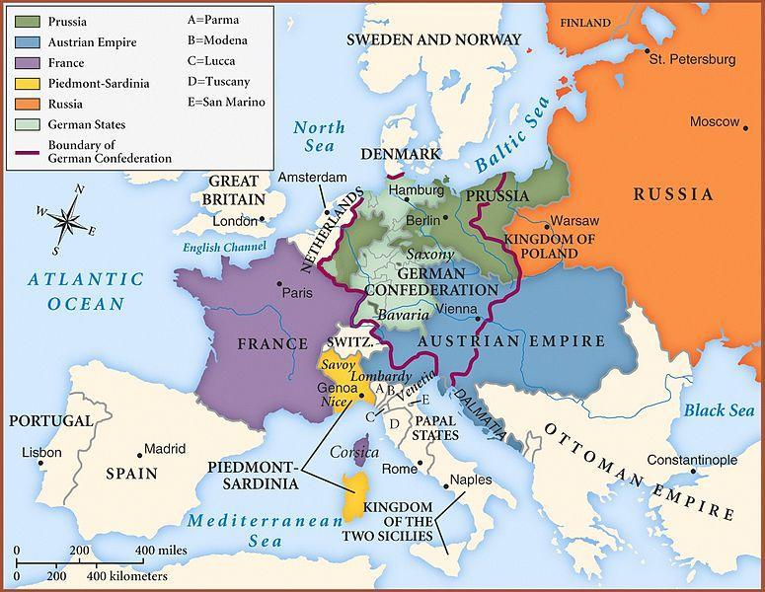
Europe after the Congress of Vienna, 1815

Slide 28
Concert of Europe 1815-1914

Slide 29
Describes a series of conferences held throughout the 19th century designed to avoid European-wide war
Functioned quite well – the 1815 to 1914 period saw no major multi-national wars
Conference leaders enforced Conservatism while being challenged by the forces of Liberalism & Nationalism
Review these conferences in 19th Century Review PowerPoint and Units 5-6 notes

Slide 30
Main Points of Conflict During the 19th Century: Domestic Disputes
(These can be reviewed in 19th Century Review PPT)
Revolutions of 1830
Revolutions of 1848
Crimean War
Unification of Italy
Unification of Germany – Danish War, Austro-Prussian/7-Weeks War, Franco-Prussian War
French Civil War

Slide 31
Main Points of Conflict During the 19th Century: Foreign Disputes (Due to Imperialism)
(These can be reviewed in 19th Century Review PPT)
Boer and Zulu Wars
Sepoy Rebellion
Opium War
Russo-Japanese War

Slide 32
World War I “The Great War” 1914-1918

Slide 33
Background Causes of WWI – M.A.I.N.
Militarism – Having no European-wide wars for almost 100 years led to a glorification of the “good old days” of the Napoleonic Wars where there were large clashes on open battlefields and decisive winners and losers
Early 20th Century Europeans had a romanticized view of war because of this; Wilhelm II was a major aggressor
Alliances – Bismarck built a network of alliances in the hopes of keeping Europe out of war; main ones that existed prior to WWI were the Triple Alliance (Germany, Austria-Hungary, and Italy and the Triple Entente (France, GB, Russia)
Little did he know that these alliances would widen the conflict, not keep it from occurring

Slide 34
Background Causes of WWI – M.A.I.N. - Continued
Imperialism – World-wide colonization and land grabbing led to increased competition between European countries, vying for international holdings to help fuel their Industrial Revolutions with natural resources, labor, and new markets to force into trade agreements
Nationalism – The desire for national autonomy that sprang up among minority European in the wake of Napoleon’s empire and surfaced in the Revolutions of 1830 and 1848 continued as a driving force for the coming War
This desire was especially present in the Balkan Peninsula, the “Powder keg of Europe”

Slide 35
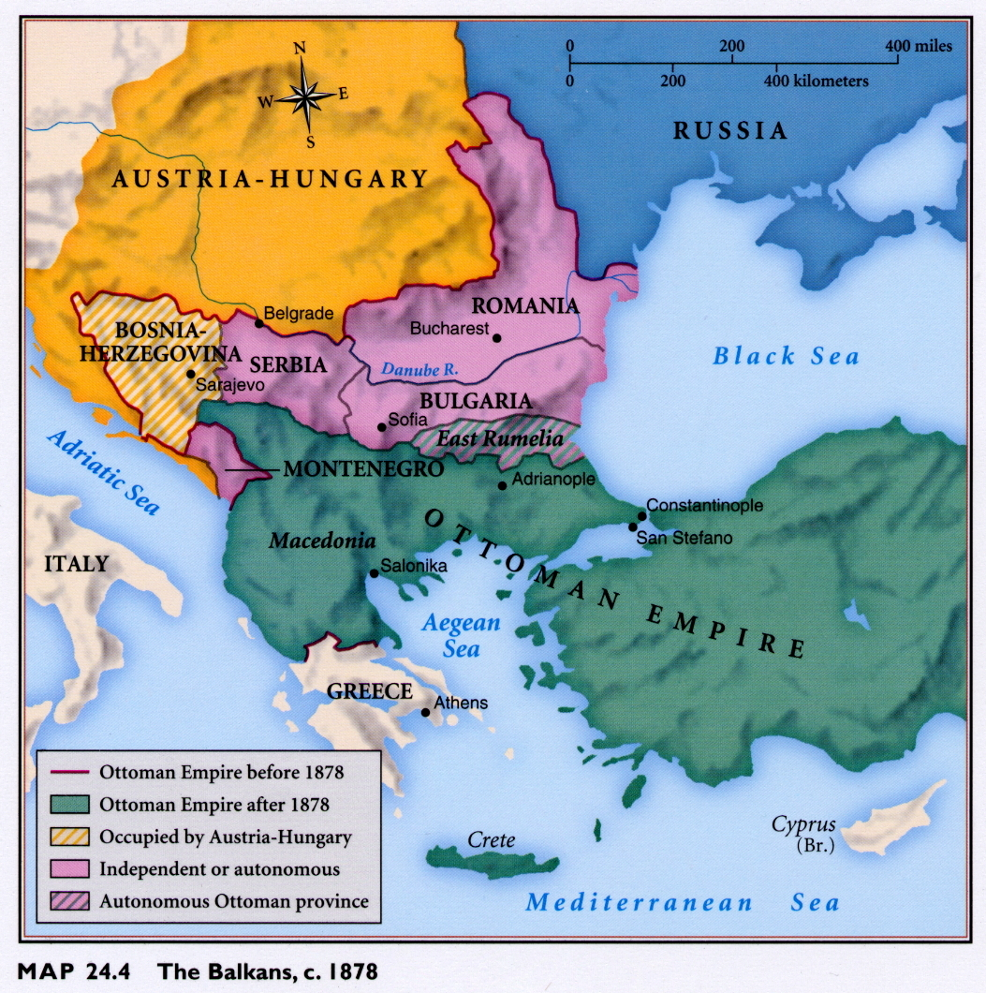
The Balkans, c. 1878

Slide 36
Outbreak of War
“The Spark” – Assassination of Archduke Franz Ferdinand in Serbia by nationalist terrorist group The Black Hand (Gavrilo Princip) on June 28, 1914
Over the next month the following occurred:
Wilhelm II (itchin’ for a fight) encouraged Austria to issue an ultimatum to Serbia
Serbia cannot fulfill all demands
Austria declares war on Serbia July 28, 1914
Serbia reaches out to Slavic homeland Russia for help
Russia mobilizes for war
Wilhelm II declares war on Russia August 1st and France August 3rd (due to Triple Entente)
Germany implements Schlieffen Plan and invades France

Slide 37
The Key Players in WWI
Central Powers | Allied Powers
Germany | Russia
Austria-Hungary | Serbia
Ottoman Empire | France
Bulgaria | Great Britain
 | USA
 | Italy
 | Japan

Slide 38
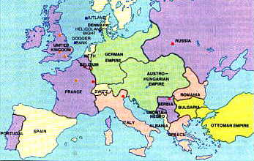
Europe in 1914

Slide 39
Major Fronts
Western Front – characterized by trench warfare & stalemate until the US arrival in 1917
Schlieffen Plan fails b/c Russia mobilizes too quickly and Germany is forced to split troops; British troops arrive to aid French troops and are an even match for Germany
Important battles: Verdun and the Somme – large losses (together over 2 million) and little gains on either side
Eastern Front – Germany and Russia win and lose large amounts of land, still with little in long-lasting gains
Important battle: Tannenberg – halts Russian advance
New technology kept movement to a minimum: machine guns, tanks, airplanes, grenades, flamethrowers, etc.

Slide 40
Major Fronts Continued
The Middle East – Allies tried but failed to secure Istanbul
The War at Sea – GB blockaded German ports; Germany responds with unrestricted submarine warfare, attacking both military and civilian vessels
Leads to sinking of Lusitania with American civilians on board in 1915; Pres. Wilson demanded an end to attacks on civilians and Germany complied for a while
US Entry – April 1917
US remained neutral until 2 things occurred: Germany resumed unrestricted submarine warfare in 1917 and the Zimmerman note was discovered, a telegram from Germany to Mexico encouraging it to cause trouble on the southern US border to get back Mexican Cession

Slide 41
End of the War
US arrival on the Western Front in early 1918 finally breaks the stalemate
Germany puts all it has left into 2nd Battle of the Marne but fails
Allies advanced into Germany & Wilhelm II advocates and a new German Republic is declared

Slide 42
Outcomes of World War I
10M dead, 20M wounded – left behind veterans and writers known as the Lost Generation
Economies were strained, even for the victors
Allies owed heavy debts to America
German, Austro-Hungarian, Turkish, and Russian empires collapsed
US entered European affairs
Fascism emerges in Italy, Germany, and Spain
Establishment of Communism in Russia…more in a bit on this

Slide 43
What was the most important Treaty that came from the Paris Peace Conference to settle War World I?

Slide 44
Treaty of Versailles, 1919

Slide 46
Some Particulars of the Treaty
Wilson’s Fourteen Points seen as too idealistic
Alsace Lorraine returned to France.
No German troops in Rhineland (must demilitarize)
Germany loses all its colonies in Africa and Indonesia
War damages (reparations) to be paid by Germany
Germany forced to give up fleet, merchant marine ships, make coal deliveries, and give up all property owned by German citizens abroad.
Germany must sign a war guilt clause accepting responsibility for the war (Article 231)
New independent states of Finland, Estonia, Latvia, Lithuania, Poland, Czechoslovakia, and Yugoslavia created in spirit of self-determination

Slide 47
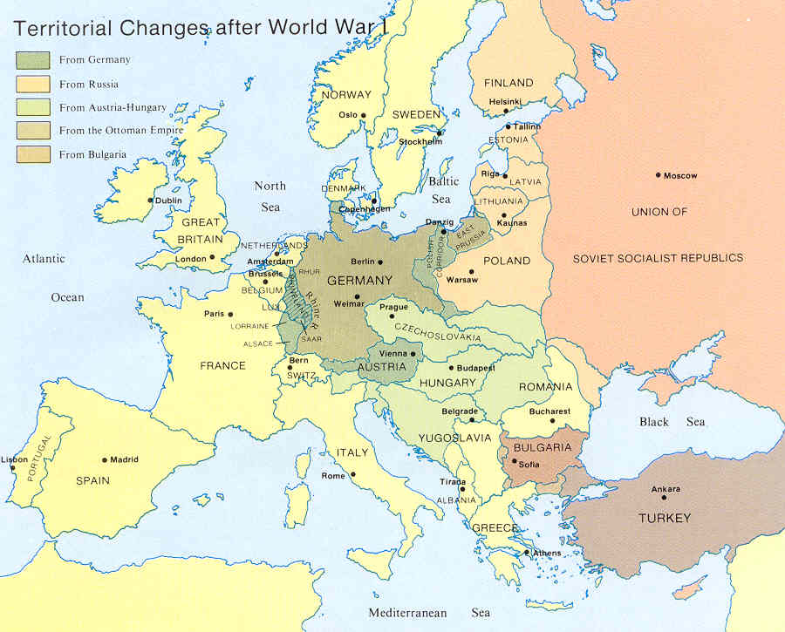

Slide 48
The Russian Revolution and Russian Civil War
1917-1921

Slide 49
During WWI, society was in a state of unrest due to the heavy casualties of war and growing discontent with the Czarist government
In the spring of 1917, revolution broke out in major Russian cities and Czar Nicholas II abdicated
An interim gov’t began creating a Russian Republic & decided to stay in the war effort
The German gov’t secreted Russian Marxist Lenin back to Russia to spread revolutionary unrest among Bolsheviks
Lenin promised the people of Russia “Peace, land, and bread” – with “peace” being an end to WWI

Slide 50
In November, 1917, Russian soviets (elected worker & peasant councils) supported the Bolsheviks in an overthrow of the interim gov’t which led to the Russian Civil War
Supporters of the Bolsheviks were organized by Lenin’s right-hand man Trotsky into the Red Army while Czarists allied with Russian liberals who supported a republic to become the White Army
During the course of the War, the Czar and his family were executed and Lenin signed a treaty with Allies to end Russia’s involvement in WWI
Can you name this Treaty?

Slide 51
Treaty of Brest-Litovsk, December , 1917

Slide 52
In the Treaty, Russia gave up Poland, Ukraine, Finland and the Baltic Provinces
Lenin believed that Germany would eventually be defeated and Russia will get some of the land back
With this peace agreement, Germany sent Eastern front soldiers to the Western Front to continue fighting against the Americans who arrived in May 1917

Slide 53
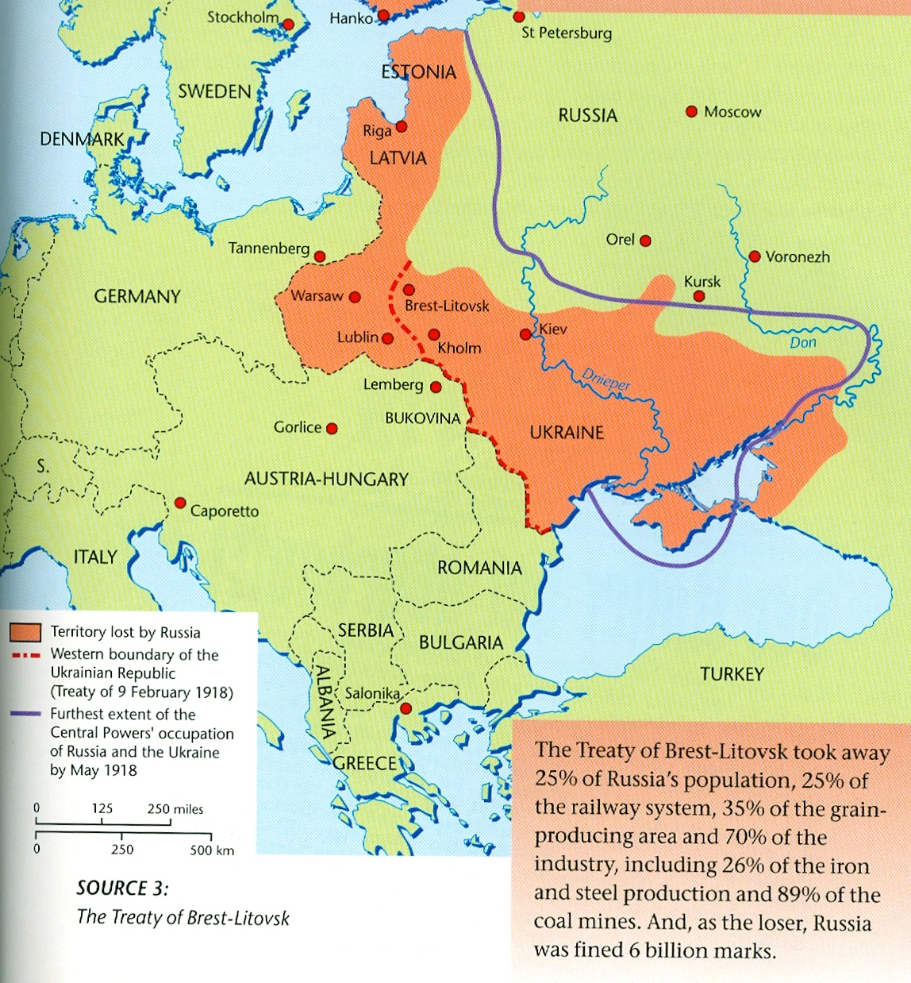

Slide 54
Can you name the Peace Talk at the very end of World War II?

Slide 55
Potsdam, July 1945

Slide 56
Germany divided into zones of occupation by British, French, Americans and Russia
Germany disarmed and de-militarized.
De-nazification process and war trials to be held
Reparations from Germany to all zones, but additional reparations to be given to Russia from the three Western Zones.
Cold War begins.

Slide 57
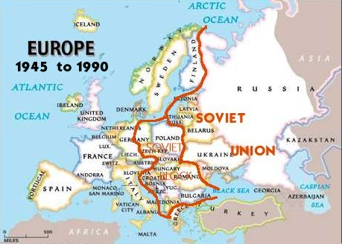

Slide 58
What Treaty Created the European Union?

Slide 59
The Treaty on European Union, signed in Maastricht on 7 February 1992, entered into force on 1 November 1993.
This is the Treaty that set the goal of a common currency – Euros launched in 1999

