Slide 1
Important Wars and Treaties from European History

Slide 2
Part 1: Before the French Revolution

Slide 3
The Hundred Years War 1337-1453

Slide 4
France won but only after a long fight with the English over a vacant French throne
The English Longbow was superior technology and led to early English victories but Joan of Arc gave France a rallying point and tide turns after Battle of Orleans.
How did the Hundred Years War affect the rise of national monarchies, often referred to as the growth of national sentiment?

Slide 5
Monarchies of France and England used the War as justification for centralizing their power over society.
Europe entered the H.Y.W. in a feudal state but emerged in the early modern world with the beginnings of centralized monarchies.

Slide 6
English Longbow

Slide 7
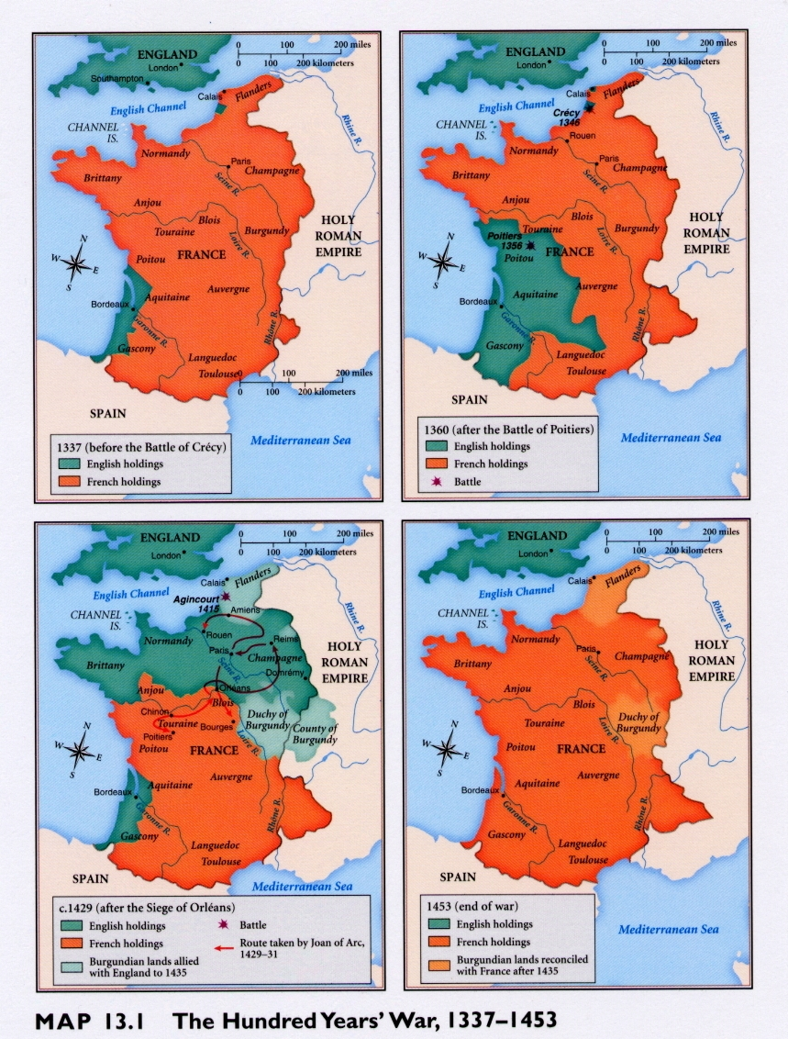

Slide 8
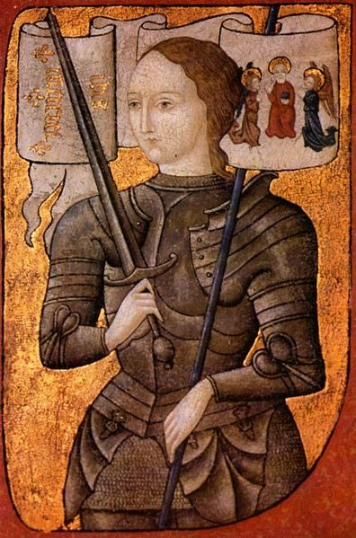
Joan of Arc c. 1412-1431

Slide 9
The Wars of the Roses 1455-1485

Slide 10
Fought in England between the Lancasters (family symbol red rose) and Yorks (family symbol white rose) after losing the H.Y.W.
Ended with Lancaster victory and establishment of Tudor Line under Henry VII, a branch in Lancaster family line.

Slide 11
Henry VII 1st of Tudor Line r. 1485-1509

Slide 12
Europe after the Rise of Monarchies in the 15th Century
Hapsburgs in control of Spain and HRE
Valois in control of France
Tudors in control of England

Slide 13
Habsburg-Valois Wars and the French Invasions of Italy 1494-1559

Slide 14
It was the war between France and the Hapsburgs (mostly Charles V) to control the independent states of Italy as well as territorial disputes on their borders.
France invaded Italy 3 times; during the 3rd invasion of 1527, Rome was sacked ending the High Renaissance.

Slide 15
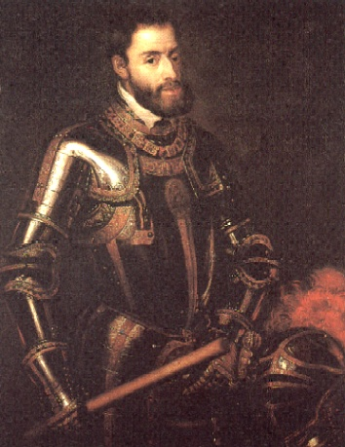
Charles V, HRE & King of Spain 1500-1558

Slide 16
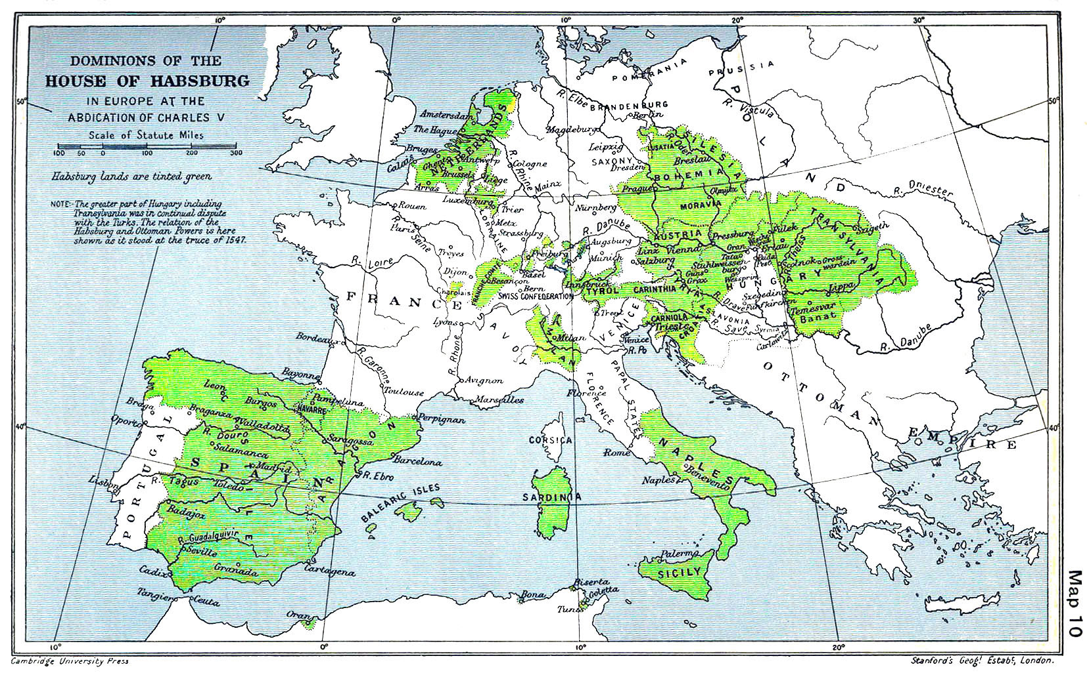
Habsburg Holdings

Slide 17
The Wars of Religion
16th Century

Slide 18
German Wars of Religion: The German Peasants’ War (Peasants’ Revolt) and the Schmalkaldic War

Slide 19
First, the Peasants’ War
Peasants revolted 1524-1525 in response to rise of Protestantism, but mostly for political and economic rights against German princes;
Denounced by Luther and put down by German princes.

Slide 20
Formation of the Schmalkaldic League
Charles V ordered all German princes to revert to Catholicism after Peasants’ War
In 1531 German Protestant princes responded by forming the League which was a defensive alliance
League issued Augsburg Confession – a moderate statement of Prot. beliefs

Slide 21
Schmalkaldic War
1547- Charles V’s imperial armies crushed Schmalkaldic League & he issued Augsburg Interim saying German Prots had to readopt Catholic beliefs and practices but German princes continued to resist.
Charles V finally realizes by 1555, he can no longer stop growth of Protestantism

Slide 22
What was the Peace Treaty that established Catholic and Lutheran religions in Germany according to ruler of the region given by Charles V?

Slide 23
The Peace of Augsburg of 1555

Slide 24
This peace established that the ruler’s religion sets the religion for that area (cuius region, ejus religio)
This was a great victory for Protestants b/c It was official recognition of the newly arrived Lutheran church
But, it would continue to keep Germany (The H.R.E.) fragmented

Slide 25
The French Wars of Religion 2nd Half of 16th Century

Slide 26
Catherine de Médicis (queen mother regent) and 3 French families grapple for power
Bourbons: main Huguenot leaders
Montmorency-Chatillons: also Huguenots
Guises— Catholic; controlled Catholic League
Catherine played all against each other, trying to keep Valois house powerful… case in point The Bartholomew’s Day Massacre

Slide 27
Catherine de Médicis 1519-1589

Slide 28
St. Bartholomew’s Day Massacre

Slide 29
Worst of the wars was
War of the Three Henrys
King Henry III allied with his Prot. Bourbon brother-in-law Henry of Navarre against Catholic league led by Henry of Guises.
Henry III is assassinated but Henry of Navarre takes throne as Henry IV, wins the war, signs the Edict of Nantes in 1598, converts to Catholicism and starts Bourbon line of French kings.

Slide 30
Henry III of France r. 1574-1589

Slide 31
Henry IV of France (of Navarre) r. 1589-1610

Slide 32
The Dutch Resistance 1559-1648

Slide 33
Who are they resisting? The Spanish!
Why? They’re Prot. and Spain is Catholic…oh, and they want independence….
Dutch resistance led by William of Orange (“the Silent”) against Philip II, king of Spain; Philip II sends in Duke of Alba to quiet them. Rules with his Council of Blood but to no avail.
Phillip II eventually gives up and Netherlands nominally independent in 1596 and formally independent at Treaty of Westphalia, 1648

Slide 34
Philip II of Spain (son of Charles V) r. 1556 -1598

Slide 35
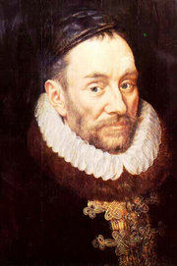
William I of Orange “the Silent” 1533-1584

Slide 36
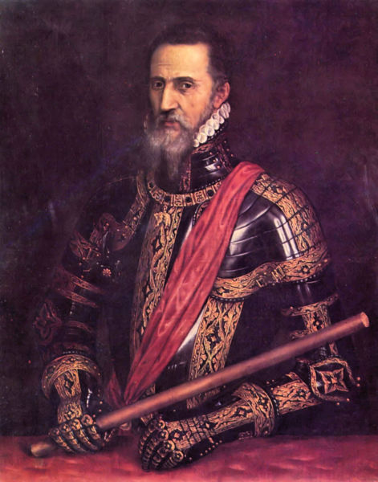
The Duke of Alba 1507-1582

Slide 37
Imperial England vs. Imperial Spain 1567-1588

Slide 38
When the Duke of Alba comes to the Netherlands in 1567, Elizabeth I gets worried that Spain will eventually invade from the Netherlands.
Relations w/ Spain’s Philip II deteriorate b/c:
English privateering
Elizabeth I’s papal excommunication (brings back Anglican church after sister “Bloody” Mary Tudor tried to end it
Her execution of Mary Queen of Scots (Catholic cousin – part of Stuart family line)

Slide 39
Philip II builds the Spanish Armada to invade England which is defeated/wrecked in 1588 due to faster English ships & the “Protestant Wind”
England now increasing in power, Spain begins long, slow decline

Slide 40
The English Civil War 1642-1651

Slide 41
Stuarts replace Tudor Line after Elizabeth I’s death (no children)
James I has major problems with Parliament, especially due to his Catholic sympathies (had only nominally converted to Anglican church) and tax collection

Slide 42
His son, Charles I ruled by divine right
Angers Parliament which issued Petition of Right trying to limit monarchial power
Charles I dissolved Parliament but brings it back due to a need for tax collection after a Scottish invasion – called the Long Parliament which continued to meet after Civil War ended
Long Parliament issued the Grand Remonstrance – list of grievances

Slide 43
Charles I responds in anger by trying to arrest Protestant agitators in Parliament, namely John Pym but he escapes
Parliament gathers an army of supporters called Roundheads; their army is called the New Model Army commanded by Oliver Cromwell

Slide 44
Charles I’s supporters are known as Cavaliers
Cavaliers lose an important Battle of Naseby; Charles I is captured at Battle of Marston Moor ending English Civil War
Make sure you know what happens under Commonwealth, Protectorate, Restoration, and Glorious Revolution!

Slide 45
The Thirty Years War 1618-1648

Slide 46
Germany embroiled in another round of religious wars due to German princes vs. Holy Roman Emperor (political and economic reasons)
Charles V’s Brother Ferdinand II wants to do what his brother never could, reestablish Catholicism as only religion in HRE, ending the Peace of Augsburg of 1555
War goes through 4 periods.

Slide 47
The Bohemian Period (1618-1625)
Ferdinand II (Hapsburg) was king of Bohemia and also in line for HRE; to restore Catholicism to Hapsburg lands he revoked religious freedoms of Bohemian Prots who responded by throwing one of his regents out the window (Defenestration of Prague).
When he became HRE, Bohemians revolted and chose Protestant Frederick V as their leader
Escalated into internat’l war; Spain sent troops to help Ferdinand
Maximilian of Bavaria and elector of Saxony (Lutheran who wanted territorial gain) also helped Ferdinand; Ferd wins over Fred & re-Catholocizes HRE

Slide 48
The Danish Period (1625-1629)
Lutheran king Christian IV of Denmark wanted to extend Danish influence & began new phase of Prot. Resistance
Invaded HRE but humiliated by Maximilian of Bavaria; forced to retreat
Ferdinand II didn’t trust Maximilian any more – too powerful; forms new alliance with Albrecht of Wallenstein

Slide 49
The Swedish Period (1630-1635)
Lutheran king of Sweden Gustavus Adolphus takes up Prot. cause and invades but is killed by Wallenstein
Wallenstein has now also become too powerful so Ferdinand II has him assassinated
Ferd’s forces crush remaining Swedes

Slide 50
The French Period (1635-1648)
Longest and most devastating
France enters war and sends $ and troops
During 13-year period Swedes, French, Spanish soldiers battled throughout HRE
Germans not united so couldn’t keep other countries out; peace talks began in 1644 but by this time 1/3 German population died due to the War
Worst European catastrophe since Black Death

Slide 51
What was the Peace Treaty that ended the Thirty Years War (and thereby the Wars of Religion)?

Slide 52
Treaty of Westphalia, 1648

Slide 53
Details of the Treaty of Westphalia
Continued terms of Peace of Augsburg of 1555 but with Calvinism added to Lutheranism as officially accepted religions in HRE
Dutch and Swiss now officially independent, recognized
The Treaty maintained independence and Sovereignty of 300 separate German States. Germany was fragmented and wrecked by the war (basically, kept the HRE)
This was the last great war over religious issues
Prussia emerged as strongest German state
Winners: Sweden, Prussia, Calvinists, Swiss Confederation, The Netherlands, German Princes, & France
Losers: Hapsburg HRE’s and Hapsburg Spain – another defeat after Armada

Slide 54
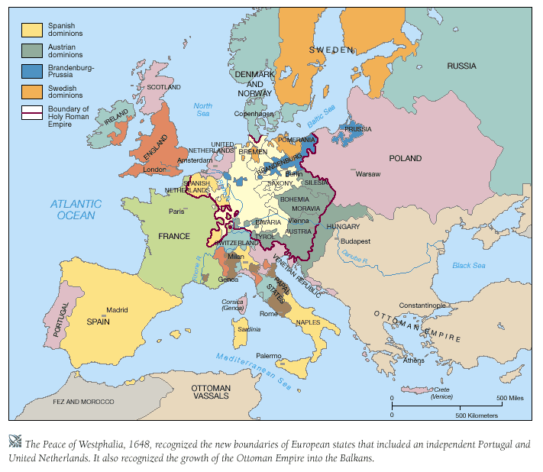

Slide 55
Louis XIV’s Wars 1667-1713

Slide 56
War of Devolution 1667-1668

Slide 57
1st great foreign war of France
Fought over Louis’s claim to Spanish Belgium (aka Spanish Netherlands) through his wife Marie Therese Philip IV (King of Spain) died and left all land to son Charles II from a 2nd marriage (Marie was 1st child from 1st marriage) but Louis claimed the property should devolve to child from 1st marriage b/c of local Belgian laws so he sent armies in 1667
England, Sweden, Holland formed Triple Alliance forcing Louis to back down
Treaty of Aix-la-Chapelle (1668)—Louis given control of certain towns on border of Sp. Netherlands

Slide 58
The Dutch War 1672-1678

Slide 59
1670 – France signed Treaty of Dover with England against the Dutch and Triple Alliance crumbled
Louis now in good position to invade which he did in 1672; felt beating the Netherlands would allow him to finally gain Spanish Belgium
Faced by William III of Orange (future King William III England due to Glorious Revolution) who united 7 Dutch provinces together and then joined with HRE and Spain against Louis XIV
Peace of Nijmegen (Ny-may-gen) ended war—Netherlands kept most territory and Louis only gained a few more towns on French border of Spanish Netherlands

Slide 60
The Nine Years’ War (War of the League of Augsburg) 1688-1697

Slide 61
Louis kept army at full strength, ready to go to war if needed, b/c he wanted to push borders to the Rhine
In 1681, he conquered HRE border town of Strasbourg
League of Augsburg created in 1686 to resist further French expansion into German states; included HRE, England, Spain and the Netherlands
Eventually stalemate and exhaustion forced all to sign a peace agreement
Peace of Ryswick signed 1697 – big win for William III who secured Netherlands borders and Louis XIV only got to keep Strasbourg

Slide 62
War of Spanish Succession 1701-1714

Slide 63
In 1700 Charles II of Spain dies and now both Louis and Hapsburg HRE Leopold I claim rights to the throne through their marriages (Leopold married Marie Therese’s younger sister)
Louis’s grandson Philip of Anjou was put on the throne as Philip V by Charles II at his death b/c had better claim to the throne (older sister)
1701 – Grand Alliance forms in response to expanding French power; included England, Holland, HRE & Louis responded by claiming William and Mary were not rightful heirs of England…the abdicated James II’s Catholic child was
Them’s fightin’ words!

Slide 64
War broke out between Louis XIV and the Grand Alliance in 1701 and engulfed most of Europe
By this point, France low on money, resources, military generals and the English were superior in all ways
After France started losing battles had to deal with internal problems like famines, uprisings, heavy tax burdens (same old story…)
After over a decade of fighting, all were ready to begin signing treaties in 1713

Slide 65
Now, name the most important Treaty that ended the War of Spanish Succession…

Slide 66
Treaty of Utrecht, 1713

Slide 67
Main Points of the Treaty of Utrecht
Philip V remains on the throne in Spain beginning Bourbon line of Spanish kings but Spain’s dominions are broken up and dispersed:
Gibraltar and Minorca goes to British giving them lost of control in Mediterranean
Sardinia goes from Spain to Italy (becomes Piedmont-Sardinia)
The Spanish Netherlands is now Austrian Neths.
Spain keeps New Spain holdings in S. America
In Canada, Newfoundland/Nova Scotia go to Britain
Britain gets Asiento privilege to provide slaves to New Spain; British greatest winners of the Treaty

Slide 68
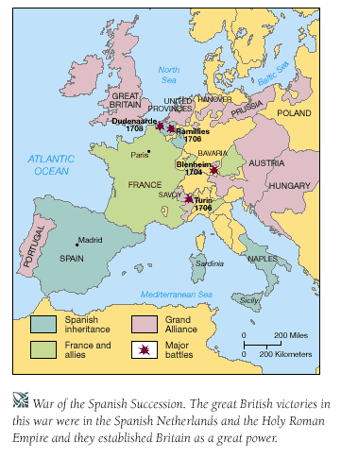

Slide 69
Mercantile Empires Wars of the 18th Century

Slide 70
Treaty of Utrecht set up a new reason for war: trade rivalries built on mercantilist goals; also keeping the balance of power was important
Other points of the Treaty:
Britain and France got holdings in India
The Dutch gain supremacy in Pacific (Indonesia)
The French solidify holdings along St. Lawrence River, Great Lakes, Mississippi River Valley
Spain, Britain, & France all had holdings in West Indies (Caribbean)
Expanding empires + Expanding trade networks + Previous major rivalries = WAR

Slide 71
War of Jenkins’ Ear Started 1739

Slide 72
West Indies was a hotbed of trade rivalry between England and Spain and add to that the Asiento privilege and British privateering, seeds of war planted
In 1731, a fight broke out when a Spanish patrol crew boarded an English ship and the English captain Robert Jenkins’ ear was cut off
Years later, Jenkins testified before Parliament about Spanish “atrocities;” War began in 1739
Meanwhile…

Slide 73
War of Austrian Succession Started 1740

Slide 74
Frederick II “The Great” (F.t.G.) of Prussia decided to test just how powerful Maria Teresa, the new Holy Roman Empress (thanks to Pragmatic Sanction) would be
In 1740 he invaded and seized Silesia, starting the War
Maria Teresa rallied support among Austrian and Hungarian nobility (promised them more power, Hungarian local autonomy) and this kept F.t.G from advancing further
Meanwhile…

Slide 75
France finally decides to choose sides in both wars, Jenkins’ Ear and Austrian Succession
It supports Prussia against Austria (anti-Hapsburg move) and Spain against Great Britain (Bourbon ties)
France basically brings both wars together which end in a stalemate in 1748 at another Treaty of Aix-la-Chapelle which said:
Spain kept Asiento contract w/ GB, Prussia kept Silesia, British/French holdings remained the same; this was just a break in the action…

Slide 76
The Diplomatic Revolution of 1756 and Seven Years’ War 1756-1763

Slide 77
Many countries concerned that France was again tipping the balance of power in its favor
Drives F.t.G. in Prussia to reach out to Great Britain by signing defensive alliance called Convention of Westminster
Gives Maria Teresa an excuse to join with former Hapsburg enemy, France, in a defensive alliance
Now, a reversal of alliances, called the Diplomatic Revolution of 1756 has occurred: Britain and Prussia vs. France and Austria
Leads to a new round of fighting…

Slide 78
The Seven Years’ War
Has two major areas of conflict – The Continental War and the Colonial War
First, the Continental War
F.t.G. opens hostilities again by invading Saxony (part of HRE) in his continued fight against Austrian power and Maria Teresa who had hoped to regain Silesia
After 7 years of fighting and hundreds of thousands dead with very little land gains, Treaty of Hubertusburg signed between Austria and Prussia
Made no significant changes in pre-war borders

Slide 79
The Seven Years’ War
Now, the Colonial War
British secretary of state William Pitt the Elder, saw the Continental War as an excuse (due to Diplomatic Revolution alliances) to fight France in world-wide colonial holdings, but especially North America
Britain sent 40K troops to its colonies and the French sent troops and allied with a Native American confederacy led by the Iroquois (hence the American name for the War, the French and Indian War)
American colonists joined in the fight and the French-Native American alliance was defeated

Slide 80
Can you name the Treaty that ended the Colonial side of the Seven Years War?

Slide 81
Treaty of Paris of 1763

Slide 82
The Treaty of Paris of 1763
The French give the British almost all of their North American territory— St. Lawrence River valley and Quebec in Canada, the Great Lakes, the Ohio and Mississippi River Valley to the south which doubles British territory in North America
The French also had to give up their colonial holdings in India
France is no longer an international threat and Great Britain is now poised to build an empire on which the “sun never set”

Slide 83
