Slide 1
Welcome to Civics!
Mrs. Ashley Adkins

Slide 2
What will we learn about?
See the What is Civics? part of your syllabus
Important historical documents such as the Declaration of Independence and the Constitution
The 3 branches of government and how they affect our lives
Voting and elections, focusing on upcoming election seasons
The American court and legal system

Slide 3
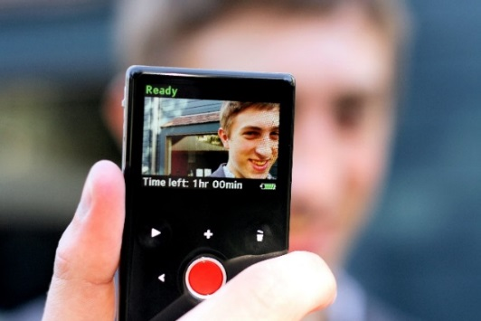
Class Activities
We will listen to and discuss 60-second Civics Podcasts, starting today!
Today's Podcast (Go to 916)
You will also be acting as Roving Reporters, documenting student opinions and reactions to current events and Civics- related topics.

Slide 4
Class Activities Continued
iCivics.org
You will be completing
activities on this website.
We’ll get you started on the set-up today!
Socrative.com
Here, you’ll do assignments
and submit them for grading
online.
And finally, here’s something you’ll use a lot:
My website: www.mrsadkinsdhs.weebly.com

Slide 5
Grading Policy
See Grading section of syllabus
Remember you EARN your grades – I don’t give them to you!
I make it easy to be successful in this class. If you put forth effort daily, your grades will reflect that. If not, your grades will suffer.

Slide 6
Supplies – Needed Daily!
See Materials Needed Daily section of your syllabus
Notice you do not need your textbook daily. We will keep them in the classroom.

Slide 7
Let’s Be Nice!
See Class Policies section of syllabus
Following class policies helps us enjoy each others’ company since we’ll be together until December!

Slide 8
Taking a break…
Let’s discuss the hand signals.
Don’t abuse these privileges by wandering the halls, losing the pass, etc.
My passes will be used for any requests to leave the classroom; pink passes for the nurse
Don’t bend or tear passes and return them immediately when you come back to the room

Slide 9
Make-Up Work
It is your responsibility to get all make-up assignments.
Make up all missed work in 5 days
Alternate arrangements can be made for extended leave.

Slide 10
About Me
I attended Hillcrest High School and then Furman University
I’m married with 2 kids
I have 3 Chihuahuas as pets

Slide 11
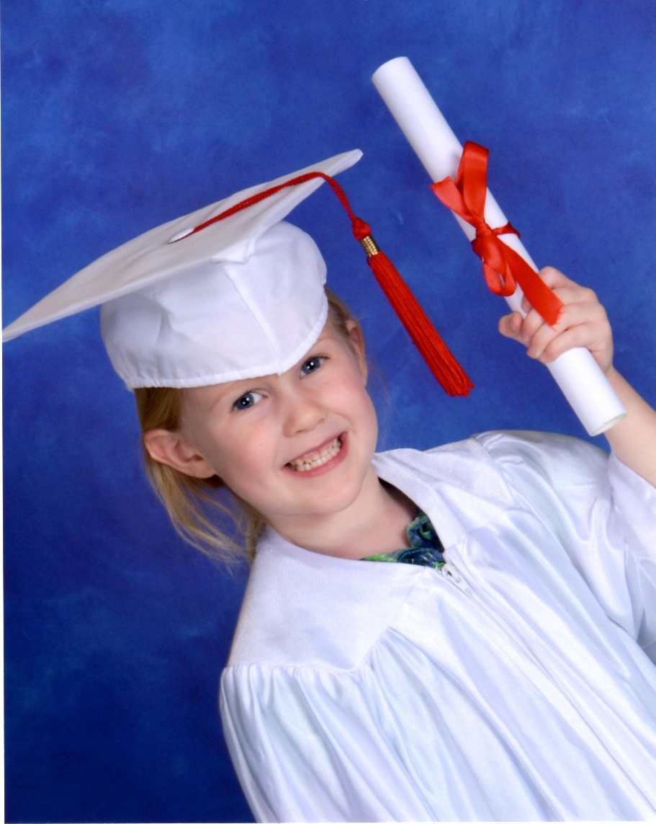
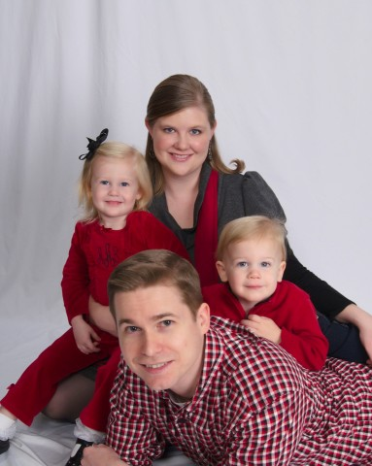
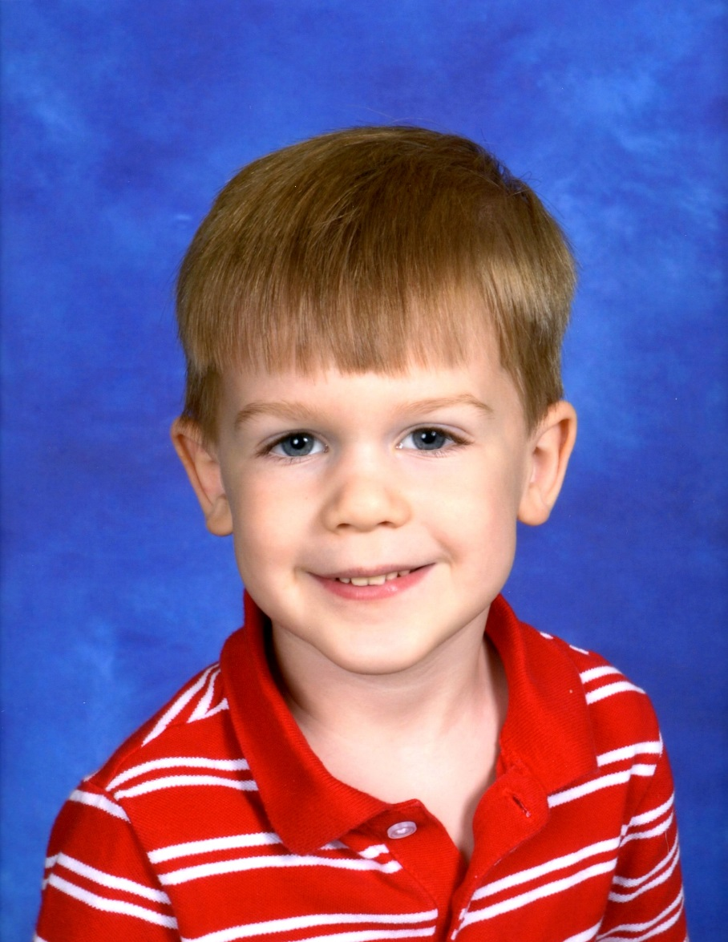

Slide 12
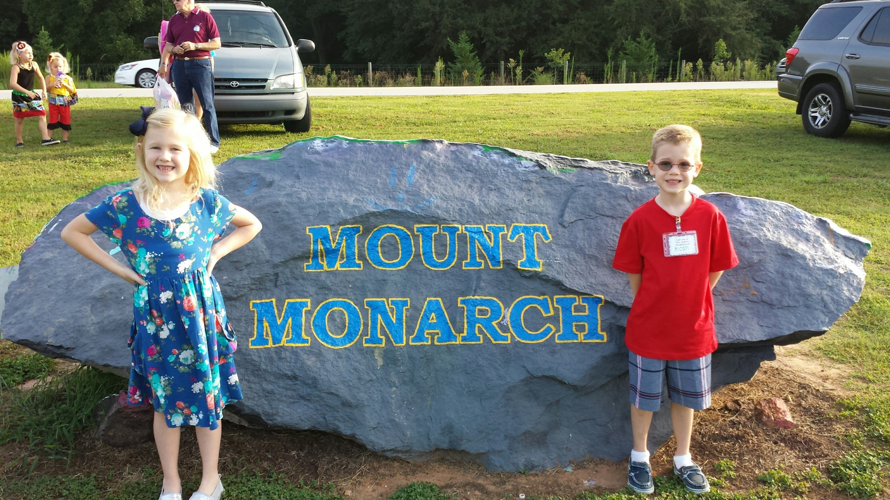

Slide 13
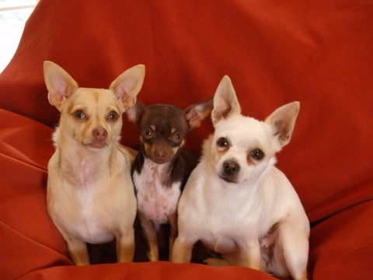
The Other Family Members

