Slide 1
Chinese Dynasties and Philosophies Review Part II
AP World History

Slide 2
Late Postclassical to Modern Day China
Yuan, Ming, and Qing Dynasties
Chinese Republic
Chinese Communism
Modern Day China

Slide 3
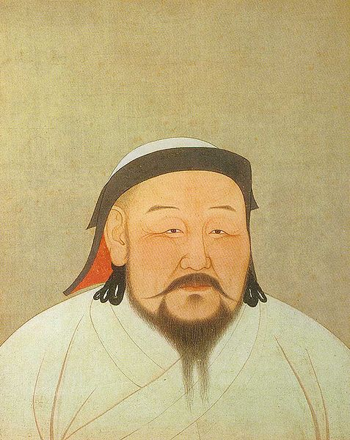
Kubilai Khan r. 1260-1293

Slide 4
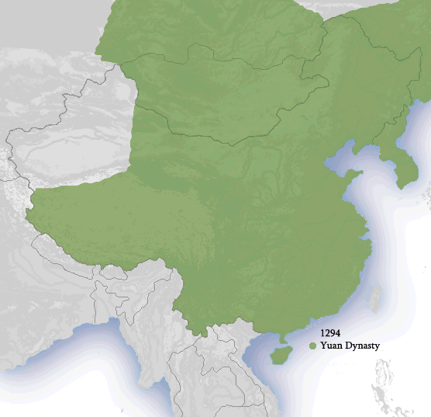

Slide 5
Yuan Culture and Decline
Mongol women reject Confucian patriarchy – don’t adopt footbinding, seclusion of Neo-Confucianists; shown by Chabi, wife/advisor to Kubilai
Mongols known for tolerance, support of other cultures’ influence: new tax systems, better medicine from Muslims, calendars from Persians, Eur. connections from Marco Polo
Elevated musicians/artists/actors (formerly considered mean people) as seen by popularity of Romance of the West Chamber
Decline: softening of leadership, scholar-gentry resistance, banditry, rebel leaders, failed conquests in Korea/Japan, White Lotus Society wanted to overthrow gov’t, peasant uprisings – one is successful

Slide 6
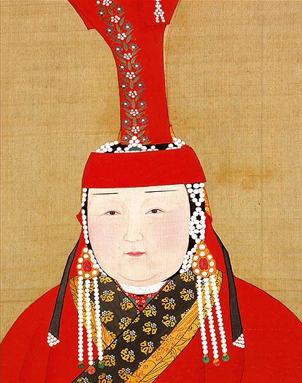
Chabi

Slide 7
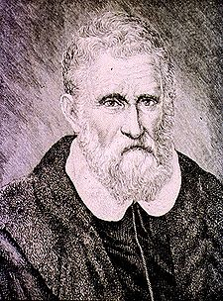
Marco Polo 1254-1324

Slide 8
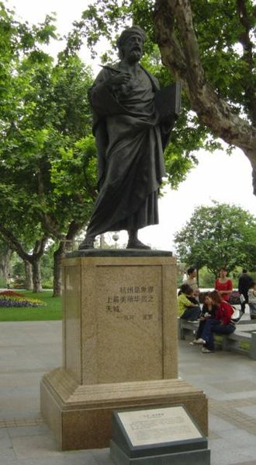
Statue of Marco Polo in Hangzhou

Slide 9
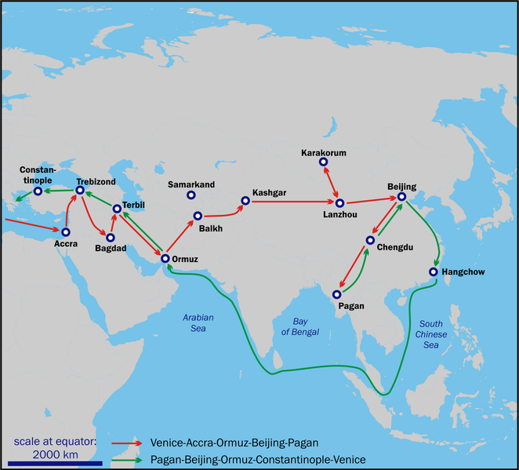
Marco Polo’s Journey

Slide 10
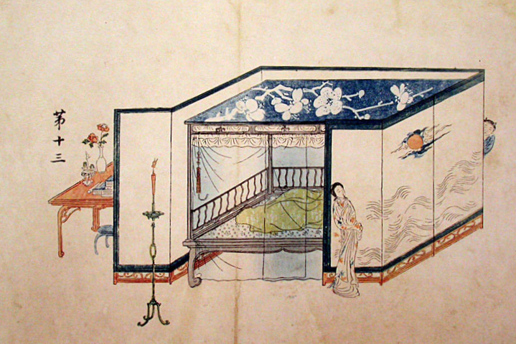
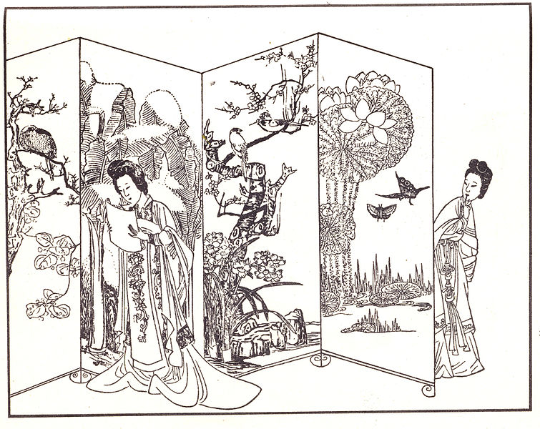
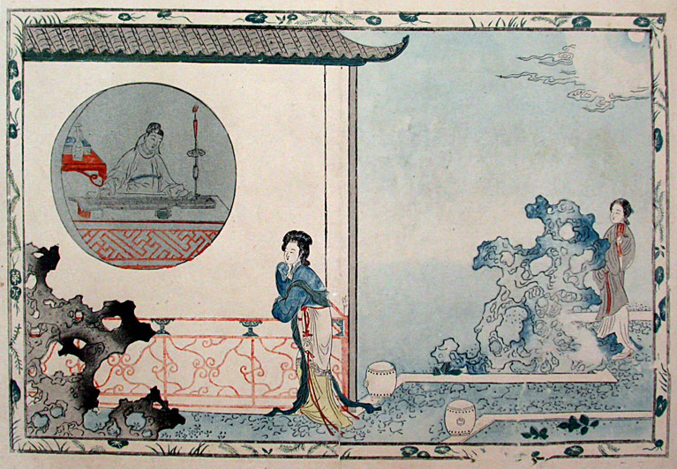
Scenes from The Romance of the West Chamber

Slide 11
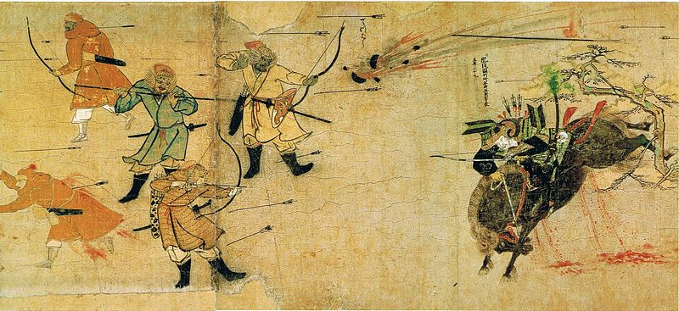
Failed Mongol Conquest of Japan

Slide 12
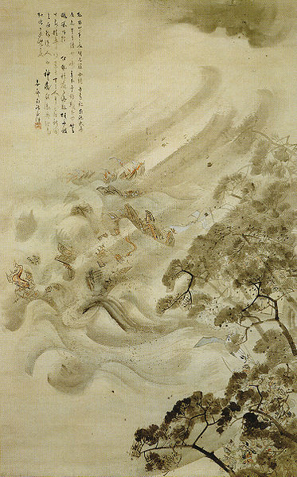
Mongol fleet destroyed by a typhoon – called the “Divine Wind” or Kamikaze

Slide 13
Ming Dynasty: 1368–1644
Zhu Yuanzhang led peasant army to conquer Yuan Dynasty then began Ming Dynasty with the name Hongwu
Viewed scholar-gentry with suspicion and tried to rid China of Mongol influences
Foreign influence (esp. Western) increased in port cities of Macao, Canton and Ming outreach increased throughout Asian Sea Trading Network
Voyages led by Zheng He and Chinese vessels called junks are most impressive in the world

Slide 14
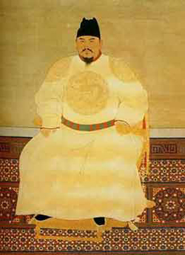
Zhu Yuanzhang Hongwu r.1368-1398

Slide 15
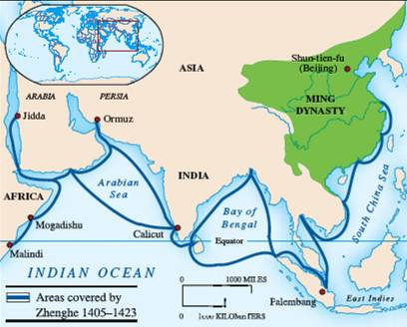

Slide 16
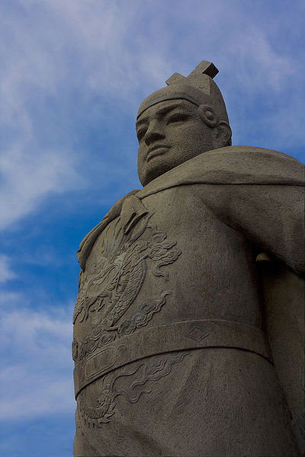
Zhenghe 1371-1433

Slide 17
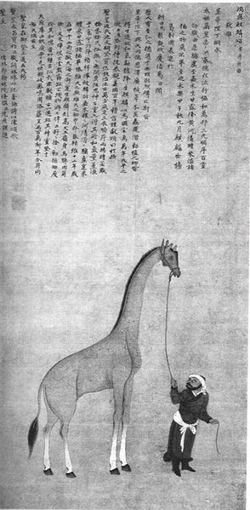
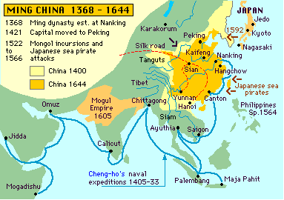
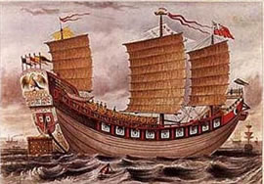

Slide 18
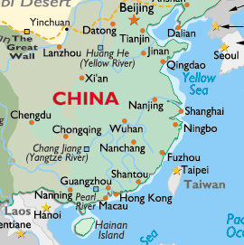
Canton (Guangzhou) Macao

Slide 19
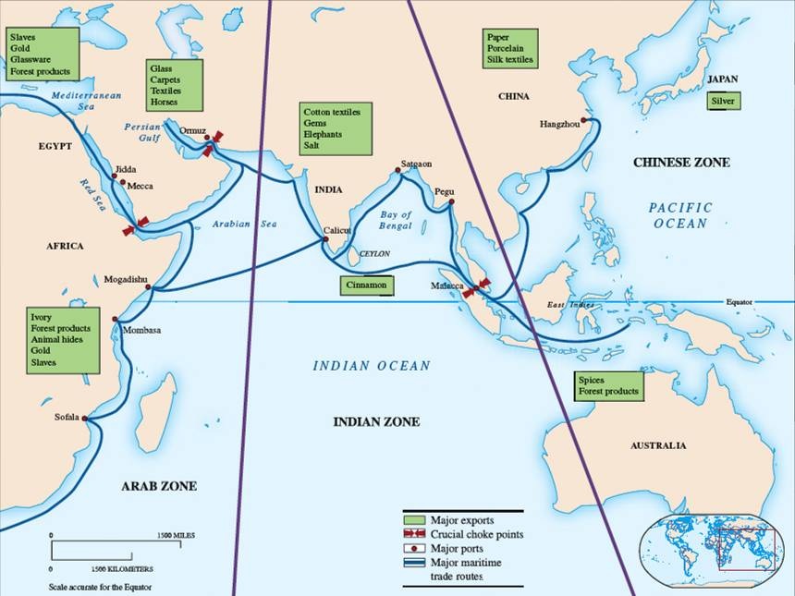

Slide 20
Ming Decline
Exploration deemed too expensive so funding cut; bad b/c Europeans now rapidly expanding, sending Jesuit missionaries (Matteo Ricci) and Portuguese are a part of Asian Sea Trade
Despite early Ming suppression of shi class, they resurge, and examination system more complex than ever before
Ming decline comes with same dynastic cycle problems and eventually toppled by banner armies of Manchu nomads from the north

Slide 21
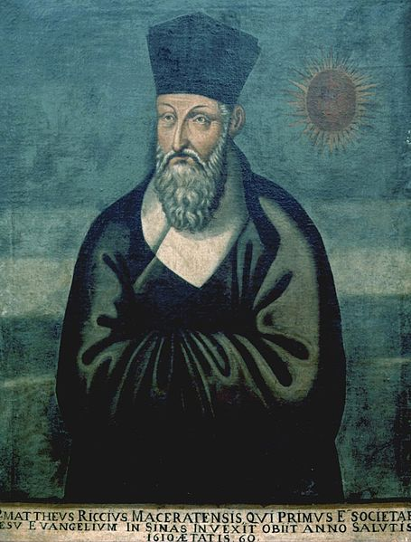
Matteo Ricci 1552-1610

Slide 22
Qing Dynasty: 1644-1912
The last dynasty!
Begun by Manchurian invaders led by Nurhaci
Invasion/takeover more due to Ming decline than Manchu might
Forced other nomads into submission and ruled largest empire in the world at that time
Largest Chinese dynasty ever
Retained most Ming gov’t processes & allowed scholar-gentry to continue their role, & called themselves Sons of Heaven even though not ethnically Chinese

Slide 23
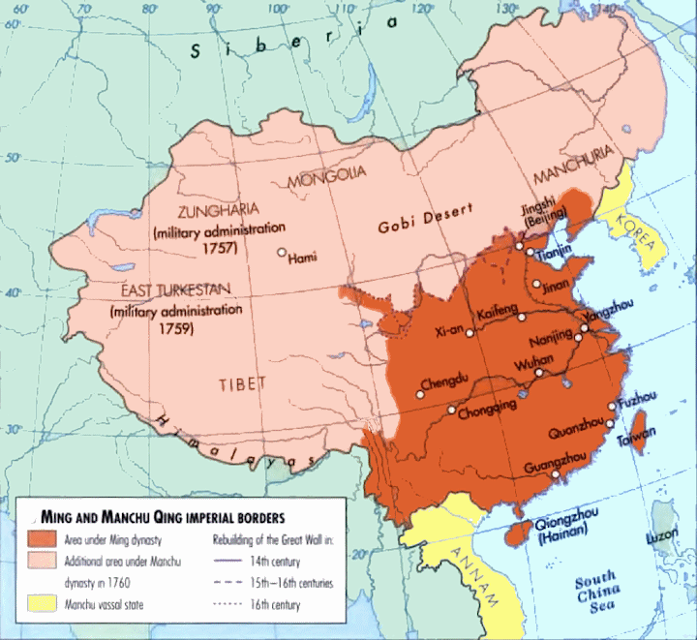
Manchu Conquest and Qing Dynasty Establishment

Slide 24
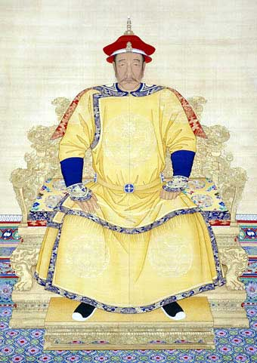
Nurhaci Manchu Uniter

Slide 25
Qing Dynasty Continued
Kangxi – Emperor/Conf. scholar who compiled Chinese learning
Focused on improving lives of peasants since this was such a problem at end of Ming Dynasty
New group, compradors, emerge – wealthy Chinese merchants who specialized in imports/exports that tied China to global mkt.
Dynastic cycle problems return: breakdown of bureaucracy due to cheating on exams, buying gov’t positions (esp. by wealthy compradors), tax $ pocketed, infrastructure in disrepair, banditry - looked like traditional end of cycle, new beginning

Slide 26
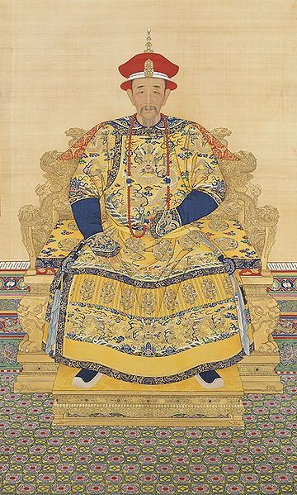
Emperor Kangxi r. 1661-1722

Slide 27
Wars, Rebellions, and Qing Decline
1839 Opium War with the British after Lin Zexu tries to end opium trade which leads to Treaty of Nanjing – pro-British
1850-1864 Taiping Rebellion led by Hong Xiuquan – failed attempt to overthrow gov’t led by mentally unstable Christ-like figure; actually captured much of China before put down
Late 19th c. Self-strengthening Movement tries to counter the West by calling for infrastructure improvements, modernizations; led by provincial leaders, not Qing Dynasty
1898-1901 Boxer Rebellion tried to expel foreigners but failed due to W. intervention; showed weakness of Qing leaders

Slide 28
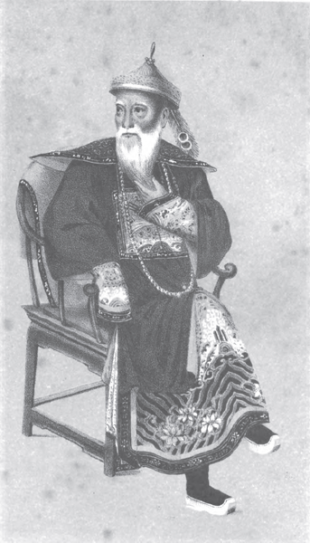
Lin Zexu Qing Drug Commissioner

Slide 29
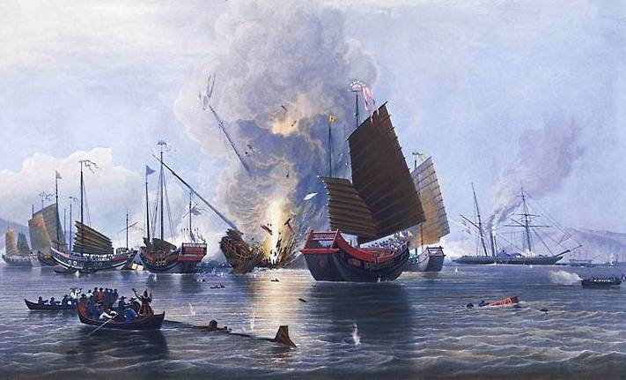
Opium War

Slide 30
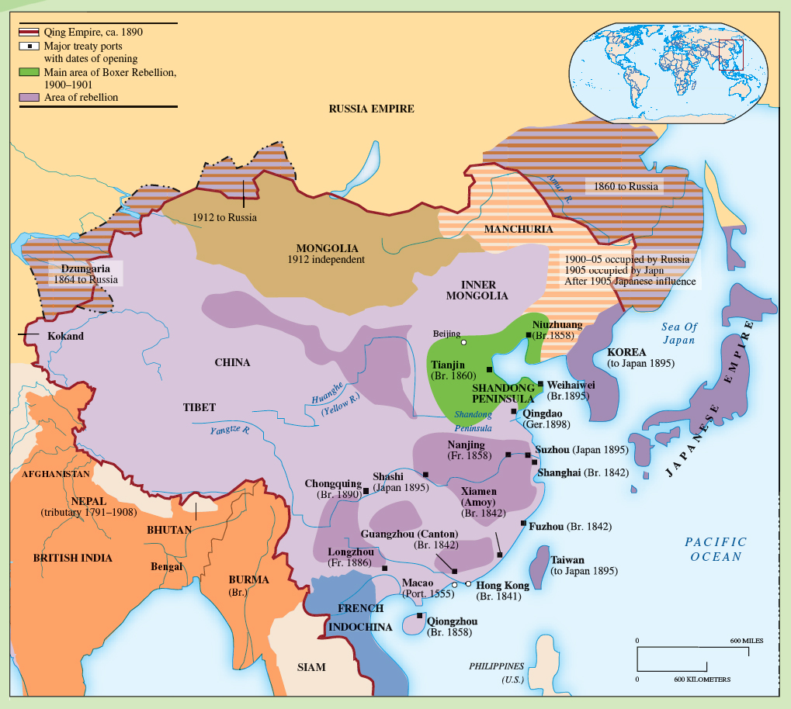
Qing Empire from Opium War (ends 1841) to WWI

Slide 31
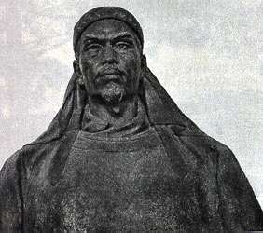
Hong Xiuquan 1814-1864

Slide 32
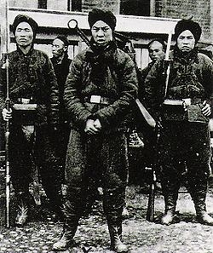
Boxer Rebels

Slide 33
End of the Qing Dynasty
Sun Yat-sen heads a revolutionary alliance that desired a republic, not another dynasty; led 1911 revolt against Qing
Ethnic Chinese rejected Manchu laws (cut their queues – long ponytails)
Last emperor, young Puyi (whose aunt Ci Xi ruled as regent) abdicated in 1912, ending all dynasties (after republic begun)

Slide 34
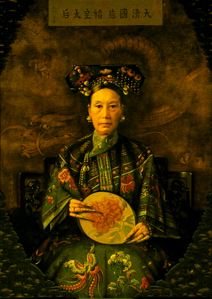
Qing Gentry Style 101: Long Nails

Slide 35
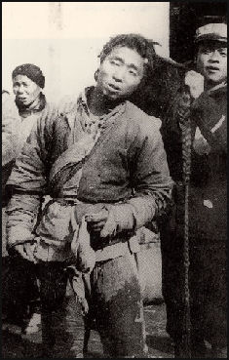
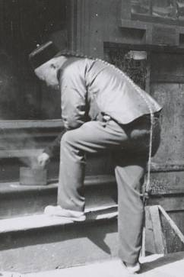
Cutting Hair Queues

Slide 36
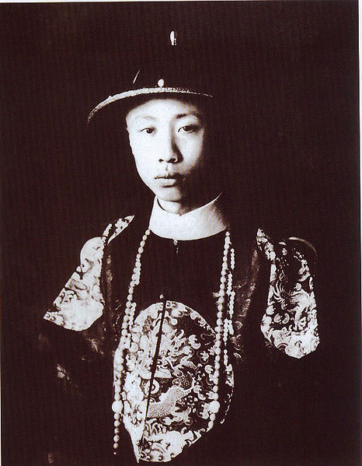
Emperor Puyi r. 1908-1912

Slide 37
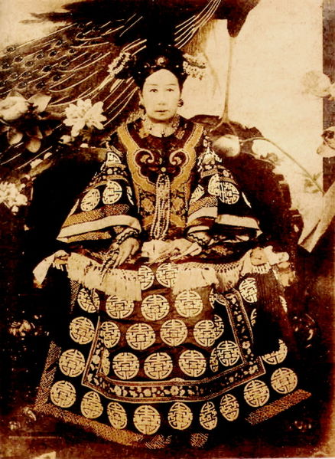
Empress Dowager Cixi (Regent to Puyi) r. 1861-1908

Slide 38
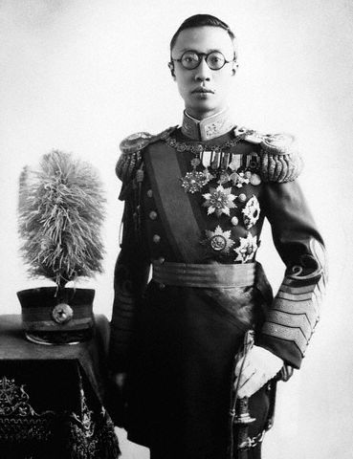
Emperor Puyi Last Chinese Emperor

Slide 39
Sun Yat-Sen (Yixian) r. 1911 - 1912

Slide 40
The Chinese Republic
Sun Yatsen led republic as president but abdicated 1912 after problems developed & rise of warlord power
Yuan Shikai, regional warlord comes to power; hoped to found new dynasty but unable to do so; ruled as president until 1916 and when he resigned, this started a free-for-all of leadership
May Fourth Movement 1919 –mvmt. of students/liberals who wanted a liberal democracy; done in response to Japanese advances from Paris Peace Conf. concessions of German land

Slide 41
Yuan Shikai r. 1912-1916

Slide 42
Chinese Civil War
Marxist philosophy arrives to China, led by Li Dazhao, followed by Mao Zedong; angered by betrayal at PPC; hostile to merchants/commerce dominated by West; form Comm. Party
Sun Yatsen returns 1919 and leads Nationalists (Guomindang) in the south; built an army to combat Communists; later led by Chiang Kai-Shek and trained at Whampoa Military Academy
Civil War began 1927, lasted throughout 1930s, included Long March in which Mao w/ 90K followers fled north

Slide 43
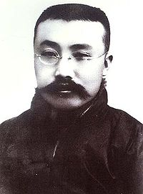
Li Dazhao r. 1888-1927

Slide 44
Mao Zedong r. 1945-1976

Slide 45
Chiang Kai-Shek (Jiang Jieshi) 1887-1975

Slide 46
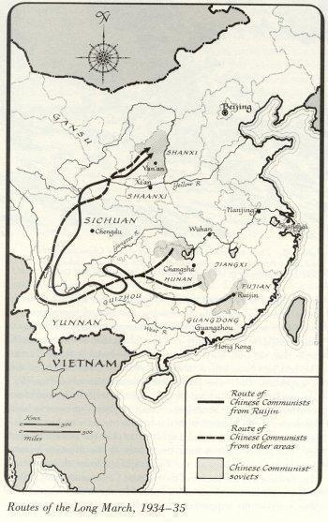
The Long March

Slide 47
End of the Civil War
Fighting put on hold after Japan invades in 1934 and both Nationalists and Communists fight Japan
Communists do better and gain followers and after Japan removed at end of WWII, Civil War resumes
Mao’s guerilla warfare bests Guomindang who flees to Taiwan
Mao and Communist Party create People’s Republic of China in ‘49 although it’s not officially recognized by US until ’78

Slide 48
Mao’s China: 1949-1976
He administered China w/ help of People’s Liberation Army (Communist Army)
Used Mass Line approach to Communism w/ collectives
Great Leap Forward tried to bring industrialization in small-scale, local ways
Both collectives (Mass Line communism) and Great Leap Forward led to economic disaster, starvation, ended in 1960;
Led Cultural Revolution to campaign against capitalism, “betrayers of the revolution” using Red Guard (student militia) as force

Slide 49
Post-Mao China
Mao and his closest allies called “the Gang of Four” were challenged by a reform-minded group called the Pragmatists
Deng Xiaoping led the Pragmatists and began limited capitalist reforms after Mao’s death in 1976
Student uprisings in 1989 in Tiananmen Square ended in many deaths (Tiananmen Square Massacre) so Pragmatists still weren’t ready for full Westernization
Modern-day China still Communist with Capitalist elements

Slide 50
Deng Xiaoping Chairman 1978-1989

Slide 51
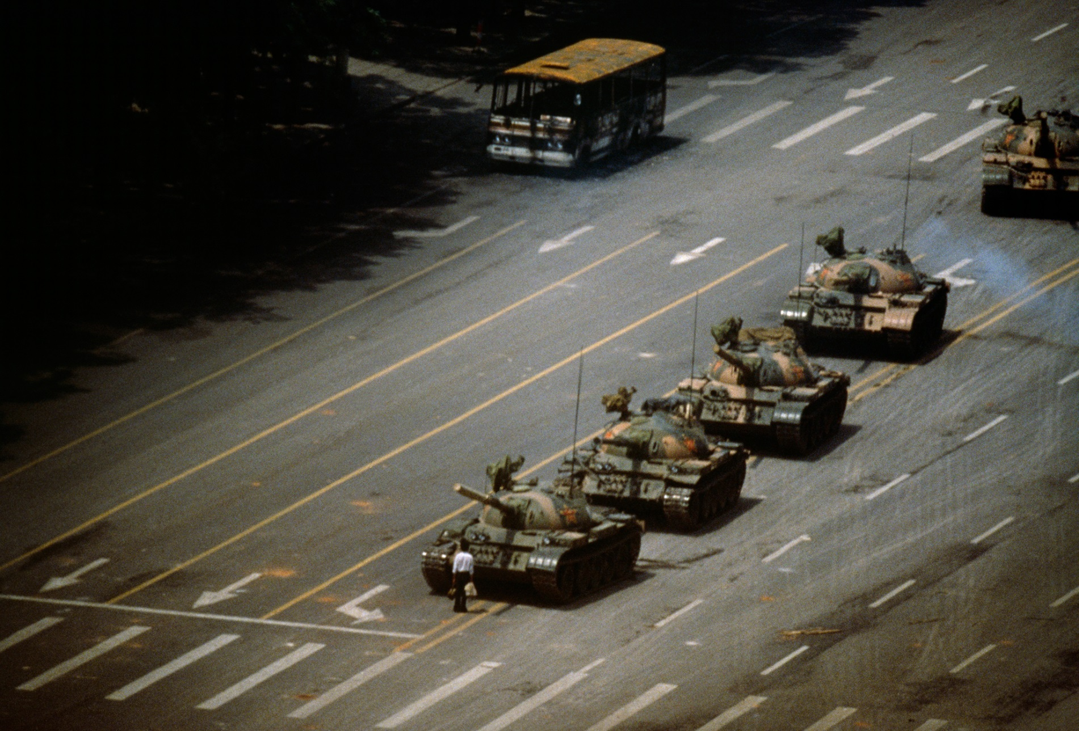
Tiananmen Square Uprising

Slide 52
Chinese Dynasties Song

