Slide 1
Chinese Dynasties and Philosophies Review Part I
AP World History

Slide 2
The Dynasties
From Shang to Song

Slide 3
The Shang Dynasty c. 1600 BCE - 1046 BCE
1st Dynasty in Huang He (Yellow River) Valley Civilization for which we have archeological evidence
Ruled area around Yellow River valley during Bronze Era (pre-Classical)
Based on agriculture: millet, wheat, barley, silkworms, pigs, dogs, sheep, and oxen
Shang leaders were head of military, society, and religion and were served by a sizeable bureaucracy – however, still relied on alliances so not fully centralized

Slide 4
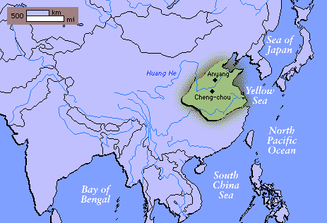

Slide 5
Shang Dynasty Culture
Religion was based on ancestor worship and polytheism
Oracles of great importance – shamans or priests who foretold the future through interpretation of animal bones cracked by heat
  inscriptions led to formation of Chinese script which is ideographic – pictographic characters group to create ideas)
Accomplishments: Earliest glazed pottery, bronze casting for rituals, wine, food, weapons and tools, advanced jade carving, set the year as 365 ¼days, study of diseases, 1st Chinese script, chariots

Slide 6
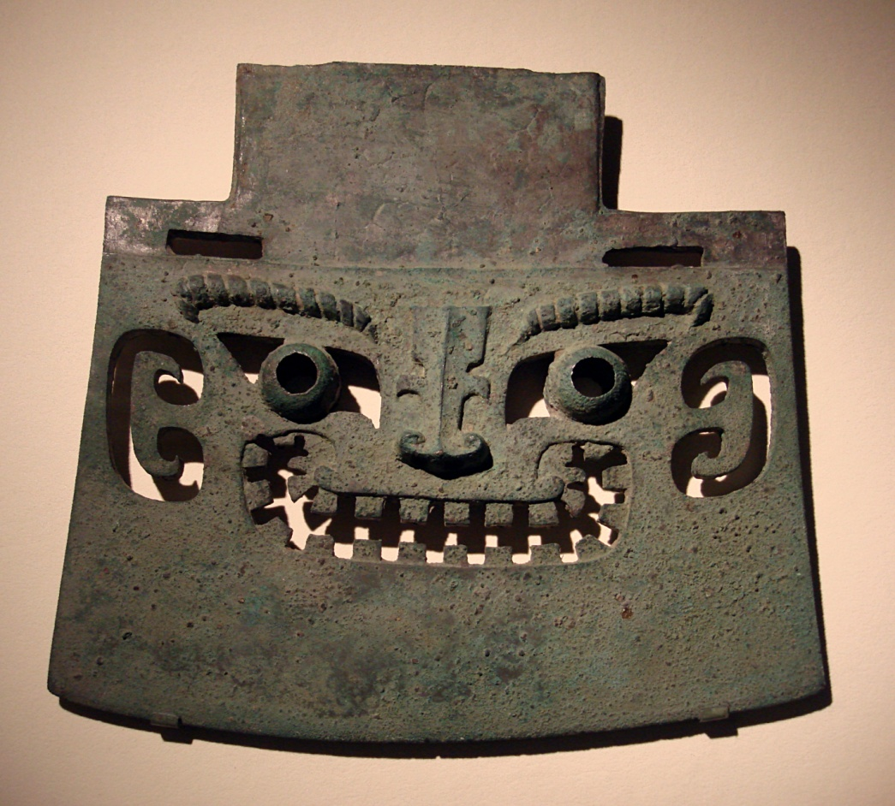
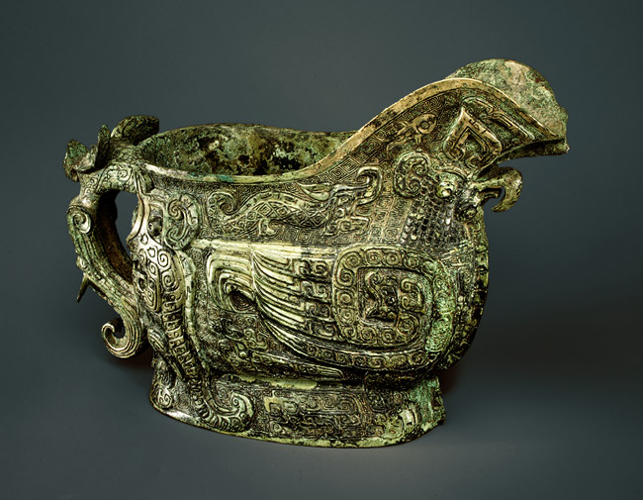
Shang Era Bronze

Slide 7
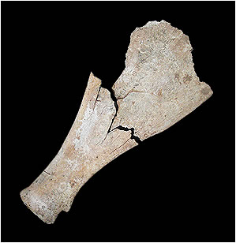
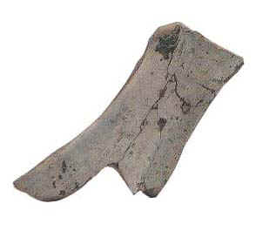
Oracle Bones

Slide 8
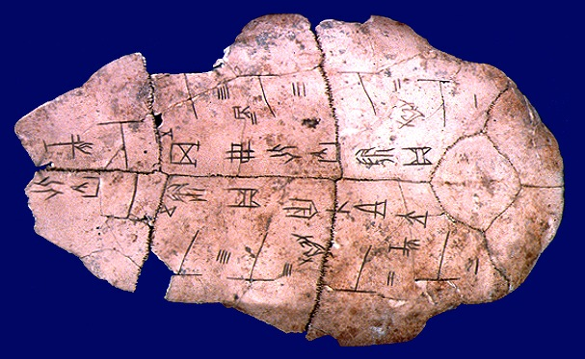
Shang Era Writing – Earliest Chinese Script

Slide 9
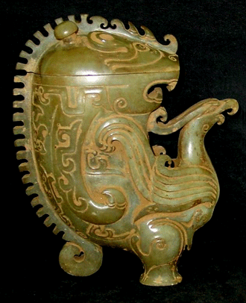
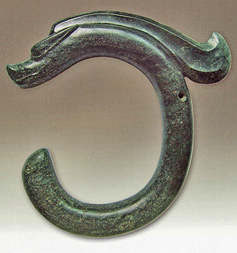
Shang Era Jade

Slide 10
The Shang Dynasty’s End
The final, tyrannical king of the Shang killed his own son, tortured and murdered his ministers and was overly influenced by his concubine.
The Zhou army defeated the last king of the Shang who self immolated (ritual suicide)
Zhou used Mandate of Heaven to justify overthrow

Slide 11
The Dynastic Cycle
New Dynasty
Claims the Mandate of Heaven
Defeat of old ruling family
Brings peace and prosperity
Population increases
Mandate of Heaven builds loyalty
(Re)builds public works
Gives land to the peasants
Protects the people
New Dynasty Claims Mandate of Heaven
Generations go by, New Dynasty becomes the Old Dynasty
Old Dynasty loses the Mandate of Heaven
Natural events: floods, famine, earthquakes, etc. may occur
Bandits raid the countryside
Food shortages lead to mass migrations
Invaders attack the empire
Tax collections grow smaller
Nobles begin to seize power
Rebellion is now justified
Peasants revolt as dynasty loses the Mandate of Heaven
Old Dynasty – Period of Decline
Less able rulers come to power
Officials & bureaucrats become corrupt
Corruption of examination system
Bureaucracy grows too large
Taxes people too much
Not enough taxes to defend kingdom and repair/build public works
Public works neglected and decay
Stop protecting people
Diversion of state revenue to private fortunes

Slide 12
Mandate of Heaven Explained
A Chinese philosophical concept that says heaven blesses the authority of a just ruler but would be displeased with a despotic ruler and would withdraw its mandate, leading to the overthrow of that ruler
Confucian beliefs form the basis of being “just”
The Mandate of Heaven would transfer to those who would rule best
The mere fact of a leader having been overthrown is itself indication that he has lost the Mandate of Heaven.

Slide 13
Mandate of Heaven Continued
The Mandate of Heaven does not require that a legitimate ruler be of noble birth (both Han and Ming were founded by “mean people”)
It was first used to support the rule of the kings of the Zhou Dynasty in their overthrow of the earlier Shang dynasty.
It was not limited to ethnic Chinese dynasties as it was used to support the Yuan & Qing Dynasties
It offers a way to limit the abuse of power by the ruler in a system that otherwise offered no other check to this power
It had no time limitations

Slide 14
The Zhou Dynasty: 1029-258 BCE (Longest one)
Begins the Classical Era (Included 3 Dynastic Cycles: Zhou, Qin, and Han)
Also never established highly-centralized powerful gov’t; rather, ruled through alliances with regional princes and the nobility so this is often called China’s feudal period
Came from the north and displaced Shang Dynasty through war (had been vassals to Shang); used M.o.H. to justify
Extended the territory of China by encouraging the settling of the Yangzi (Yangtze) River – giving us the core of the Middle Kingdom
Population increases due to specialization: rice in south, wheat in north

Slide 15
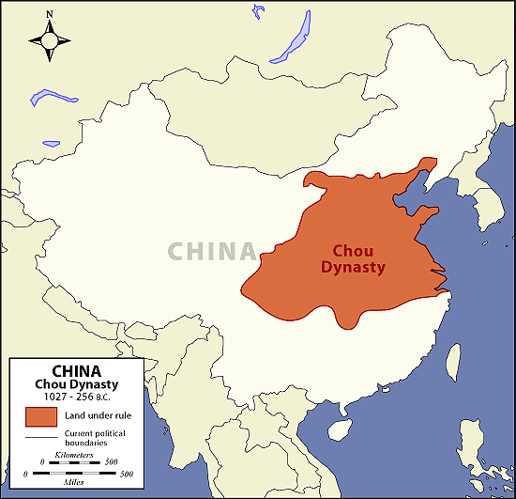

Slide 16
Zhou Dynasty Culture & Decline
Worked toward cultural unity: discouraged human sacrifice in religion, promoted widespread use of Mandarin Chinese
Iron introduced during this time which leads to jump in technology
Confucius (Kung Fuzi) wrote at end of Zhou Dynasty which led him to call for restoration of order in society in his Analects (from Five Classics; was part of shi class
Also during late Zhou, Daoism emerges with Laozi – more elaborately spiritual, harmony of nature, contemplate the Dao (life force/path)
During late Zhou (period of slow, steady decline), land-owning aristocrats disregard central gov’t, form their own power bases; led to Era of Warring States

Slide 17
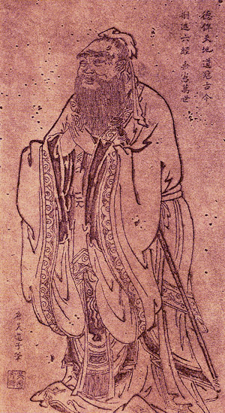
Confucius
551-478 B.C.E.

Slide 18
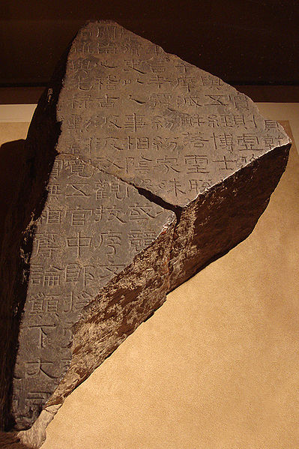
Stone Fragment of the Five Classics

Slide 19
Confucius on Politics in Great Learning (Part of the Analects)
“From the Son of Heaven down to the mass of the people, all must consider the cultivation of the person the root of everything besides….It cannot be, when the root is neglected, that what should spring from it will be well ordered.”
Translation: An orderly, top-down society headed by the emperor relies on all levels to be protected, down to the commoners. Every social group has an important role to play in an orderly society

Slide 20
Great Learning Continued
“What is meant by "In order rightly to govern the state, it is necessary first to regulate the family," is this:-It is not possible for one to teach others, while he cannot teach his own family. Therefore, the ruler, without going beyond his family, completes the lessons for the state. There is filial piety:-therewith the. sovereign should be served. There is fraternal submission:-therewith elders and superiors should be served. There is kindness:-therewith the multitude should be treated.”
Translation: A state should be run like a family with mutual respect and kindness
Filial piety = respect for fathers, elders, ancestors
Fraternal Submission = respect, deference for older siblings

Slide 21
Great Learning Continued
“What is meant by ‘The making the whole kingdom peaceful and happy depends on the government of his state,’ this…when the sovereign behaves to his elders, as the elders should be behaved to, the people learn brotherly submission; when the sovereign treats compassionately the young and helpless, the people do the same. Thus the ruler has a principle with which, as with a measuring square, he may regulate his conduct. ”
Translation: The emperor’s behavior sets the standard for society

Slide 22
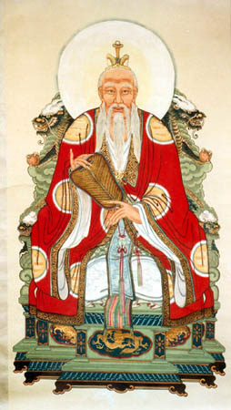
Laozi circa 5th century B.C.E

Slide 23
The Qin Dynasty
221-210 BCE (Shortest one)
Begins after the Era of Warring States ends when one warrior family leader, Qin Shi Huangdi deposed final Zhou king and unifies kingdom
Gives China its name, takes title of First Emperor and reorganized holdings into kingdoms administered by bureaucrats
Used his powerful army to crush regional resistance
Adopted political policy of Legalism: requires strict obedience to laws

Slide 24
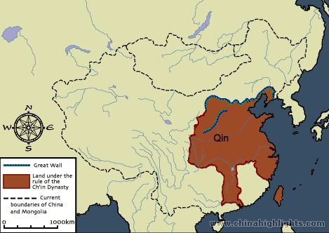

Slide 25
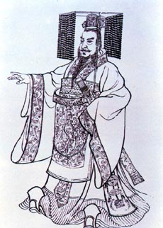
Qin Shi Huangdi r. 221-202 B.C.E.

Slide 26
The Qin Dynasty Culture and Decline
221-210 BCE (Shortest one)
Standardized coinage, weights, and made Chinese script uniform, completing the process of a single basic language, began constructing Great Wall
Gov’t-sponsored silk, irrigation, manufacturing
All of this helps when Silk Road comes in next dynasty
Negatives: attacked the shi class, collected high taxes, used brutal suppression methods
At Shi Huangdi’s death (complete with a burial tomb containing 8K soldier Terracotta Army) peasant rebellions broke out and a peasant leader founded the Han Dynasty

Slide 27
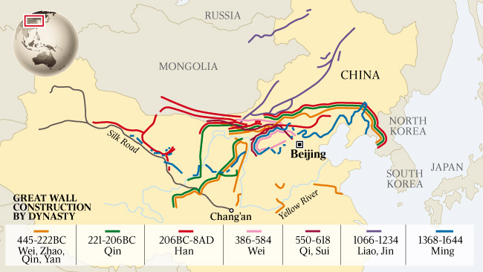
Great Wall

Slide 28
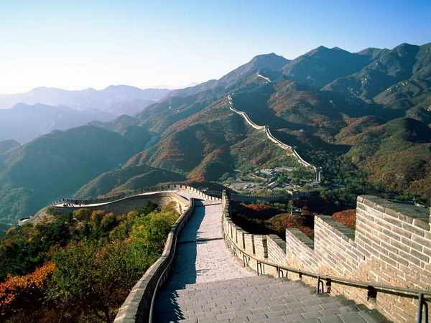
Great Wall

Slide 29
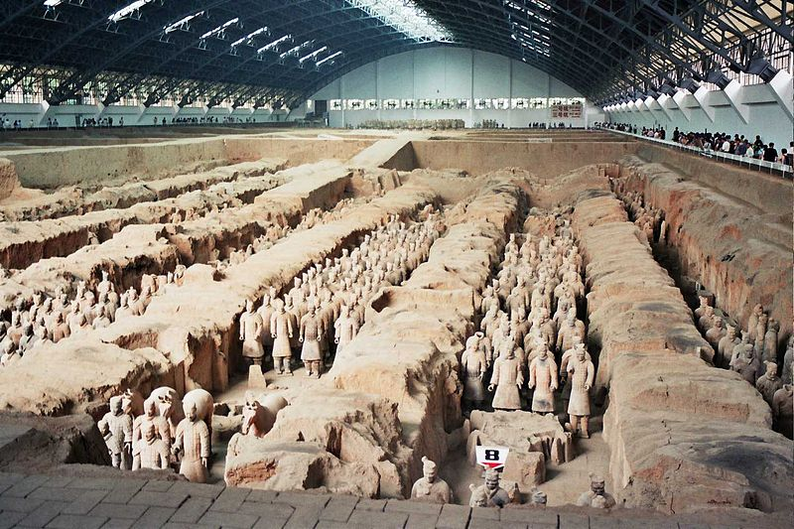
Terracotta Army

Slide 30
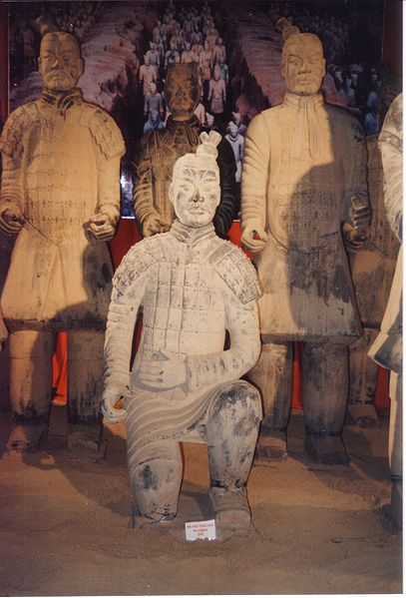
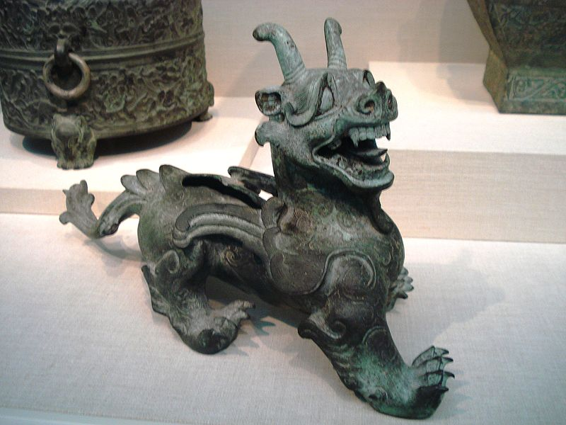
Qin Terracotta Soldier and
Han Era Bronze Statue

Slide 31
The Han Dynasty
202 BCE - 220 CE (Last of Classical Age)
Han Wu Ti – peasant leader and founder of Han Dynasty
Expanded Chinese territory into Korea, Indochina, Central Asia giving China contact w/ India & Parthian Empire, & therefore Rome
  Leads to development of Silk Road for 1st time
  Wu Ti enforced peace which brought prosperity due to safe trade
Wu Ti encouraged Confucianism – 1st time the gov’t does this – established shrines to worship Confucius w/a focus on the Analects

Slide 32
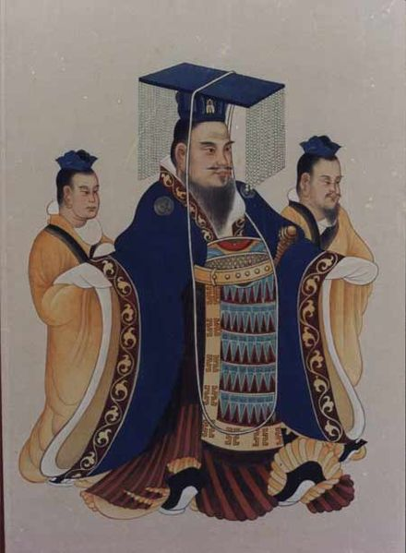
Han Wu Ti
141-87 B.C.E.

Slide 33
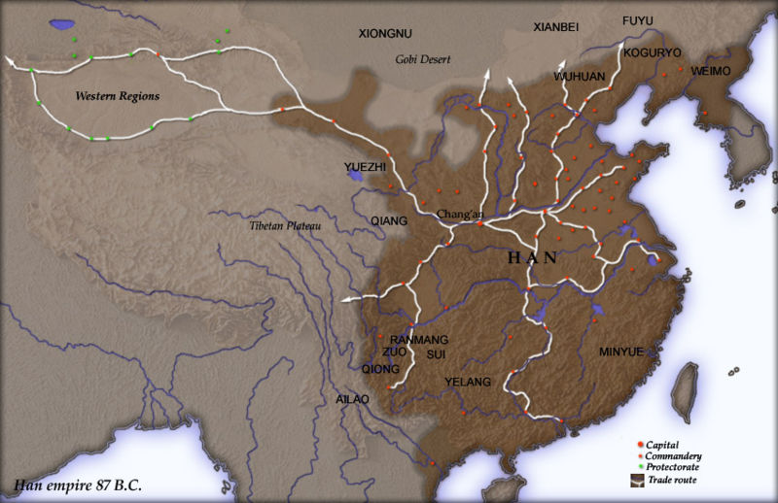
Han China

Slide 34
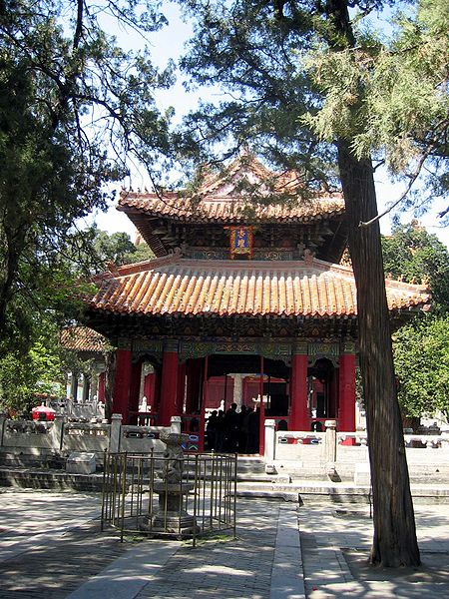
Confucian Temple at Qufu

Slide 35
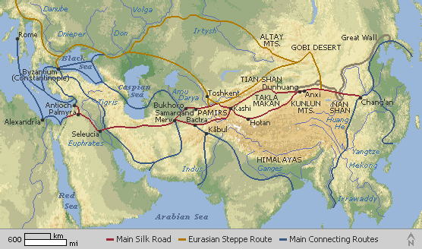
China’s Silk Road Network

Slide 36
Han Dynasty Contributions
Civil Service Exams (tied to Confucian political theory) introduced for 1st time during this dynasty; expands the bureaucracy & shi class
  Exams mostly based on the Five Classics (Discuss culture, literature, politics, history, family life)
Daoism becomes more supported & tensions emerge w/ Conf. scholars but some Chinese embrace aspects of both
Has height of Classical-era technology – plows, mills, lamps, paper, seismographs
Han Dynasty is best example of an agricultural society (pre-Industrial) being so tightly-governed – even better than Rome

Slide 37
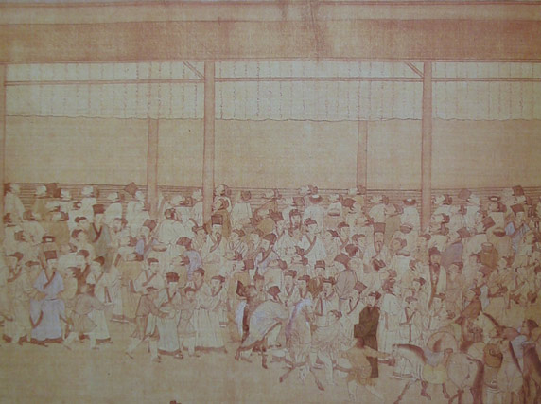
Han Civil Service Examinees

Slide 38
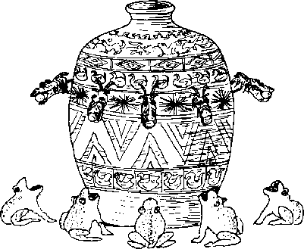
Chinese Seismograph

Slide 39
Han Decline
Decline occurs by around 100 CE as central control diminishes, bureaucrats become more corrupt, landlords become more powerful, taxes become more burdensome on peasants (typical issues associated with the Dynastic Cycle)
Daoist leaders – Yellow Turbans – begin promising a golden age that would come through divine magic leading to mass demonstrations

Slide 40
Fall of the Han Dynasty
Fall occurs when central control weakens and invasions by the Huns (northern nomads) eventually end the Han Dynasty in 220 C.E.
Leads to 3 centuries of chaos known as the Three Kingdoms or Six Dynasties Era – also called the Era of Division
During this time, Buddhism spreads rapidly throughout China and is embraced as Confucianism lessens w/ end of gov’t
Revival of dynastic cycle will come at end of 6th century CE because previous gov’t and bureaucracy structures simply too strong to die out completely

Slide 41
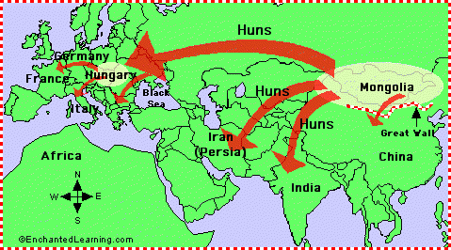
The Hun Invasions

Slide 42
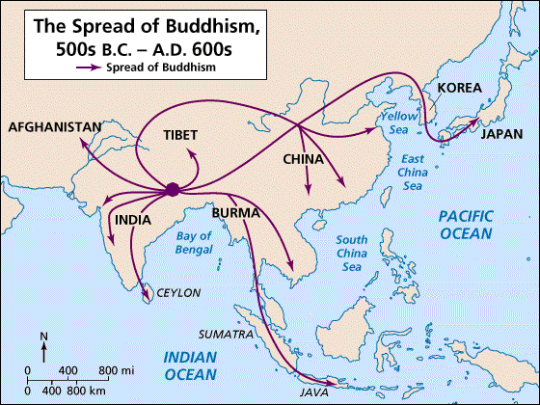

Slide 43
The Sui Dynasty
581-618 CE
Brief, restorative dynasty (similar to Qin in this way) after Era of Division that emerged from northern rulers who reunited China
Begins post-classical dynasties : Sui, Tang, Song, Yuan
Founded by Emperor Wendi who won widespread support by lowering taxes, establishing granaries for surplus grains

Slide 44
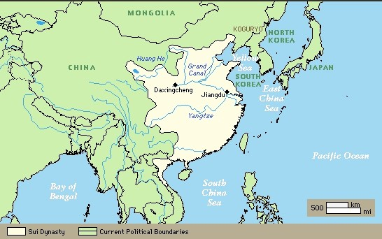

Slide 45
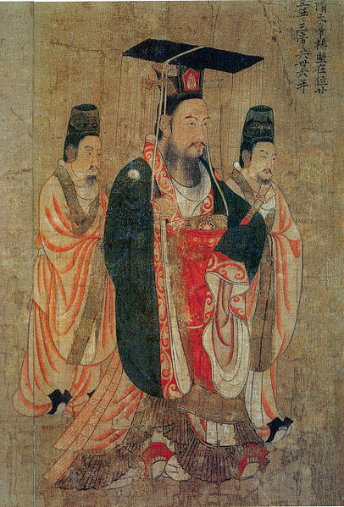
Emperor Wendi of the Sui r. 581-604

Slide 46
Sui Culture and Fall
Wendi’s son, Yangdi (who murdered Wendi) extended conquests, drove back northern nomads, brought back Confucian education, promoted scholar gentry/shi class
Constructed new capital city and Grand Canal to link northern & southern river systems & facilitate trade
Rapid decline under Yangdi occurs w/ failed invasions of Korea, defeats by Turkish nomads, breakdown of central authority
Assassinated by his own ministers in 618, bringing Sui to an end

Slide 47
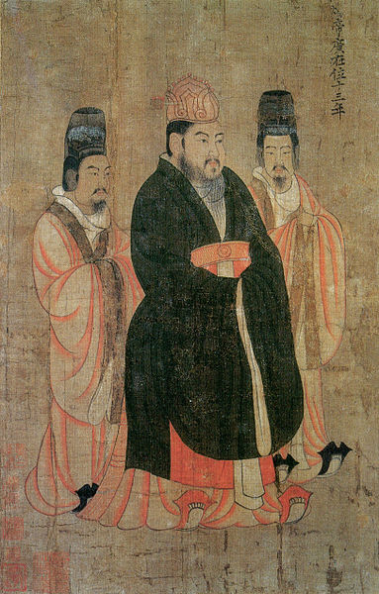
Emperor Yangdi of the Sui r. 604-618 C.E.

Slide 48
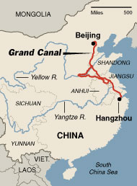
Grand Canal

Slide 49
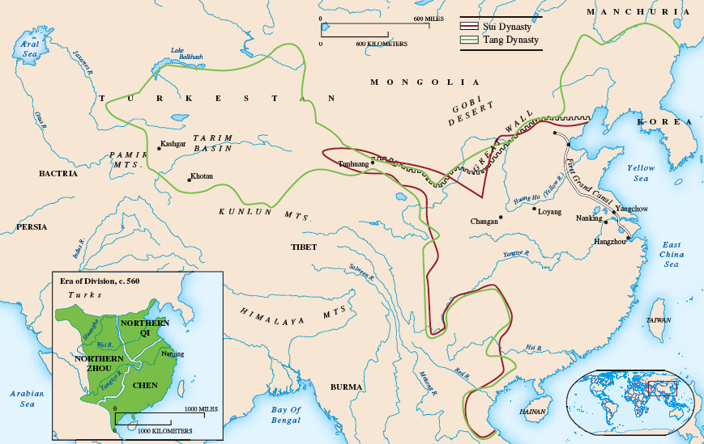
Era of Division and Sui and Tang Dynasty

Slide 50
The Tang Dynasty: 618-907 CE
Founded by one of Yangdi’s officials, Li Yuan, Duke of Tang
Together with his son laid foundations for a Golden Age
Tang armies brought submission to many nomads in central Asia & established a vassal states in Manchuria and Silla
Reestablished the central bureaucracy & revived scholar-gentry elites – something already begun under Sui
Built a new capital in Chang’an as a central location

Slide 51
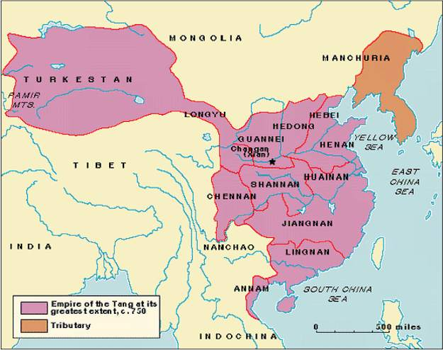

Slide 52
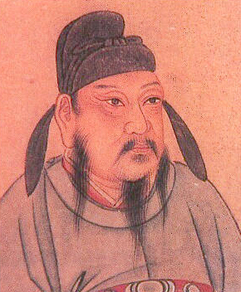
Li Yuan,
Duke of Tang
Emperor
618-626

Slide 53
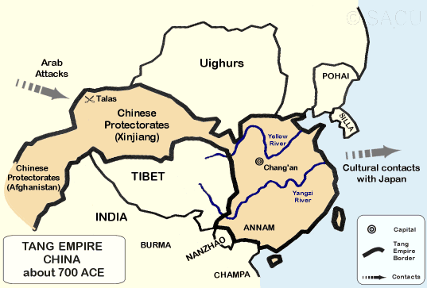
Chang’an and Silla

Slide 54
Tang Culture
Ministry of Rights created to oversee examinations and students could now earn title jinshi for passing hardest ones; could hold highest positions although birth/family connections still of great importance
Buddhism had started spreading in post-Han China
Pure land strain of Mahayana Buddhism became popular w/ peasants (emphasized salvation) while Chan/Zen appealed to educated classes (emphasized meditation, nature’s beauty)
Buddhism reached height w/ Empress Wu (late 600s) who wanted it be state religion
Made Confucian/Daoist rivals angry & led to anti-Buddhist backlash in which Emperor Wuzong persecuted in mid 800s (next dynasty) which weakened Buddhist monastic influence over gov’t

Slide 55
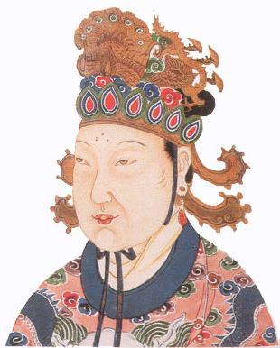
Empress Wu r. 690-705

Slide 56
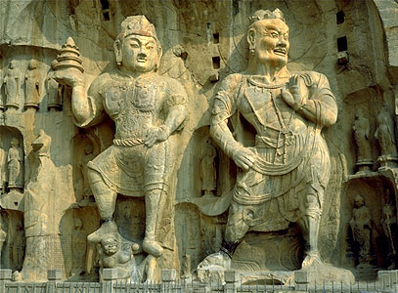
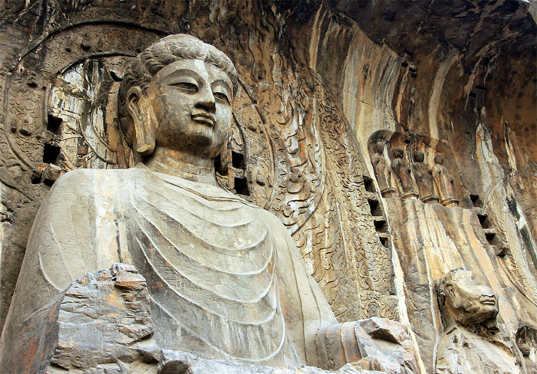
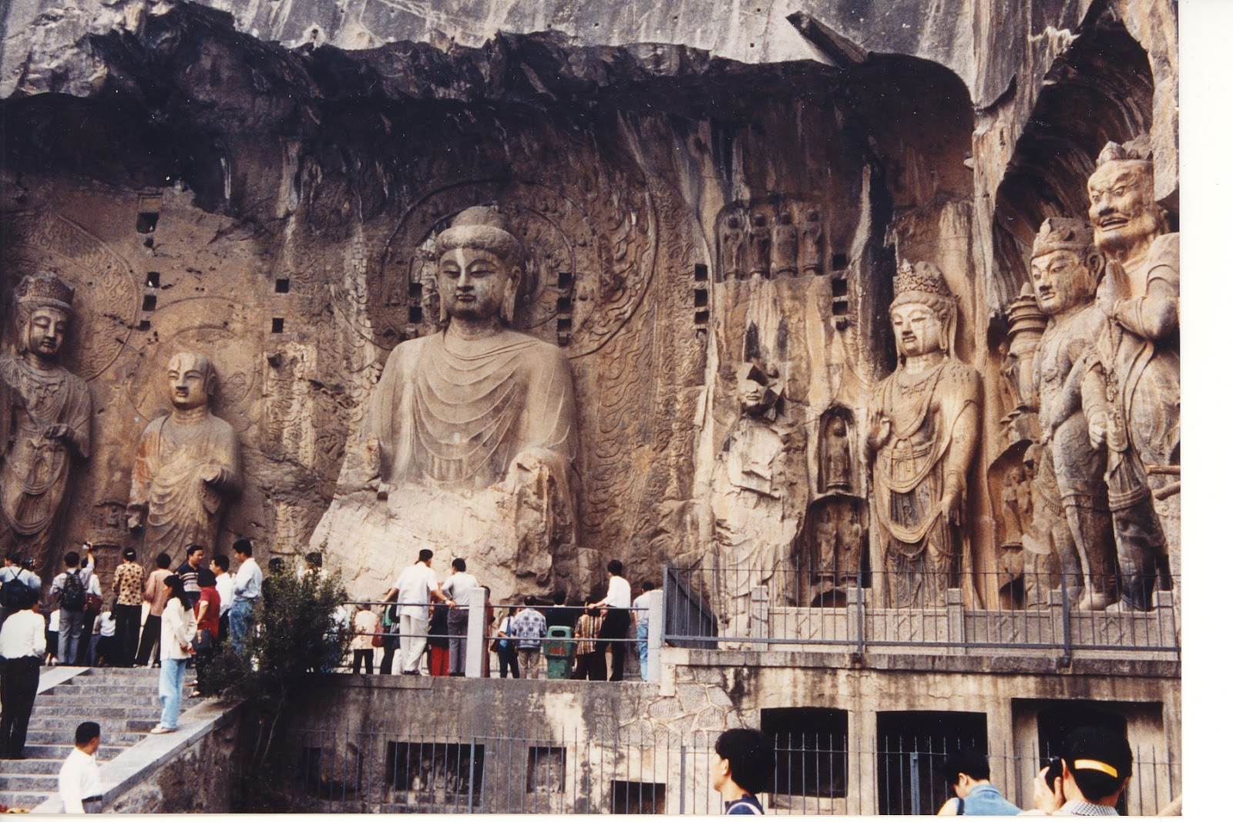
Luoyang Buddhist Statues

Slide 57
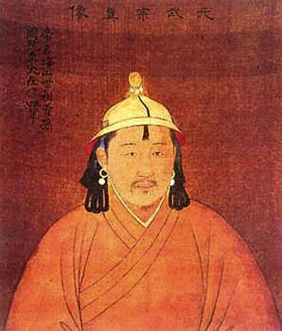
Wuzong
(Buddhist Basher of Song Dynasty) r. 841-847

Slide 58
Tang Decline and Fall
Emperor Xuanzong marks height of Tang culturally, politically but he encouraged over-expansion, neglected state affairs & became infatuated w/ concubine Yang Guifei whose family started to influence court politics
A revolt led to execution of Guifei & Tang leaders never regained prominence and power after Xuanzong dies
The Tang lost central control, regional lords raised personal armies & stopped paying taxes, peasant uprisings occurred and dynastic cycle started anew in early 900s C.E.

Slide 59
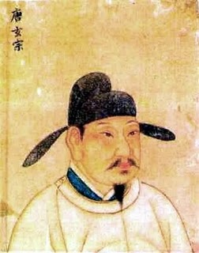
Xuanzong r. 713-756

Slide 60
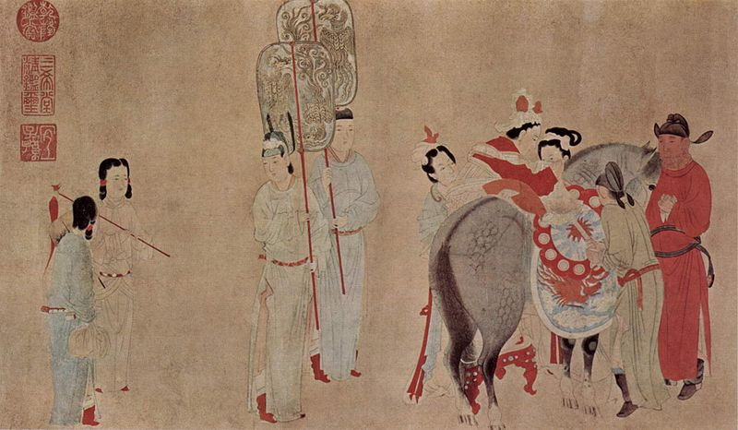
Yang Guifei

Slide 61
The Song Dynasty
960-1279 CE
After final Tang emperor resigns in 907, it looked like there would be another era of chaos but Zhao Kuangyin reunited China and took title Emperor Taizu
Able to subdue all other rivals except Liao Dynasty also founded in 907 by nomadic Khitan peoples of Manchuria who were Sinified; Song forced to pay tribute to Liao
Never match the Tang in size of empire and Confucian scholar-gentry make biggest comeback yet

Slide 62
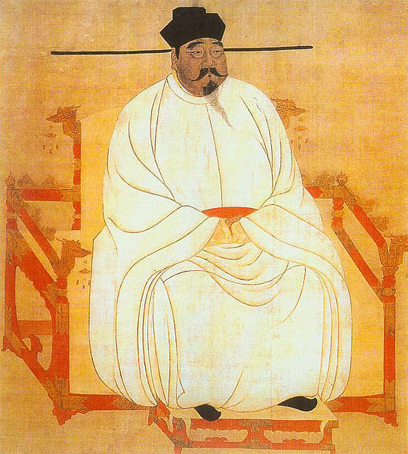
Zhao Kuangyin
(EmperorTaizu) r. 960-976

Slide 63
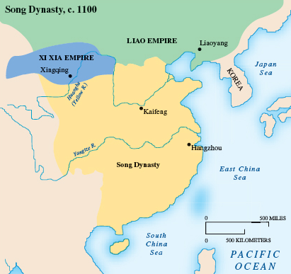

Slide 64
Neo-Confucianism in Song Era
Civil service exams fully routinized every 3 years but bureaucracy became bloated and over paid
Reflected in rise of Neo-Confucianism led by Zhu Xi – stressed application of philosophical principles to everyday life
Side effects included a revival of hostilities against Buddhism and foreign influences and footbinding for upperclass women

Slide 65
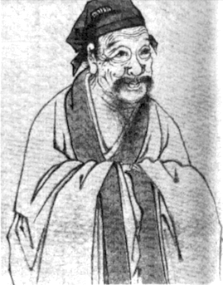
Zhu Xi
Neo-Confucianist
1130-1200

Slide 66
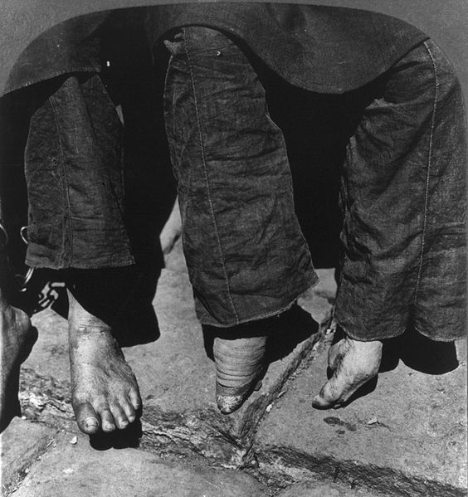
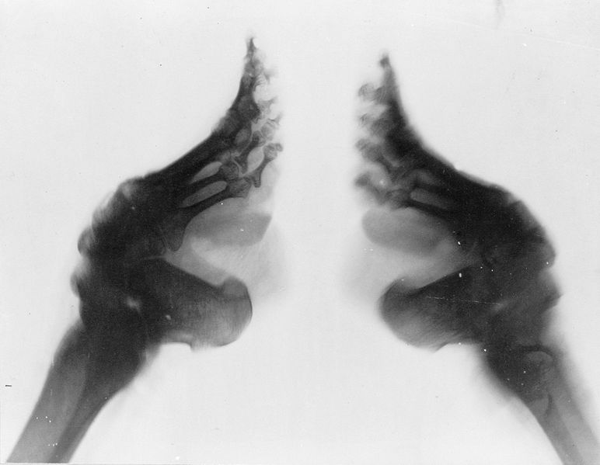
Footbinding

Slide 67
Fall of the Song Dynasty
Another kingdom pushes on Song form the NW, Xi Xia
Internal problems: big scholar-gentry, inept military commanders, taxes used for court life
Although Song leaders try Legalist reforms led by minister Wang Anshi – new taxes, public works projects, military training – didn’t work; Neo-Confucianists blocked changes
Finally, Jurchens overthrew Liao in north, established Jin kingdom, invaded Song who had to flee south and established the Southern Song kingdom in 1140 C.E.

Slide 68
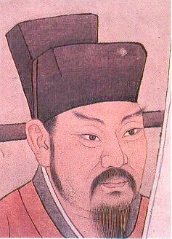
Wang Anshi
Song Minister r. 1070-1086

Slide 69
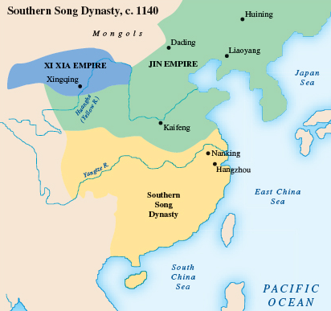

Slide 70
Tang-Song Golden Age
Despite problems, Tang-Song era a Golden Age for China
Grand Canal facilitated trade, commercial expansion
Overseas trade established using Chinese junks (best in the world)
Traders used flying money – credit vouchers for safe trade
Great agricultural output – wheelbarrow, silkworms, Champa rice (from Vietnam)
Major cultural center of Hangzhou develops
Art was at its height: landscape paintings, symbolic imagery, Li Bo’s poetry (blend nature with philosophy), woodblock printing

Slide 71
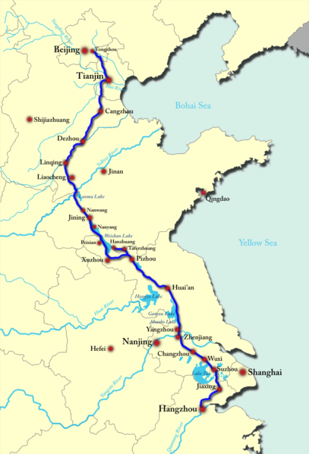
The Grand Canal by end of Tang-Song Era

Slide 72


Chinese Junks

Slide 73


Slide 74


Slide 75


Tang-Song Architecture

Slide 76


Champa Rice Fields/
Paddies

Slide 77

Chinese Wheelbarrow

Slide 78

Song-Era Bridge

Slide 79

Chinese Woodblocking

Slide 80

Chinese Abacus (European Sketch)

Slide 81



Song-Era Art

Slide 82

A Scholar in a Meadow

Slide 83

Poet Li Bo
(aka Li Bai)
A Quiet Night Thought
Moonlight before my bed
Perhaps frost on the ground.
Lift my head and see the moon
Lower my head and pine for home.

