Slide 1
APWH Period 3: Regional and Transregional Interactions, c. 600 CE to c. 1450 Textbook Part III: The Postclassical Period, New Faith and New Commerce: 500-1450 C.E. .
Chapter 9: Civilization in Eastern Europe: Byzantium and Orthodox Europe

Slide 2
The Byzantine Empire

Slide 3
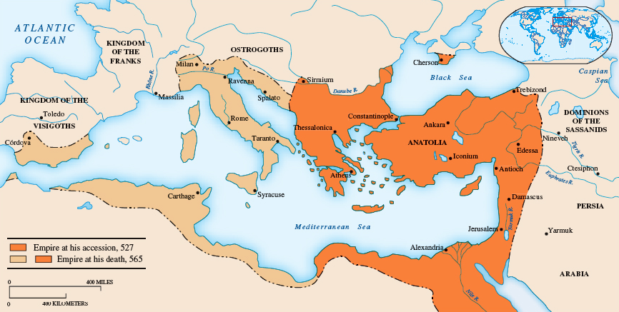

Slide 4
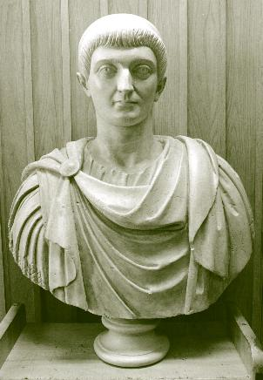
Constantine 312-337 B.C.E.

Slide 5
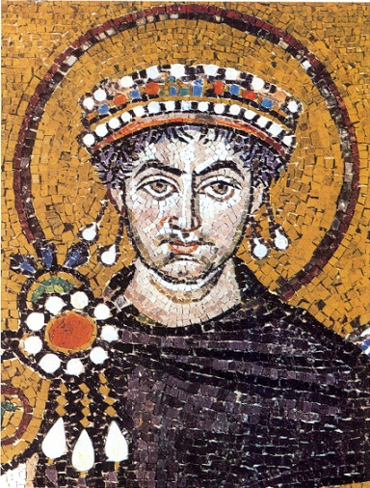
Justinian r. 527-565

Slide 6
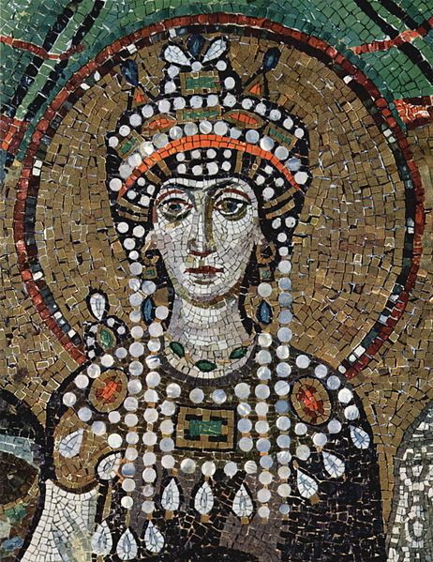
Theodora, Wife of Justinian I

Slide 7
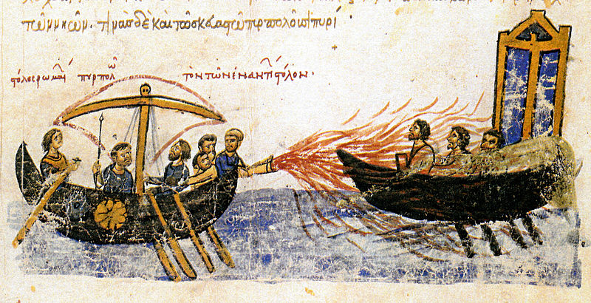
Greek Fire

Slide 8
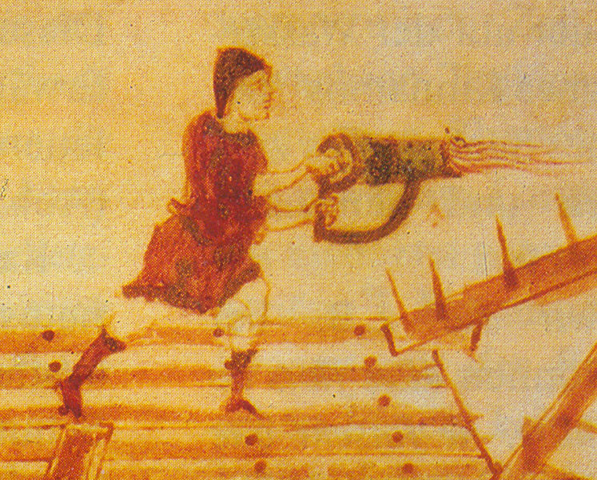
Hand Siphon for Greek Fire

Slide 9
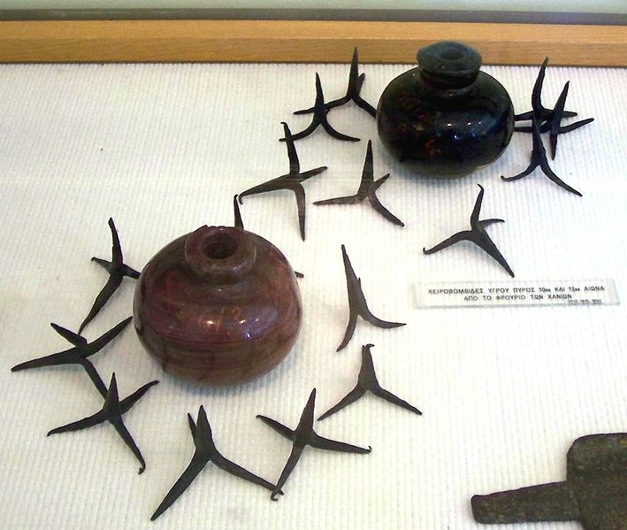
Clay Grenades for Greek Fire

Slide 10
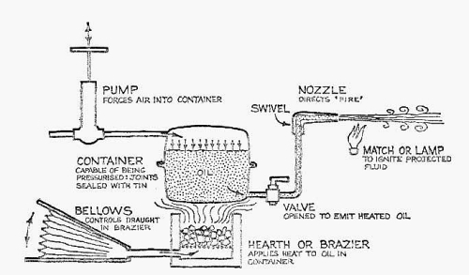
Proposed Reconstruction of Greek Fire Mechanism

Slide 11
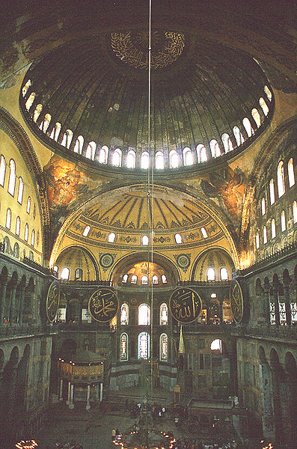
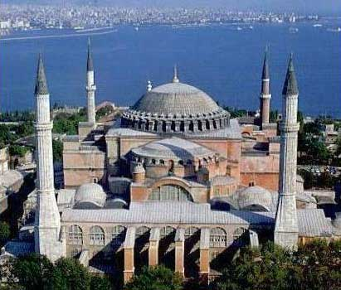
Hagia Sophia

Slide 12
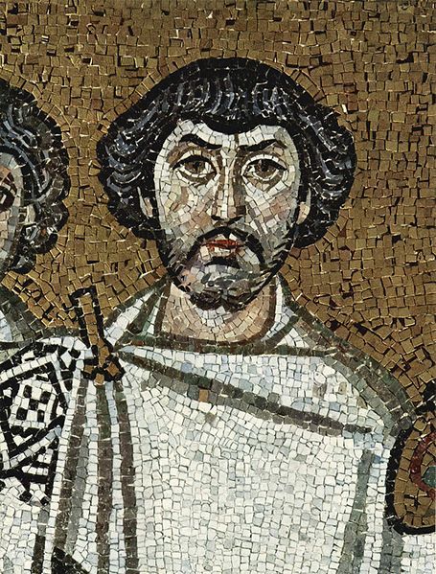
Belisarius

Slide 13
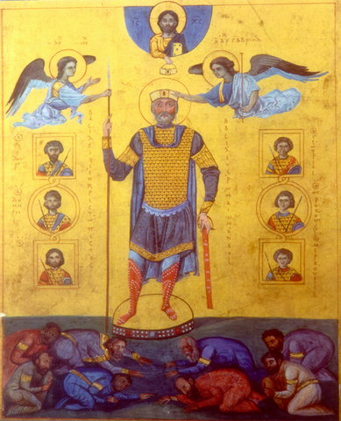
Basil II (Bulgaroktonos) r. 976-1025

Slide 14
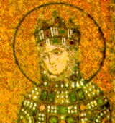
Empress Theodora r. 981-1056

Slide 15
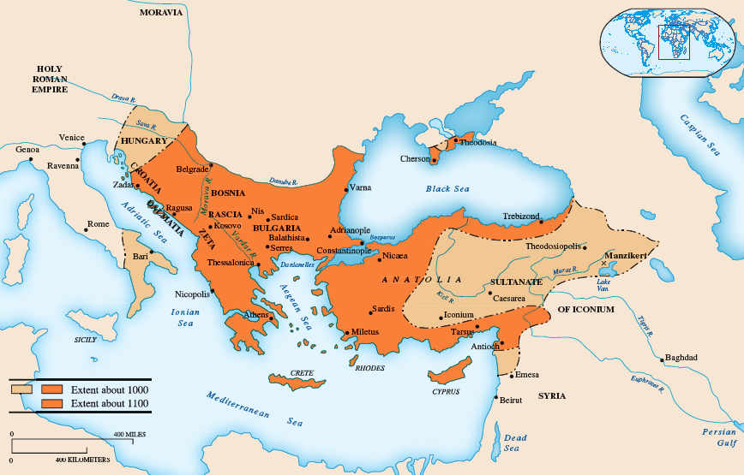

Slide 16
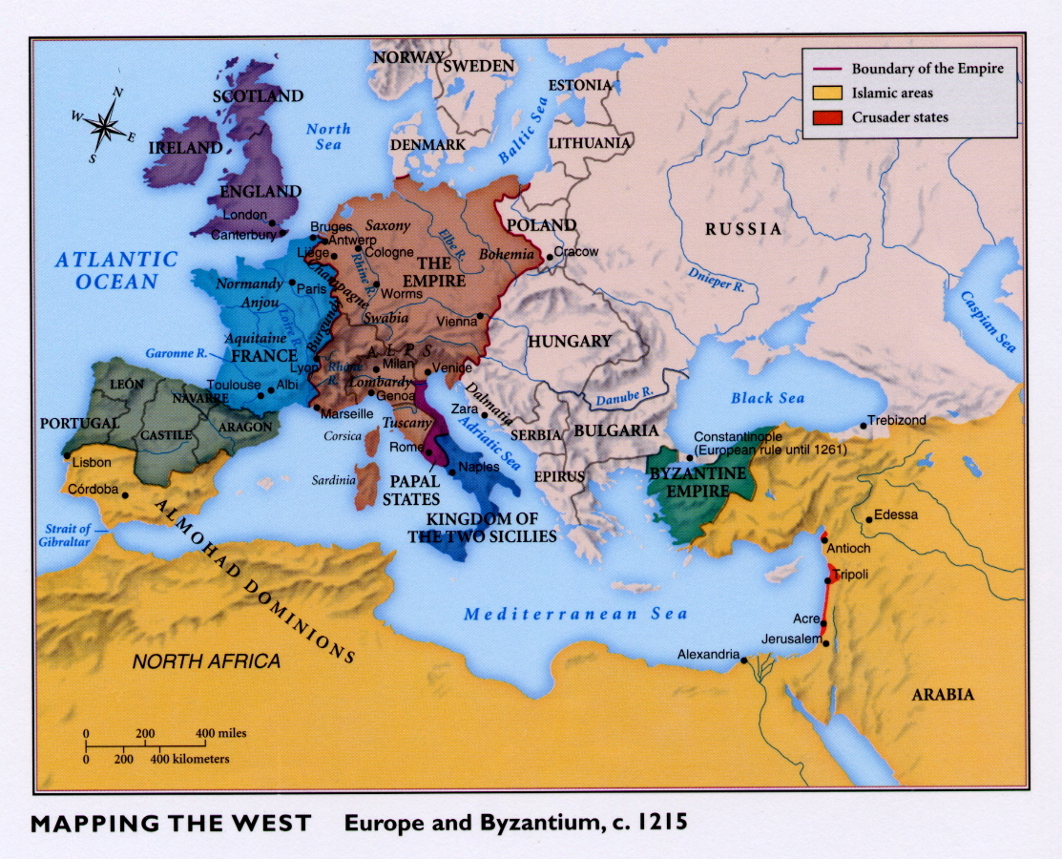

Slide 17
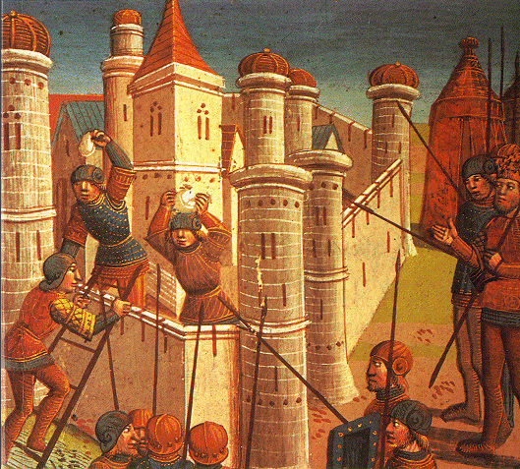
Fall of Constantinople - 1453

Slide 18
Eastern Europe

Slide 19
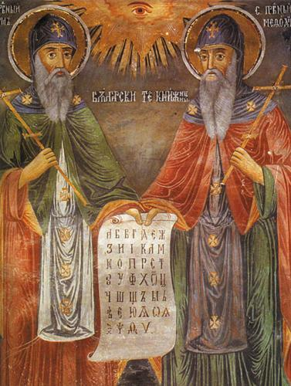
Cyril and Methodius with Cyrillic Script

Slide 21
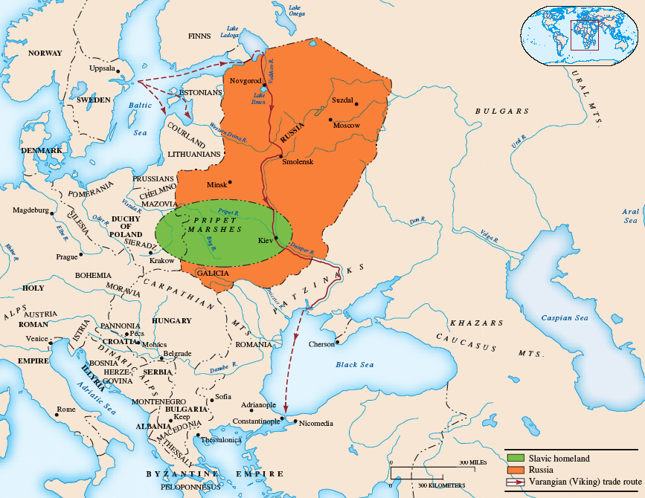

Slide 22
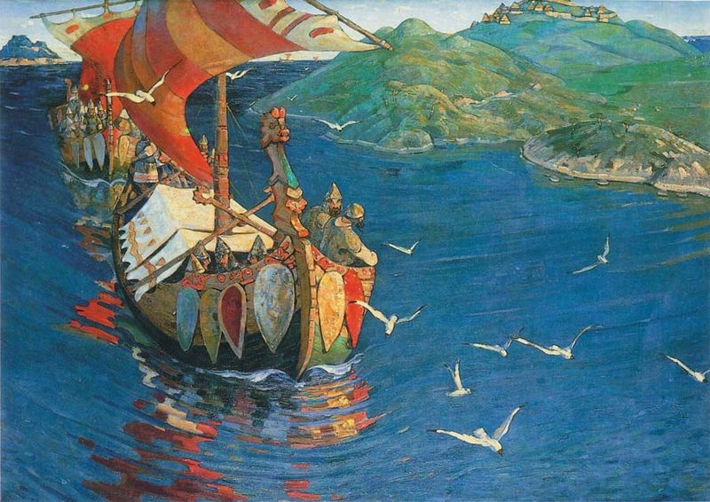
Guests from Overseas Painting Depicting the Viking Arrival - 1901

Slide 23
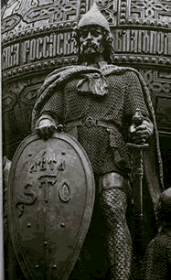
Rurik r. 864-879

Slide 24
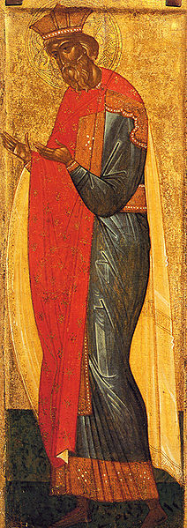
Vladimir I as Saint Vladimir r. 980-1015

Slide 25
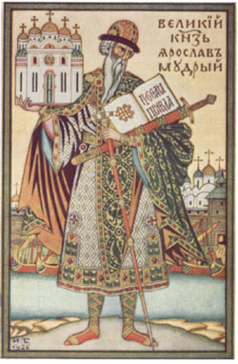
Yaroslav the Wise r. 1019-1054

Slide 26
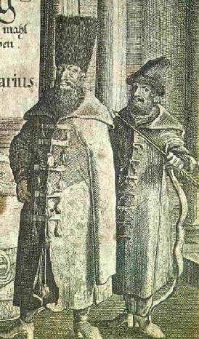
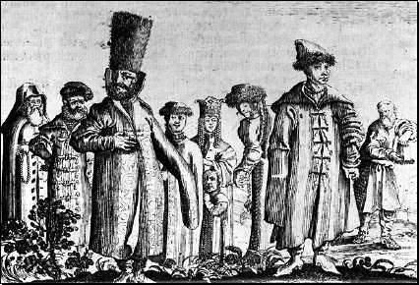
Boyars

Slide 27
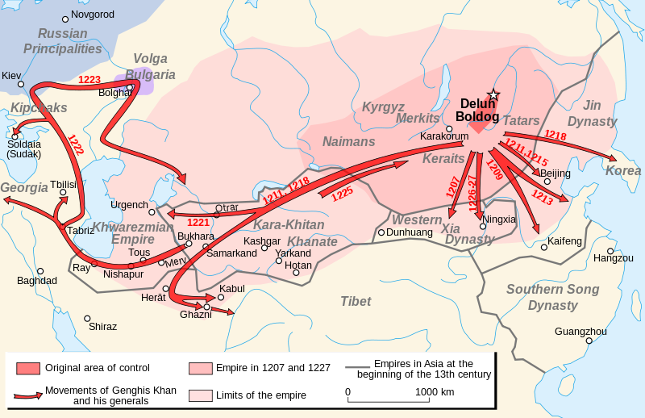
Mongol Invasions of Eastern Europe

Slide 28
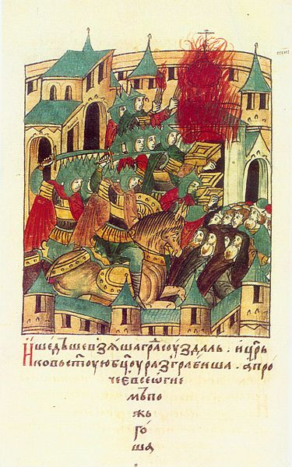
Tatars Entering Suzdal, Russia

