Slide 1
APWH Period 3: Regional and Transregional Interactions, c. 600 CE to c. 1450 Textbook Part III: The Postclassical Period, New Faith and New Commerce: 500-1450 C.E. .
Chapter 8: African Civilizations and the Spread of Islam

Slide 2
Pre-Islamic Africa

Slide 3
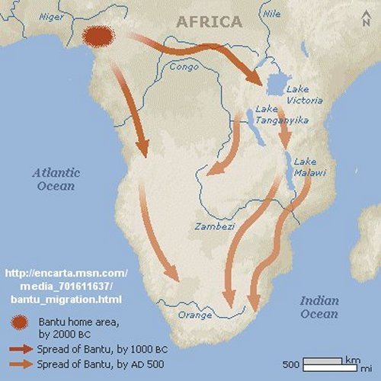
Bantu Migrations

Slide 4
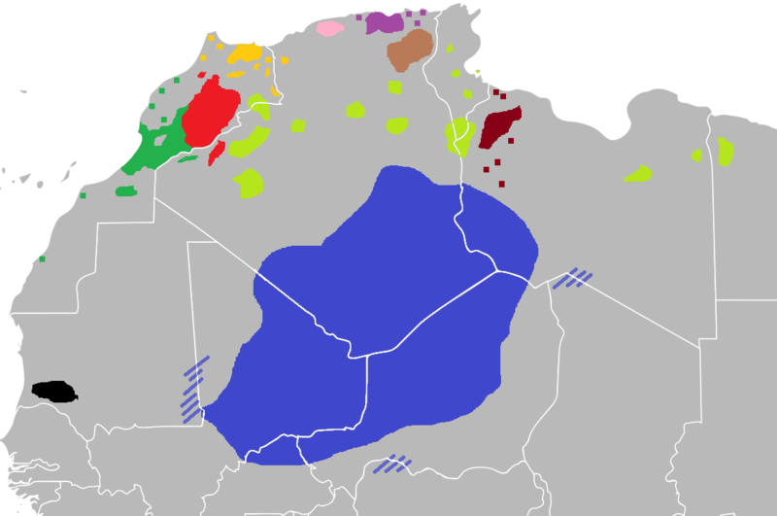
Berber Language Groups Today

Slide 5
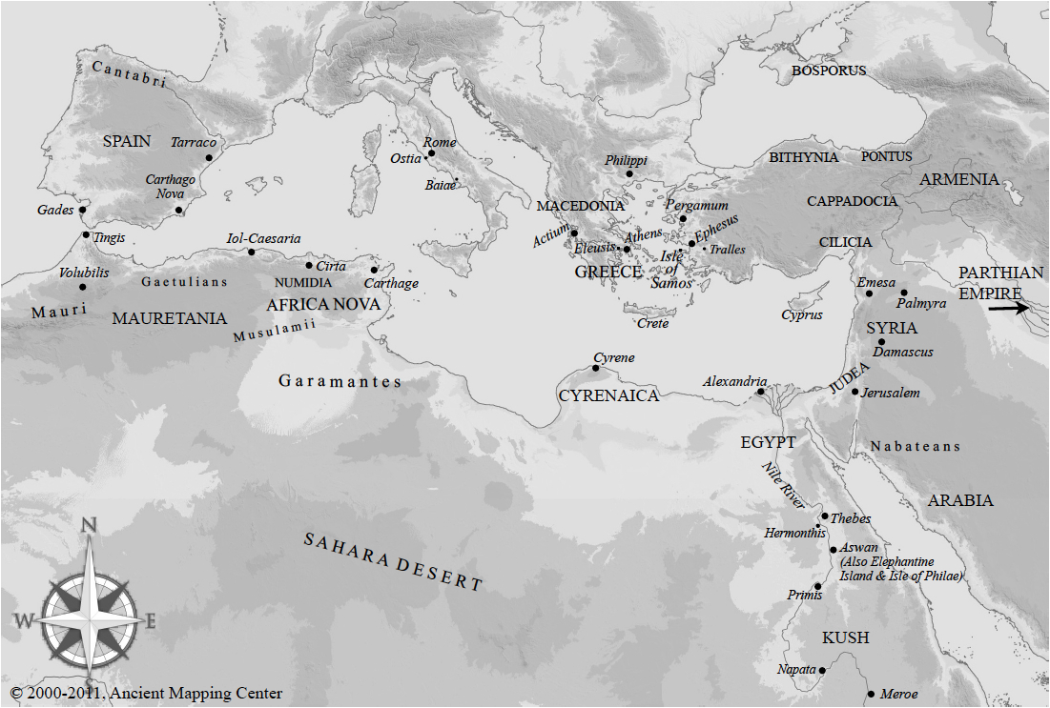
Carthage and Cyrene

Slide 6
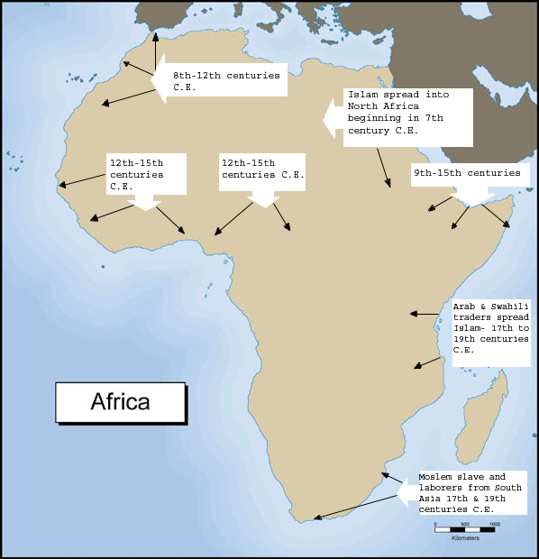
Arrival of Islam

Slide 7
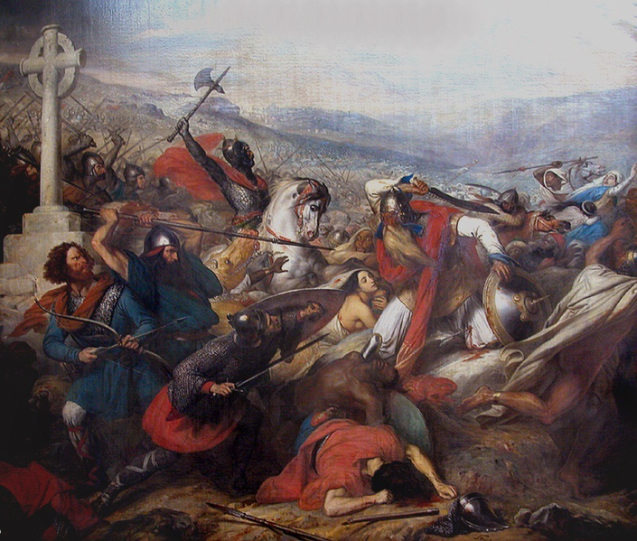
Battle at Poitiers, 732 C.E.

Slide 8
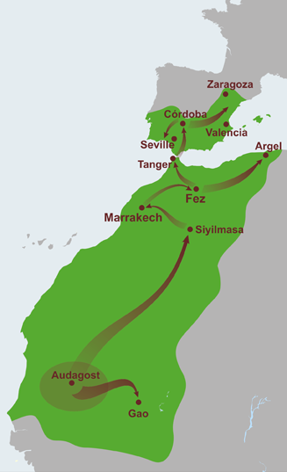
Almoravid Dynasty of 11th-12th centuries

Slide 9
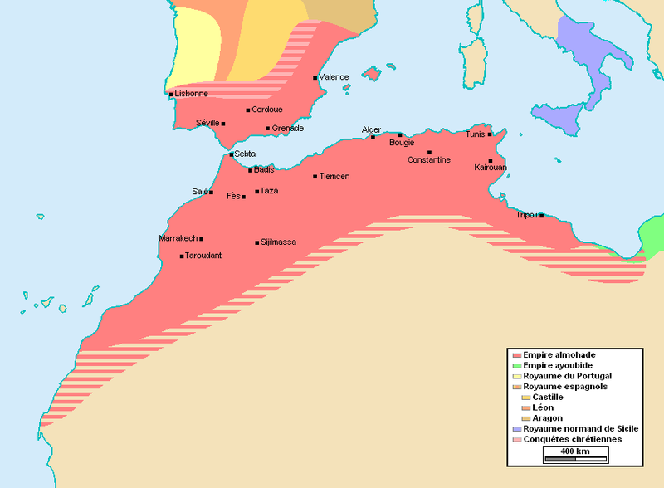
Almohad Dynasty (Almohadis) in 12-13th Centuries

Slide 10
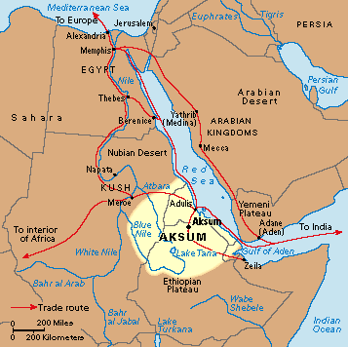
Kush/Nubia and Axum/ Ethiopia

Slide 11
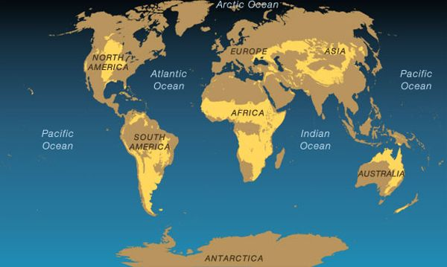
African Grasslands

Slide 12
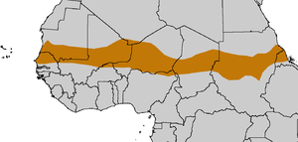
The Sahel

Slide 13
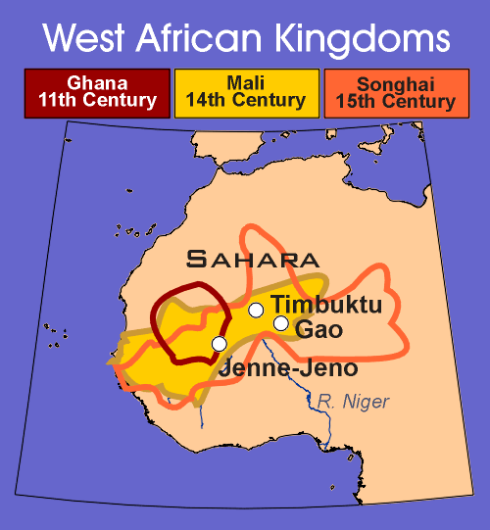

Slide 14
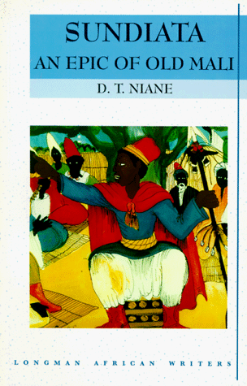
Sundiata

Slide 15
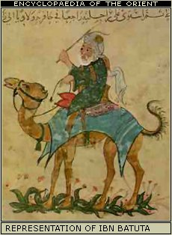
Ibn Batuta

Slide 16
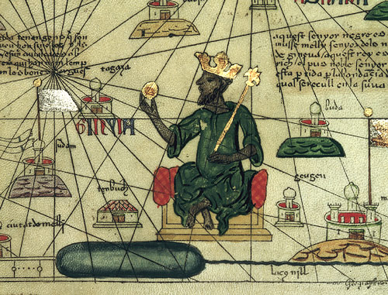
Mansa Musa Link

Slide 17
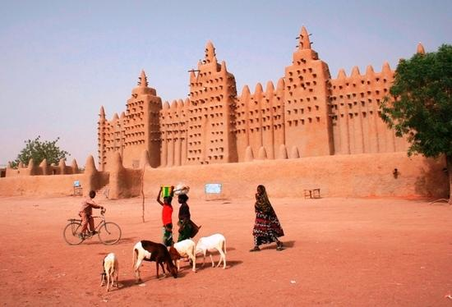
Mosque at Jenne

Slide 18
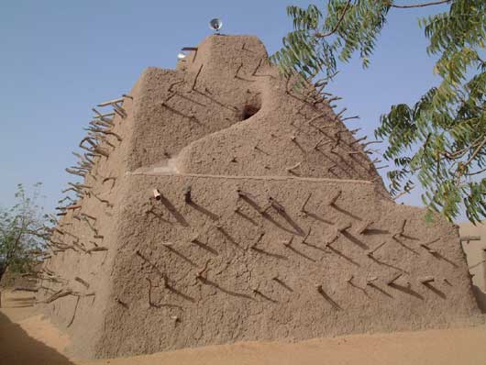
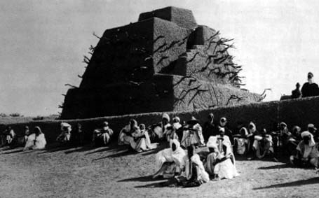
Muhammad the Great of Songhay’s Tomb

Slide 19
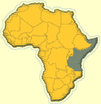
Swahili Coast

Slide 20
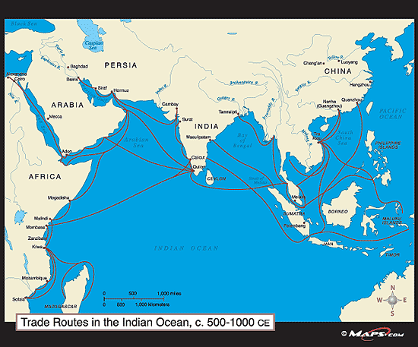
Sofala

Slide 21
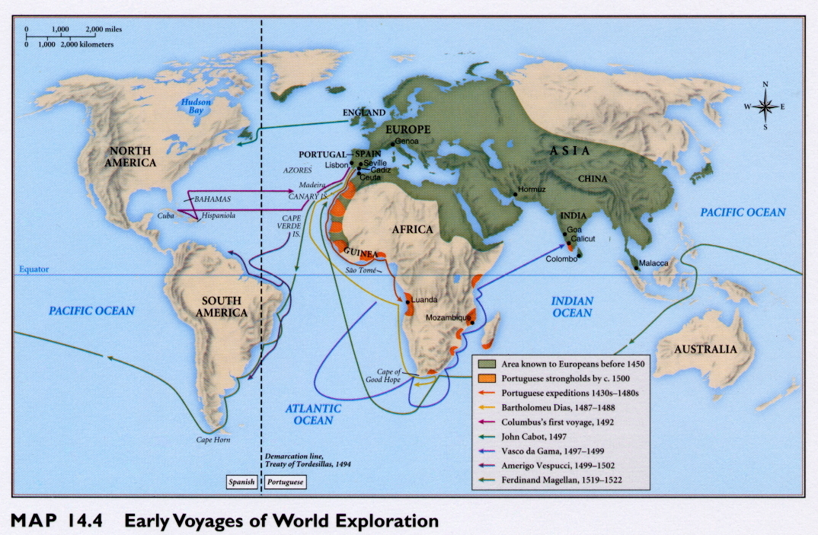
Portuguese Expansion into Indian Ocean

Slide 22
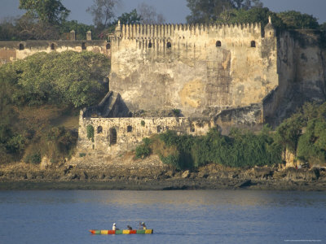
Fort Jesus

Slide 23
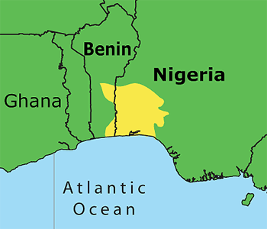
Yoruba and Benin

Slide 24
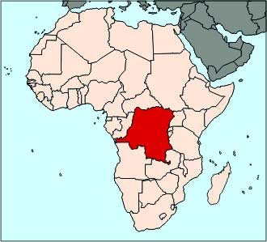
Kongo

Slide 25
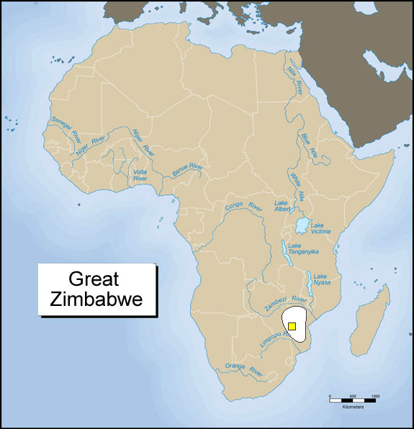

Slide 26
