Slide 1
APWH Period 3: Regional and Transregional Interactions, c. 600 CE to c. 1450 Textbook Part III: The Postclassical Period, New Faith and New Commerce: 500-1450 C.E. .
Chapter 7: Abbasid Decline and the Spread of Islam to South and Southeast Asia

Slide 2
The Middle and Late Abassid Eras

Slide 3
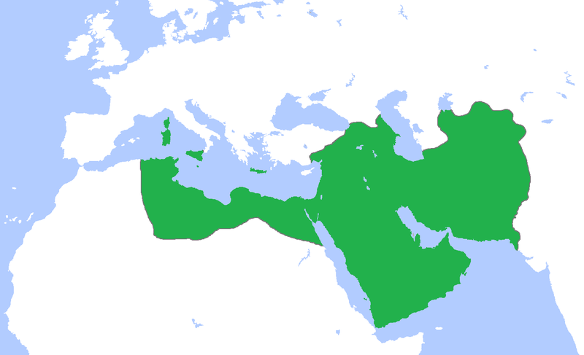
Abbasid Caliphate at its Greatest Extent

Slide 4
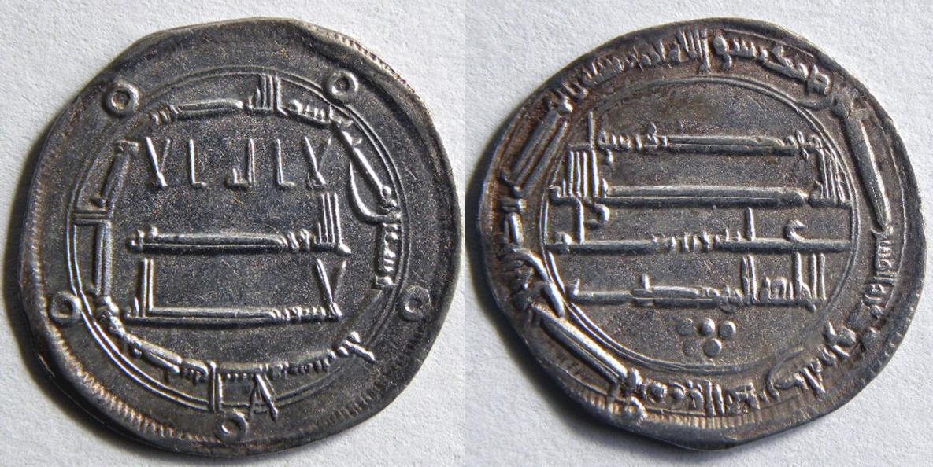
Coins from Abbasid Ruler al-Mahdi’s Caliphate

Slide 5
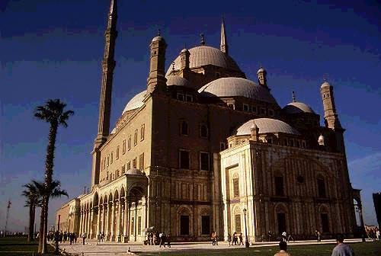
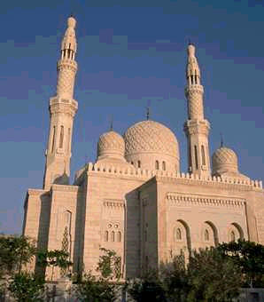
Abbasid Era Architecture

Slide 6
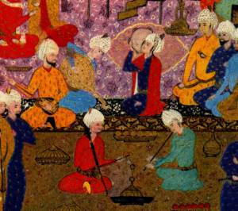
Abbasid Court Life

Slide 7
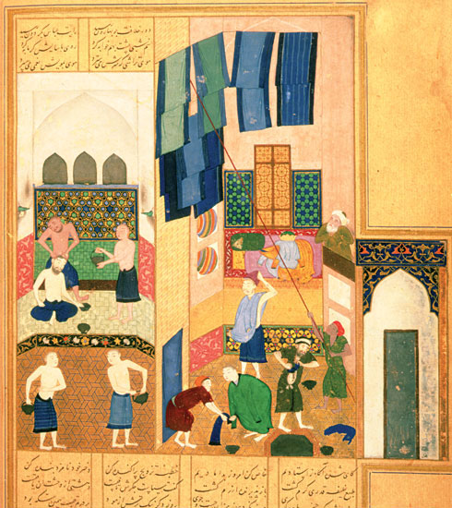

Slide 8
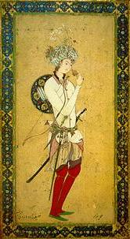
Huran al-Rashid Abbasid Caliph 786-809

Slide 9
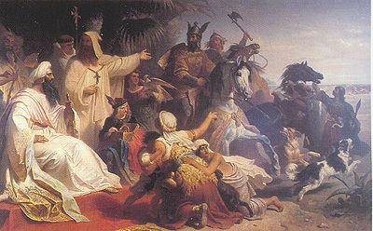
Huran al-Rashid receiving a delegation of Charlemagne

Slide 10
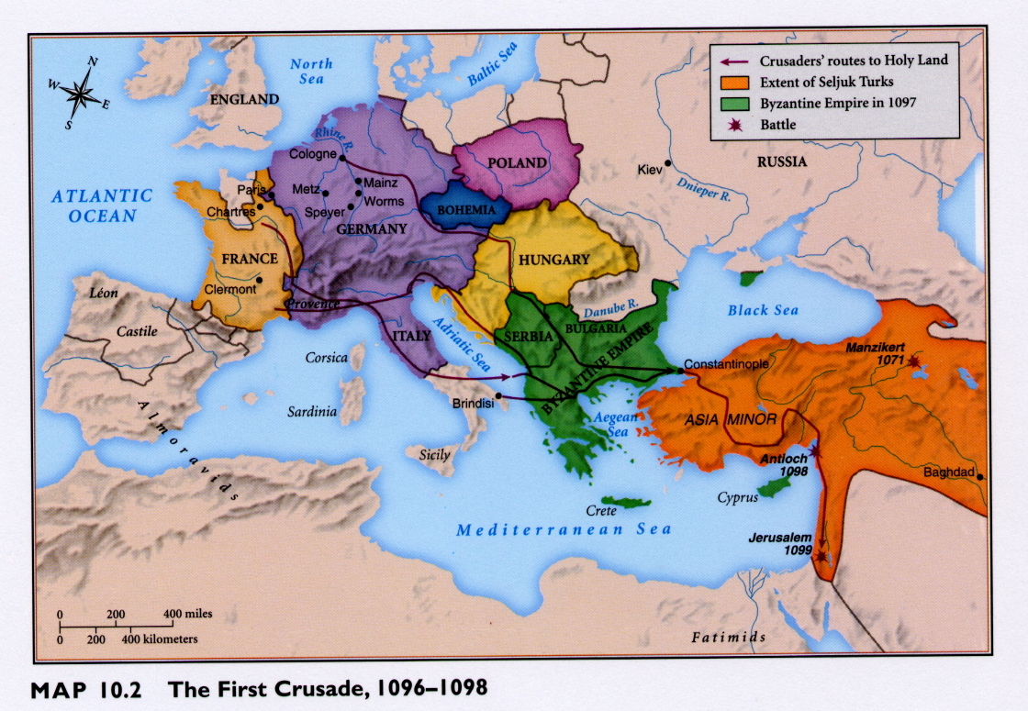

Slide 11
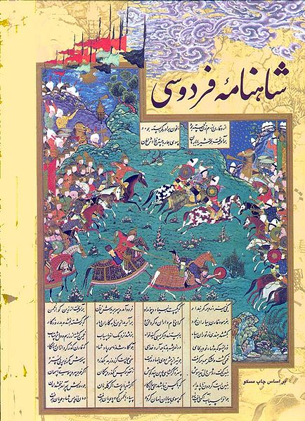
Pages from the Shah-Nama

Slide 12
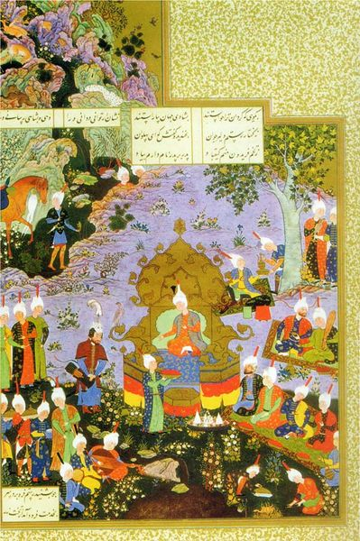

Slide 13
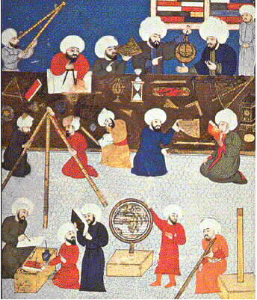
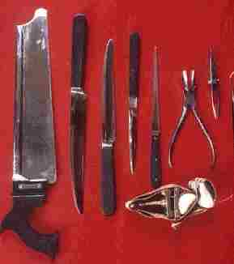
Muslim Science

Slide 14
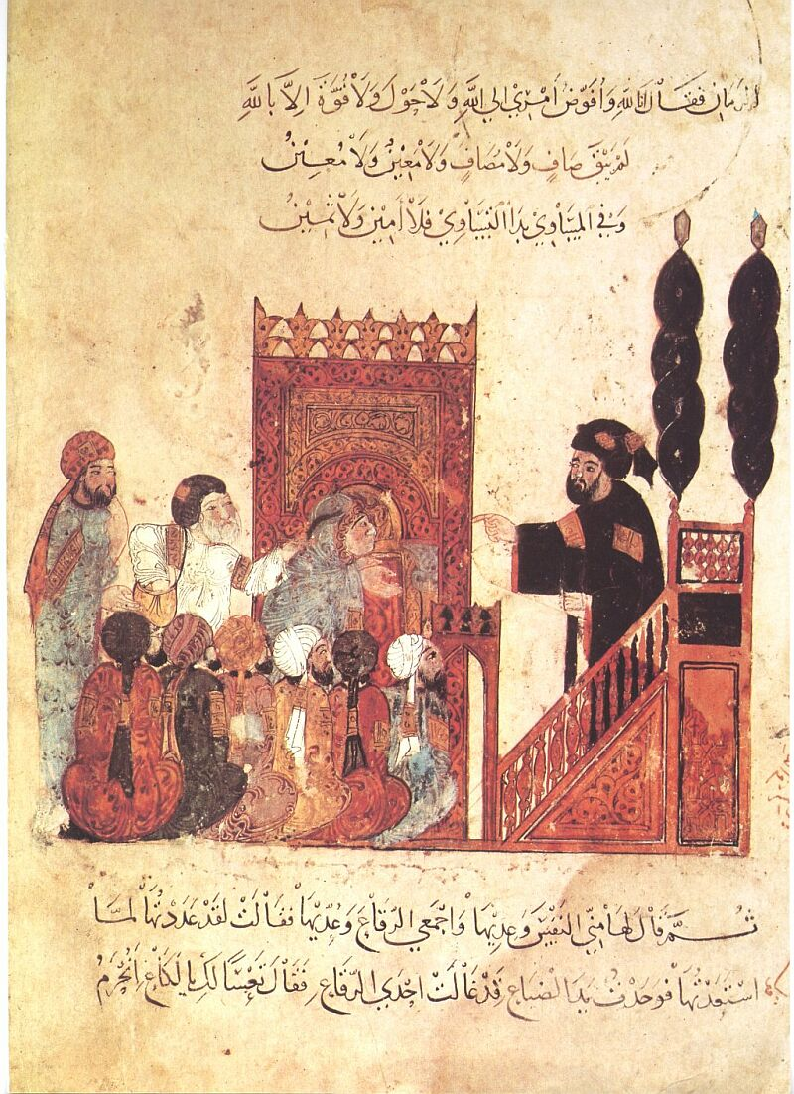
Ulama Instructing Religious Learners

Slide 15
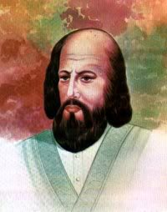
Al-Ghazali 1058-1111

Slide 16
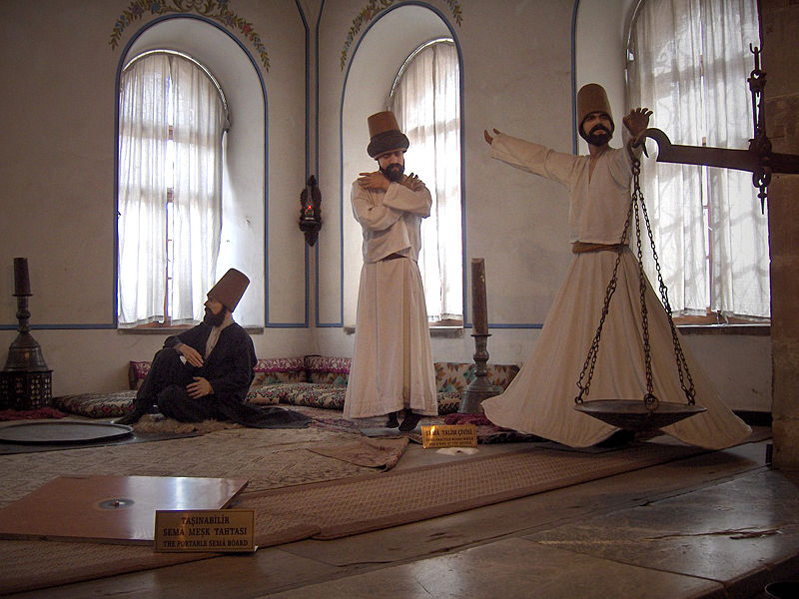
Modern Sufis

Slide 17
Whirling Dervish See Link

Slide 18
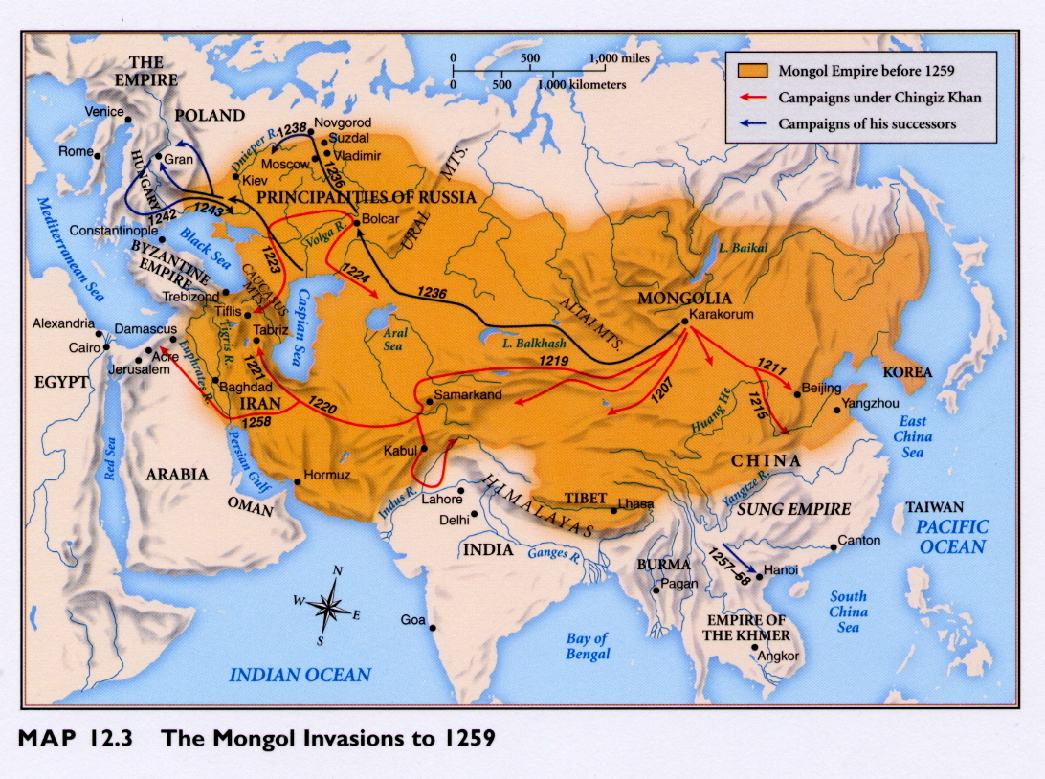

Slide 19
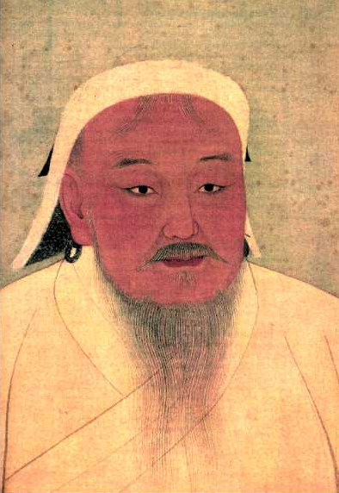
Chinggis Khan r. 1206–1227

Slide 20
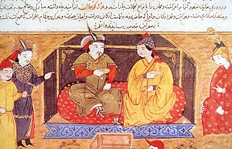
Hulegu Khan

Slide 21
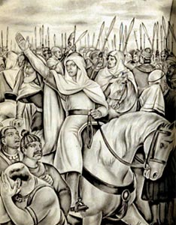
Muhammad ibn Qasim 695-715

Slide 22
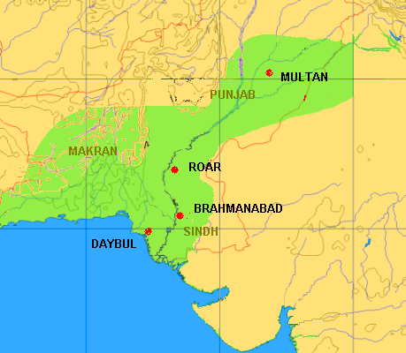
Extent of Umayyad Rule in India

Slide 23
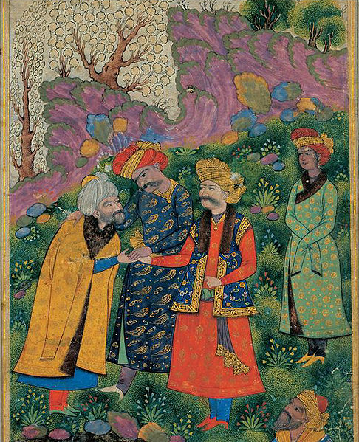
Mahmud of Ghazni r. 997-1030

Slide 24
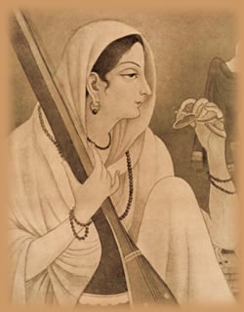
Mira Bai

Slide 25
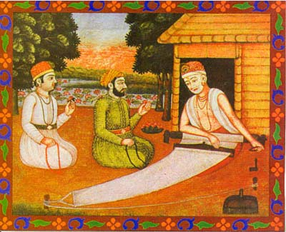
Kabir

Slide 26
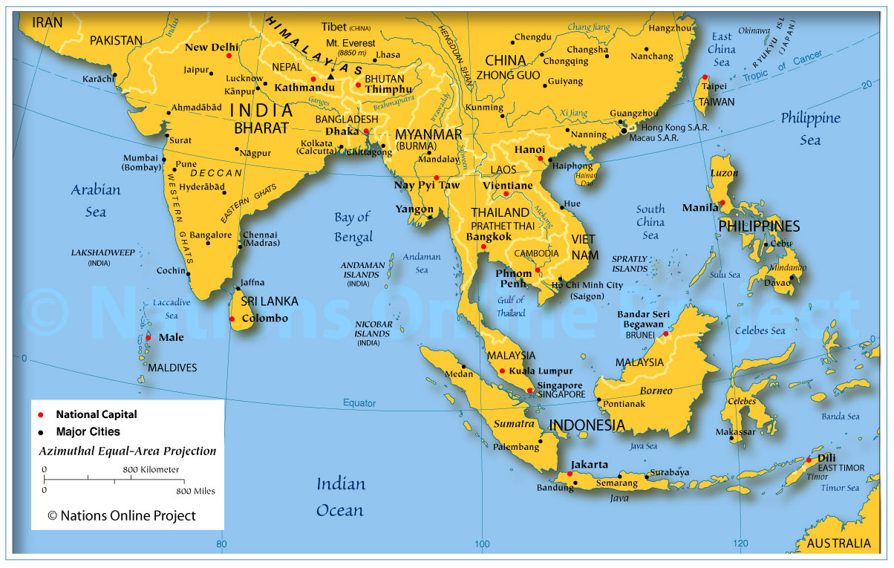

Slide 27
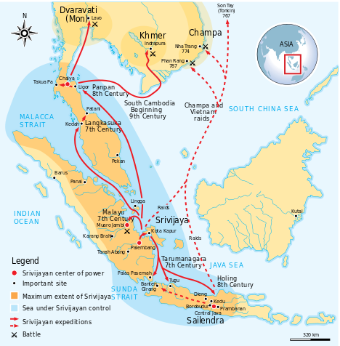
Shrivajaya

Slide 28
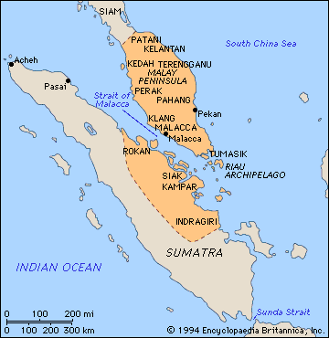
Malacca

Slide 29
