Slide 1
APWH Period 3: Regional and Transregional Interactions, c. 600 CE to c. 1450 Textbook Part III: The Postclassical Period, New Faith and New Commerce: 500-1450 C.E.
Chapter 6: The First Global Civilization:
The Rise and Spread of Islam

Slide 2
The Pre-Islamic Arab World

Slide 3
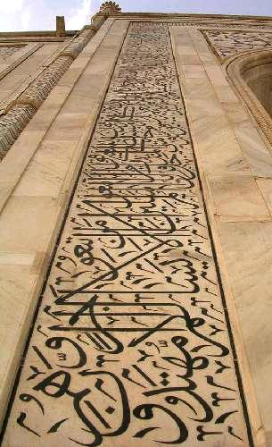
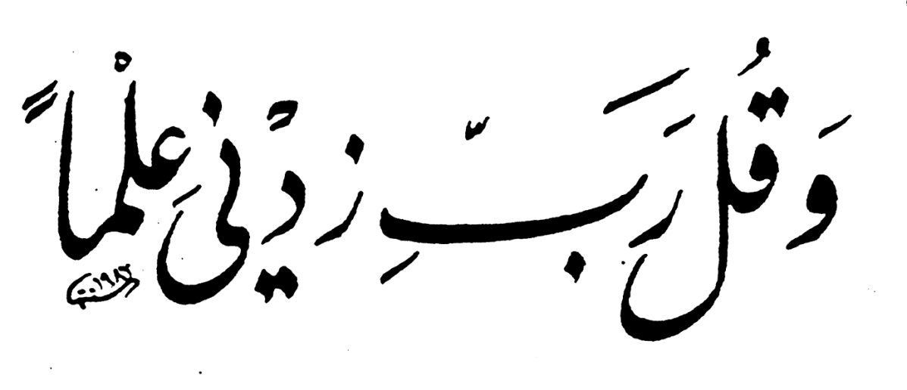
Arabic Calligraphy

Slide 4
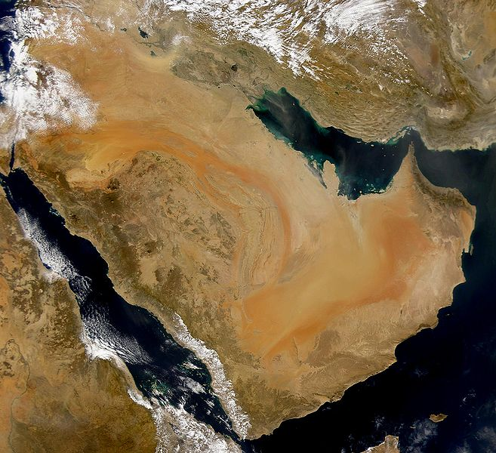

Slide 5
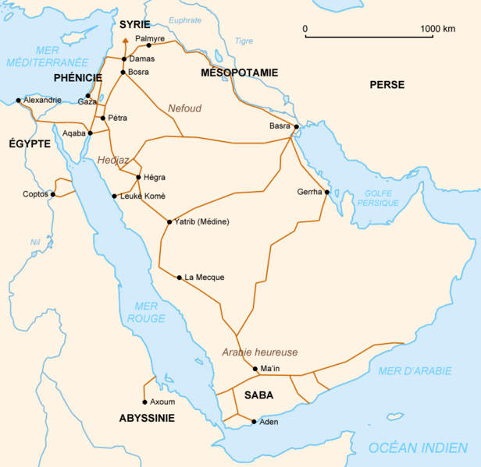
Bedouin Caravan Routes

Slide 6
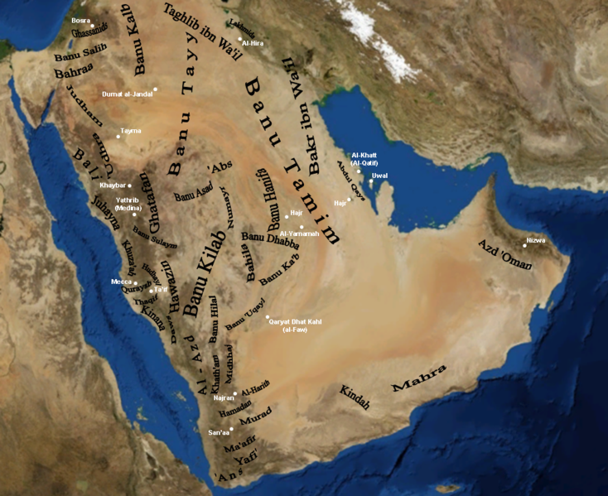
Tribes

Slide 7
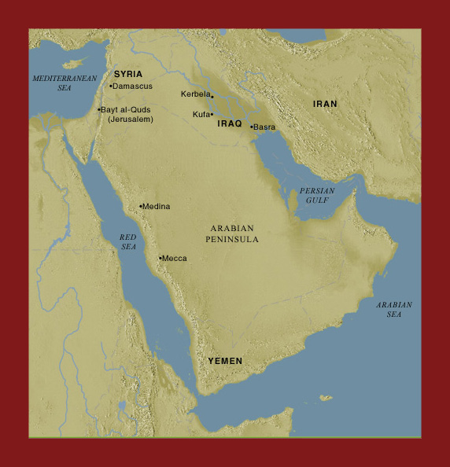

Slide 8
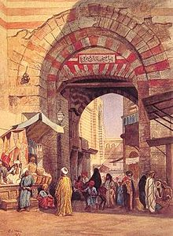
Bazaar

Slide 9
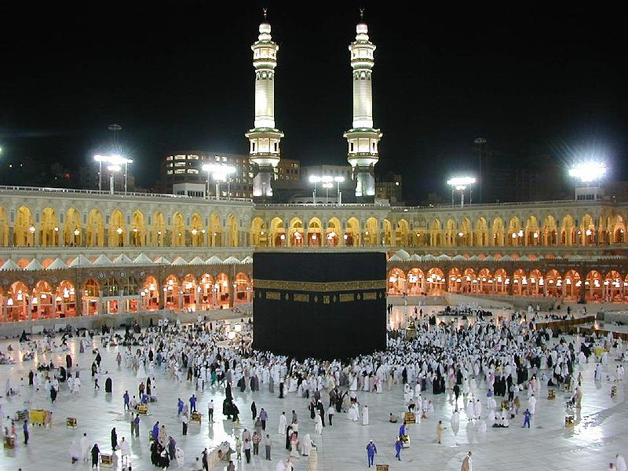
The Ka’ba at Mecca

Slide 10
Life of Muhammad and the Birth of Islam

Slide 11
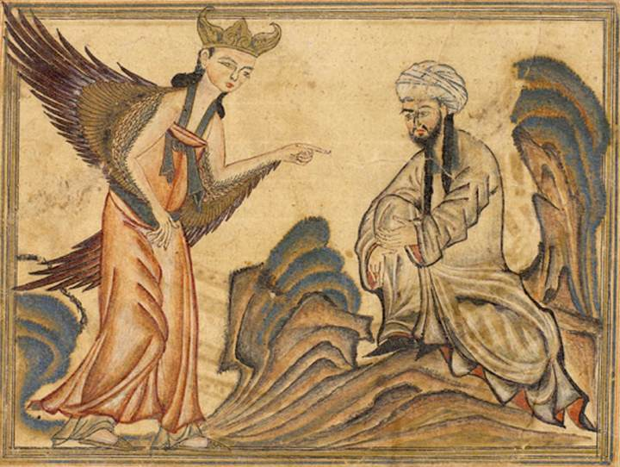
Muhammad Receives the Message from Gabriel

Slide 12
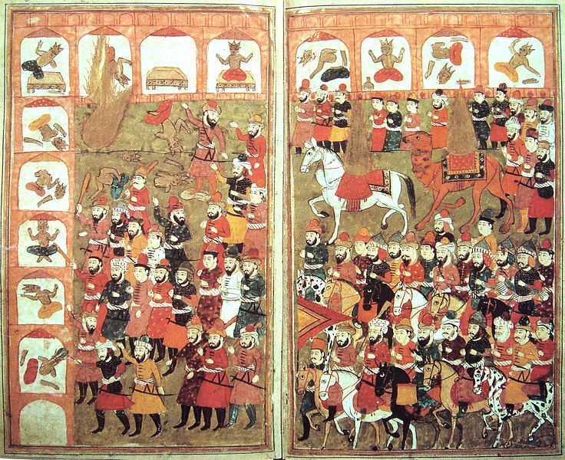
Muhammad’s Entry into Mecca and Destruction of the Idols

Slide 13
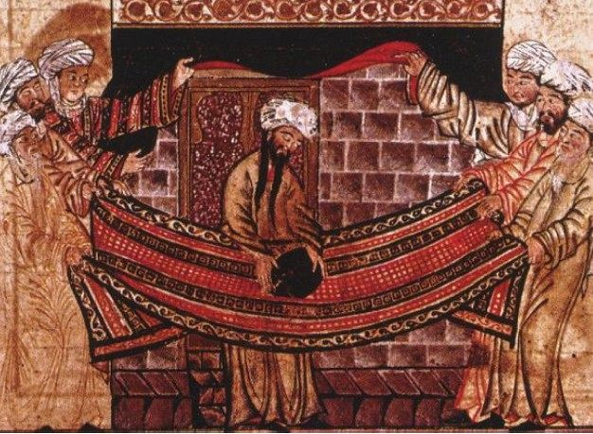
Muhammad Resetting the Black Stone in the Ka’ba

Slide 14
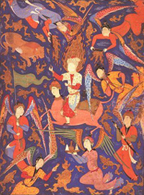
“Ascent of the Prophet to Heaven” C. 1550

Slide 15
The Umayyads

Slide 16
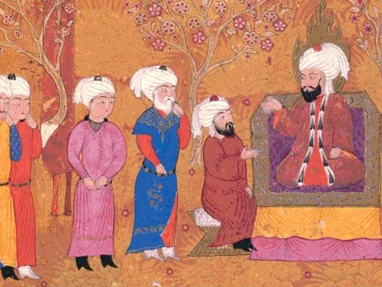
Ali (Ali ibn Abi Talib) 600-661 CE

Slide 17
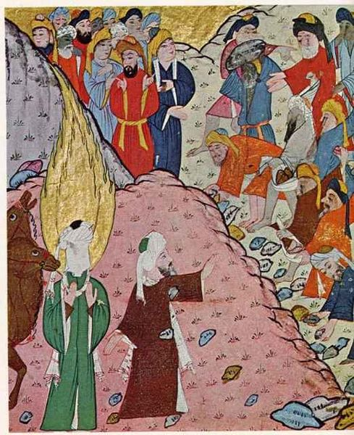
Abu Bakr 1st Caliph c. 573 – c. 634 CE

Slide 18
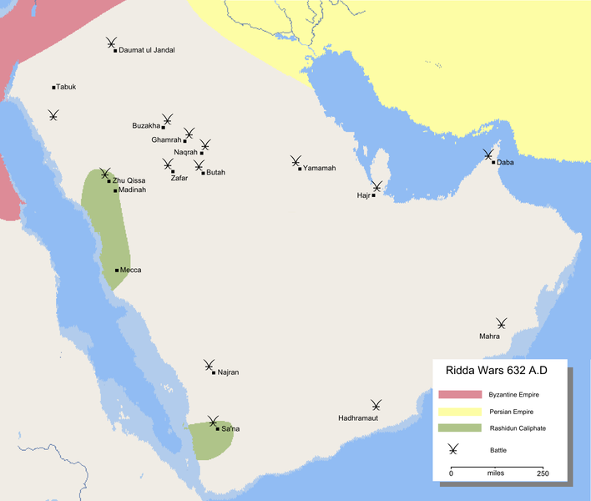
Ridda Wars

Slide 19
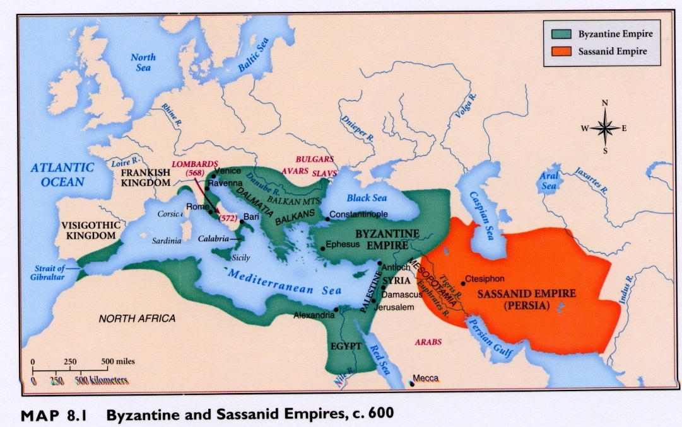
Neighboring Empires

Slide 20
The Sunni – Shi’a Split

Slide 21
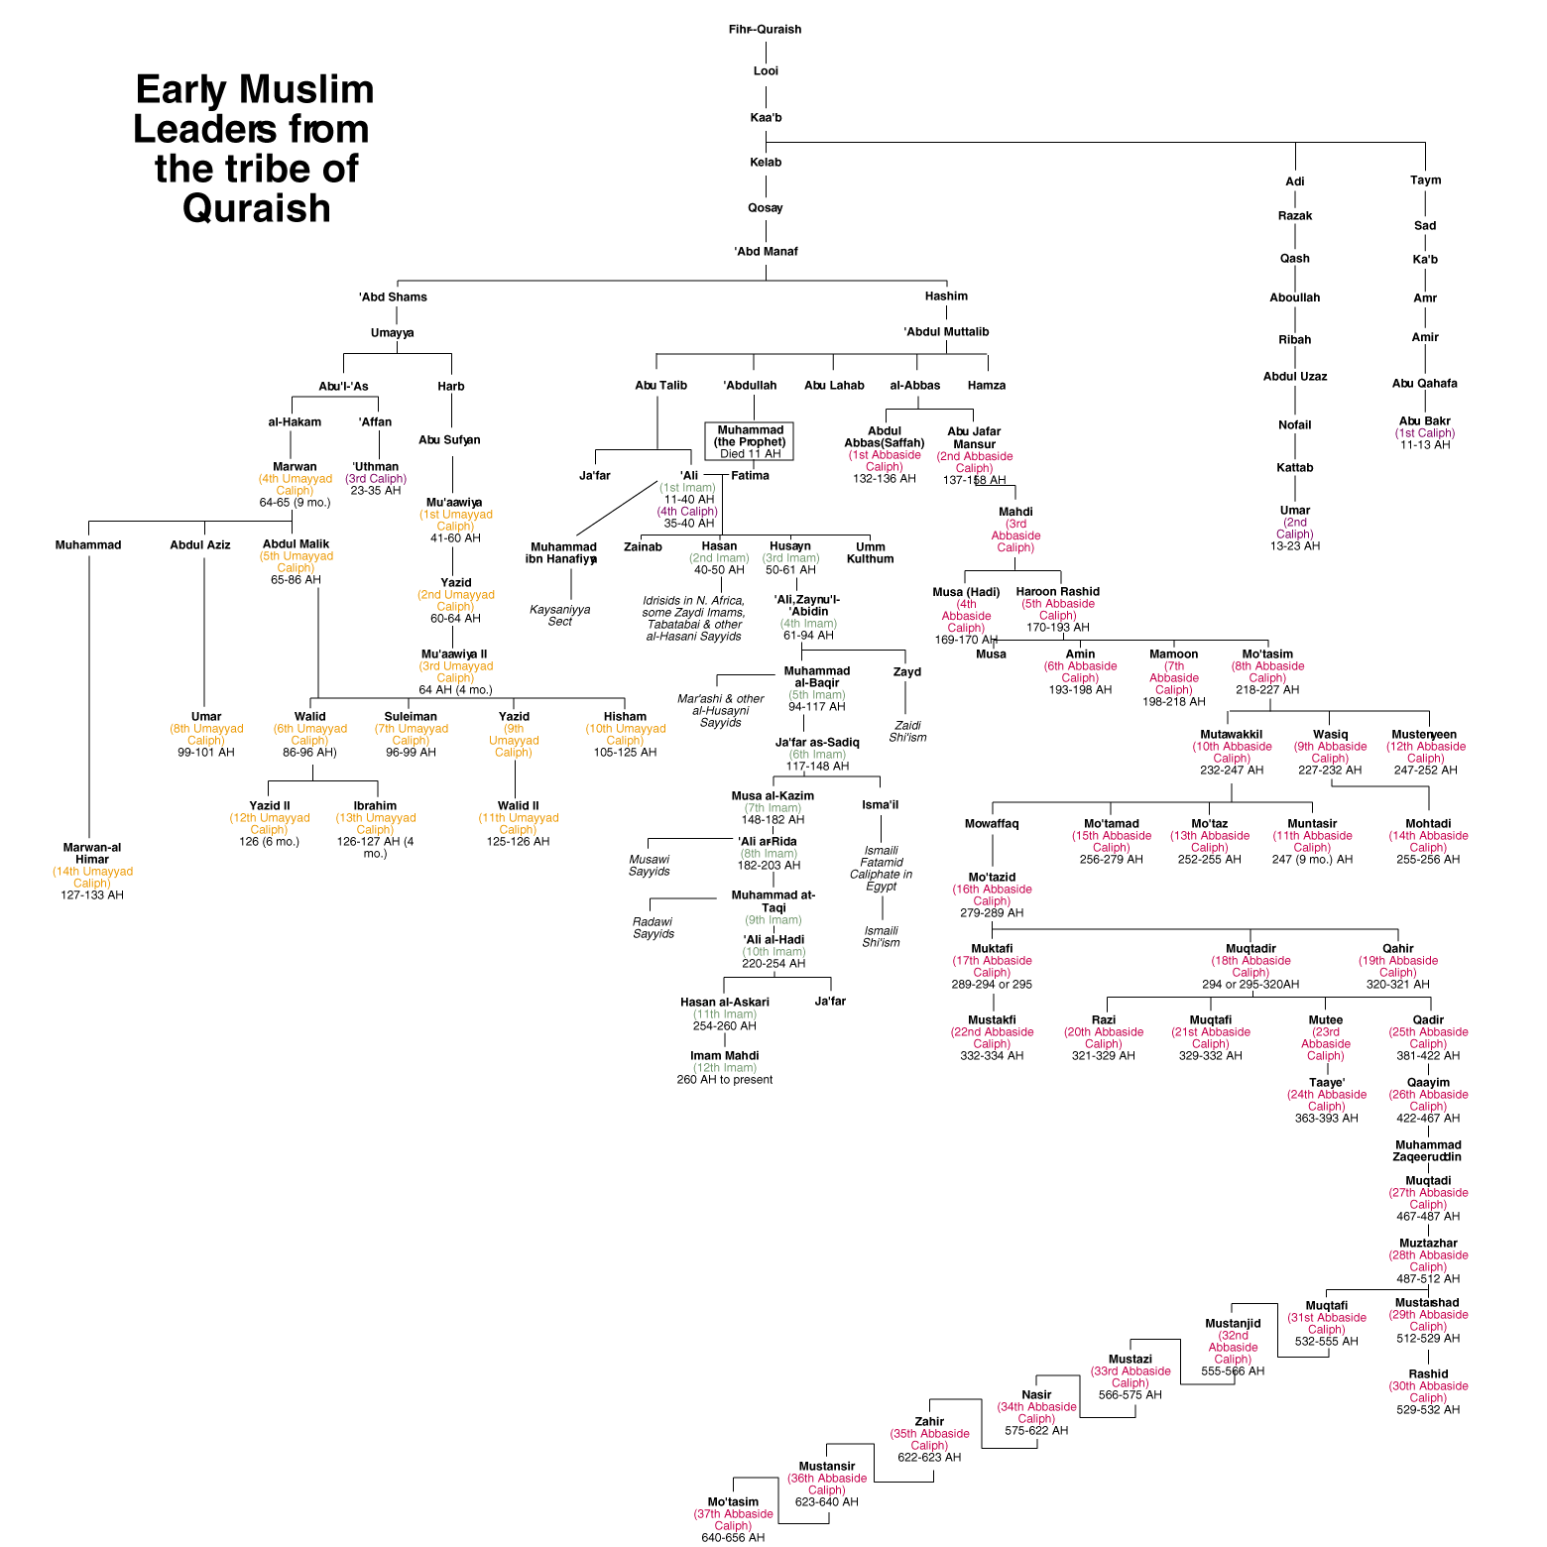

Slide 22
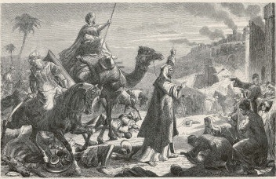
Umar 2nd Caliph c. 584-644 AD

Slide 23
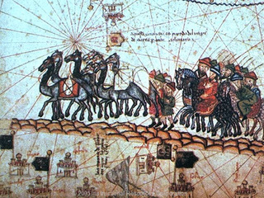
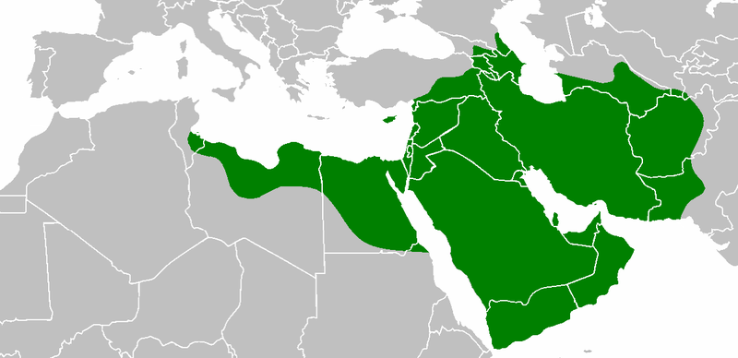
Uthman 3rd Caliph c. 579-656 AD

Slide 24
Ali (Ali ibn Abi Talib) 600-661 CE

Slide 25
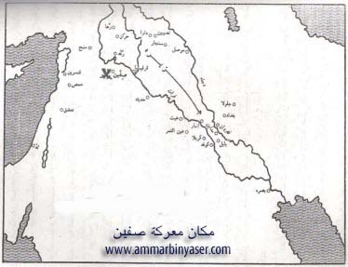
Battle of Siffin 657 AD

Slide 26
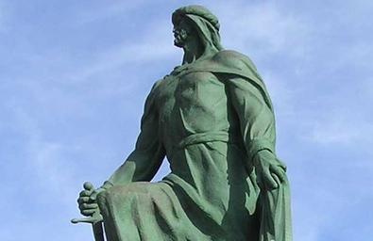
Muawiyah I – 1st of the Umayyad Caliphate 602-680 AD

Slide 27
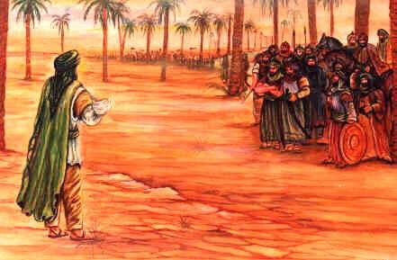
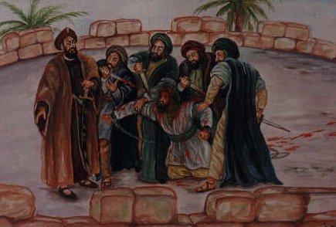
Hussayn, son of Ali Grandson of Muhammad 625-669 AD

Slide 28
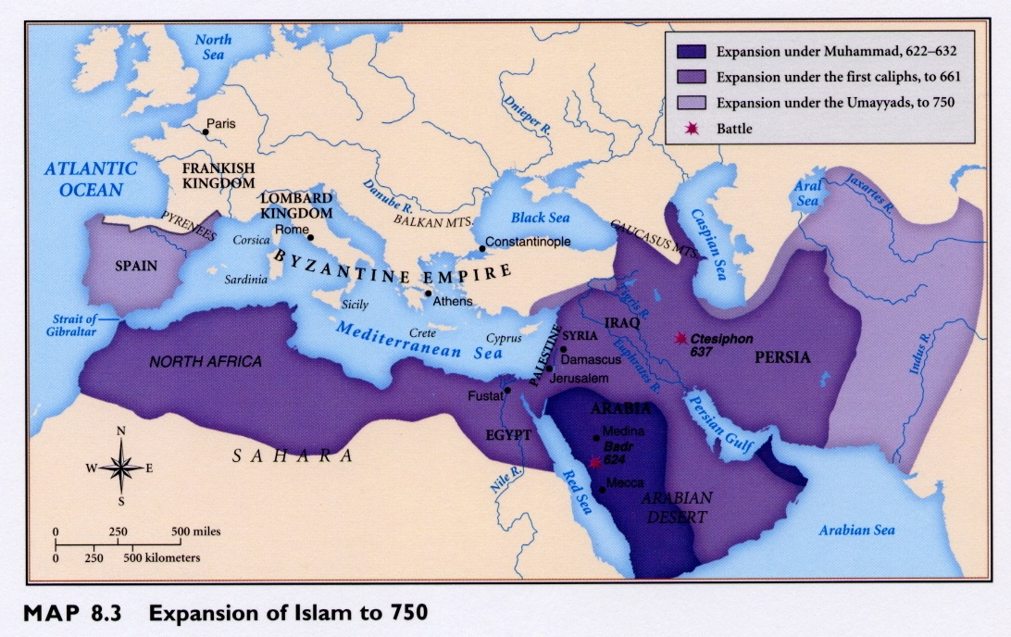
Expansion of Islam to 750 C.E.

Slide 29
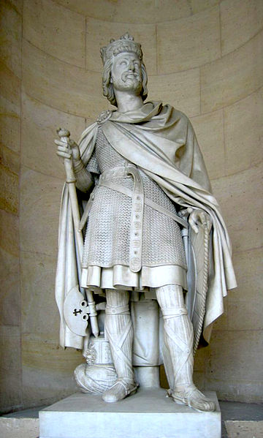
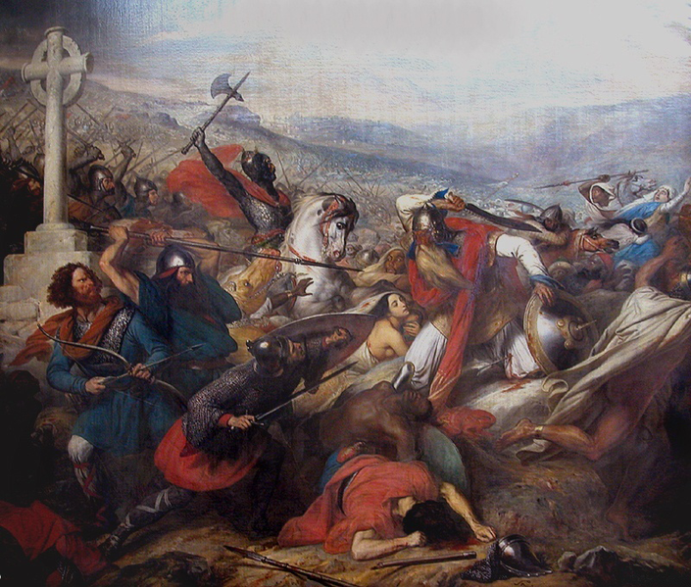
Charles Martel and the Battle of Poitiers, 732

Slide 30
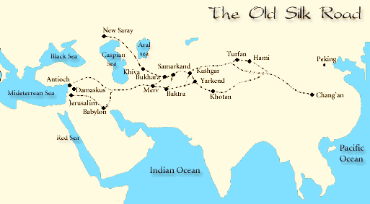
Merv

Slide 31
The Early Abbasid Era

Slide 32
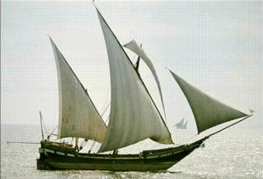
Arab Dhow with Lateen Sails

Slide 33
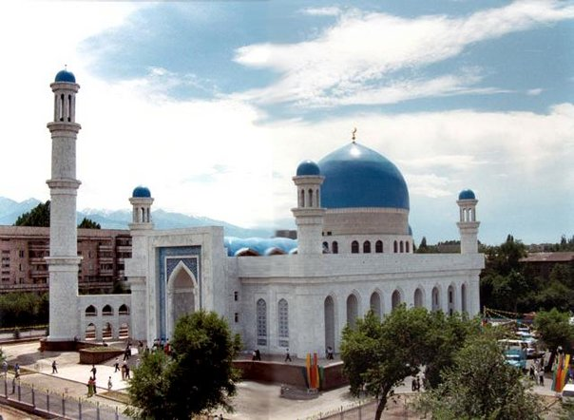
The Mosque

Slide 34
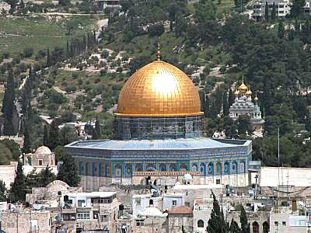

Slide 35
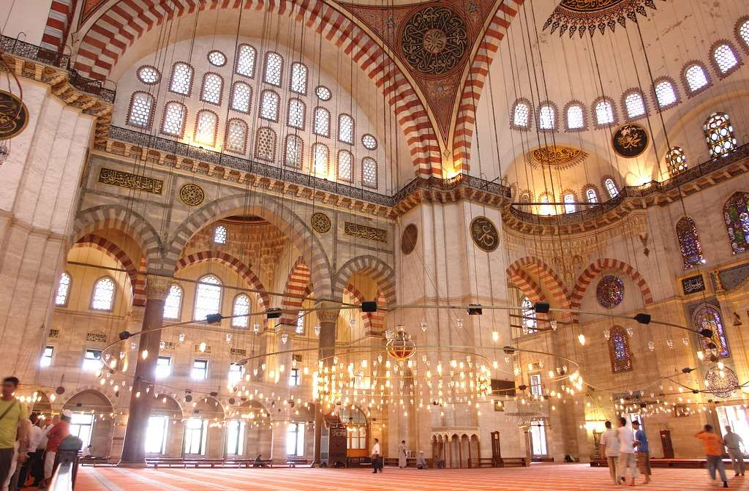

Slide 36
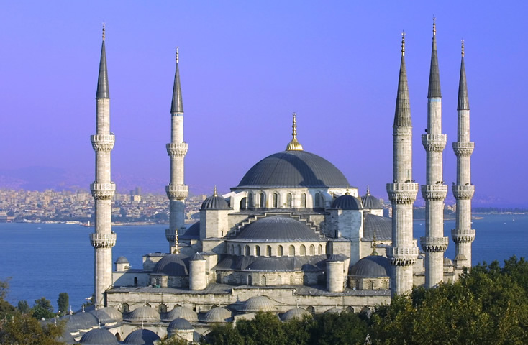

Slide 37
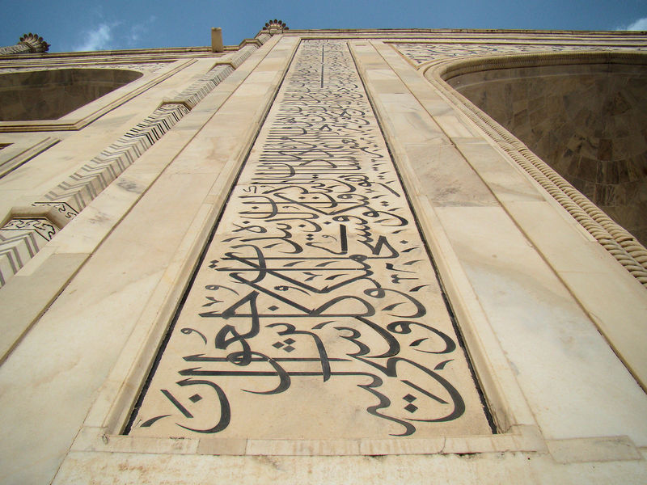
Calligraphy

Slide 38
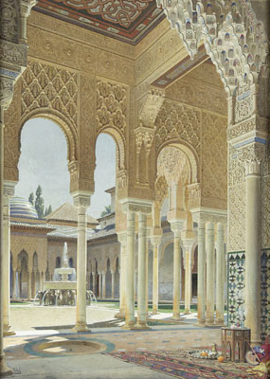
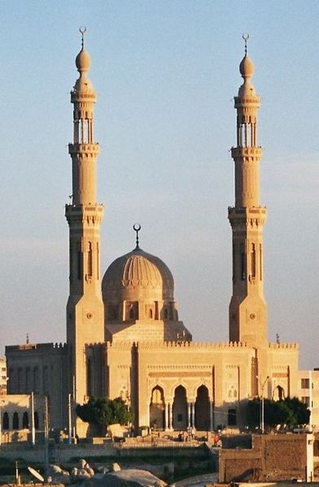
Arabesque and Minaret

Slide 39
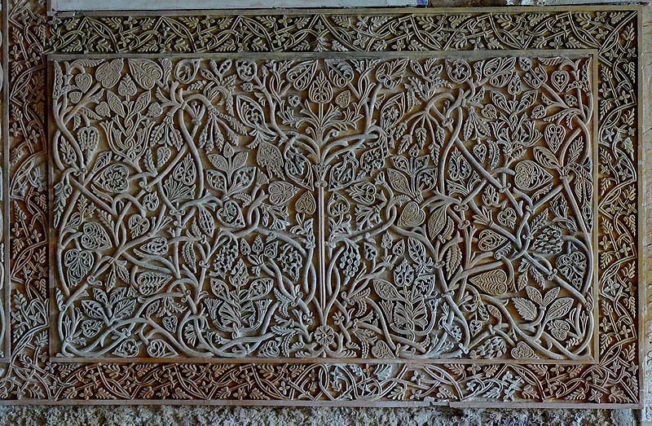
More Arabesque

