Slide 1
APWH Period 2: Organization and Reorganization of Human Societies, c. 600 BCE to 600 CE Textbook Part II: The Classical Period – Uniting Large Regions, 1000 B.C.E. – 500 C.E
Chapter 5: The Classical Period:
Directions, Diversities, and Declines by 500 C.E.

Slide 2
Other Civilizations in the Classical Era

Slide 3
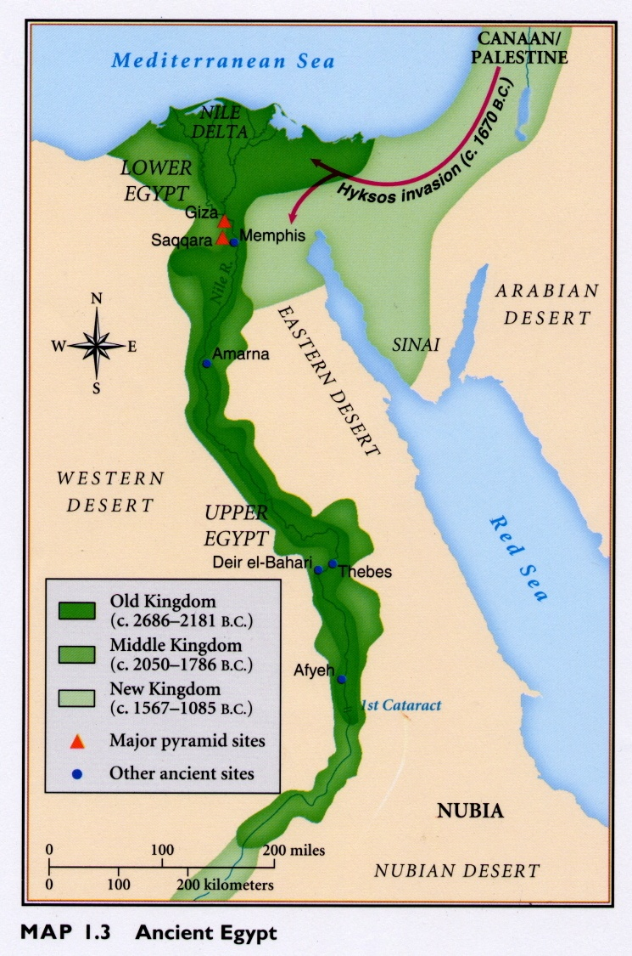
Kingdom of Kush (Nubia)

Slide 4
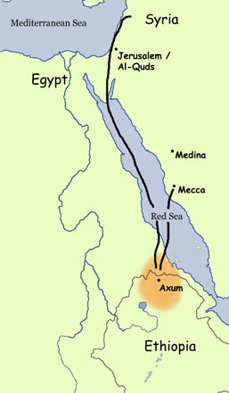
Axum Ethiopia

Slide 5
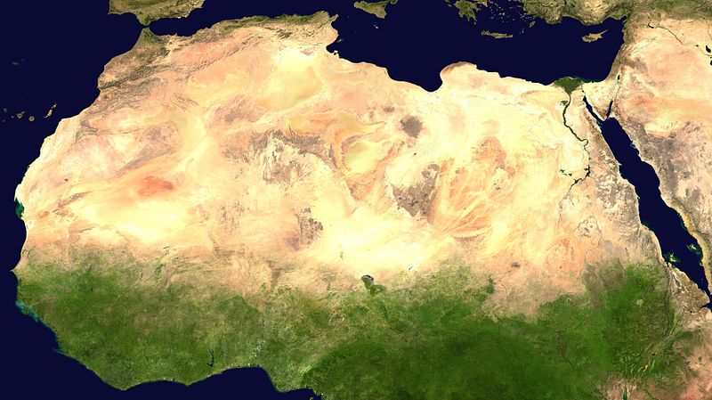
The Sahara

Slide 6
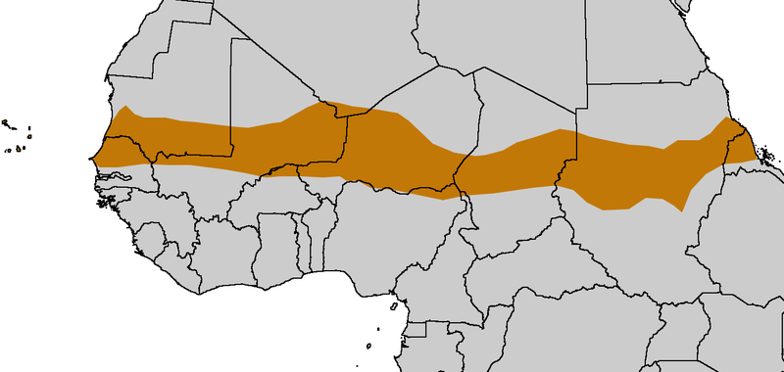
The Sahel

Slide 7
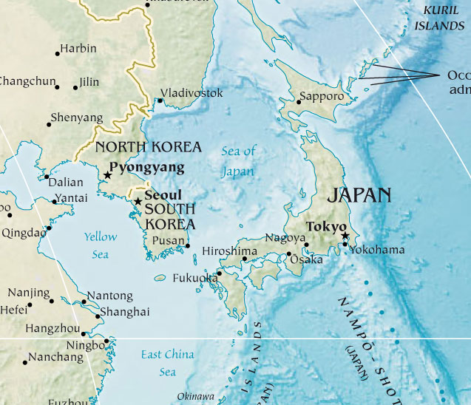

Slide 8
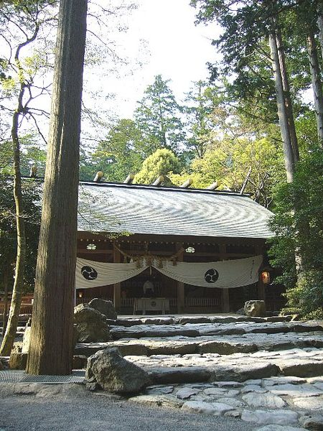
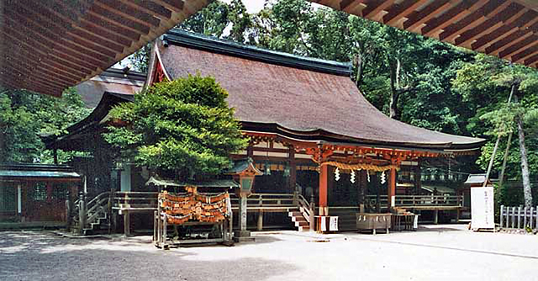
Shinto Shrines

Slide 9
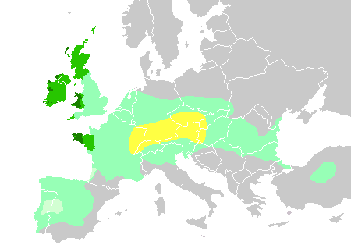
Major Celtic Regions
(started in central Europe and spread outward and upward)

Slide 10
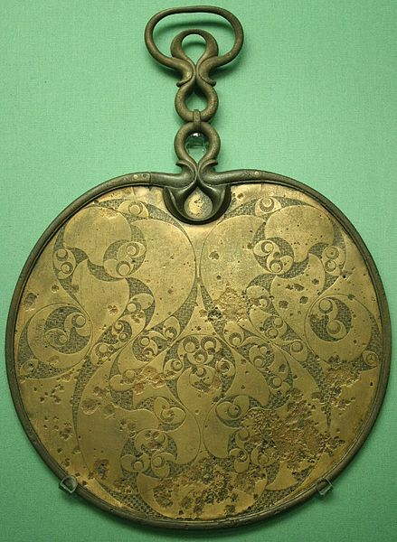
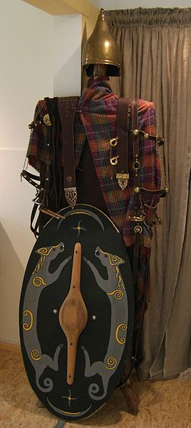
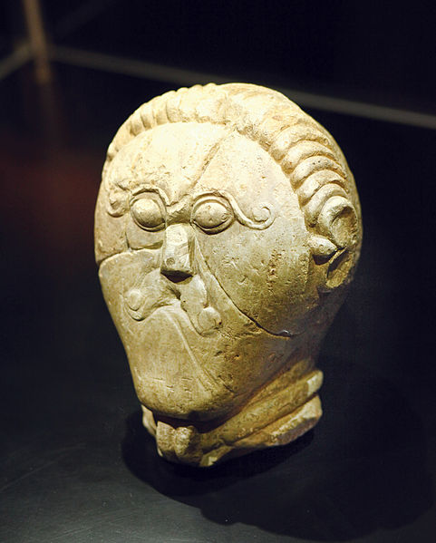
Celtic Culture

Slide 11
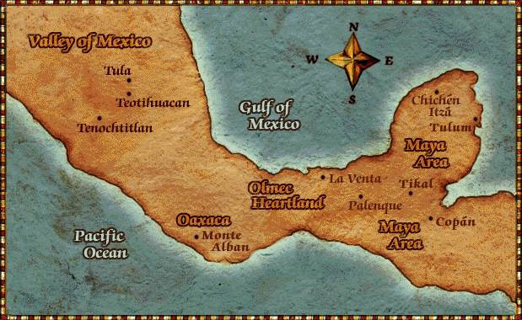
Mesoamerica

Slide 12
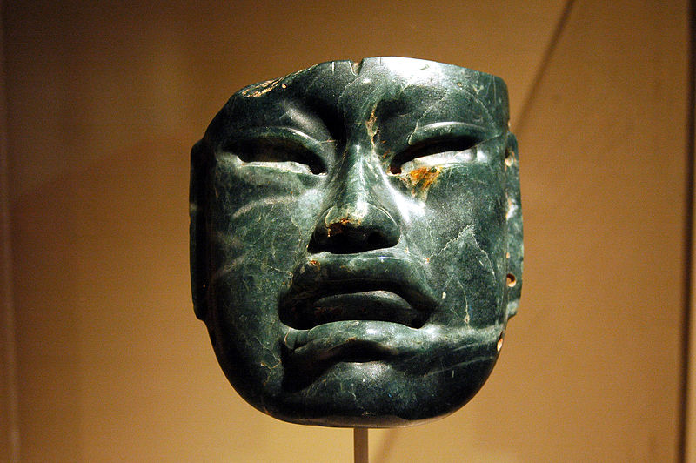
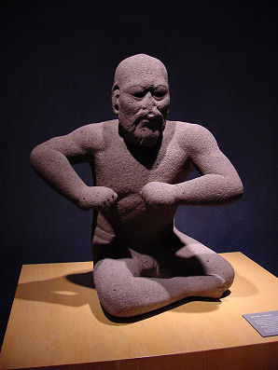
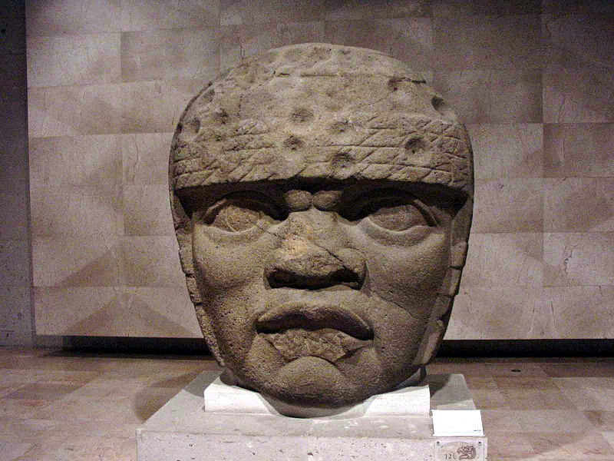
Olmec Culture

Slide 13
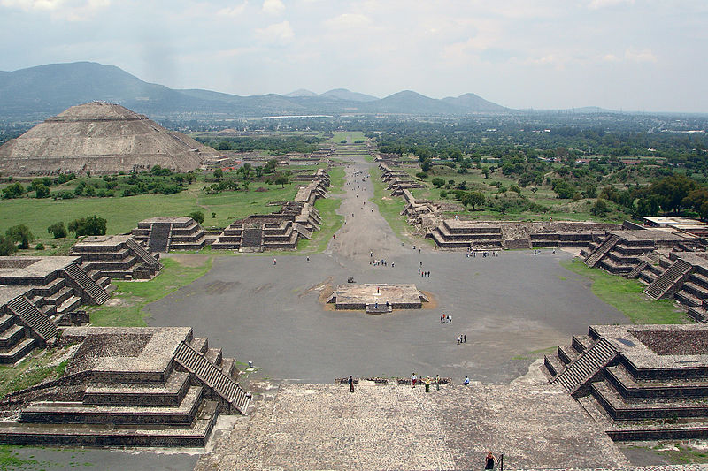
Teotihuacan Civilization

Slide 14
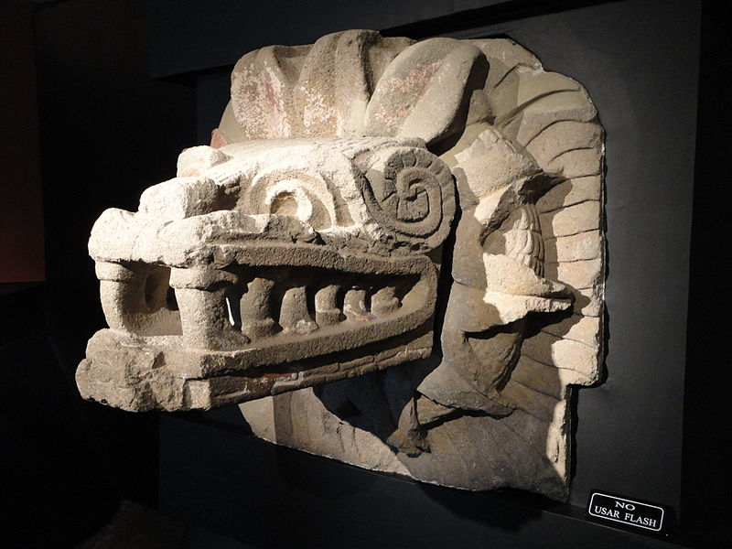
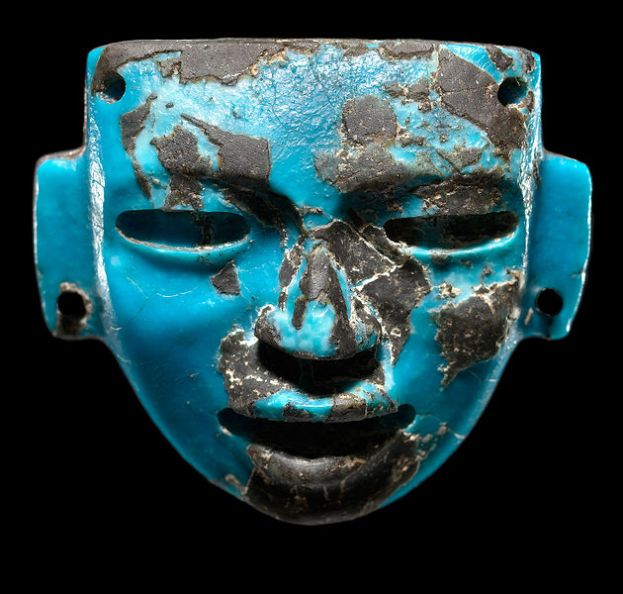
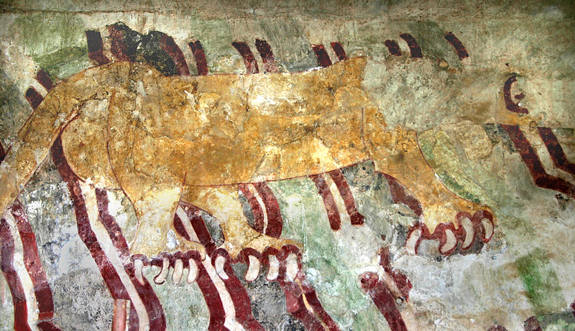
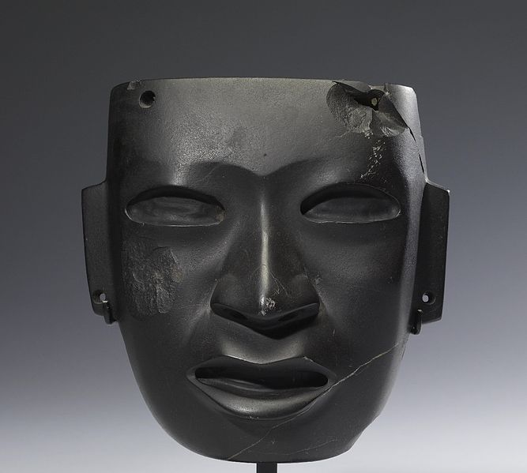
Teotihuacan Culture

Slide 15
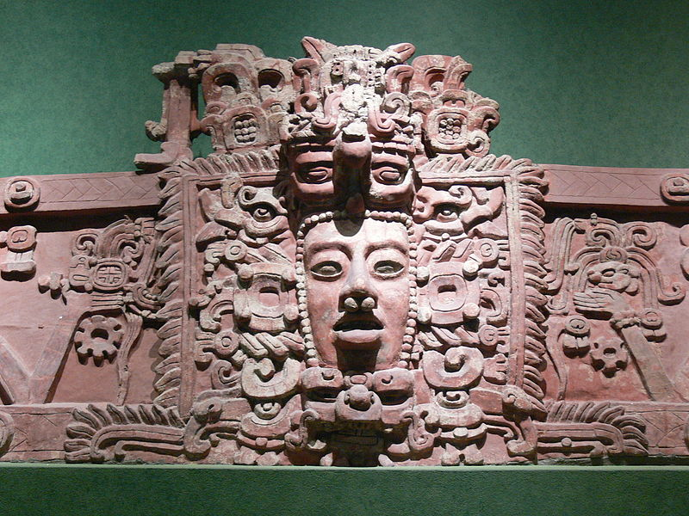
Mayan Civilization

Slide 16
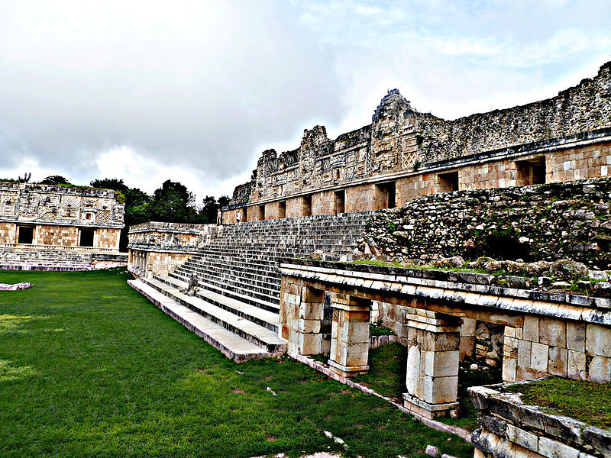
Mayan Civilization

Slide 17
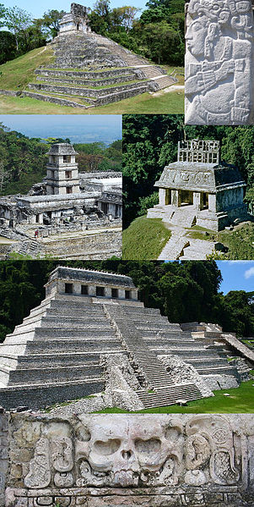

Slide 18
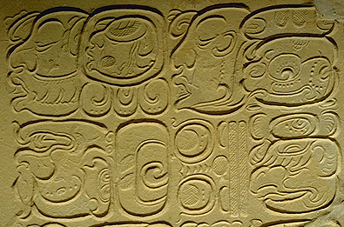
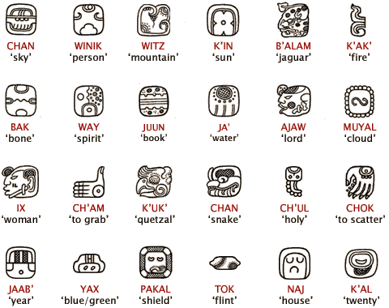
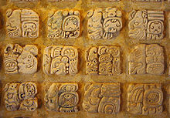
Mayan Hieroglyphs

Slide 19
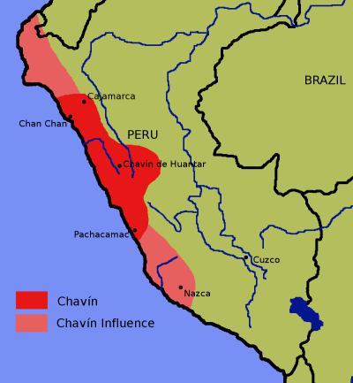
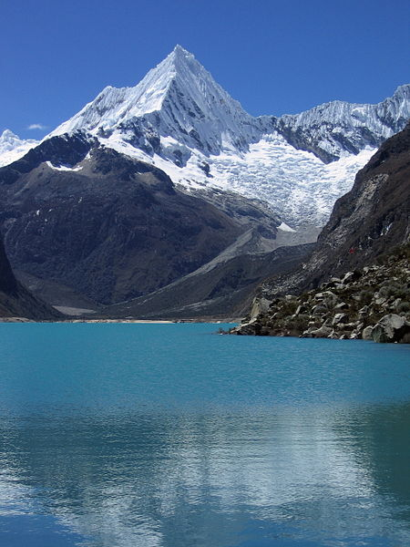
Chavín Civilization

Slide 20
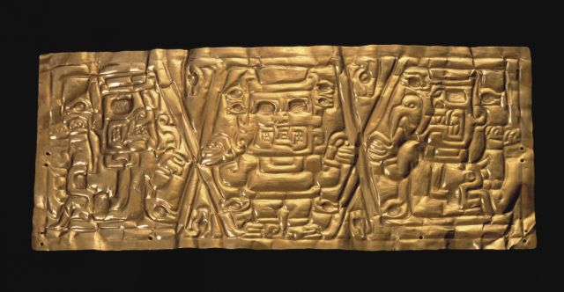
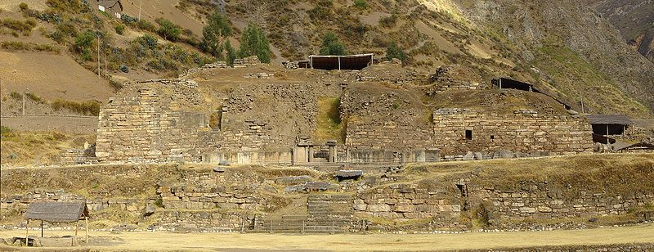
Chavín Culture

Slide 21
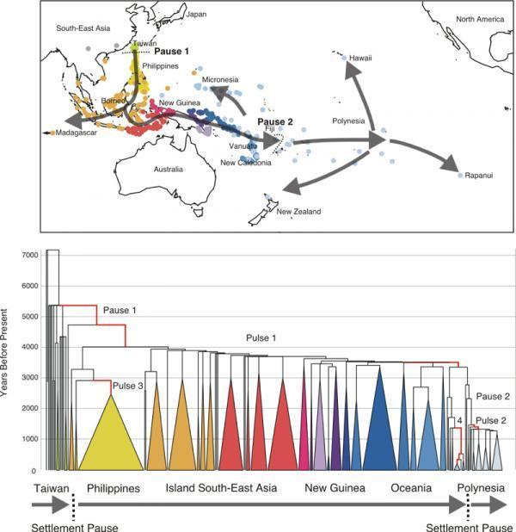
Spread of Polynesian Peoples

Slide 22
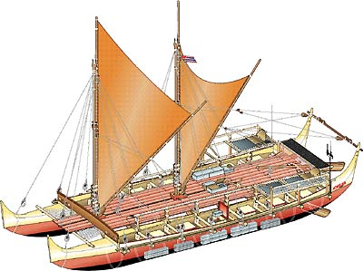
Ancient Polynesian Ships

Slide 23
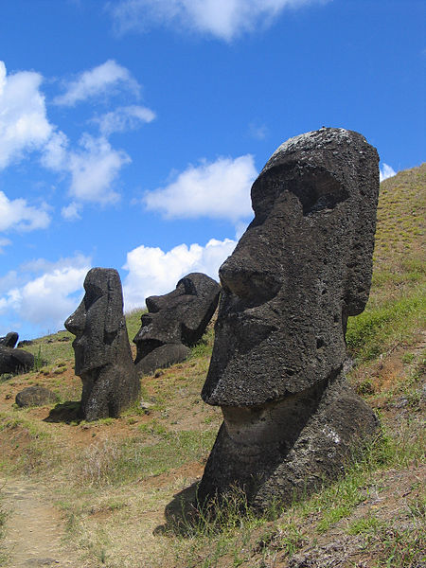
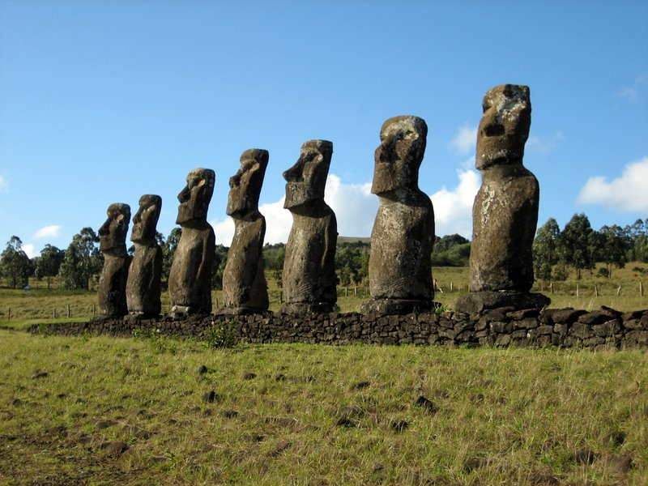
Easter Island Polynesian Culture

Slide 24
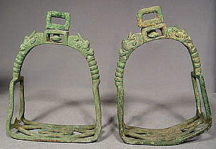
Tang Dynasty Ancient Bronze Stirrups

Slide 25
Decline and Fall in China, India, and the Mediterranean

Slide 26
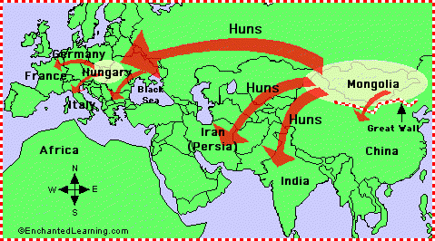
The Hun Invasions

Slide 27
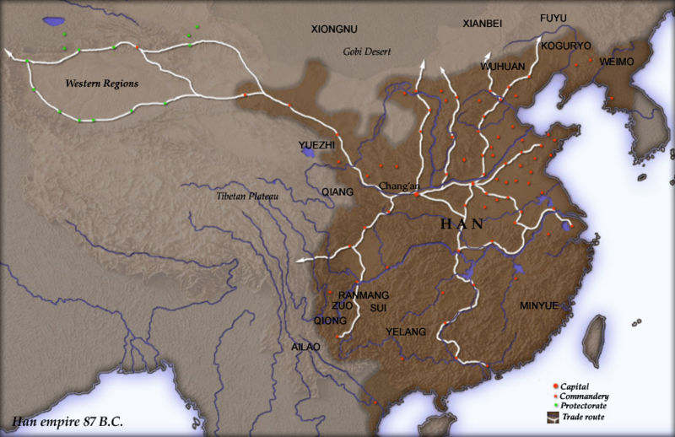
Han China

Slide 28
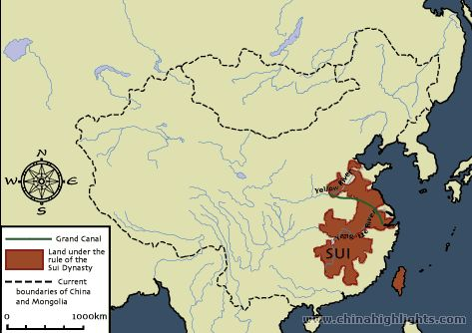

Slide 29
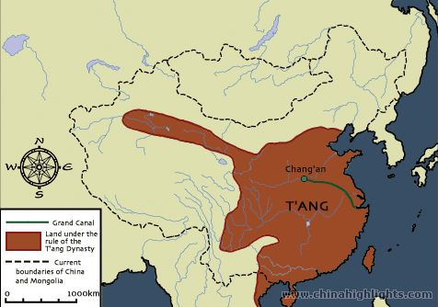

Slide 30
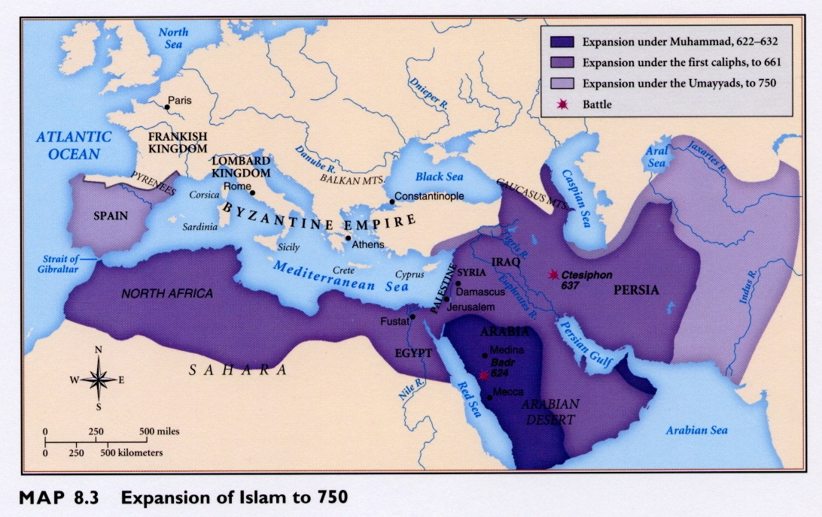

Slide 31
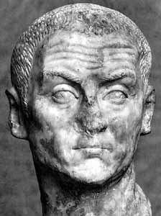
Diocletian 284-305 C.E.

Slide 32
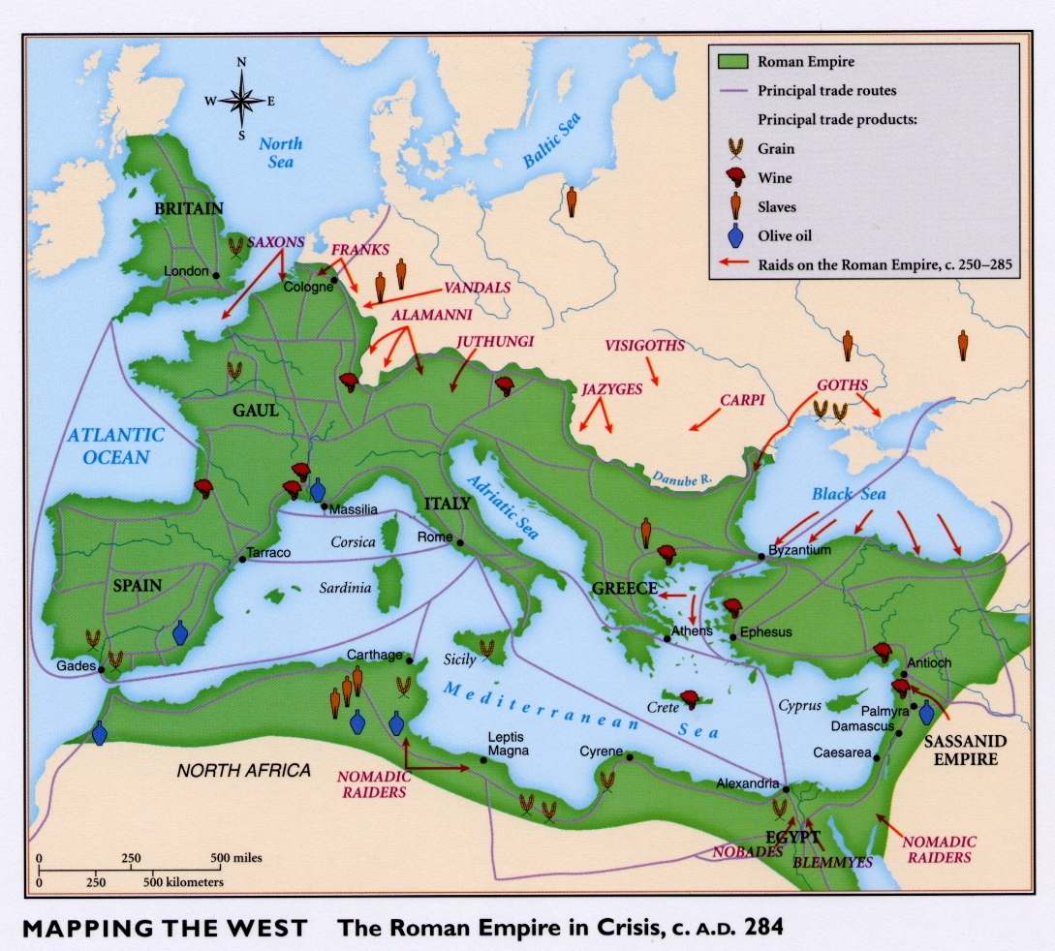

Slide 33
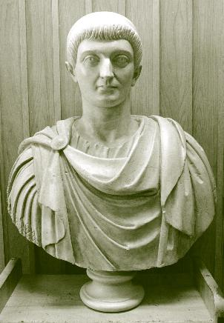
Constantine 312-337 B.C.E.

Slide 34
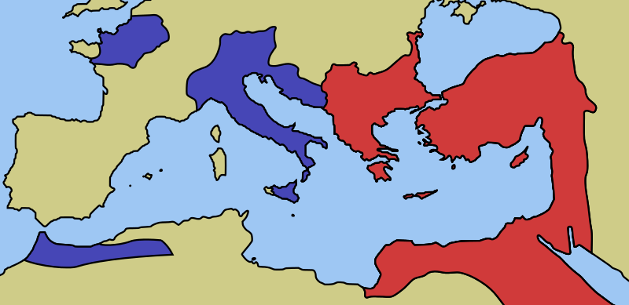
Eastern and Western Roman Empires by 476 CE

Slide 35
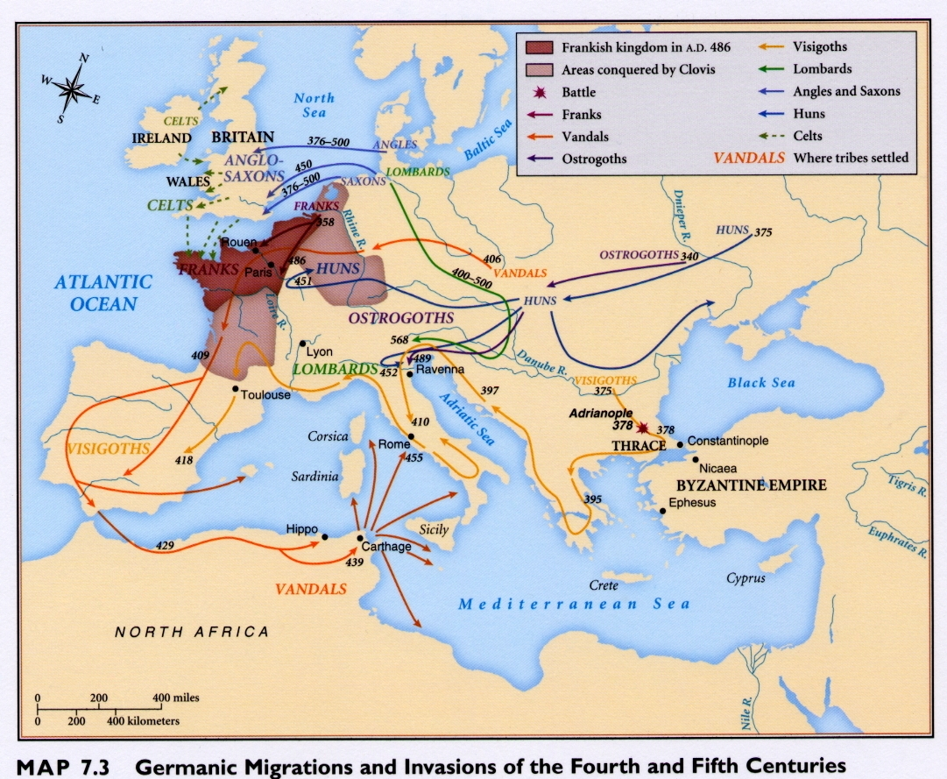

Slide 36
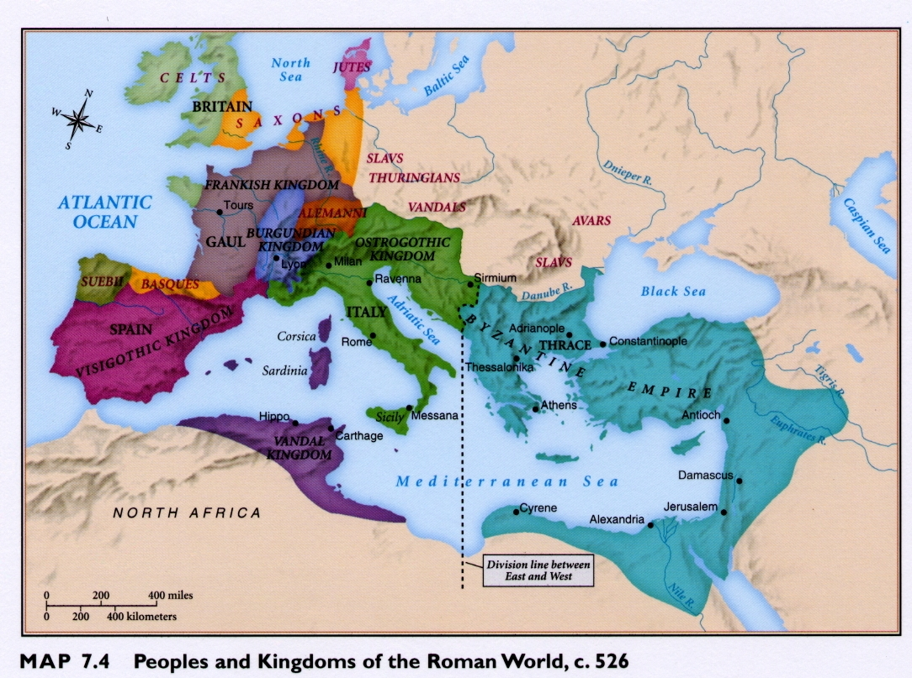

Slide 37
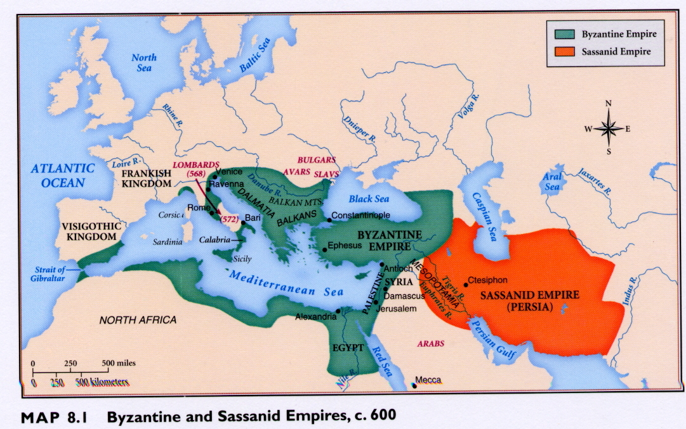

Slide 38
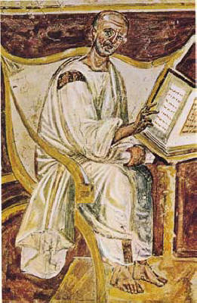
Early Portrait of Augustine, 6th Century

Slide 39
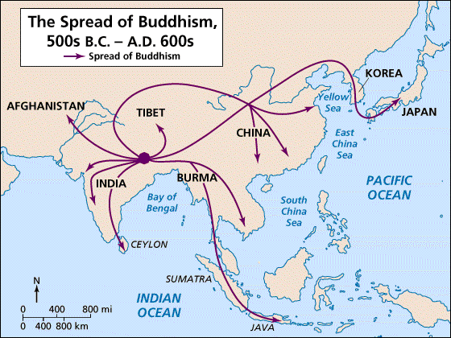

Slide 40
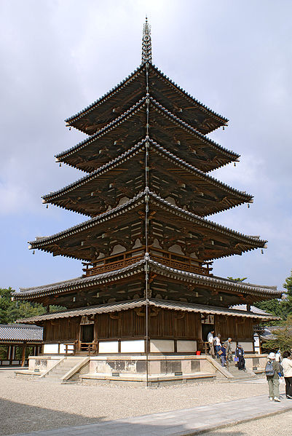
7th Century Japanese Pagoda

Slide 41
Jesus of Nazareth c. 7-2 BCE to 30-36 CE

Slide 43
Syncretism in the Race of Jesus

Slide 44
The Apostle Paul

Slide 45
Papyrus Fragment of Early New Testament

Slide 47
Saint Benedict of Nursia

Slide 48
Early Monastery in Italy

