Slide 1
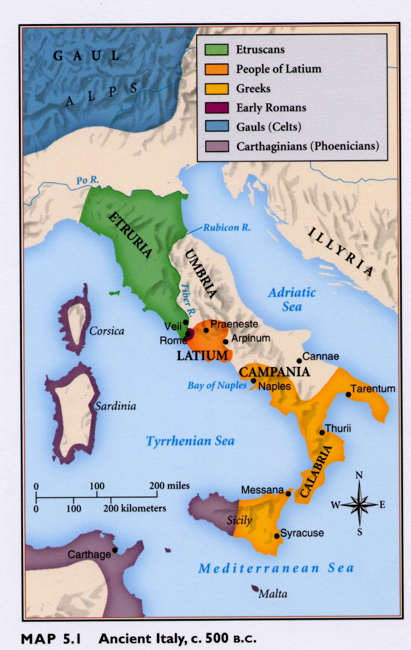
Rise of Rome

Slide 2
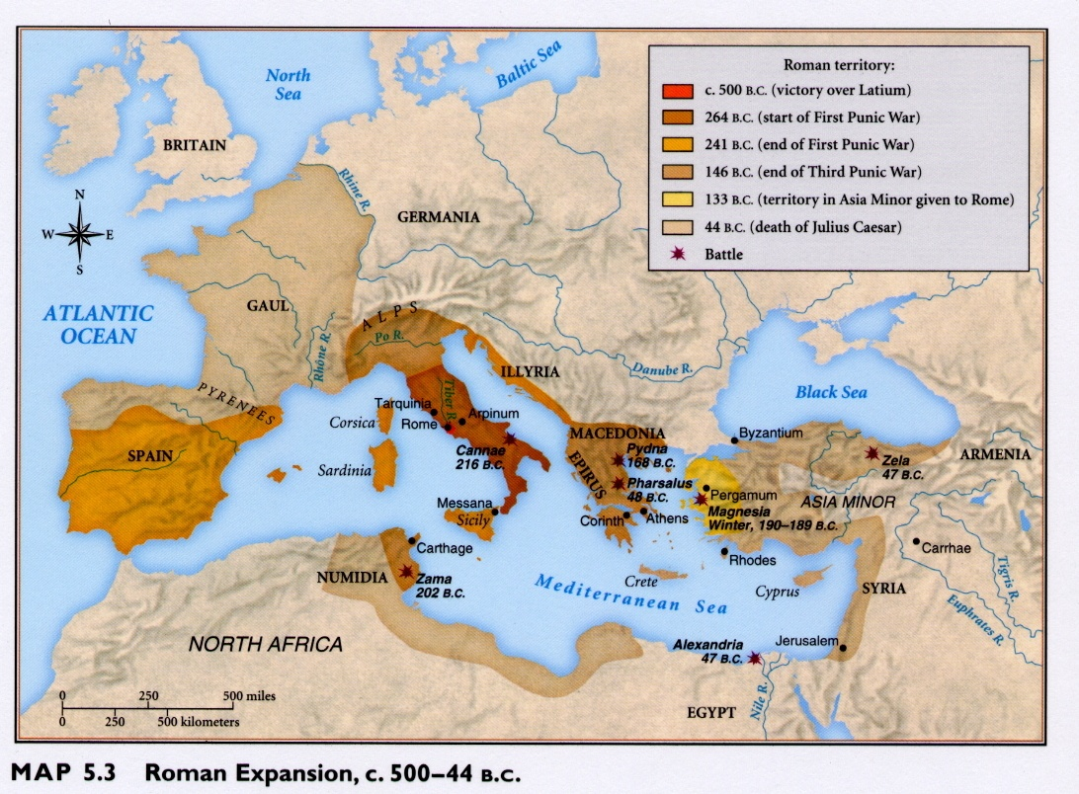

Slide 3
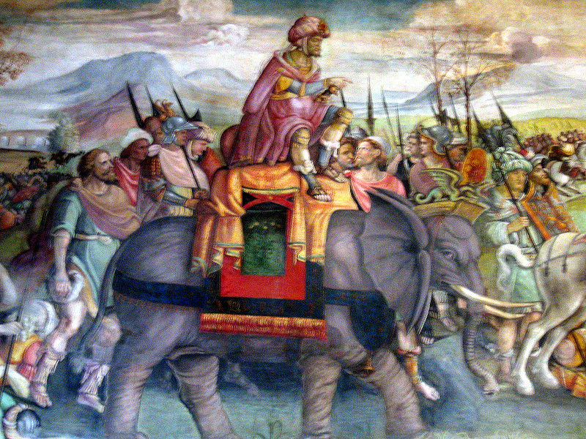
Hannibal’s Army (Fresco c. 1510)

Slide 4
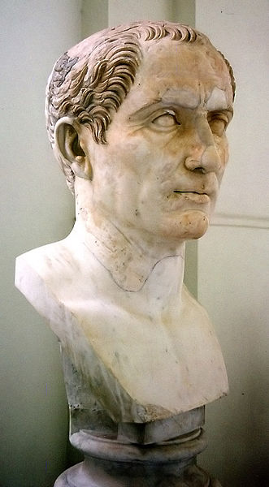
Julius Caesar c. 100 – 44 B.C.E.

Slide 5
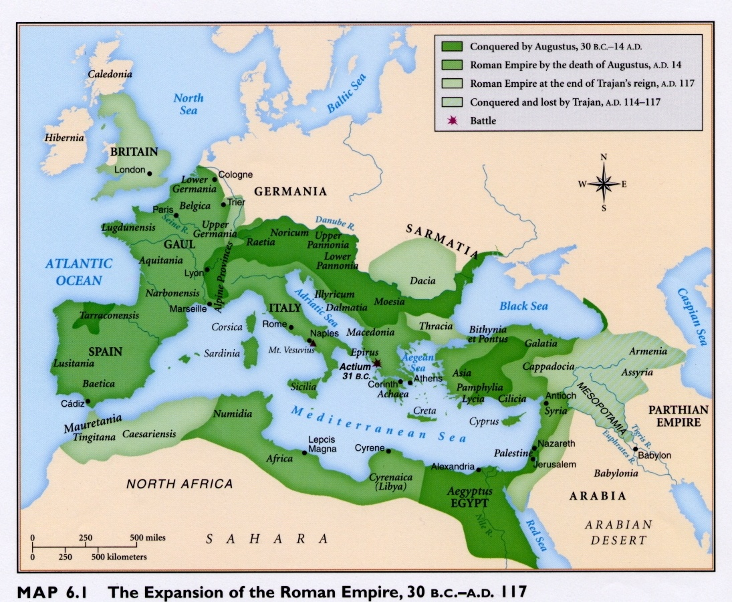

Slide 6
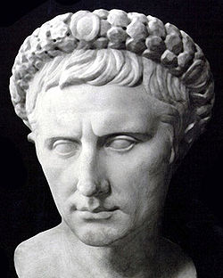
Augustus Caesar (formerly Octavian) r. 27 B.C.E. – 14 C.E.

Slide 7
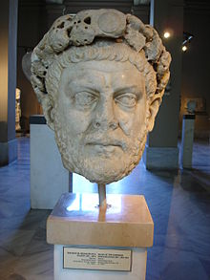
Diocletian r. 284-305 C.E.

Slide 8
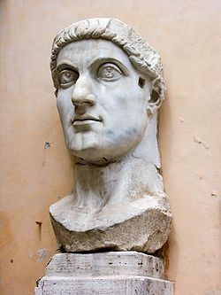
Constantine c.272-337 C.E.

Slide 9
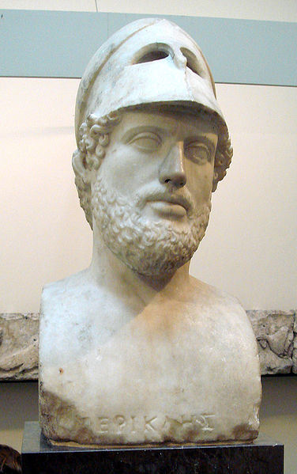
Pericles c. 495-429 B.C.E.

Slide 10
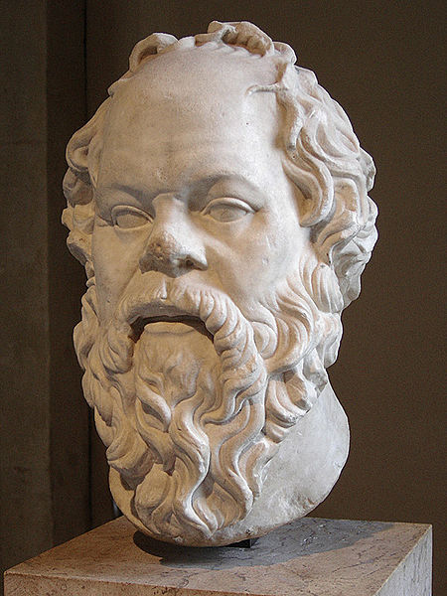
Socrates c. 469-399 B.C.E.

Slide 11
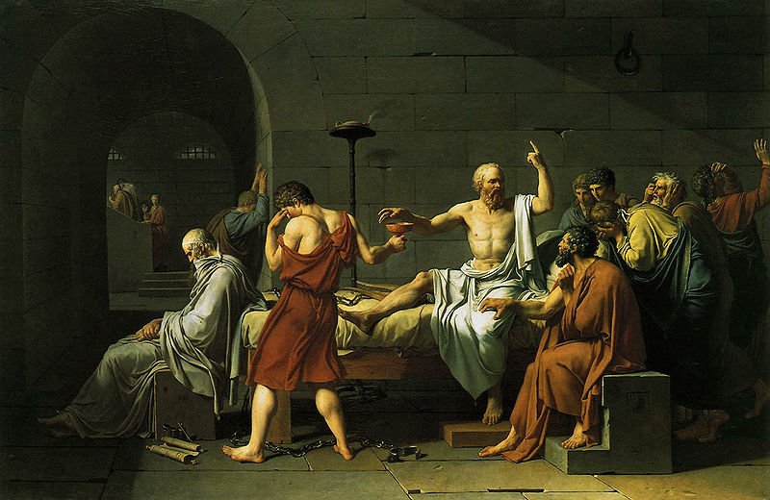
The Death of Socrates by Jacques Louis-David

Slide 12
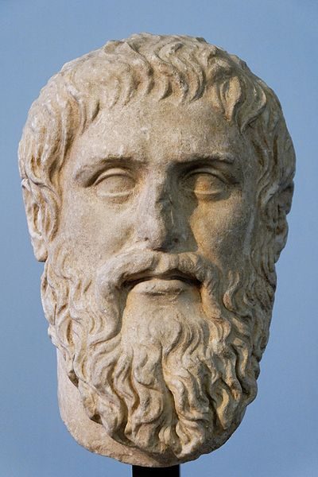
Plato c. 428-328 B.C.E.

Slide 13
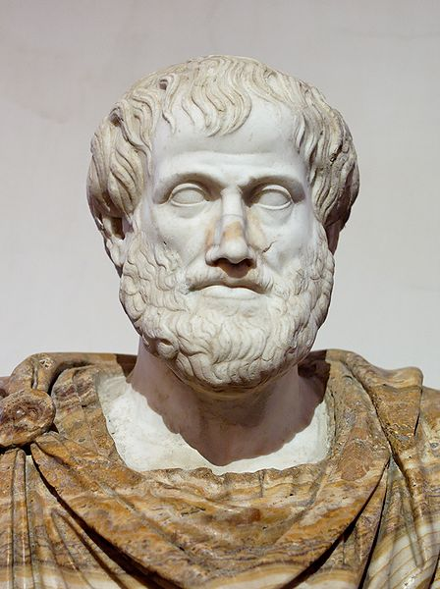
Aristotle 384-322 B.C.E.

Slide 14
