Slide 1
APWH Period 2: Organization and Reorganization of Human Societies, c. 600 BCE to 600 CE Textbook Part II: The Classical Period, Uniting Large Regions, 1000 B.C.E. – 500 C.E.:
Chapter 4: Classical Civilization in the Mediterranean:
Greece and Rome

Slide 2
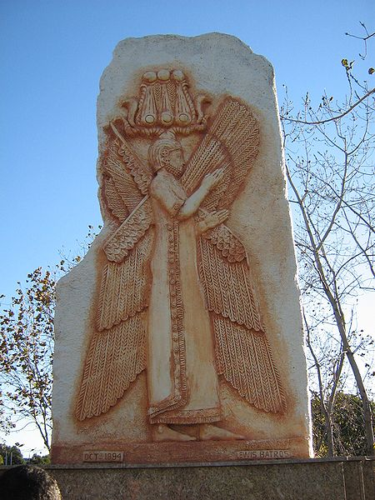
Carving of Cyrus the Great r. 559-530 B.C.E.

Slide 3
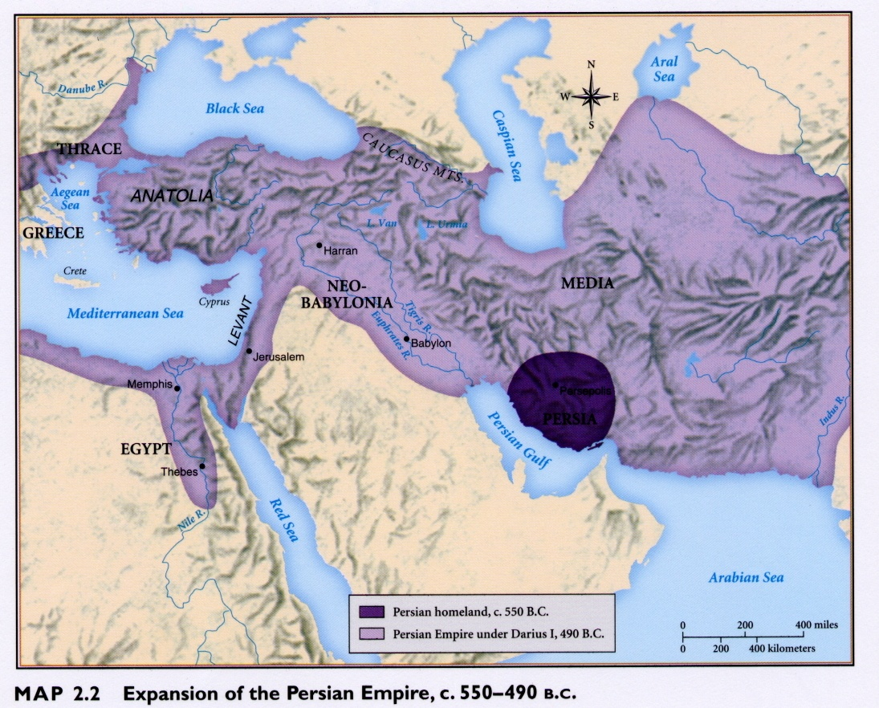

Slide 4
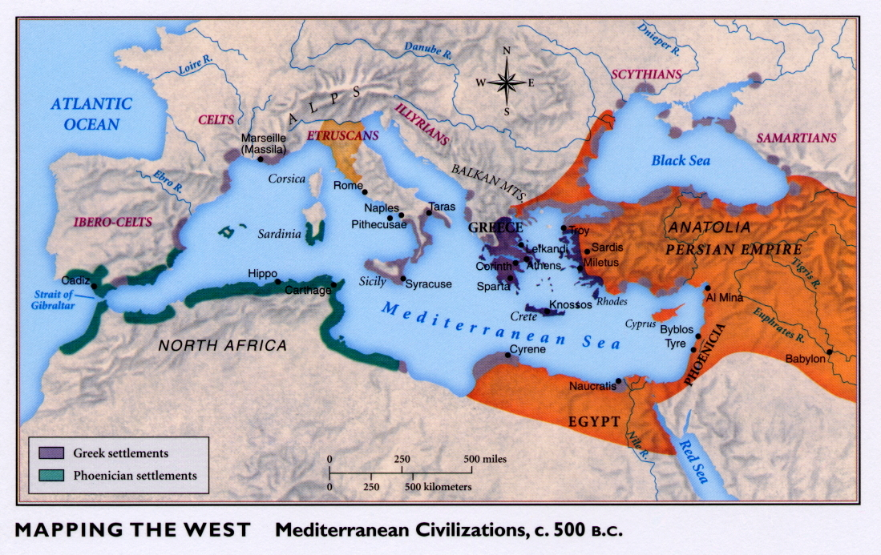

Slide 5
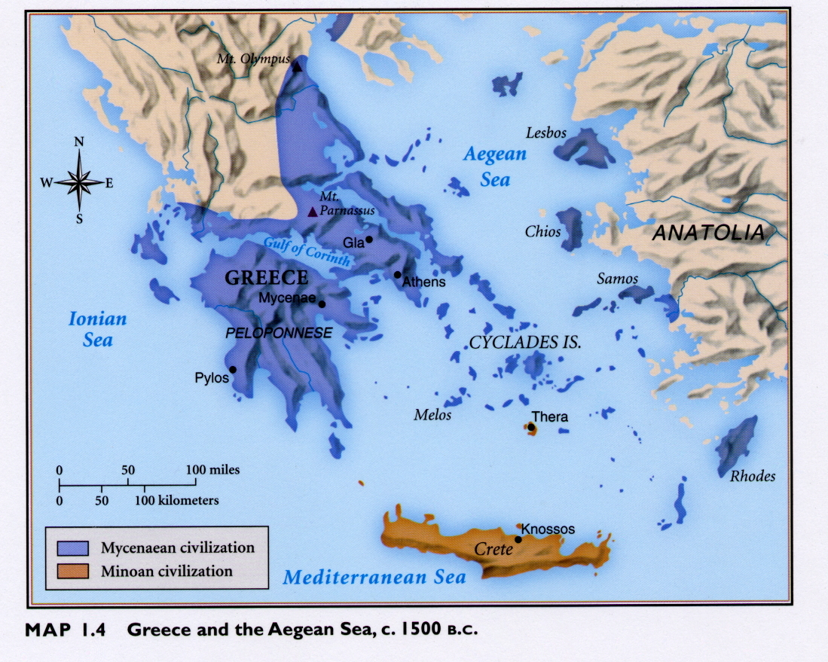

Slide 6
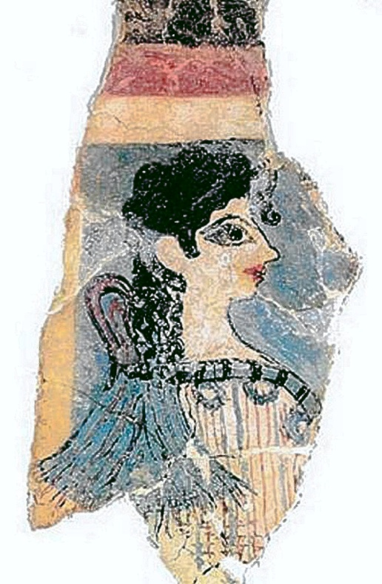
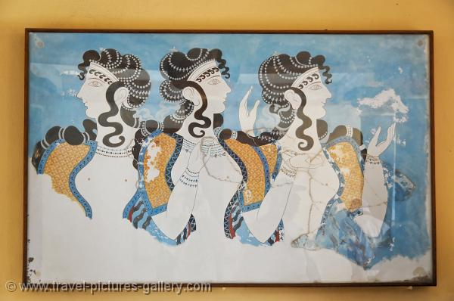
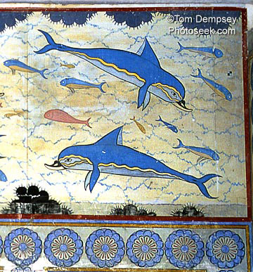
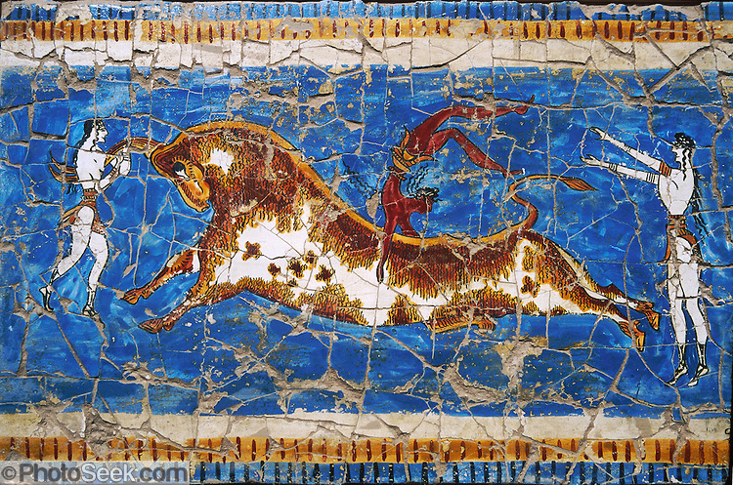
Minoan Art

Slide 7
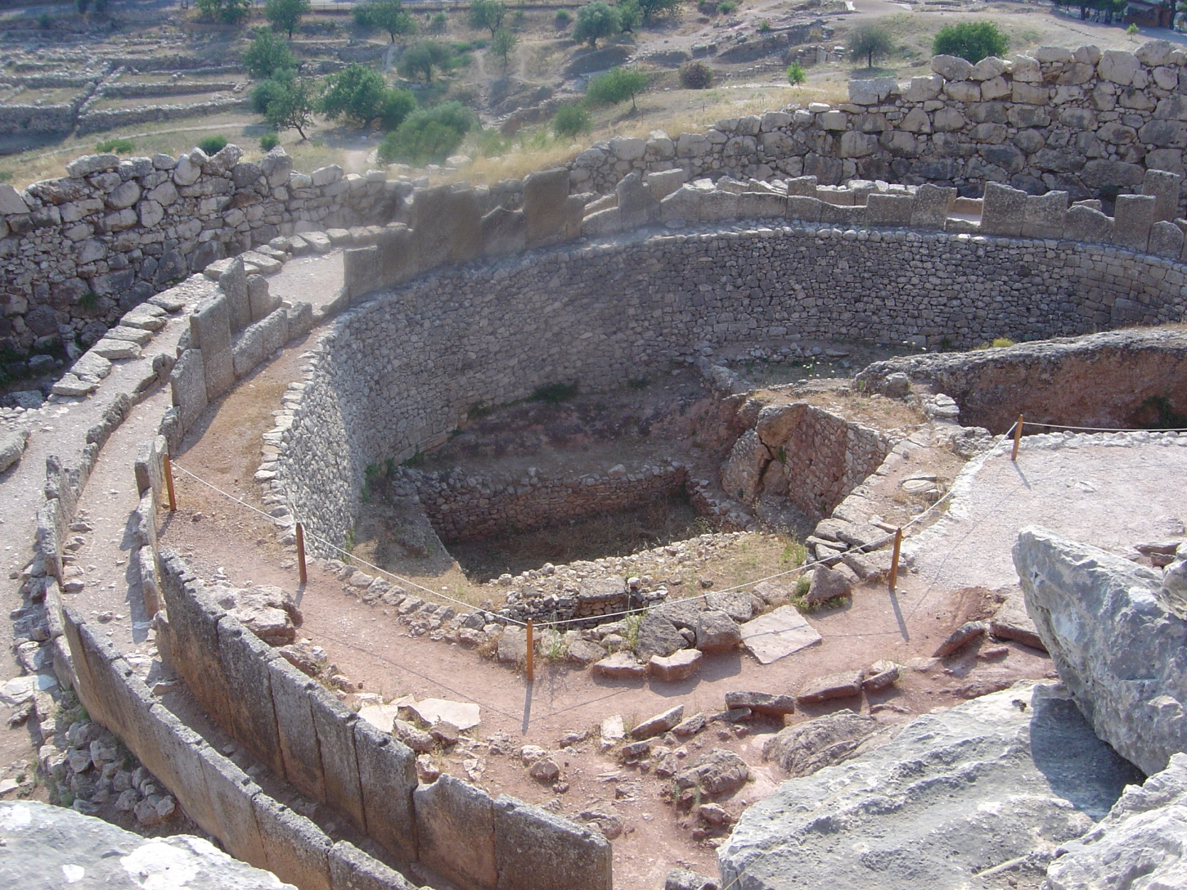
Ruins of Mycenae

Slide 8
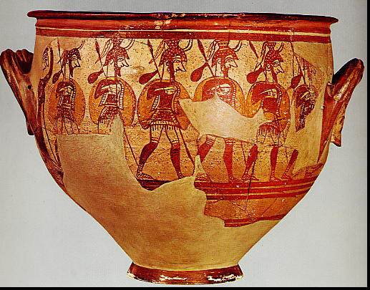
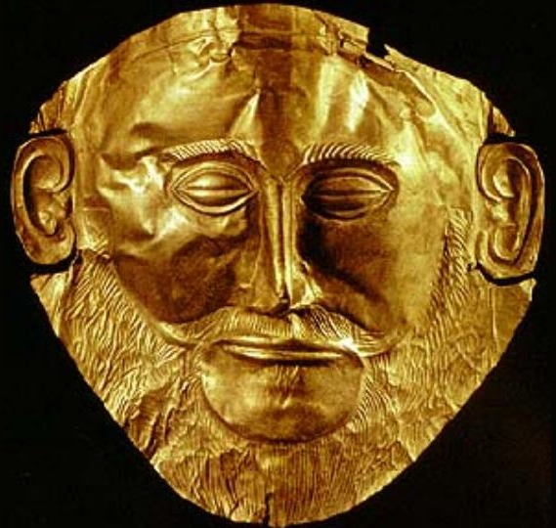
Mycenaean Art

Slide 9
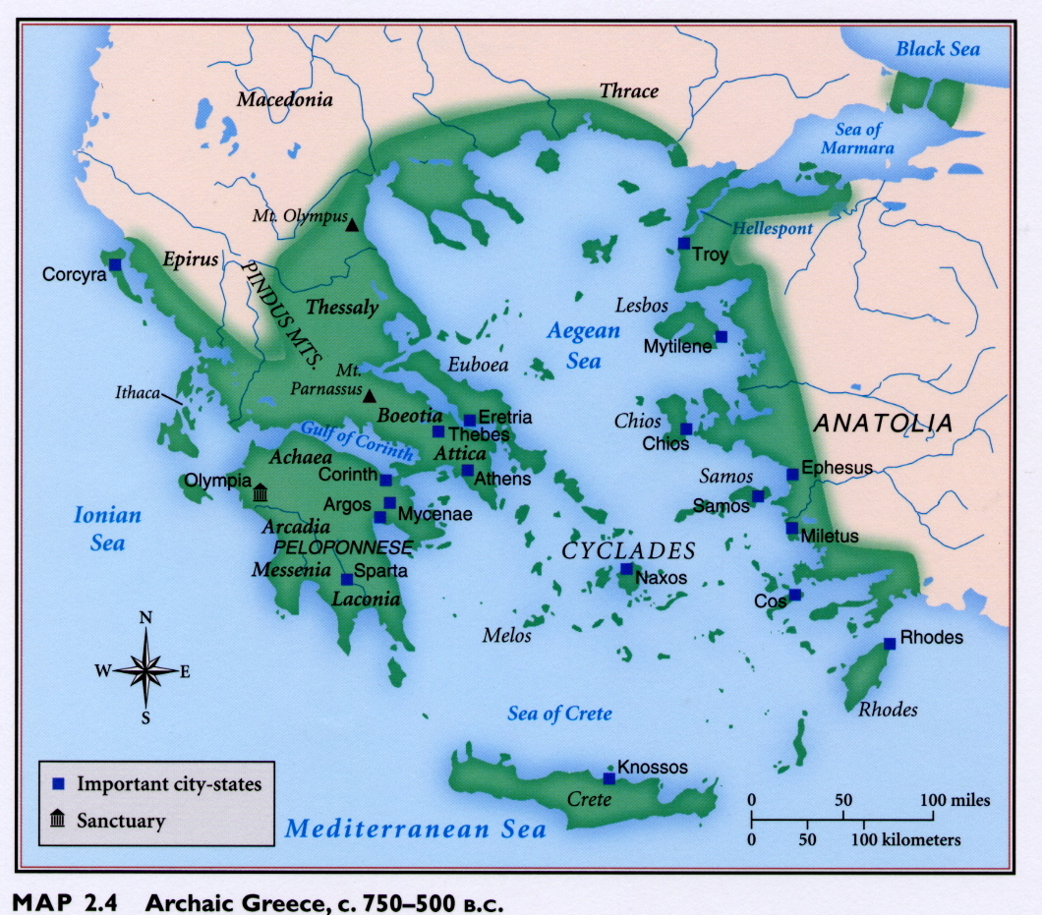

Slide 10
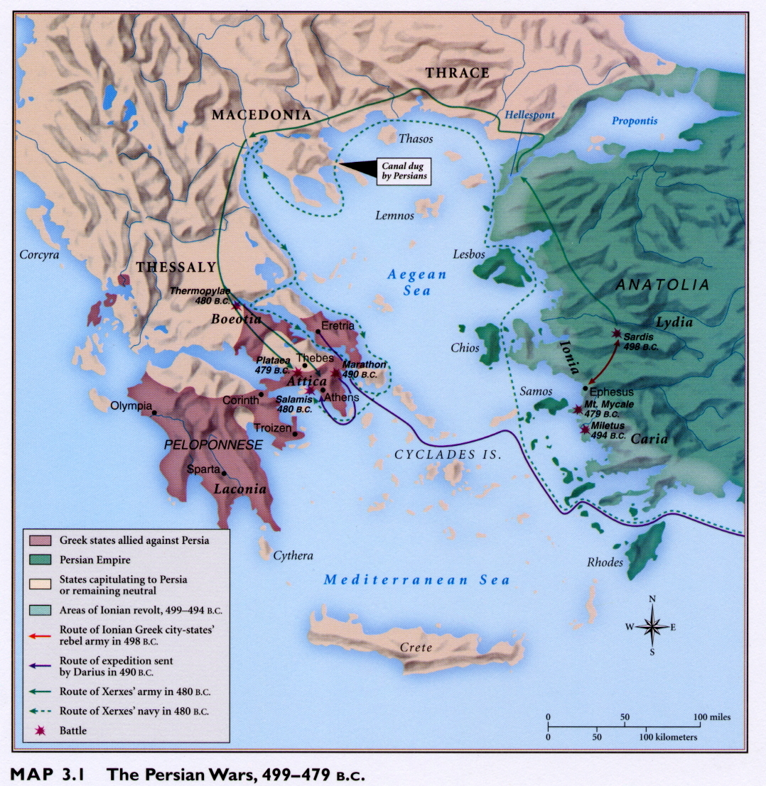

Slide 11
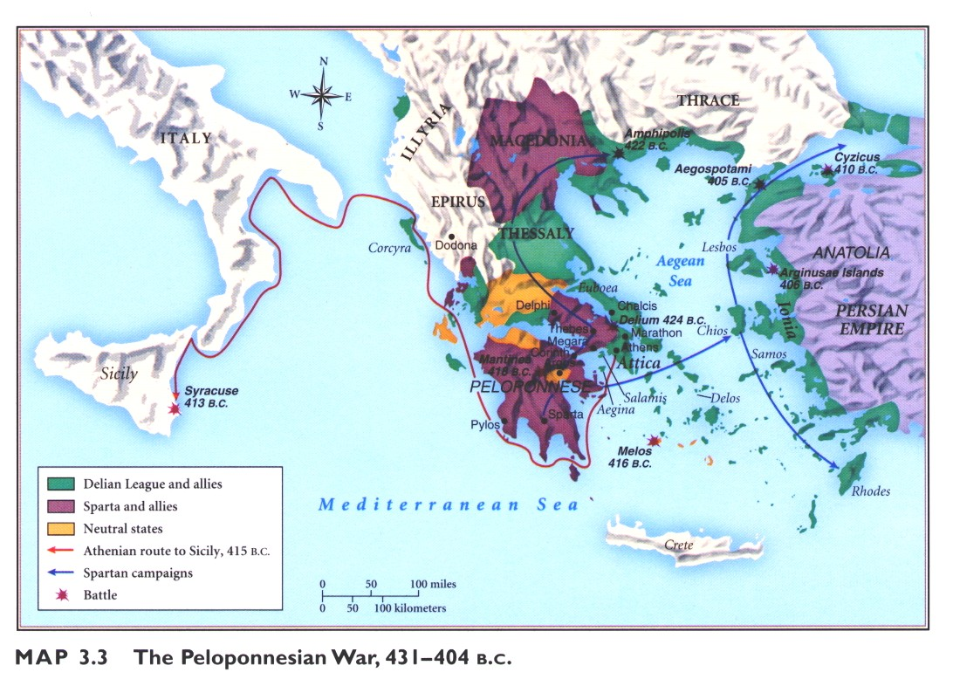

Slide 12
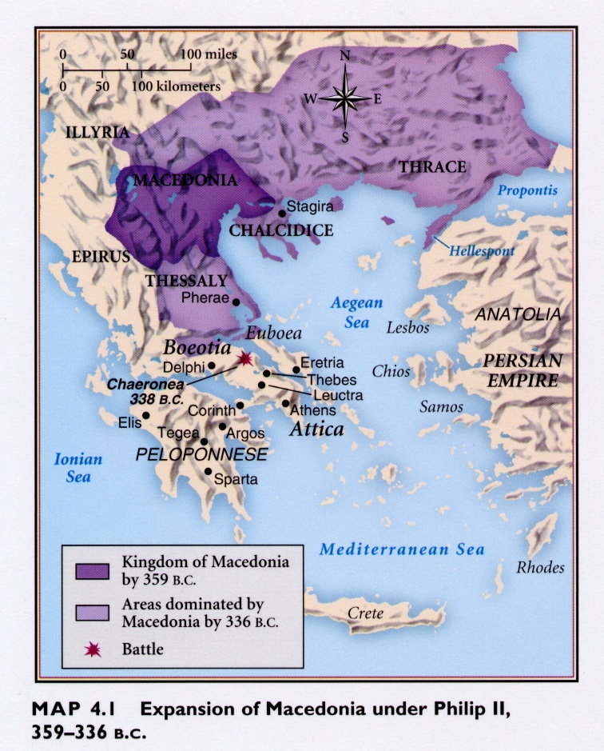

Slide 13
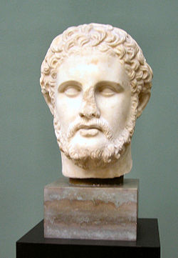
Philip II of Macedon r. 359-336 B.C.E.

Slide 14
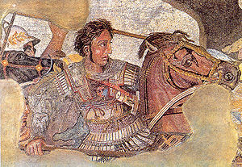
Alexander the Great r. 336-323

Slide 15
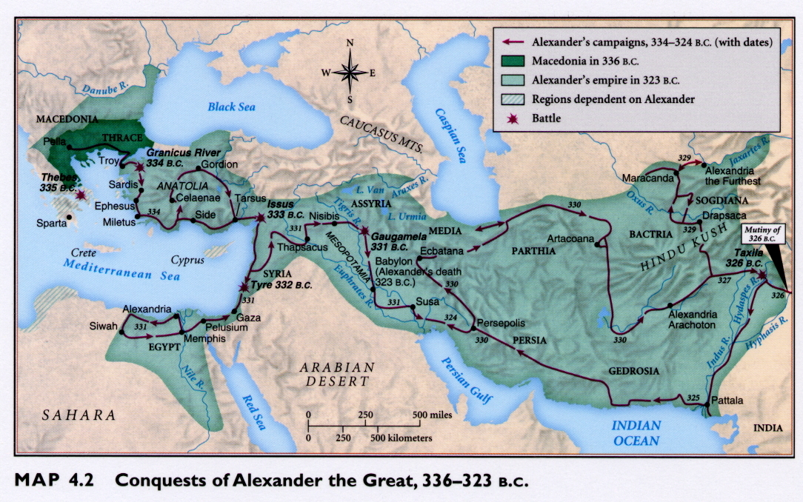

Slide 16
