Slide 1
APWH Period 2: Organization and Reorganization of Human Societies, c. 600 BCE to 600 CE Textbook Part II: The Classical Period – Uniting Large Regions, 1000 B.C.E. – 500 C.E
Chapter 3: Classical India

Slide 2
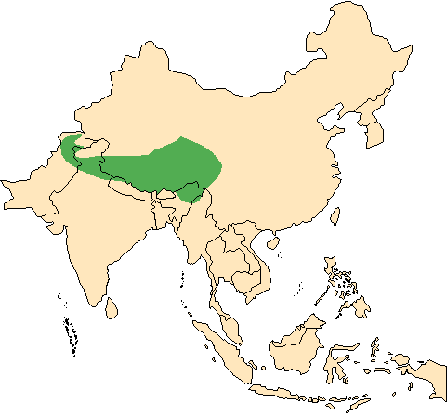
Himalayan Mountains

Slide 3
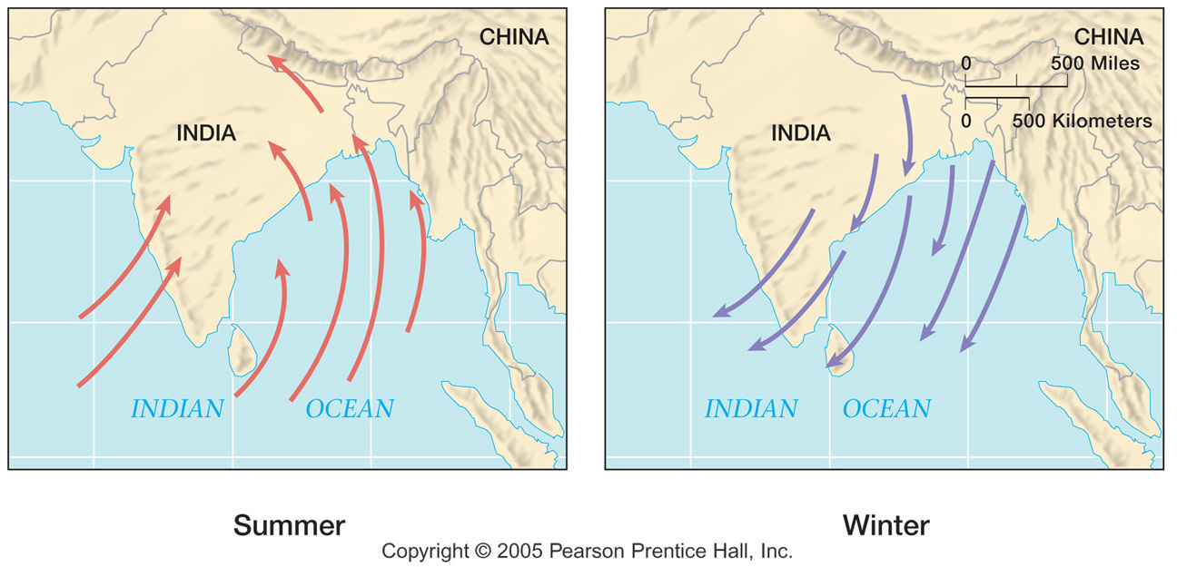
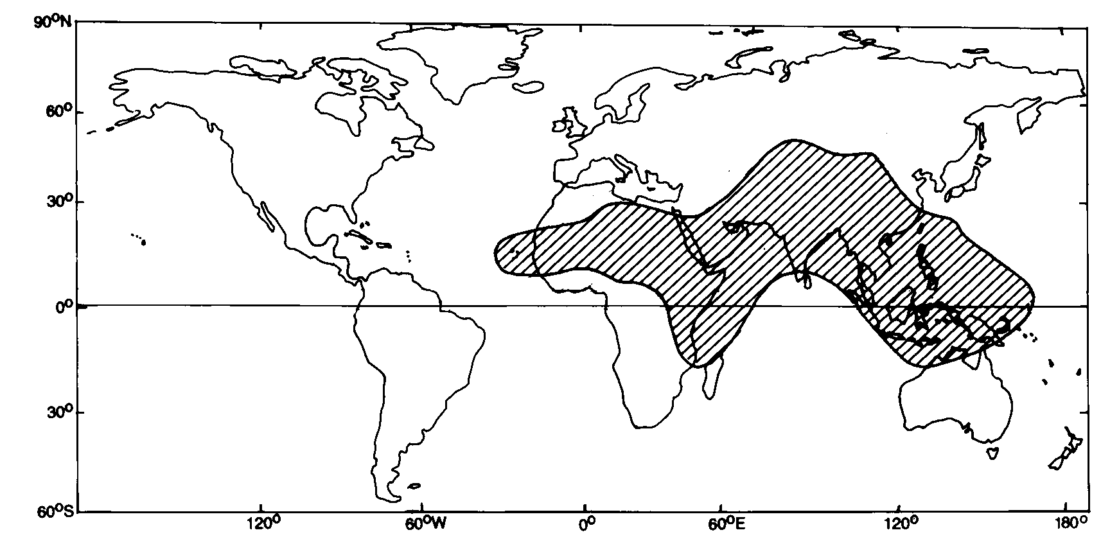
Monsoon Winds

Slide 4
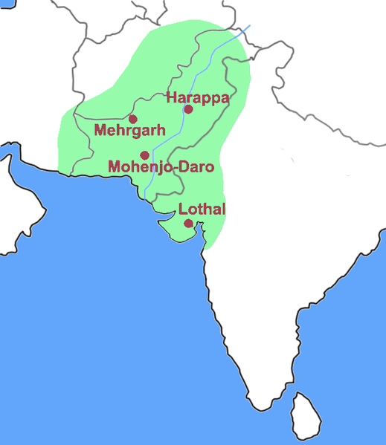
Indus River Valley

Slide 5
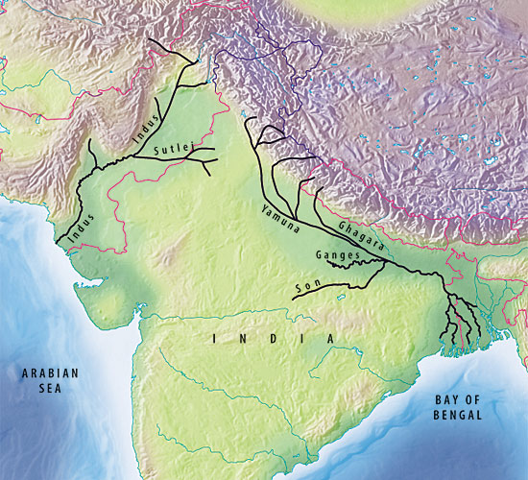
Ganges River Valley

Slide 6
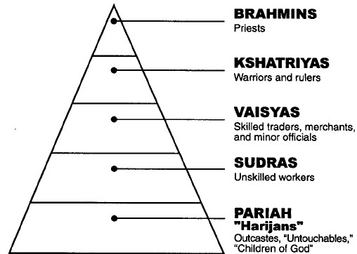

Slide 7
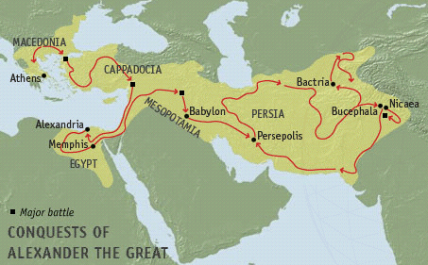
AtG’s Border State of Bactria

Slide 8
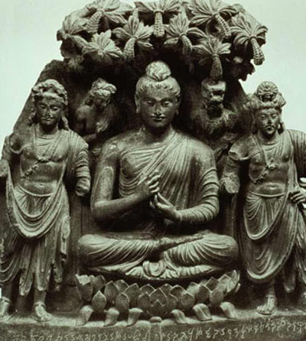
Chandragupta Maurya r. 322-298 B.C.E.

Slide 9
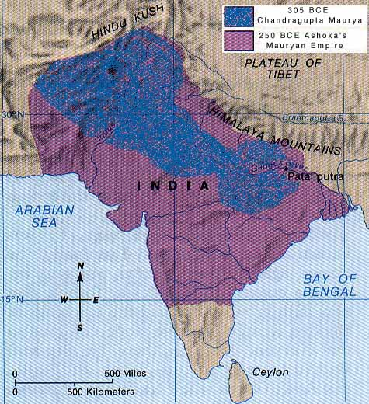

Slide 10
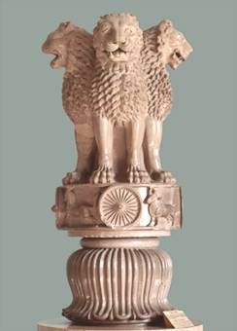
Royal Sign for Ashoka r. 269-232 B.C.E.

Slide 11
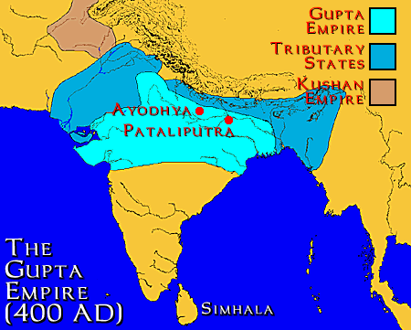

Slide 12
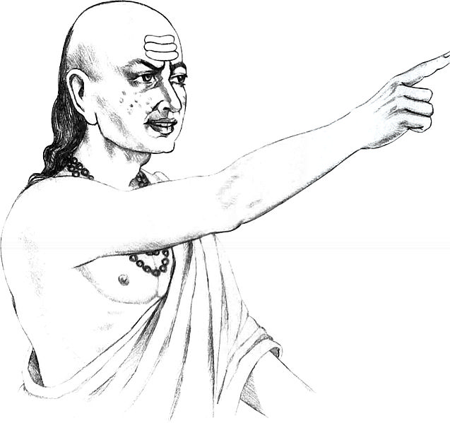
Kautilya (Chankya) Chief Minister under Chandragupta

Slide 14
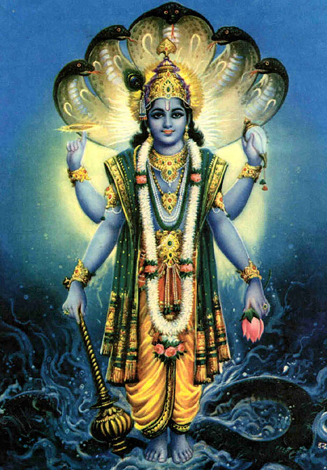
Vishnu The Preserver

Slide 15
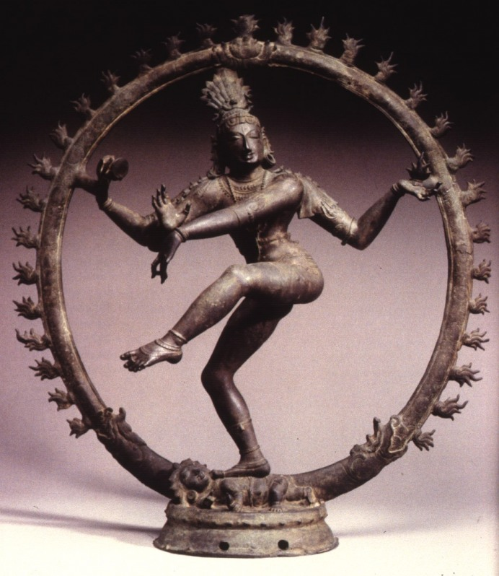
Shiva The Destroyer

Slide 16
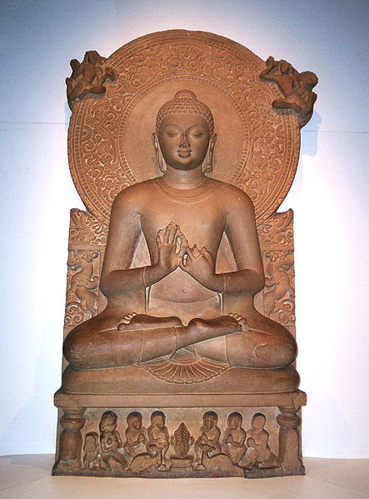
Buddha (Siddhartha Gautama) 564-483 B.C.E.

Slide 17
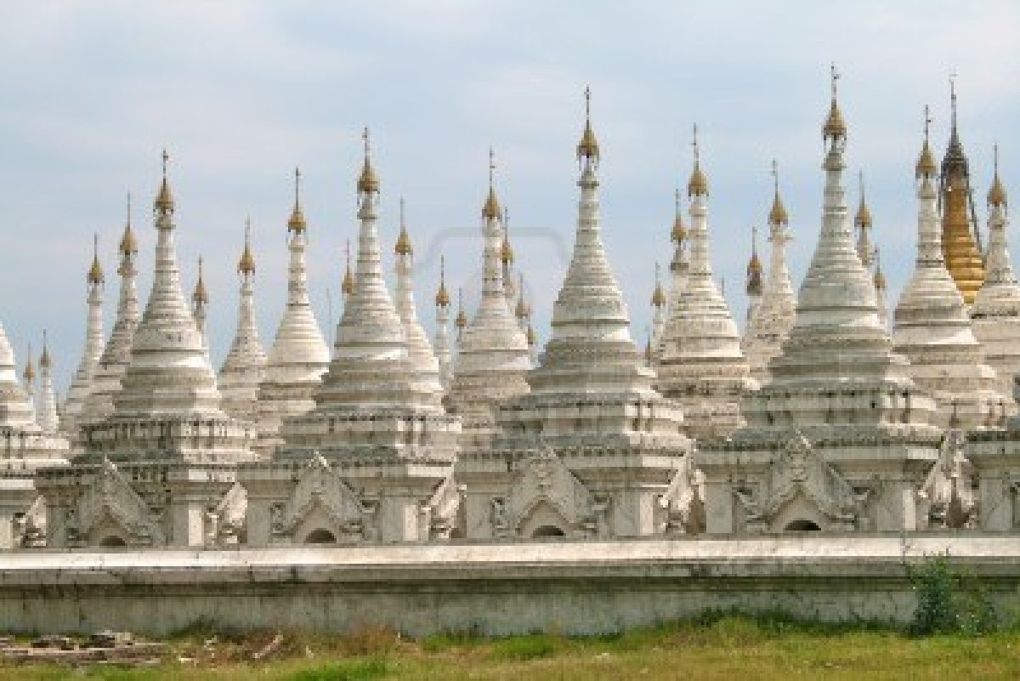
Stupas

Slide 18
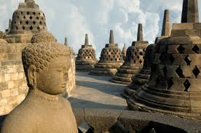
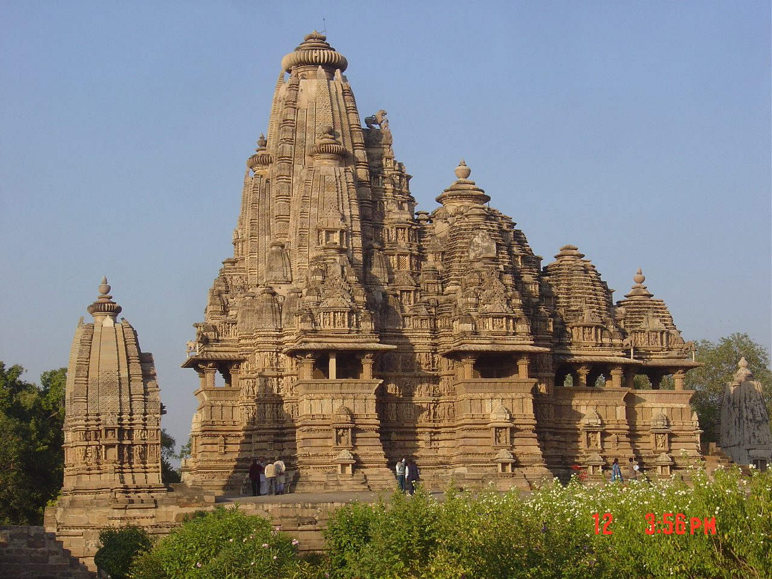

Slide 19
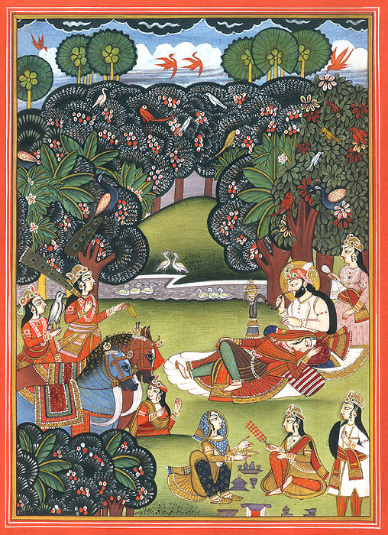
Indian Art

Slide 20
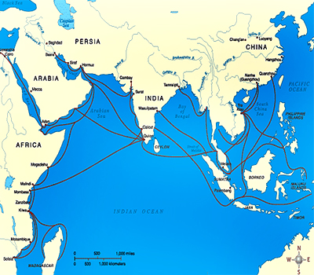
Indian Ocean Trade Network

