Slide 1
APWH Period 6: Accelerating Global Change and Realignments, c. 1900 to Present
Textbook Part VI: The World’s Newest Stage of World History, 1914-Present
Chapter 28: Descent into the Abyss: World War I and the Crisis of the European Global Order

Slide 2
The Coming of the Great War

Slide 3
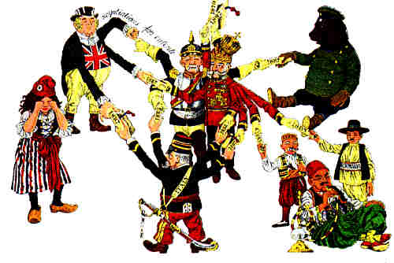
Political Cartoon of Entangling Alliances

Slide 4
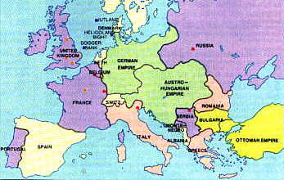
Europe in 1914

Slide 5
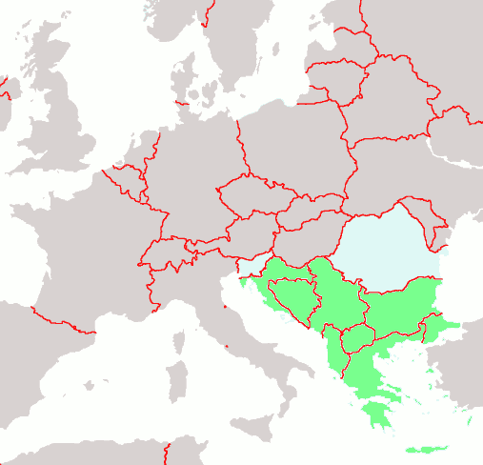
The Balkans
(in green).

Slide 6
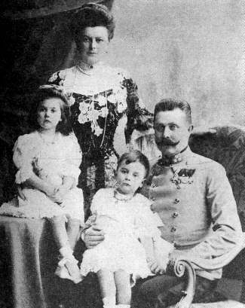
Archduke Franz Ferdinand, Countess Sophie Chotek and their children

Slide 7

In 1908 Austria-Hungary annexed Bosnia-Herzegovina. Pan-Slavists wanted to unite all areas containing Serbians. The Black Hand was formed in 1911 in order to further this goal.

Slide 8
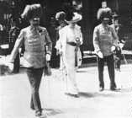
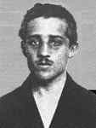
The Fateful Couple and the Assassin, Gavrilo Princip

Slide 9
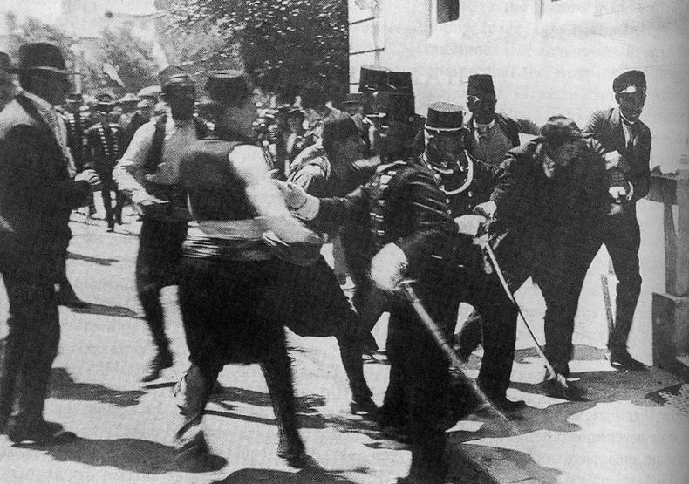
Gavrilo Princip being arrested, 1914.

Slide 10
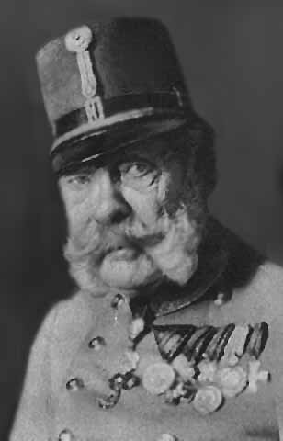
Franz Joseph I - Emperor of Austria, King of Bohemia and King of Hungary.
He was 84 when Franz Ferdinand was killed.

Slide 11
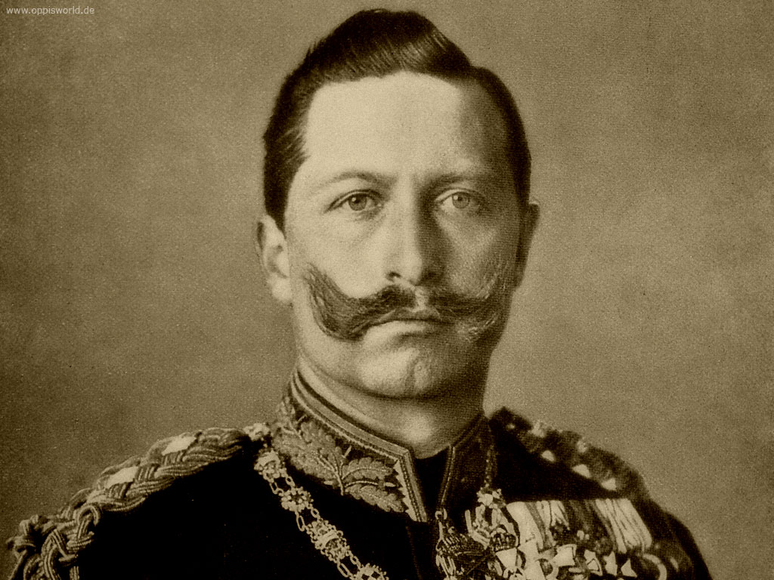
Kaiser Wilhelm II, Germany’s Emperor

Slide 12
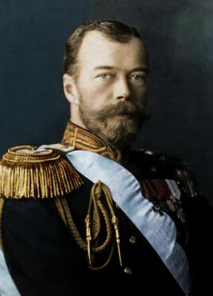
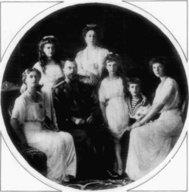
Czar Nicholas II of Russia and his Family

Slide 13
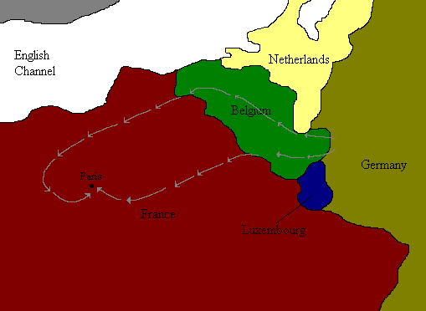
The Schlieffen Plan

Slide 14
Europe in 1914
A 2-Front War

Slide 15
The Key Players in WWI
Central Powers | Allied Powers
Germany | Russia
Austria-Hungary | Serbia
Ottoman Empire | France
Bulgaria | Great Britain
 | USA
 | Italy

Slide 16
A World at War

Slide 17
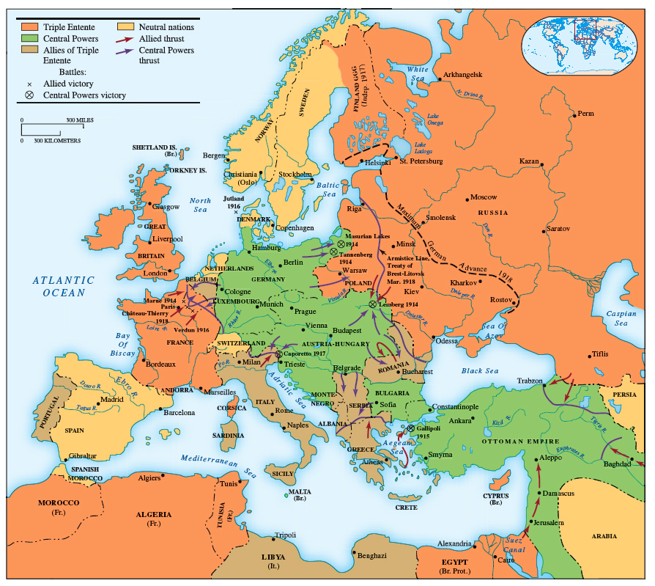

Slide 18
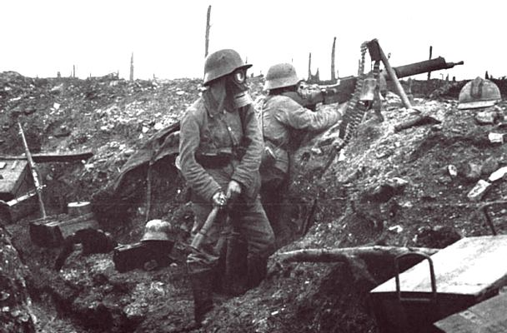
The Horrors of Trench Warfare

Slide 19
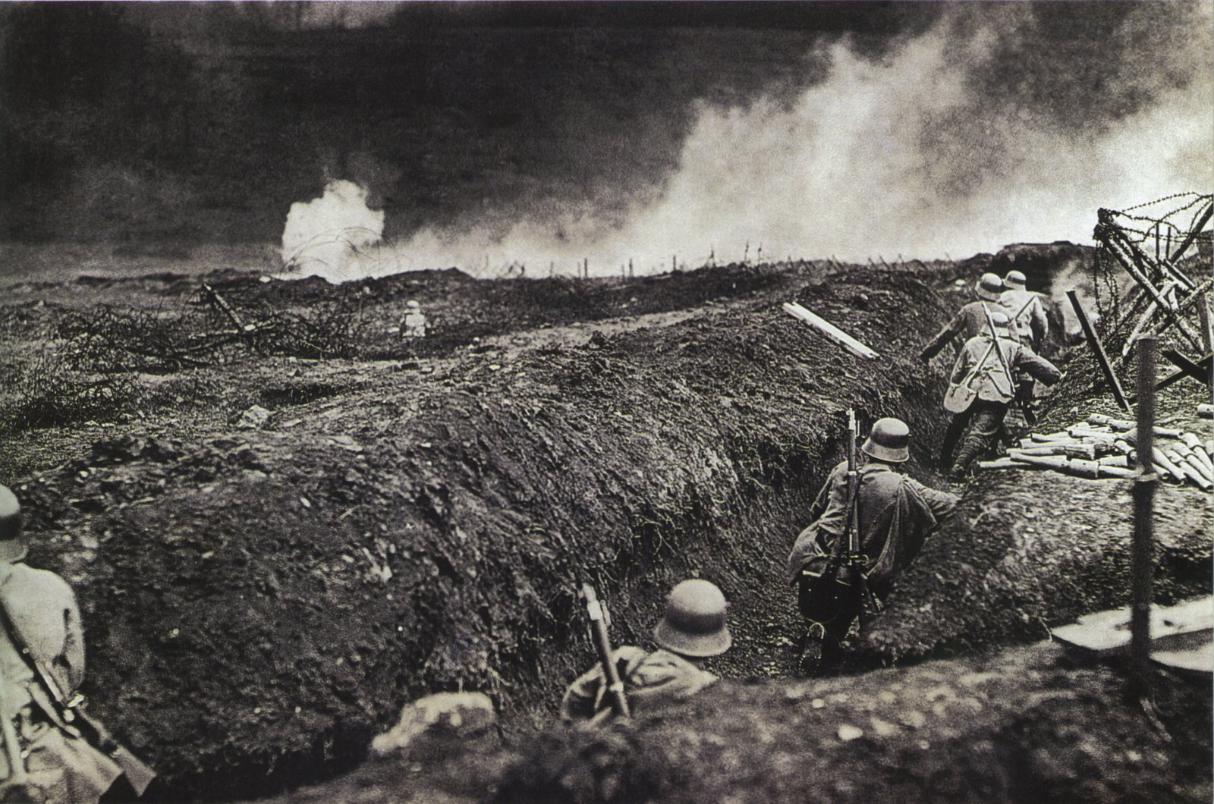

Slide 20
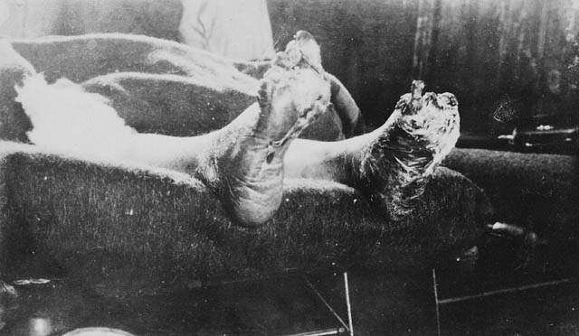
WWI Soldier with Trench Foot - France, 1917.

Slide 21
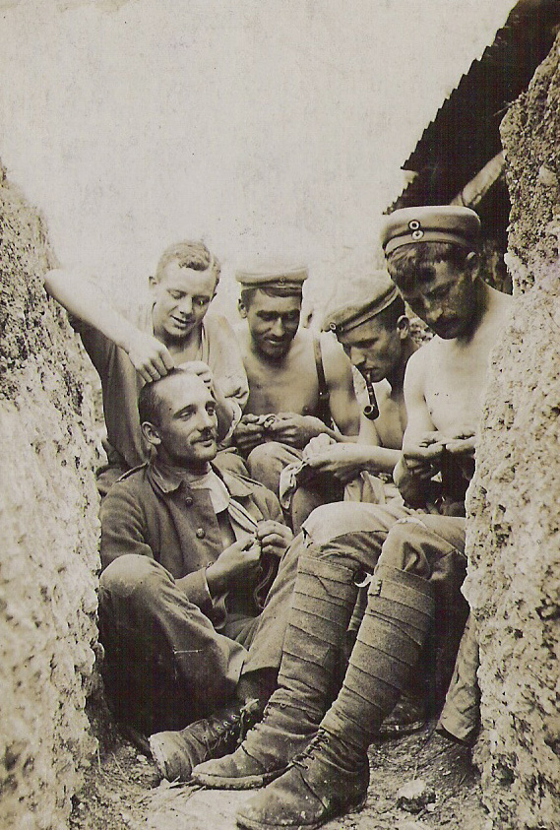
Lice were a serious problem in the trenches.

Slide 22
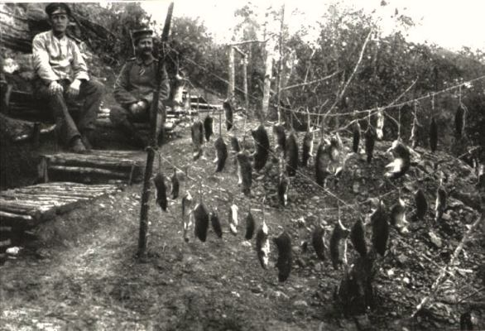
So were rats.

Slide 23
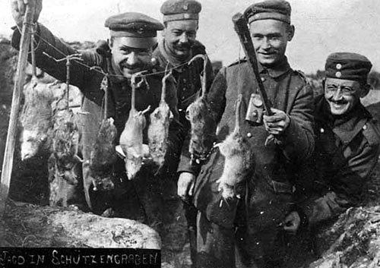

Slide 24
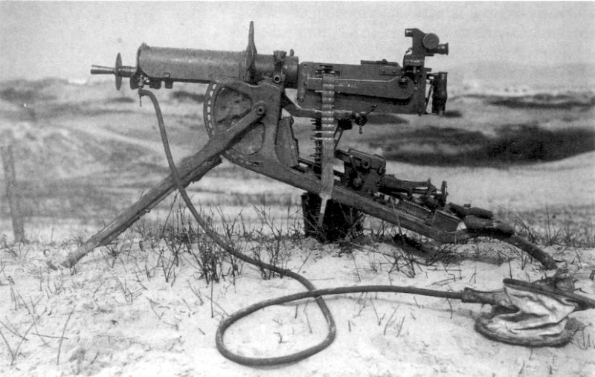
Modern Technology
Maschinengewehr ’08, A German Rapid-Fire Machine Gun

Slide 25
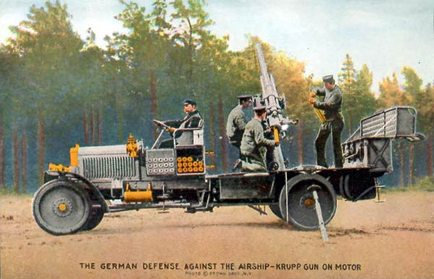
German Anti-Aircraft gun.

Slide 26
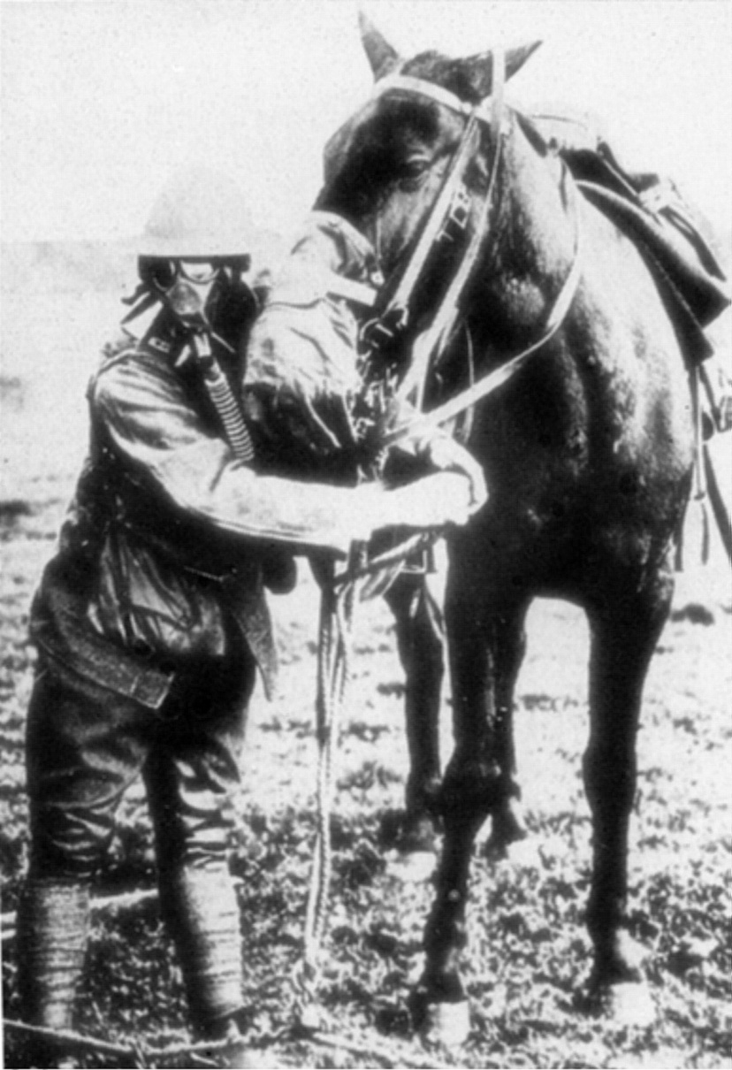
Man and horse, both with gasmasks.

Slide 27
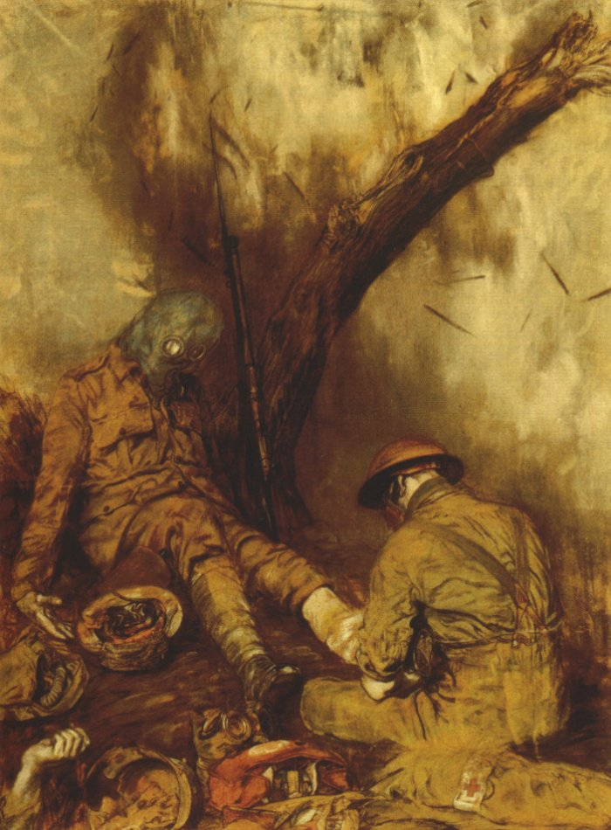
Dressing the Wounded during a Gas Attack, by Austin Spare (1918).

Slide 28
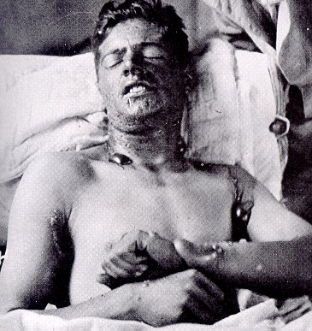
Mustard Gas burns.

Slide 29
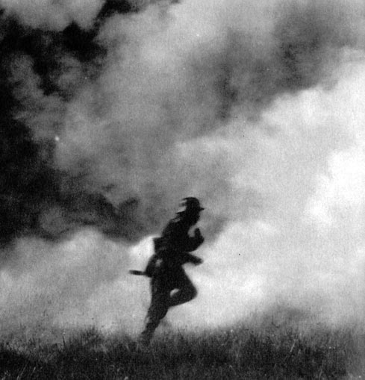

Slide 30
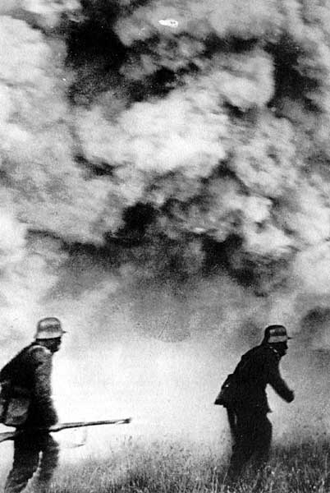

Slide 31
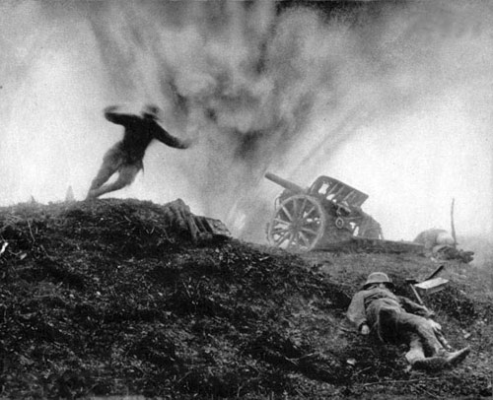

Slide 32
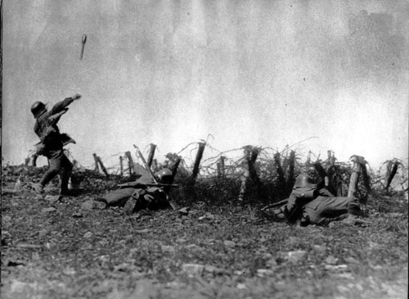

Slide 33
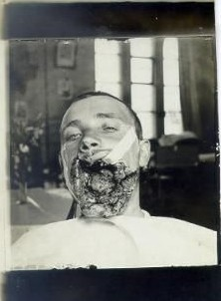
Grenade wound.

Slide 34
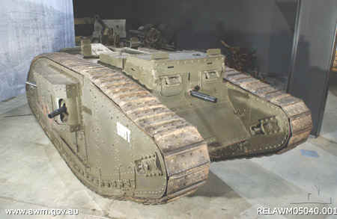
WWI British Armored Tank

Slide 35
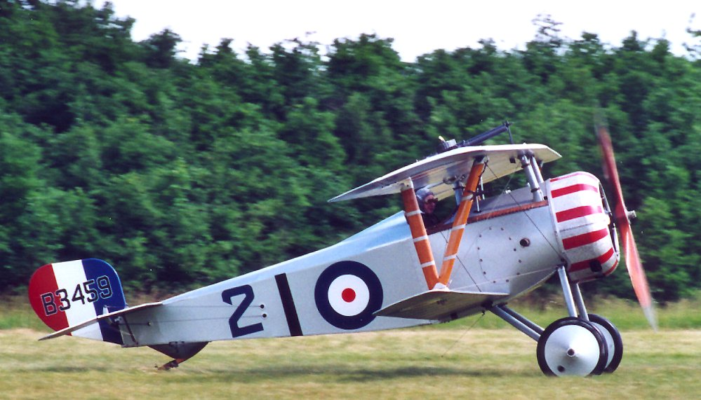
French Nieuport 17

Slide 36
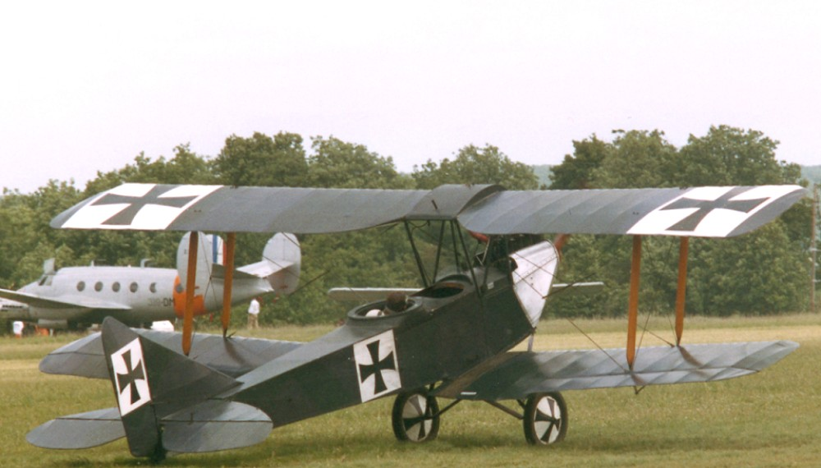
German Albatross

Slide 37
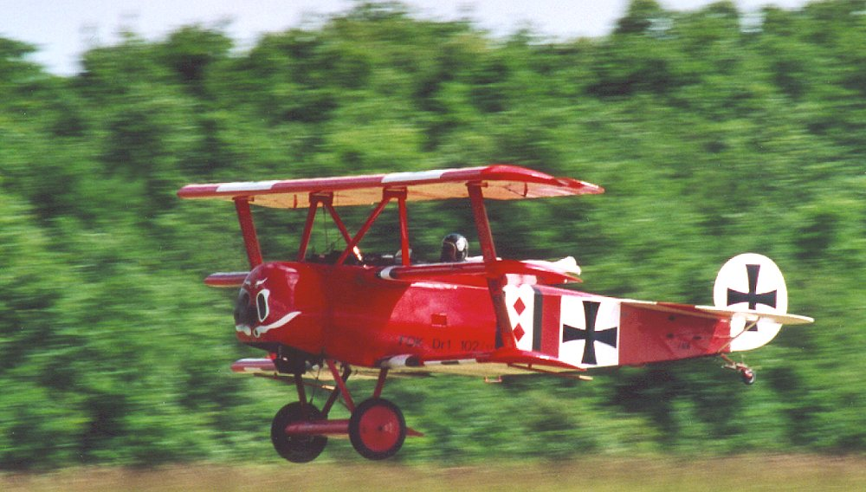
German Fokker Dr. I

Slide 38
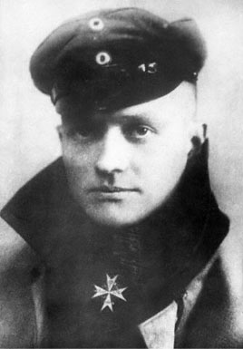
Manfred von Richthofen
“The Red Baron”
Shot down 80 planes.

Slide 39
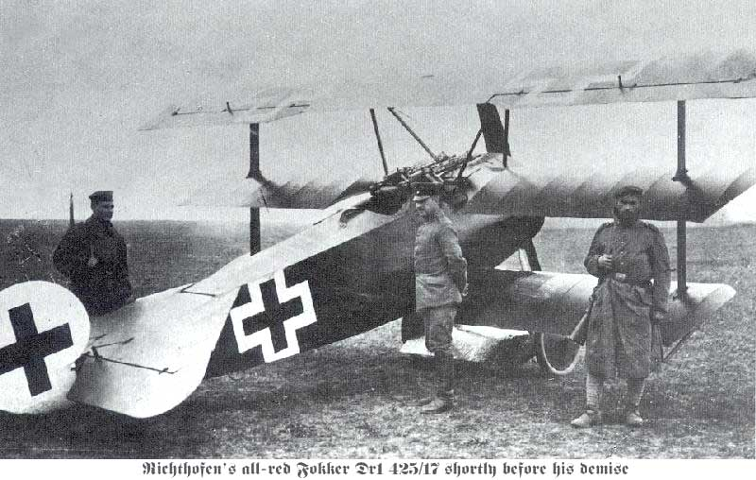
The Red Baron’s Fokker Tri-plane.

Slide 40
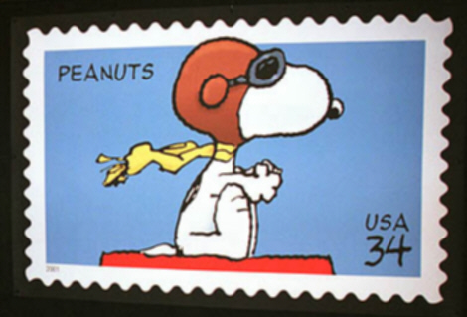
Snoopy fighting the Red Baron

Slide 41
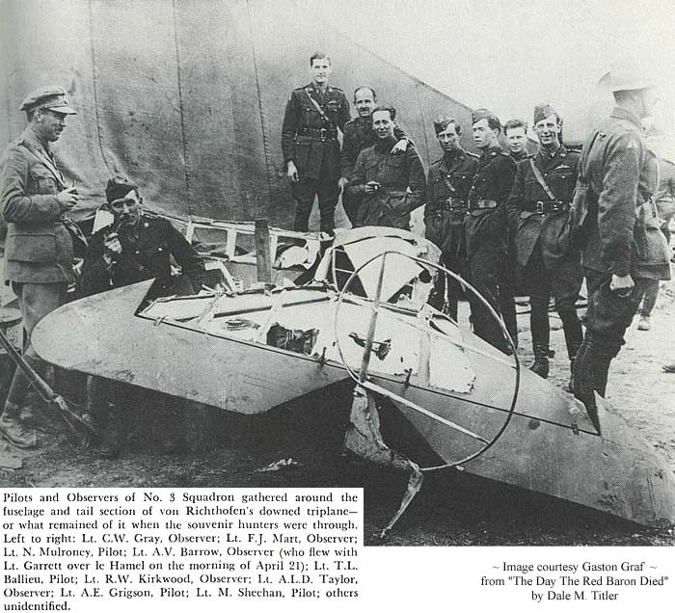
The wreckage of the Red Baron’s Plane

Slide 42
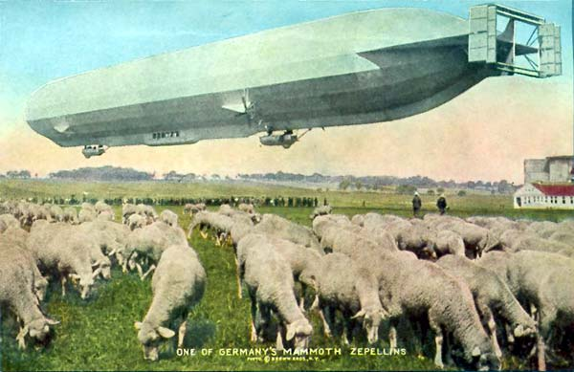
Zeppelins were used during WWI.

Slide 43
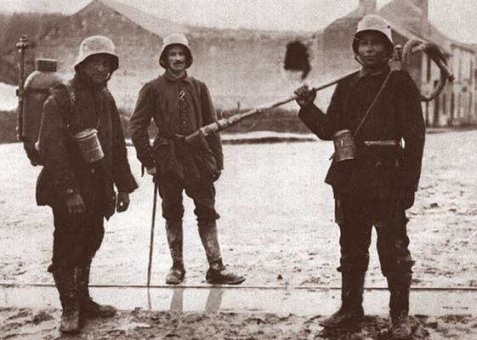
Flamethrower

Slide 44

German U-Boat
UC 44 Class U-boat:
1) Aft torpedo tubes
2) Electric motor
3) Main engine
4) Control room
5) Mine tubes
6) Forward torpedo tubes
7) Crew quarters

Slide 45
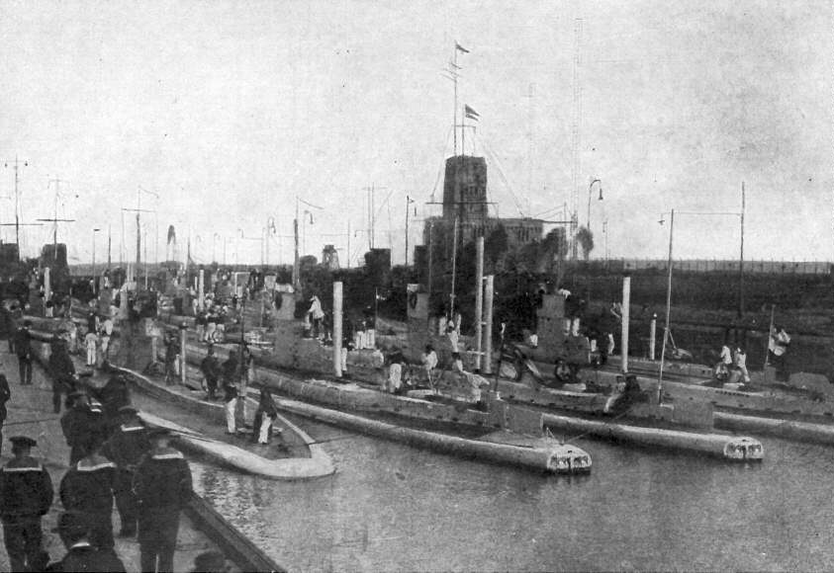

Slide 46
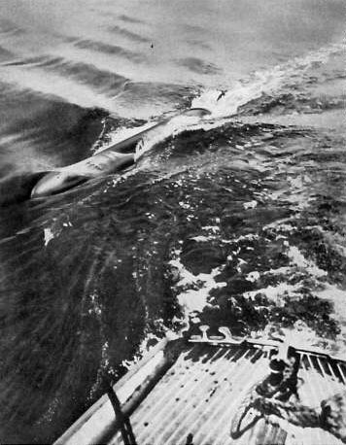
A German torpedo narrowly misses a ship.

Slide 47
The Home Fronts

Slide 48
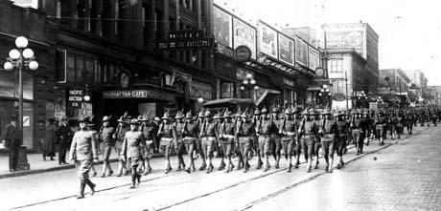
Total War
Liberty Bond Drive and Parade

Slide 49
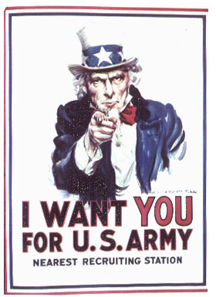
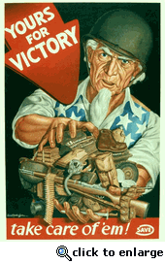
Propaganda: Recruitment Posters

Slide 50
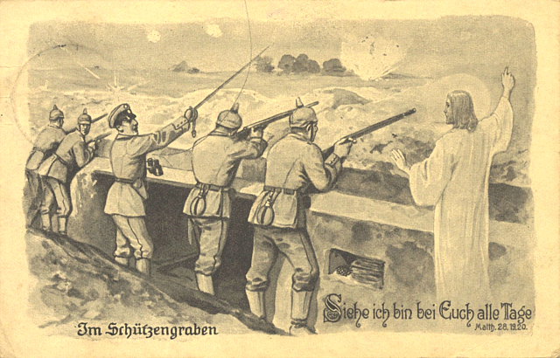
German Perspective

Slide 51
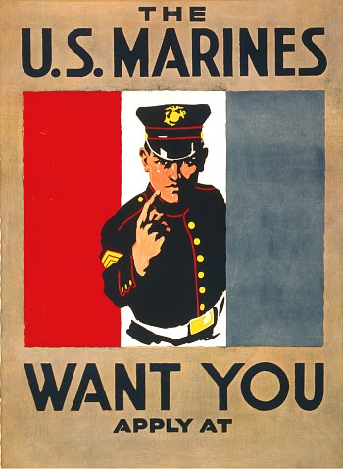
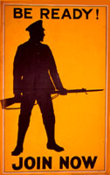

Slide 52
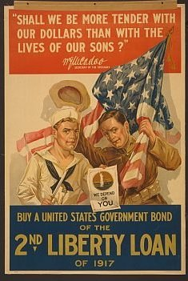
The Call to Buy Liberty Bonds

Slide 53
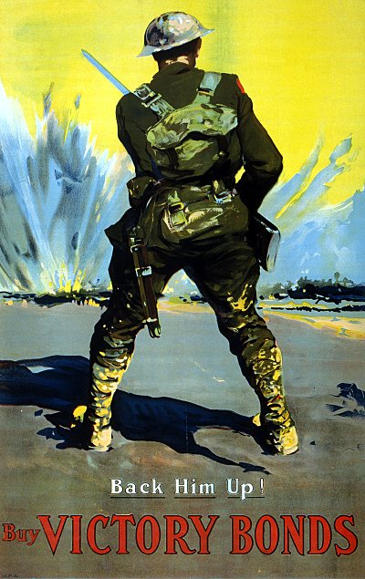

Slide 54
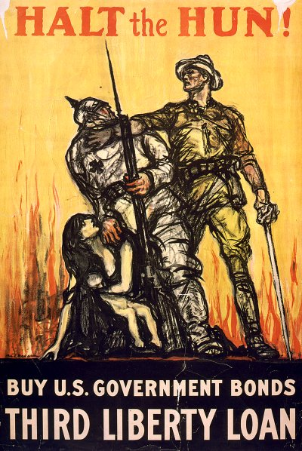
The Germans were known as “The Huns”

Slide 55

The Whole Family Gets Involved

Slide 56

Growing Victory Gardens to Help those Doughboys

Slide 57


Slide 58


Slide 59

Women Answer the Call

Slide 60



Slide 61



Slide 62
The War Beyond Europe

Slide 63


Slide 64


Slide 65

Troops from Senegal, 1917.

Slide 66


Slide 67


Slide 68


Slide 70
A Failed Peace
AKA – The “Peace to End all Peace”

Slide 71

French Premier Georges Clemenceau

Slide 72

President Woodrow Wilson of the United States

Slide 73

British Prime Minister, David Lloyd George

Slide 74

Mandates
1. Syria, 2. Lebanon, 3. Palestine, 4. Transjordan,
5. Mesopotamia, 6. British Togoland, 7. French Togoland, 8. British Cameroons, 9. French Cameroun, 10. Ruanda-Urundi, 11. Tanganyika and 12. South-West Africa

Slide 75


Slide 76
The Nationalist Assault on the European Colonial Order

Slide 77

B. G. Tilak
1856-1920

Slide 78

Mohandas Gandhi
1868-1948

Slide 79

Lord Cromer
1841-1917

Slide 80

Republic of Turkey

Slide 81

Mustafa Kemal, AKA Atatürk
“Father of the Turks”

Slide 82


Slide 83


Slide 84


Slide 85

Hussein
Sharif of Mecca 1908 – 1917

Slide 87

Leon Pinsker
1821-1891

Slide 88

Alfred Dreyfus
1859-1935

Slide 89

Theodor Herzl
1860-1904

Slide 90

Sa’d Zaghlul
1857-1927

Slide 91


Pan-Africanism
Marcus Garvey and W.E.B. Dubois

Slide 92


Négritude
Langston Hughes Léopold Senghor

