Slide 1
APWH Period 4: Global Interactions, c. 1450 to 1750 Textbook Part IV: The Early Modern Period, 1450-1750: The World Shrinks
Chapter 22: Asian Transitions in an Age of Global Change

Slide 2
Europeans and the Asian Trading World

Slide 3
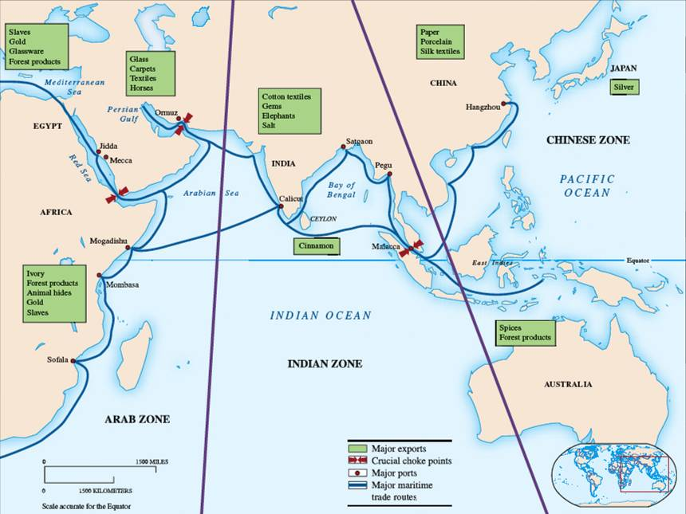

Slide 4
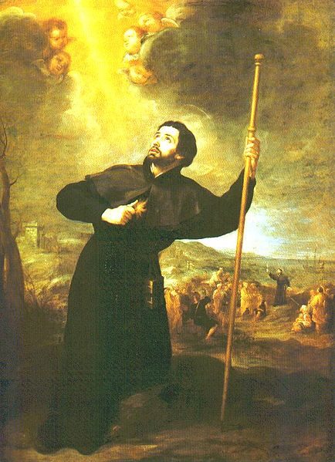
Saint Francis Xavier 1506-1552

Slide 5
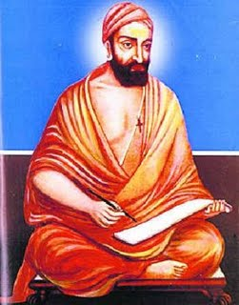
Robert di Nobili 1577-1656 (Roberto de Nobili)

Slide 6
Ming China

Slide 7
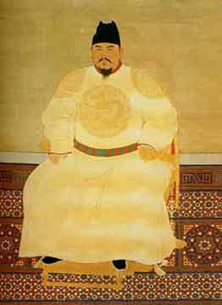
Ju Yuanzhang Later, Hongwu r.1368-1398

Slide 8
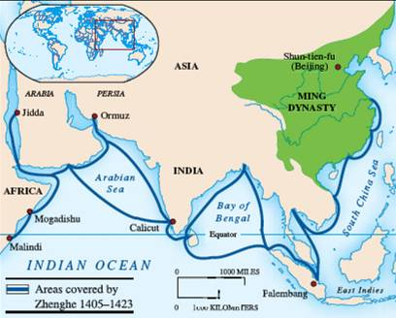

Slide 9
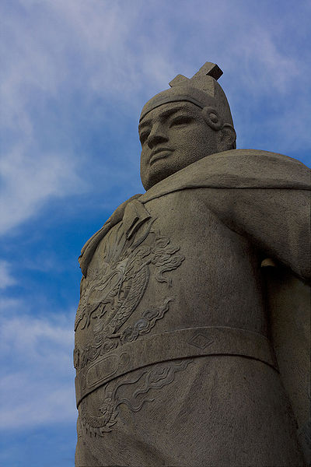
Zhenghe 1371-1433

Slide 10
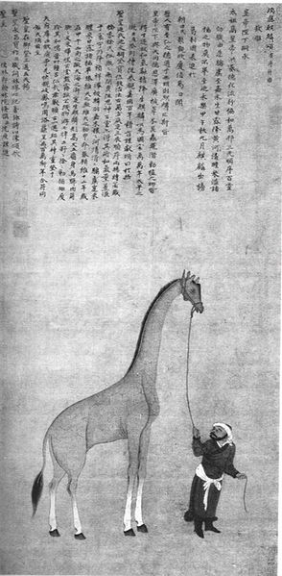
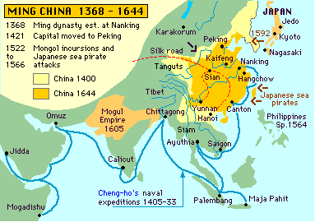
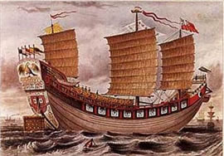

Slide 11
Japan: Reunification and the European Challenge

Slide 12
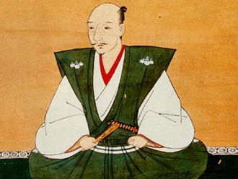
Nobunaga 1534-1582

Slide 13
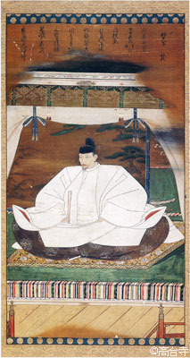
Toyotomi Hideyoshi 1536-1598

Slide 14
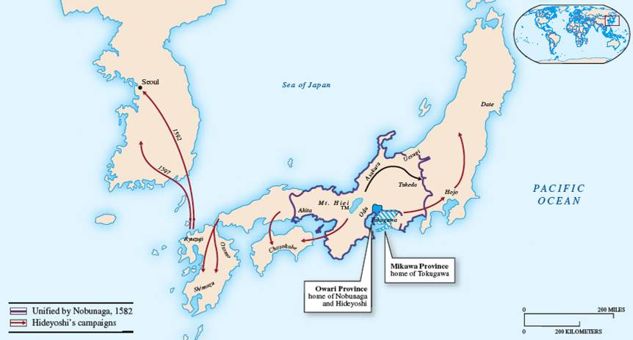

Slide 15
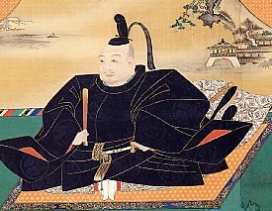
Tokugawa Ieyasu in power 1603-1616

