Slide 1
APWH Period 4: Global Interactions, c. 1450 to 1750 Textbook Part IV: The Early Modern Period, 1450-1750: The World Shrinks
Chapter 20: Africa During the Atlantic Slave Trade

Slide 2
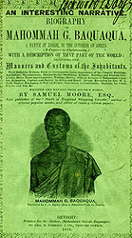
Mahommah Gardo Baquaqua

Slide 3
The Atlantic Slave Trade

Slide 4
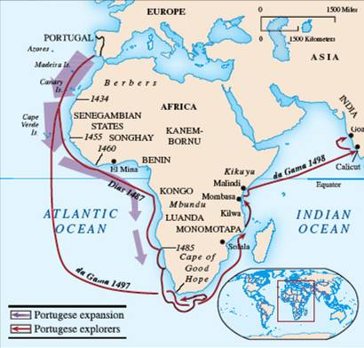

Slide 5
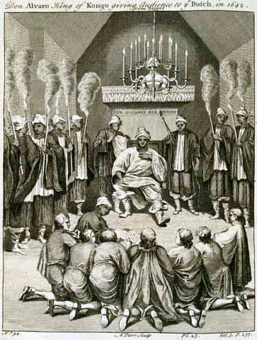
Nzinga Mvemba Portuguese: Alfonso I r. 1509-1542 or 1543

Slide 6
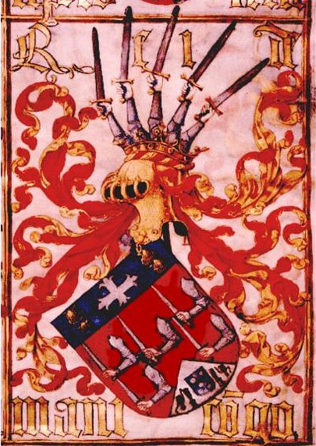
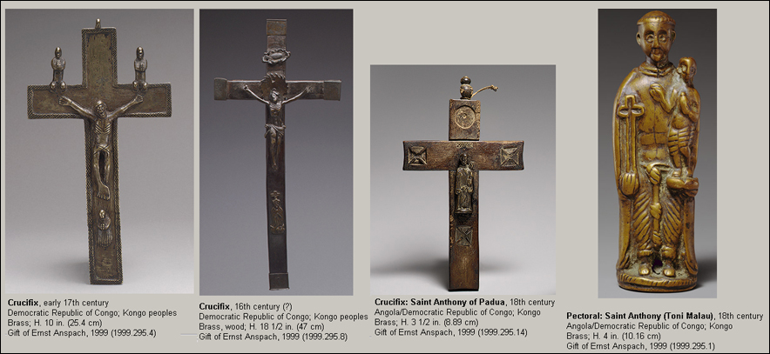
European influences on Kongo

Slide 7
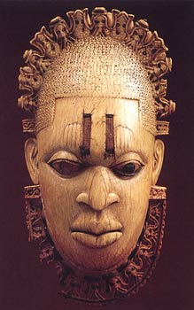
European influence on African Art A Benin monarch w/ European crown and collar

Slide 8
Slave Trade Exports

Slide 9
Slave Transport from Interior Africa

Slide 12
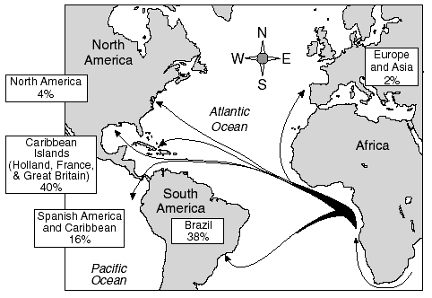

Slide 13
The Slave Trade’s Effects on African Societies

Slide 14
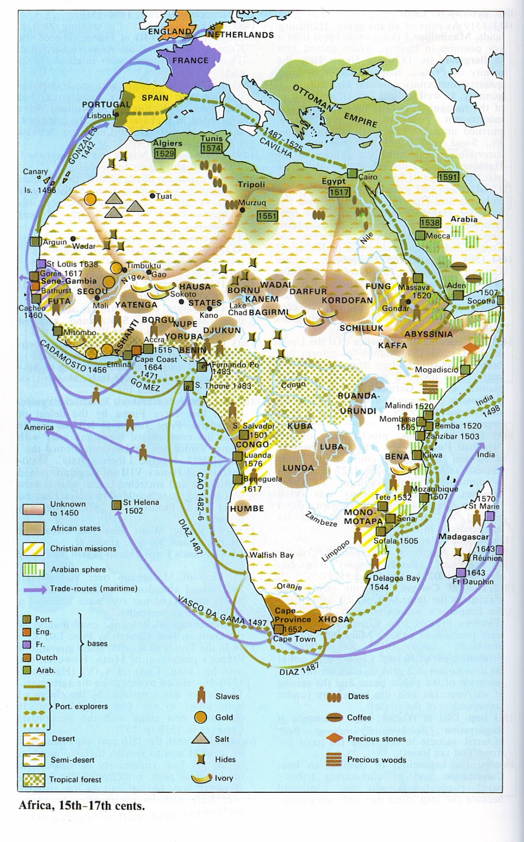
15th-17th Century Africa

Slide 15
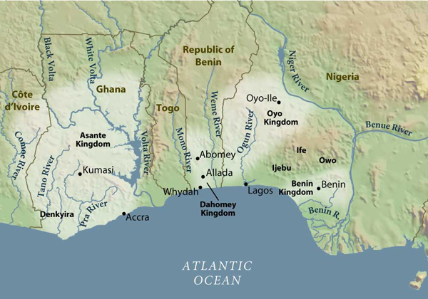

Slide 16
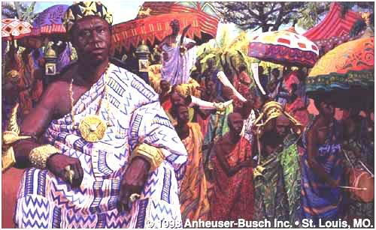
Osei Tutu I r. 1701-1717

Slide 17
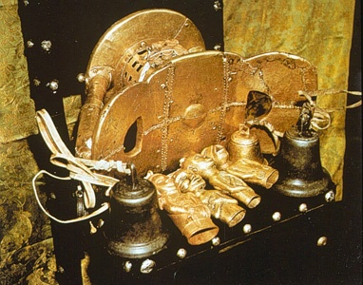
The Golden Stool – Seat of power and believed to be soul of Asante nation, living, dead and yet to be born

Slide 18
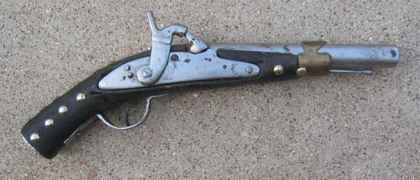
Asante Warrior Pistol

Slide 19
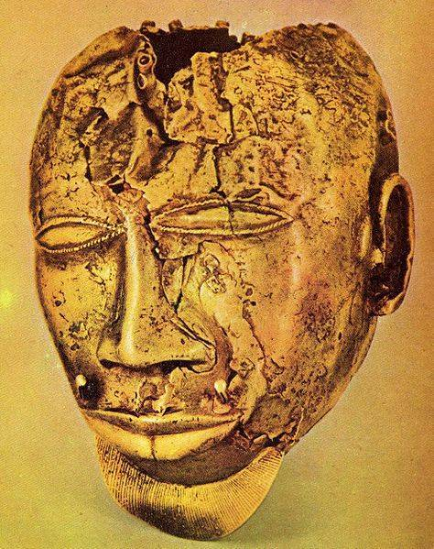
Asante Gold Mask

Slide 20
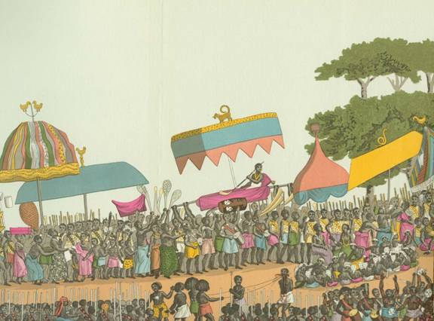
Traditional Asante Yam Harvest Festival as captured by European artists

Slide 22
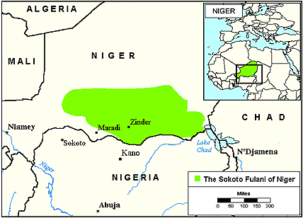
The Fulani Peoples form Sokoto

Slide 23
White Settlers and Africans in Southern Africa

Slide 24
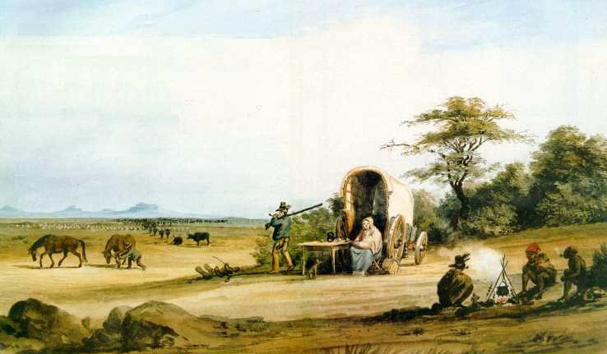
Boer Trekkers

Slide 25
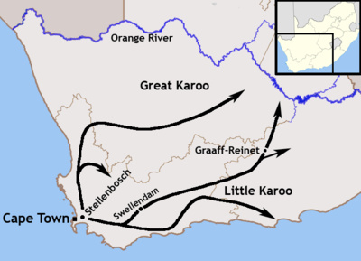
The Great Trek

Slide 26
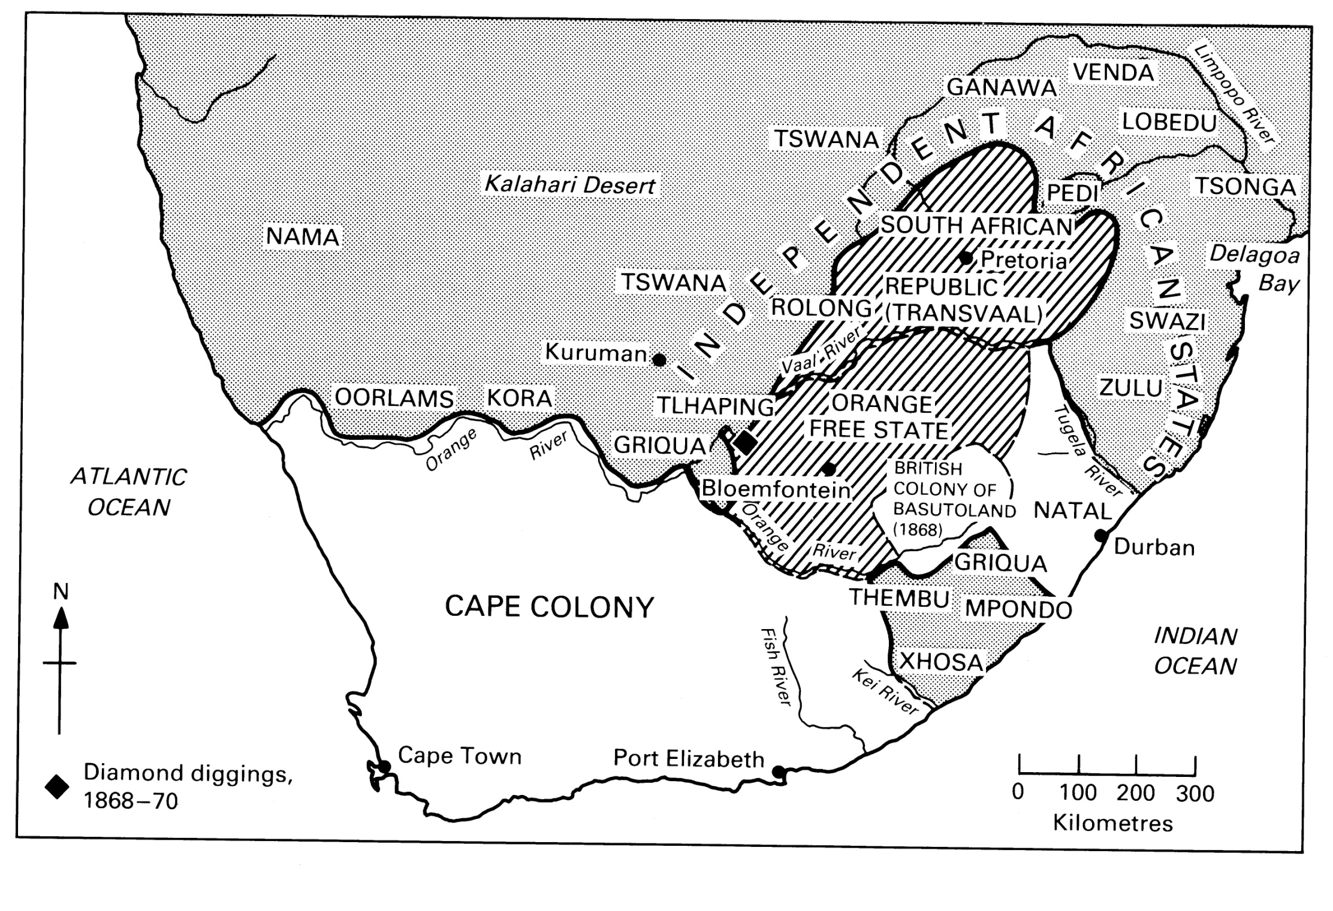
Rise of Zulu Kingdom

Slide 27
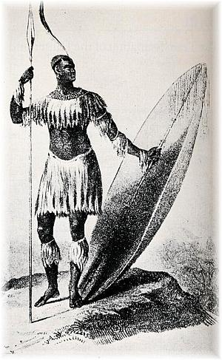
Sketch of Shaka Zulu r.1816-1828

Slide 28
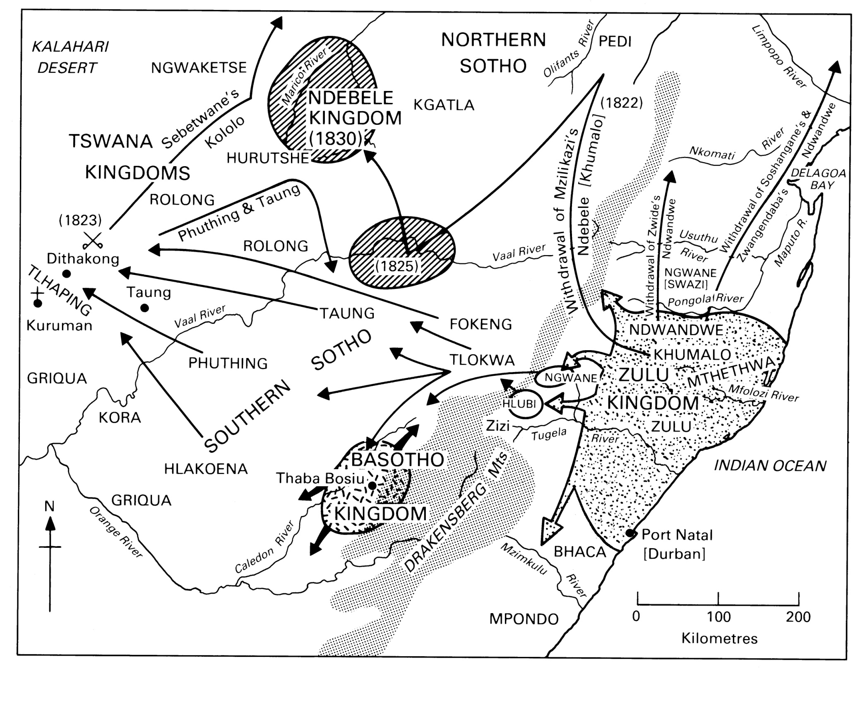

Slide 29
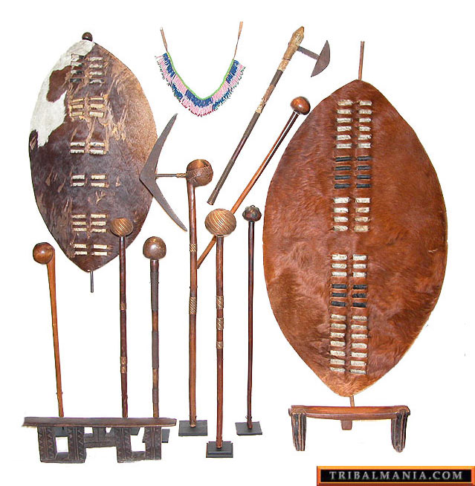
Zulu Weapons

Slide 30
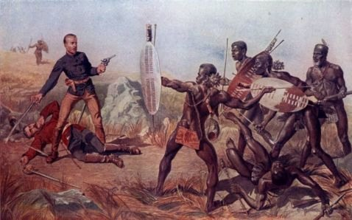
Zulu battles with Europeans

Slide 31
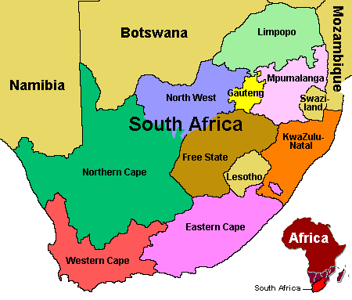
Swazi State and Lesotho

Slide 32
The African Diaspora

Slide 33
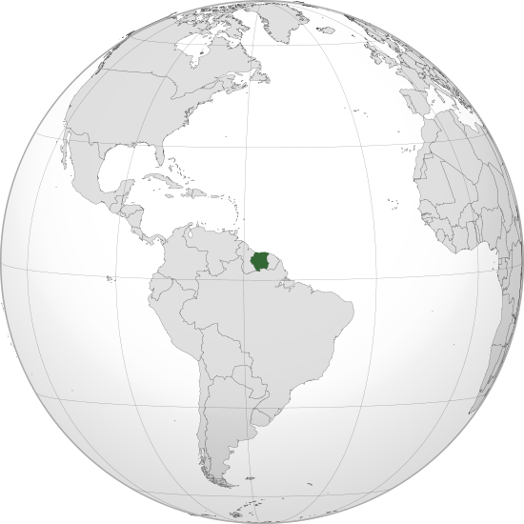
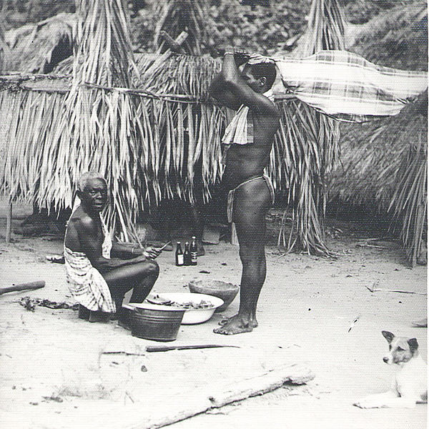
Suriname and Maroons

Slide 34
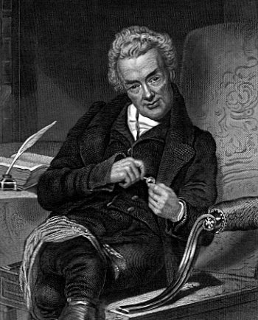
William Wilberforce British Abolitionist

Slide 35
Global Connections

