Slide 1
APWH Period 2: Organization and Reorganization of Human Societies, c. 600 BCE to 600 CE Textbook Part II: The Classical Period – Uniting Large Regions, 1000 B.C.E. – 500 C.E
Chapter 2: Classical China

Slide 2
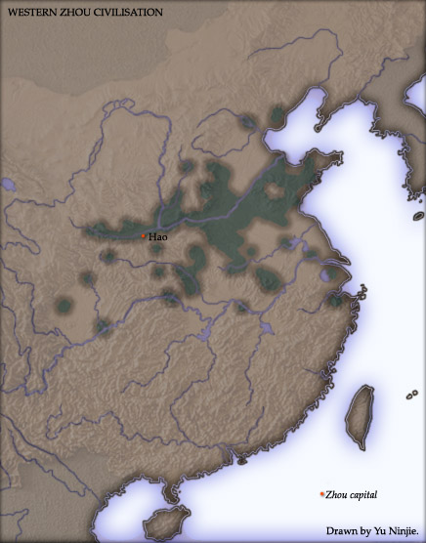
Zhou China 1029-258 B.C.E.

Slide 3
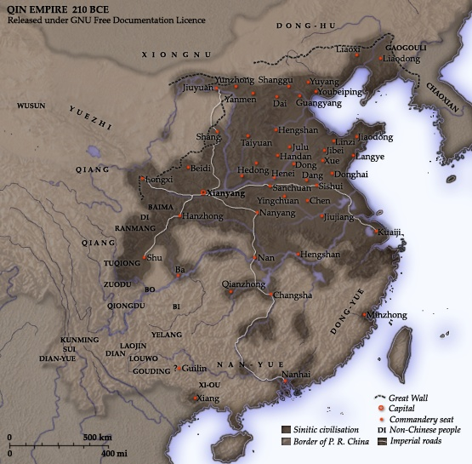
Qin China

Slide 4
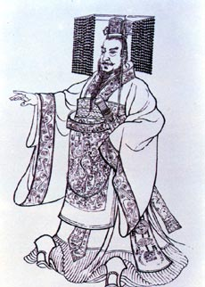
Qin Shi Huangdi r. 221-202 B.C.E.

Slide 5
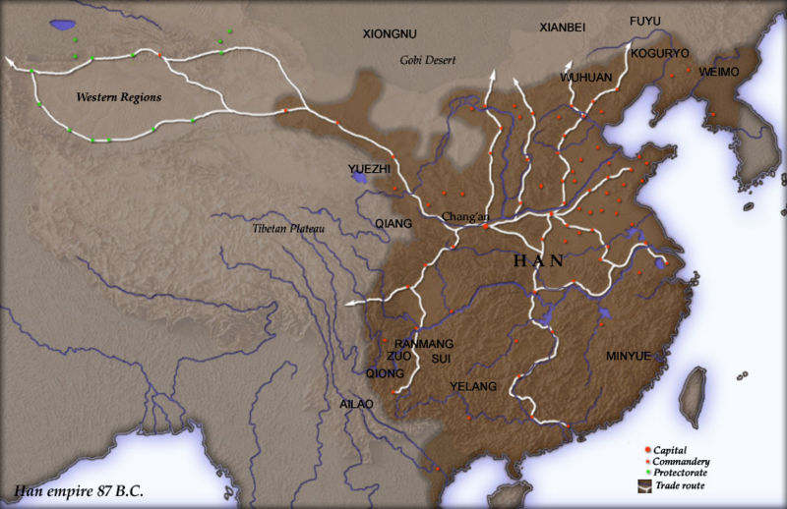
Han China

Slide 6
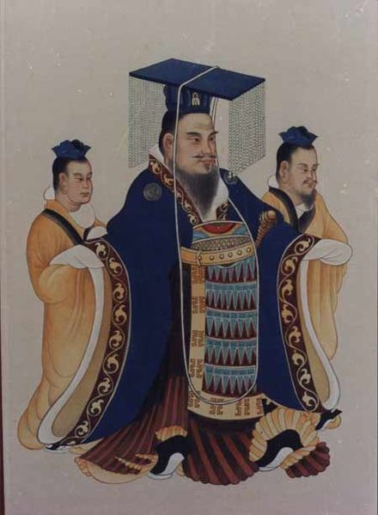
Han Wu Ti 141-87 B.C.E.

Slide 7
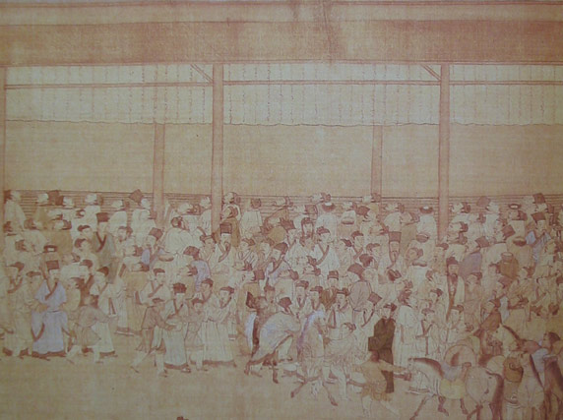
Civil Service Examinees

Slide 8
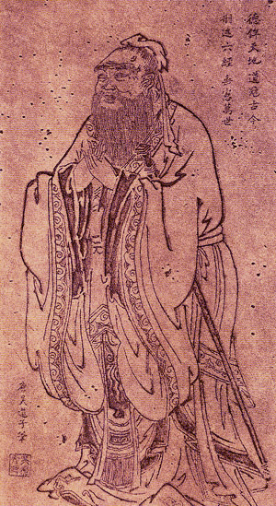
Confucius 551-478 B.C.E.

Slide 9
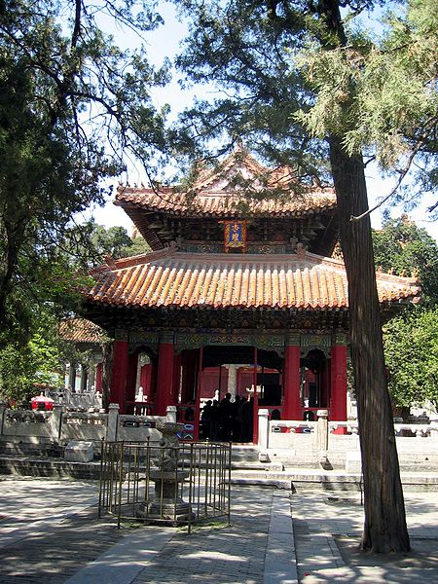
Confucian Temple at Qufu

Slide 10
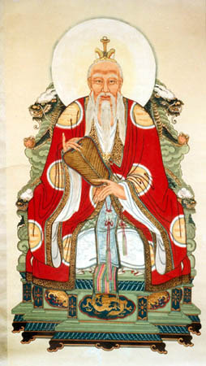
Laozi circa 5th century B.C.E

Slide 11
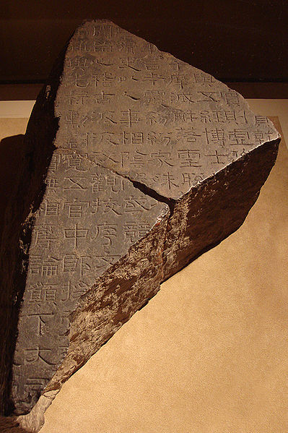
Stone Fragment of the Five Classics

Slide 12
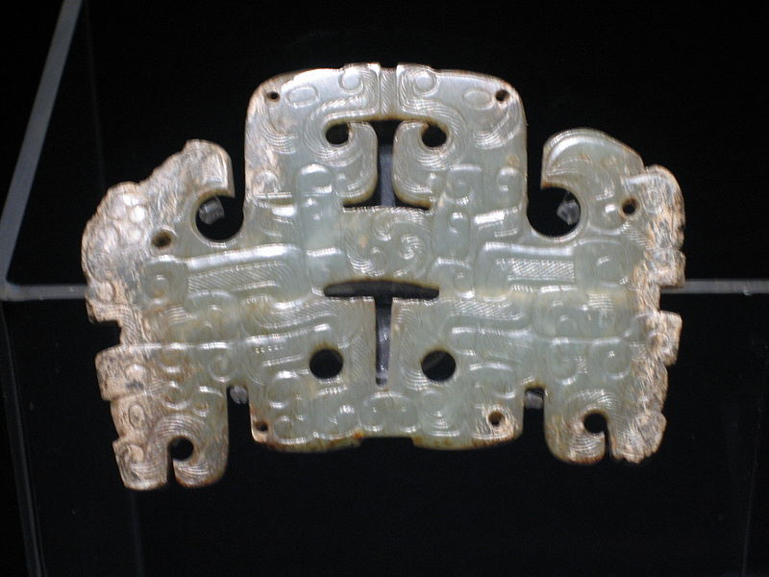
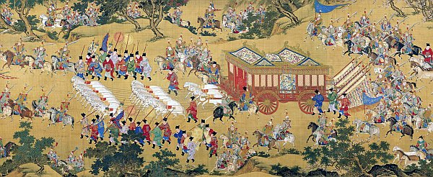
Classical Chinese Art
Phoenix and Dragon Ornament
and Silk Tapestry

Slide 13
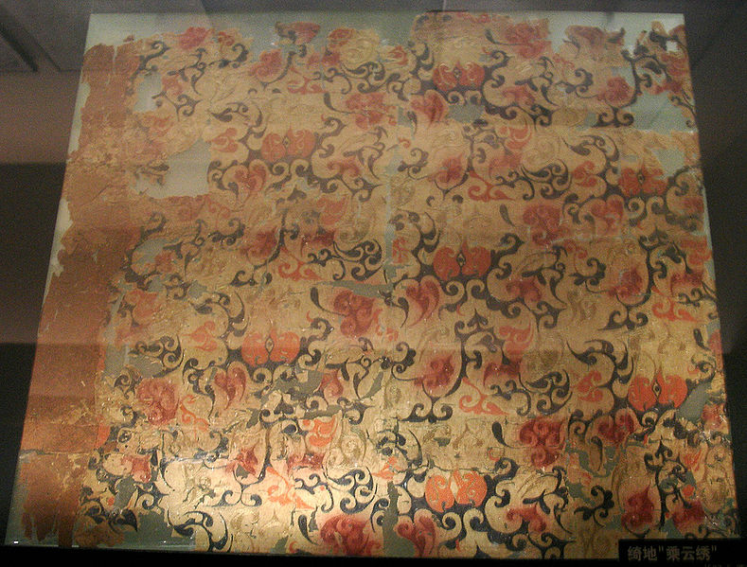
2nd Century B.C.E. Silk Tapestry

Slide 14
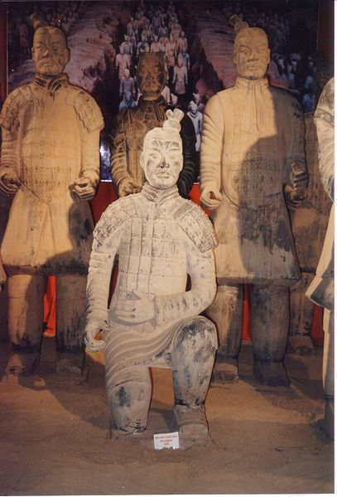
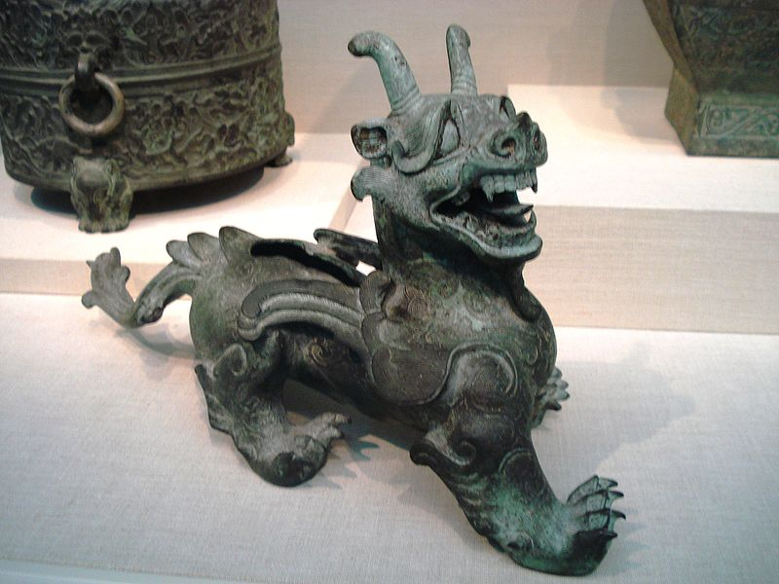
Qin Terracotta Soldier and Han Era Bronze Statue

Slide 15
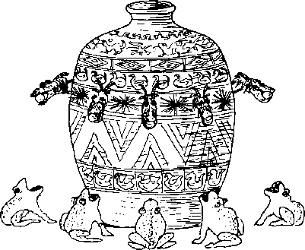
Chinese Seismograph

Slide 16
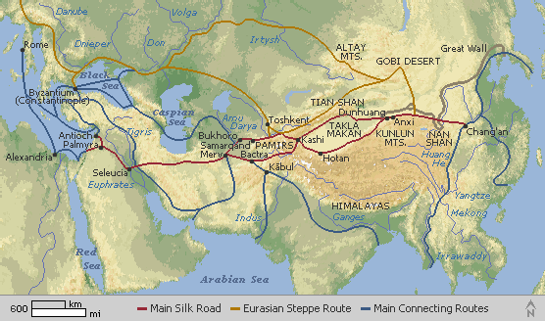
China’s Silk Road Network

