Slide 1
APWH Period 4: Global Interactions, c. 1450 to 1750 Textbook Part IV: The Early Modern Period, 1450-1750: The World Shrinks
Chapter 19: Early Latin America

Slide 2
The Spanish and Portuguese: From Exploration to Conquest

Slide 3
Ferdinand and Isabella

Slide 4
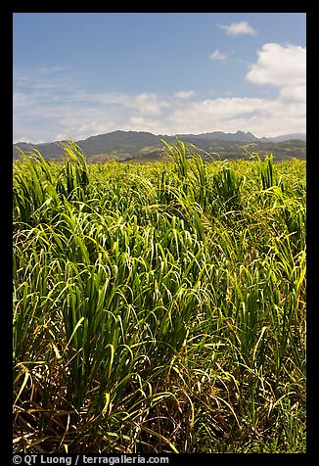
Sugar Cane Plantation in the Carribean

Slide 5
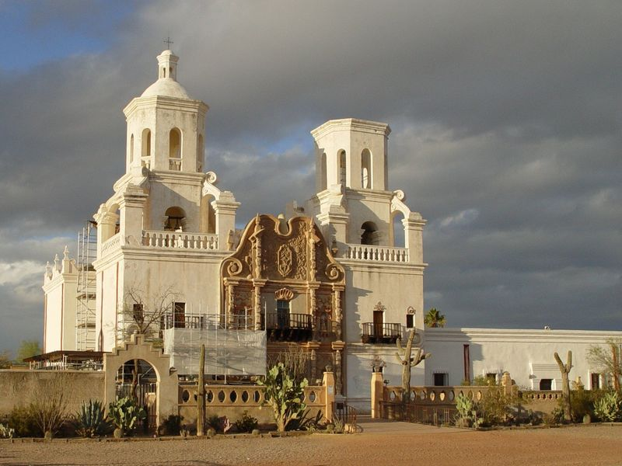
Spanish Missions – Blending Iberian Society

Slide 6
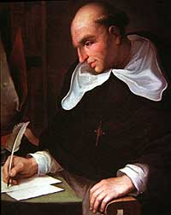
Bartolomé de las Casas 1484-1566

Slide 7
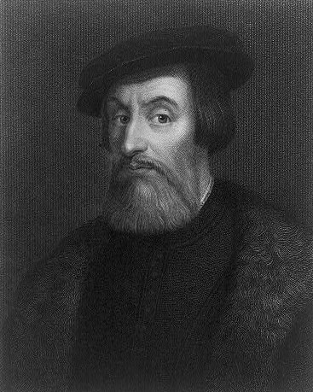
Hernán Cortés 1485-1547

Slide 8
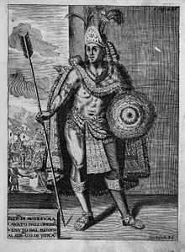
Moctezuma II

Slide 9
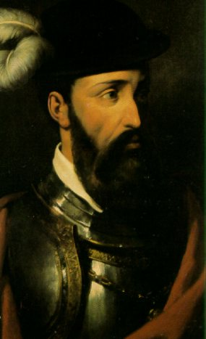
Francisco Pizarro 1475-1541

Slide 10
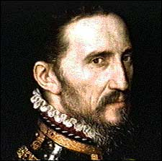
Francisco Vazquez de Coronado

Slide 11
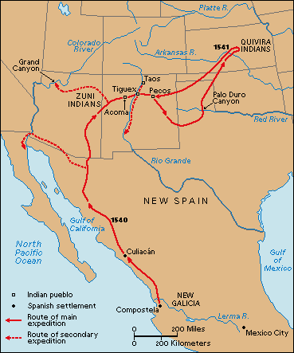
Coronado’s Explorations

Slide 12
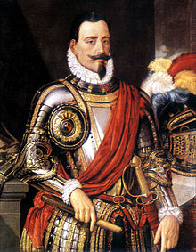
Pedro de Valdivia

Slide 13
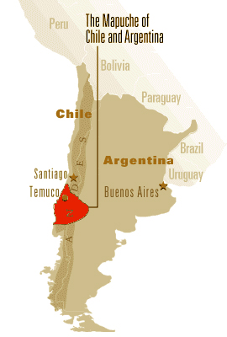
Mapuche Homeland

Slide 14
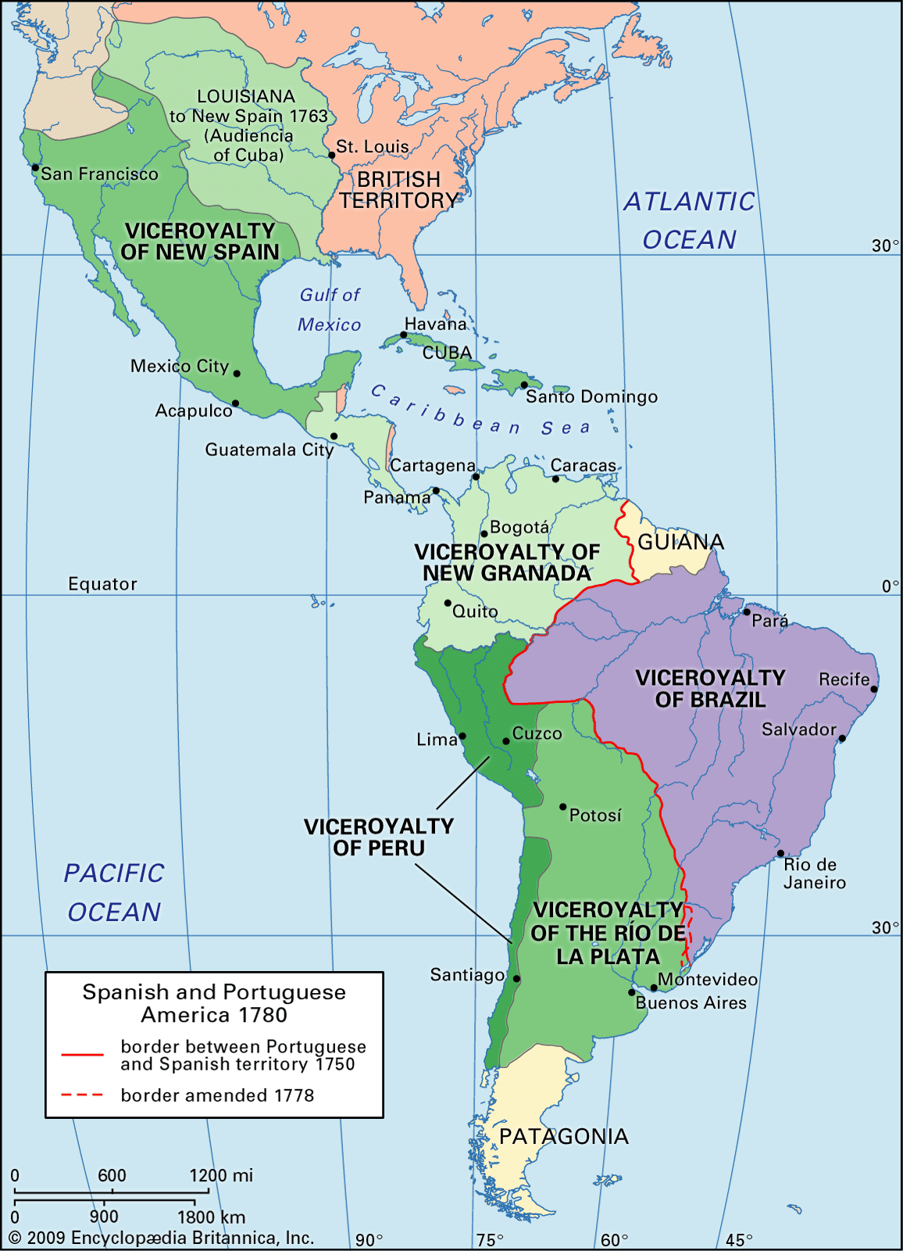
The New World By 1780

Slide 15
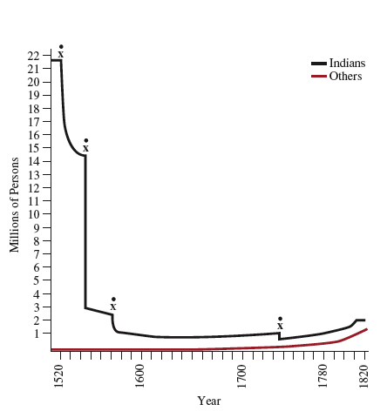
Population Decline in New Spain

Slide 16
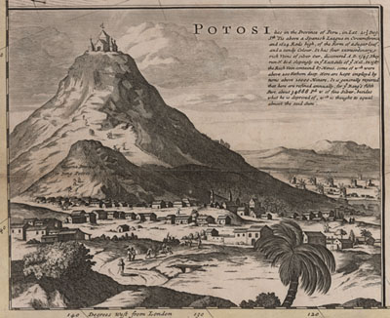
Potosí

Slide 17
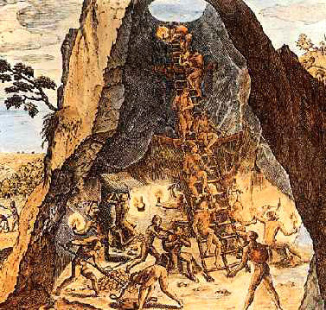

Slide 18
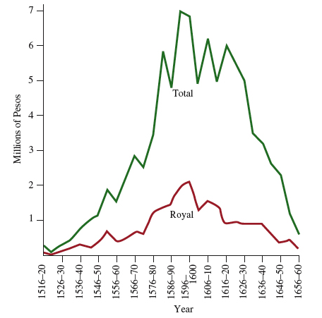
Silver Production in New Spain

Slide 19
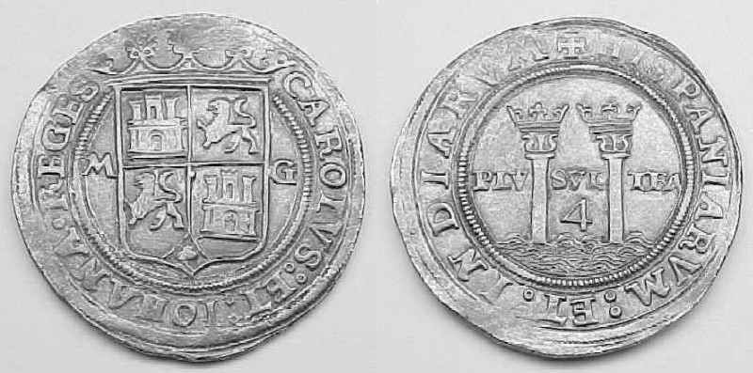
Spanish Silver Coins from 1500s

Slide 20
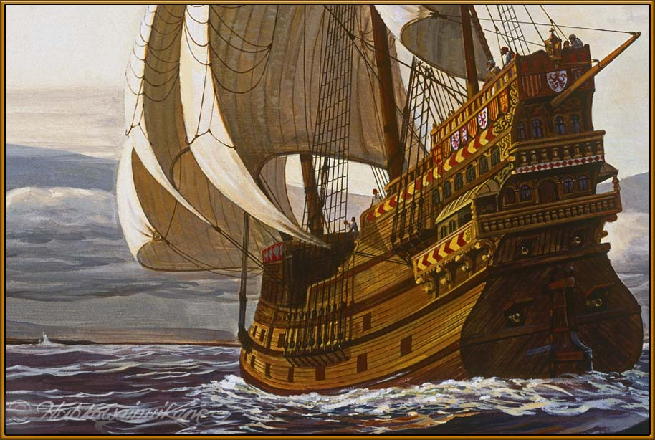
Spanish Galleon

Slide 21
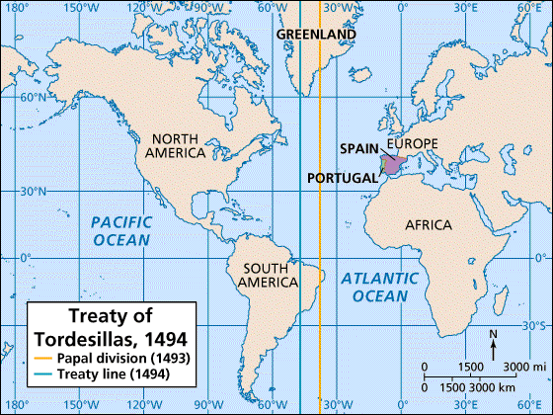

Slide 22
Brazil

Slide 23
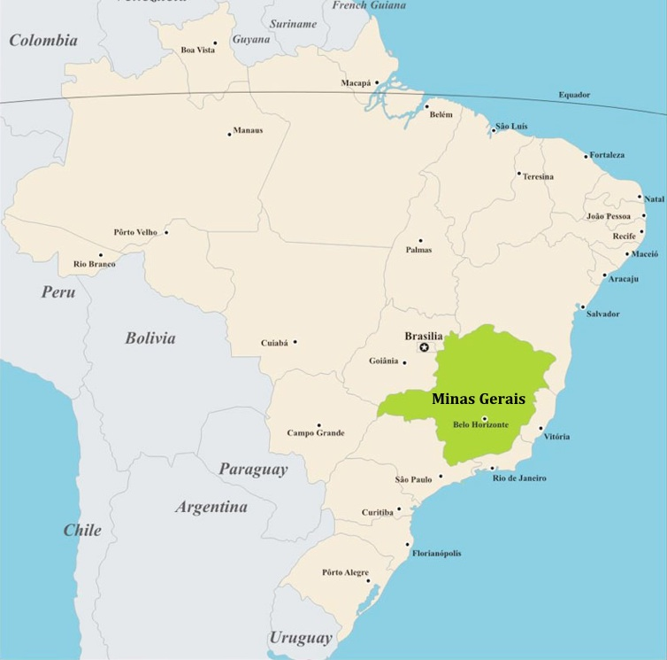
Minas Gerais Region

Slide 24
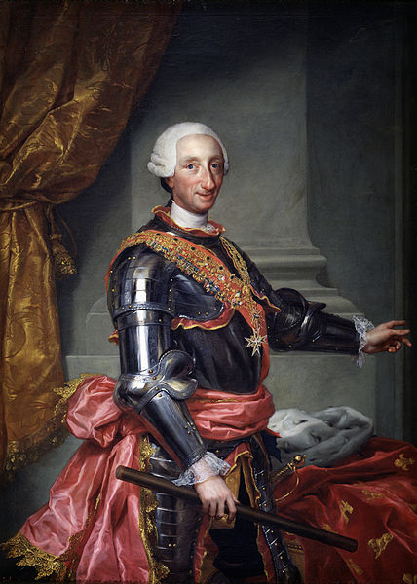
Charles III of Spain r. 1759-1788

Slide 25
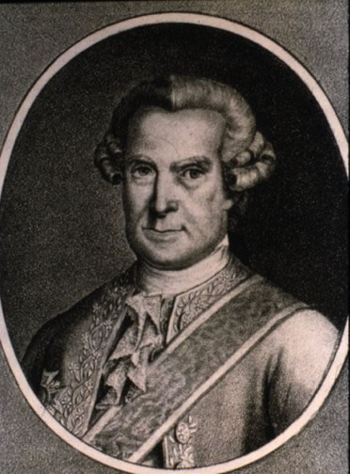
José de Gàlvez

Slide 26
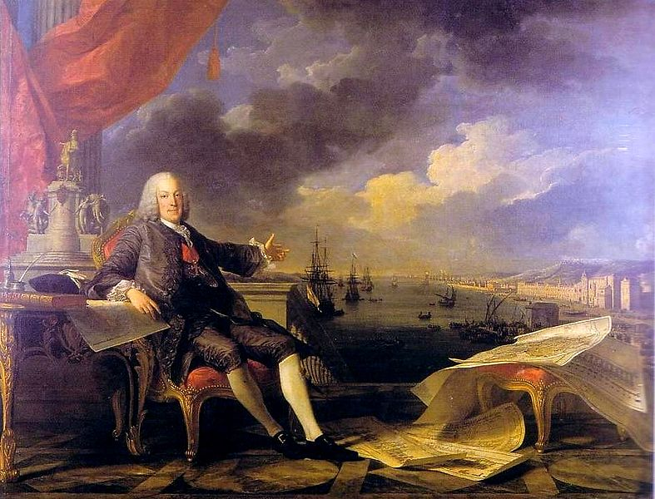
Marquis of Pombal – PM 1755-1776

Slide 27
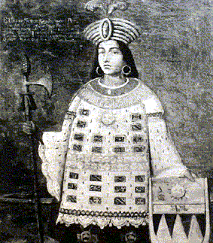
Tupac Amaru

