Slide 1
APWH Period 4: Global Interactions, c. 1450 to 1750 Textbook Part IV: The Early Modern Period, 1450-1750: The World Shrinks .
Chapter 17: The Transformation of the West, 1450-1750

Slide 2
The First Big Changes: Culture and Commerce

Slide 3
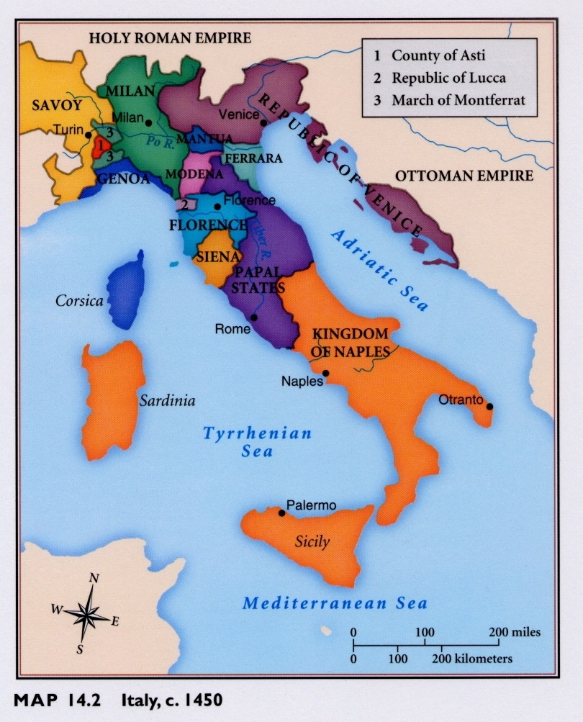
Italian City-States

Slide 4
Venetian and Genoese African and Asian Trade Routes

Slide 5
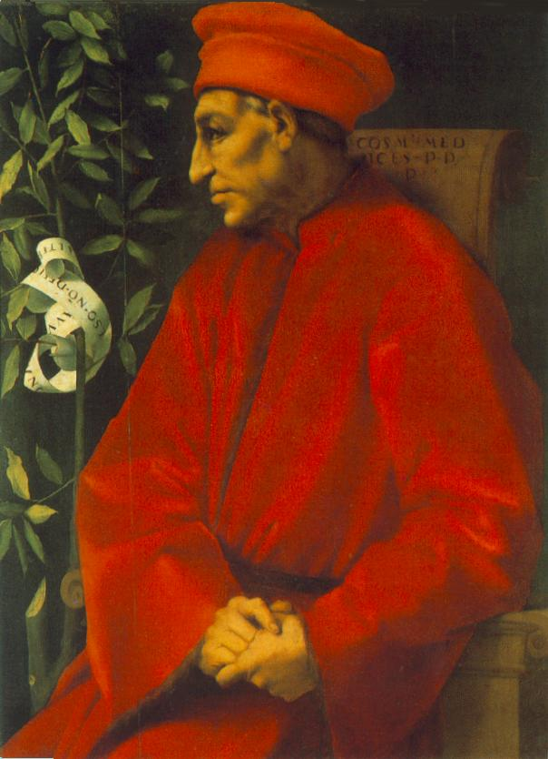
Cosimo de’ Medici 1389-1464

Slide 6
Lorenzo de’ Medici “The Magnificent”

Slide 7
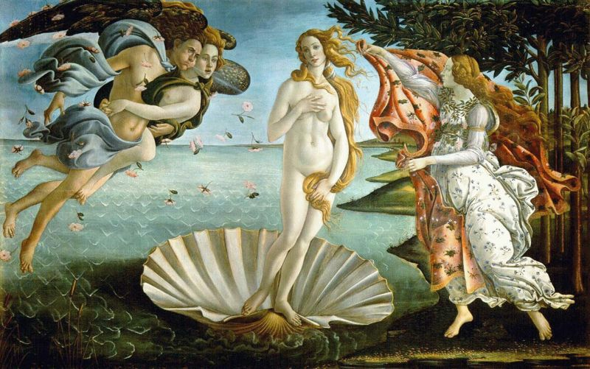
The Birth of Venus – focus on Greco-Roman past

Slide 8
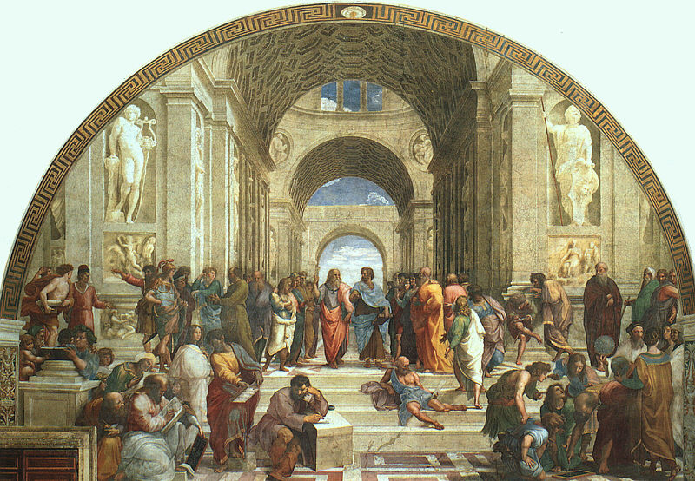
The School of Athens

Slide 9
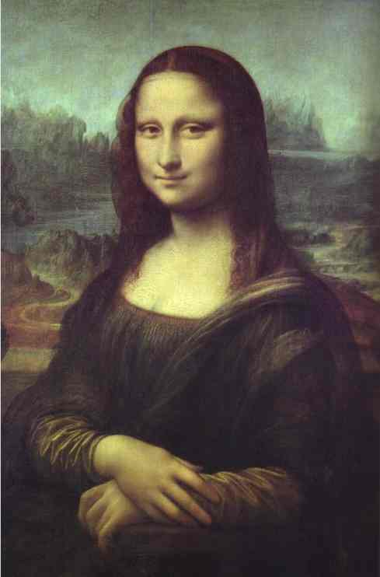
Mona Lisa Shows a focus on the individual, humanism

Slide 10
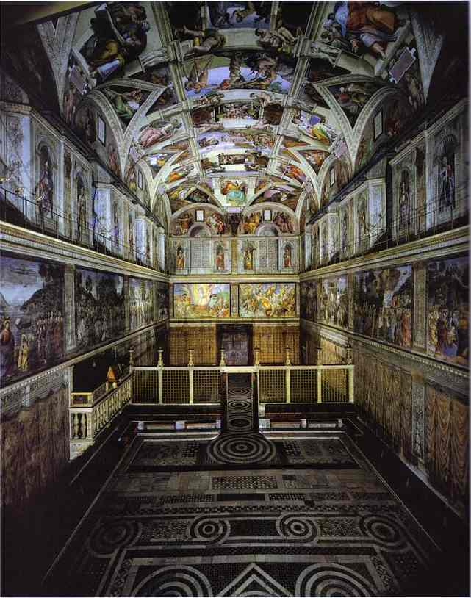
The Sistine Chapel Shows religion continues to be important in the arts

Slide 11
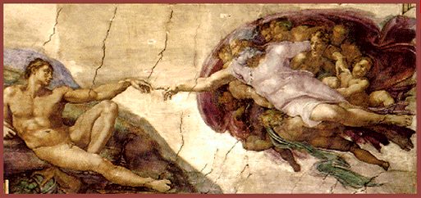
The Creation of Man

Slide 12
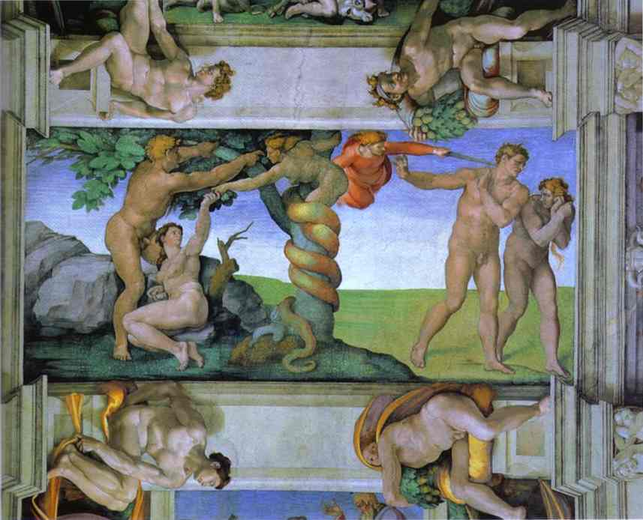
The Expulsion of Adam and Eve

Slide 13
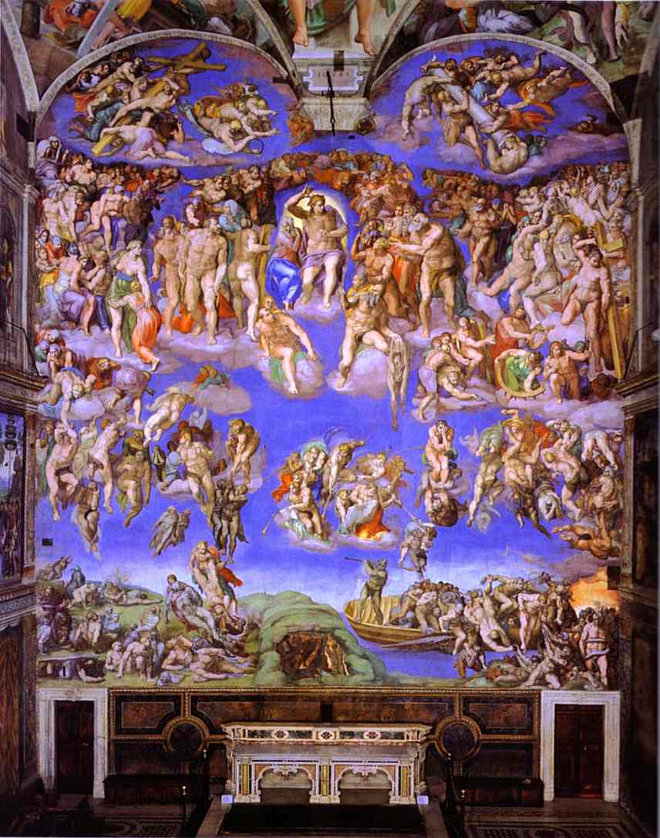
The Last Judgment

Slide 14
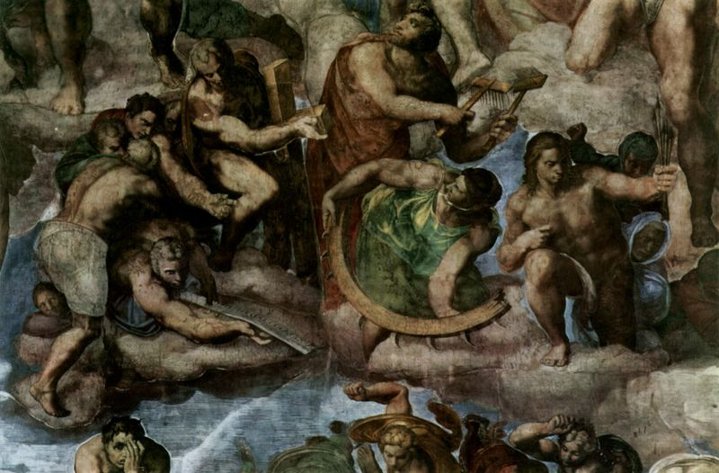

Slide 15
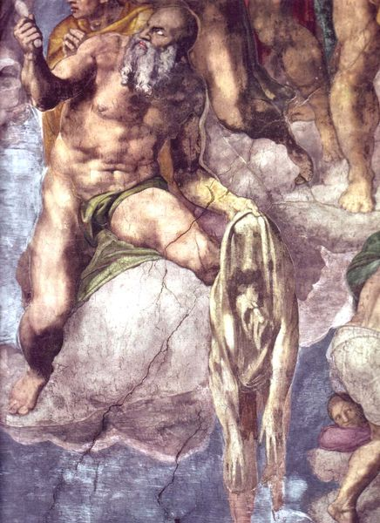

Slide 16
Niccolò Machiavelli 1469-1527

Slide 17
Northern Renaissance Art

Slide 18
The Four Horsemen of the Apocalypse Woodcut

Slide 19
Knight, Death, and the Devil Engraving

Slide 20
The Art of Jan van Eyck c. 1385-1441 Giovanni Arnolfini and His Bride

Slide 21
Netherlandish Proverbs

Slide 22
The Battle Between Carnival and Lent

Slide 23
William Shakespeare 1564-1616

Slide 24
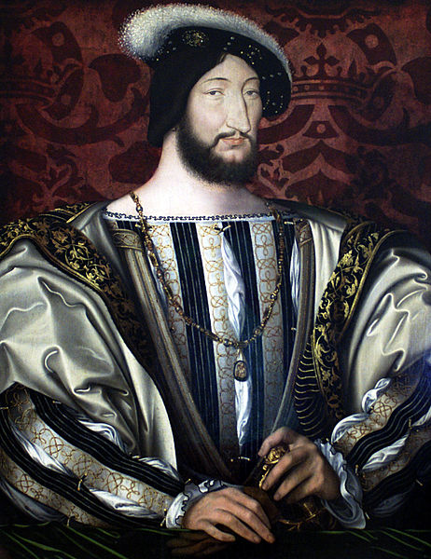
Francis I of France Famous patron of the arts r. 1515-1547

Slide 25
Johannes Gutenberg c.1400-1468

Slide 26
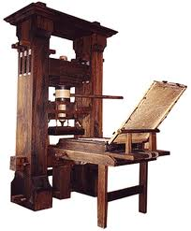
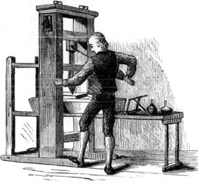
Gutenberg Printing Press

Slide 27
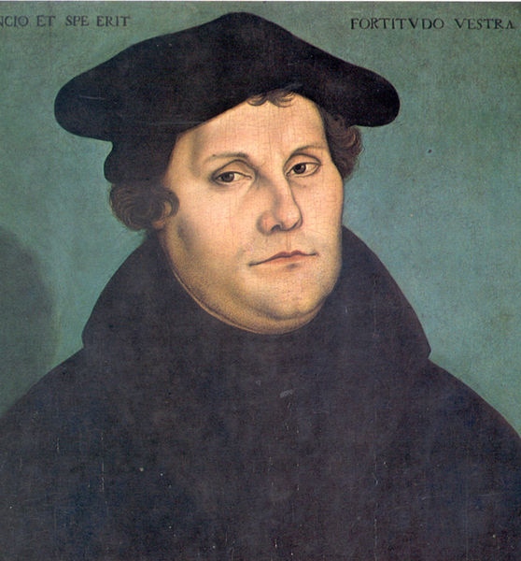
Martin Luther 1483-1536

Slide 28
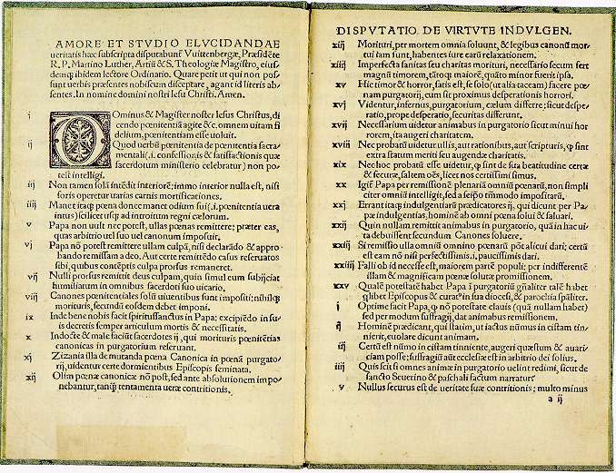
95 Theses

Slide 29
Excerpts from 95 Theses
1. When our Lord and Master, Jesus Christ, said "Repent", He called for the entire life of believers to be one of repentance.
6. The pope himself cannot remit guilt, but only declare and confirm that it has been remitted by God; or, at most, he can remit it in cases reserved to his discretion. Except for these cases, the guilt remains untouched.
27. There is no divine authority for preaching that the soul flies out of the purgatory immediately the money clinks in the bottom of the chest.

Slide 30
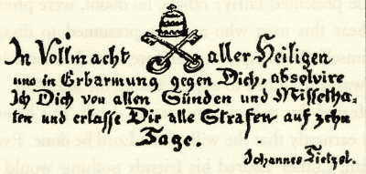
An Indulgence that reads: “With the Authority of all Saints and with mercy for you, I free you of all sins and crimes and excuse you from all punishments for ten days.” – Johann Tetzel

Slide 31
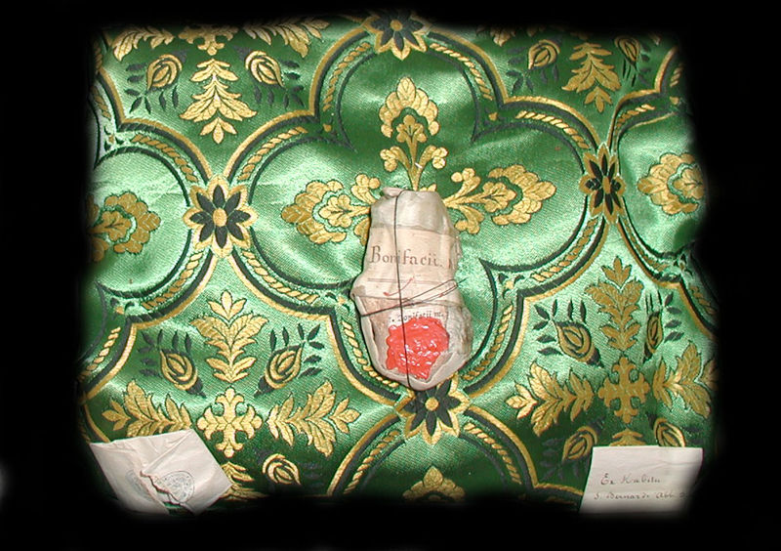
Relic: Bone from St. Boniface

Slide 32
John Calvin’s Thoughts on Relics of the Holy Cross
“There is no abbey so poor as not to have a specimen. In some places there are large fragments, as at the Holy Chapel in Paris, at Poictiers, and at Rome, where a good-sized crucifix is said to have been made of it. In brief, if all the pieces that could be found were collected together, they would make a big ship-load. Yet the Gospel testifies that a single man was able to carry it.”
— Calvin, Traité Des Reliques.

Slide 33
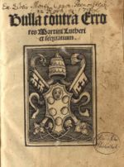
Papal Bull of Luther’s Excommunication

Slide 34
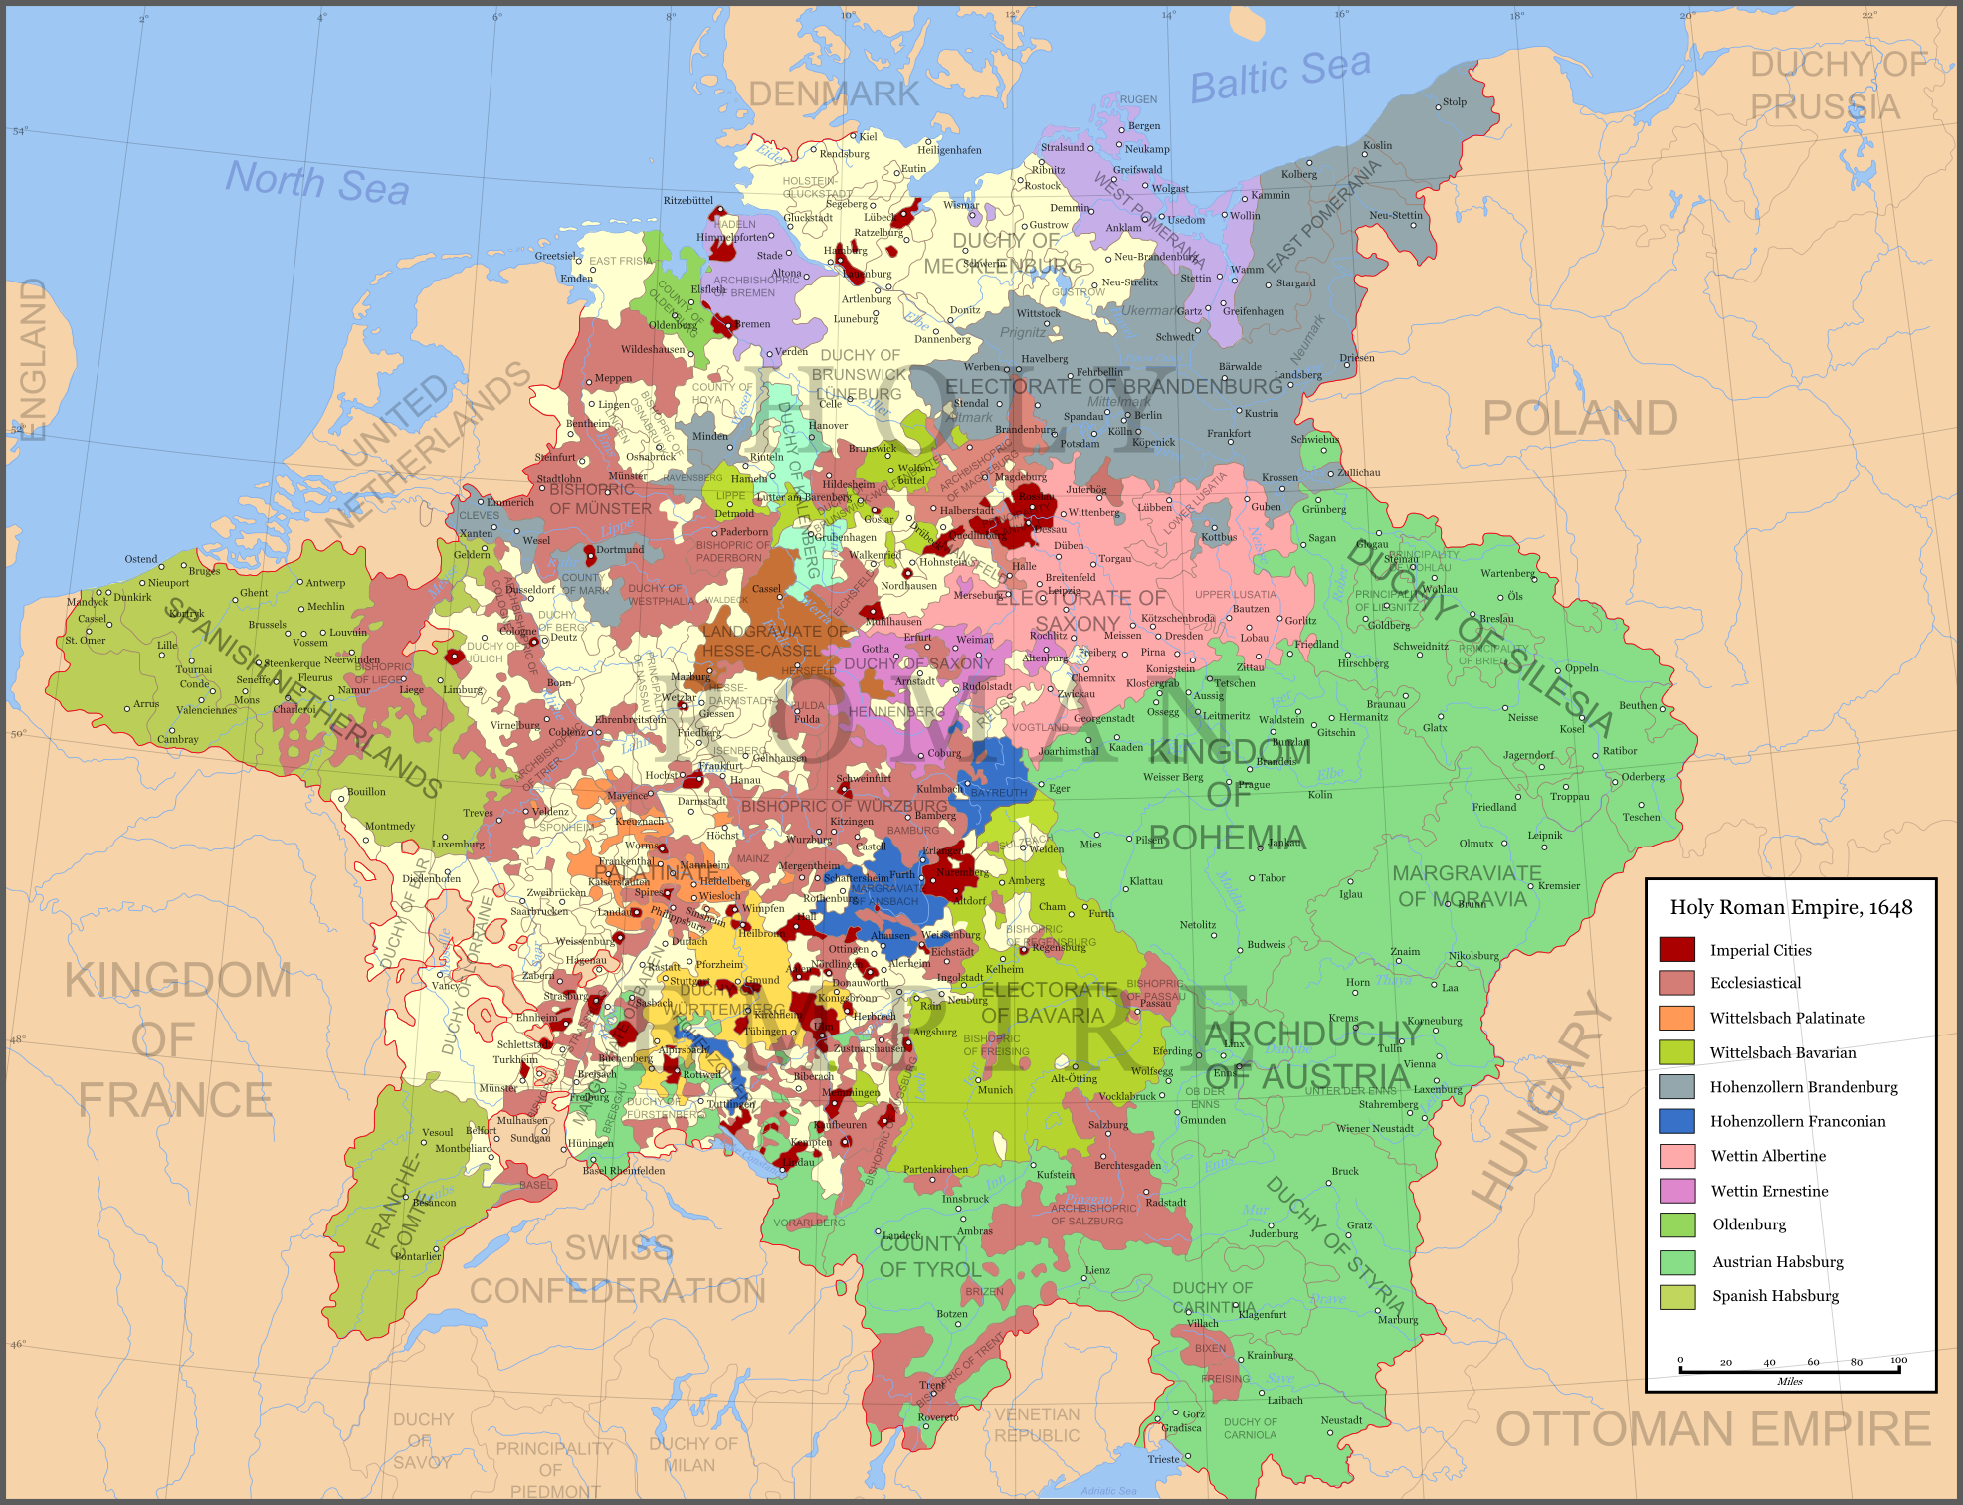

Slide 35
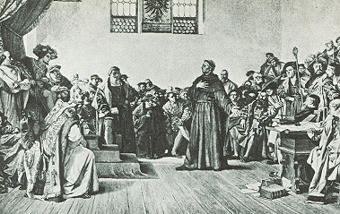
Luther before the Diet of Worms

Slide 36
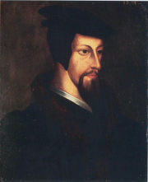
John Calvin (1509-1564)

Slide 37
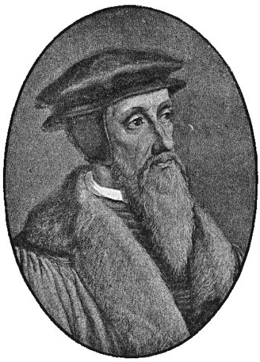
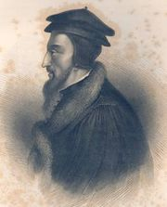

Slide 38
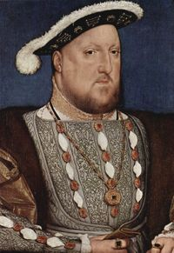
King Henry VIII (r. 1509-1547)

Slide 39
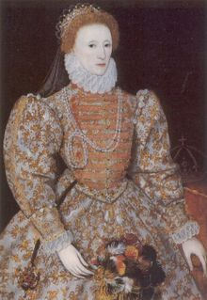
Queen Elizabeth I, daughter of Anne Boleyn r. 1558-1603

Slide 40
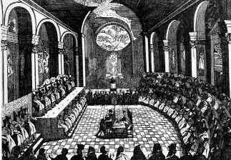
Engraving of Council of Trent

Slide 42
The Commercial Revolution’s Effects on Europe

Slide 43
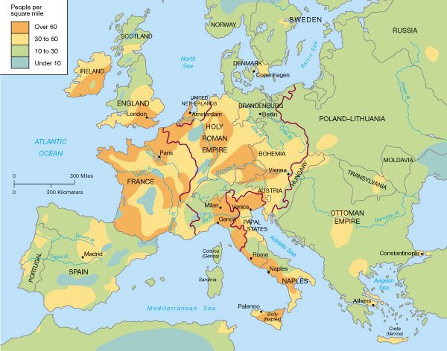

Slide 44
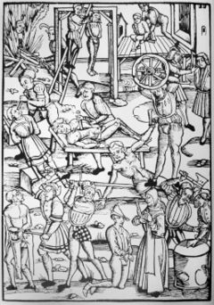
Woodcut of 16th Century Punishments for Witchcraft

Slide 45
The Scientific Revolution

Slide 46
Nicolaus Copernicus 1473-1543

Slide 47
Heliocentric Theory

Slide 48
Johannes Kepler 1571-1530

Slide 49
Kepler’s Elliptical Orbits and Laws of Planetary Motion

Slide 50
Galileo 1564 -1642 (aka Mr. Barnes)

Slide 51
Galileo in later years

Slide 52
Galileo’s Telescopes

Slide 53
Images through a Galilean Telescope
The Mountains on our Moon
Sun Spots

Slide 54
Saturn
Mars
Jupiter
Venus

Slide 55
Galileo’s writings about the moons of Jupiter

Slide 56
Galileo’s Drawings of Sun Spots

Slide 57
Galileo’s Drawings of the Moon

Slide 58
Galileo Facing the Roman Inquisition

Slide 59
William Harvey (1578-1657)

Slide 60
Sir Francis Bacon 1561-1626

Slide 61
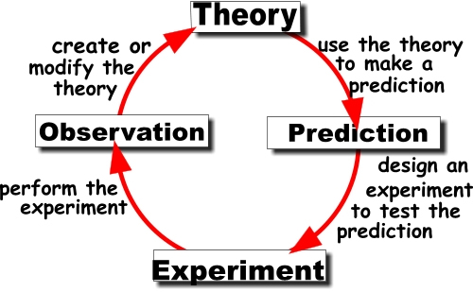
Scientific Method

Slide 62
René Descartes 1596-1650

Slide 63
Sir Isaac Newton (1643-1721)

Slide 64
Newton’s Telescope

Slide 65
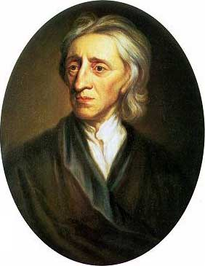
John Locke 1632-1704

Slide 66
Louis XIV r. 1643-1715 “The Sun King”

Slide 67
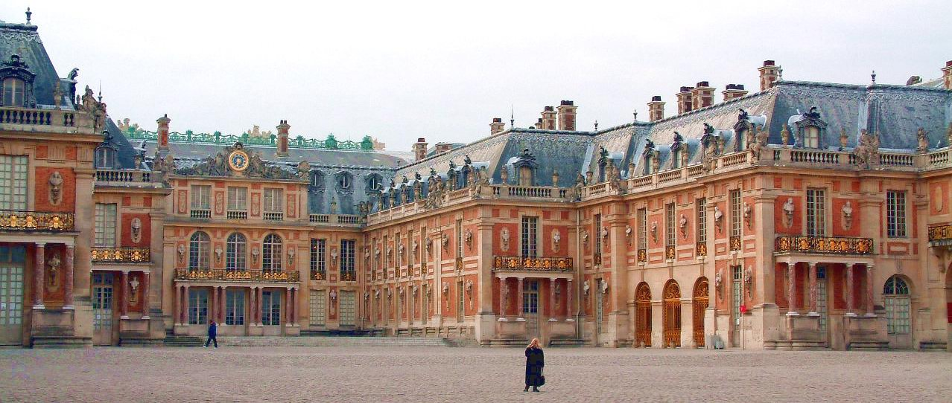
Versailles

Slide 68
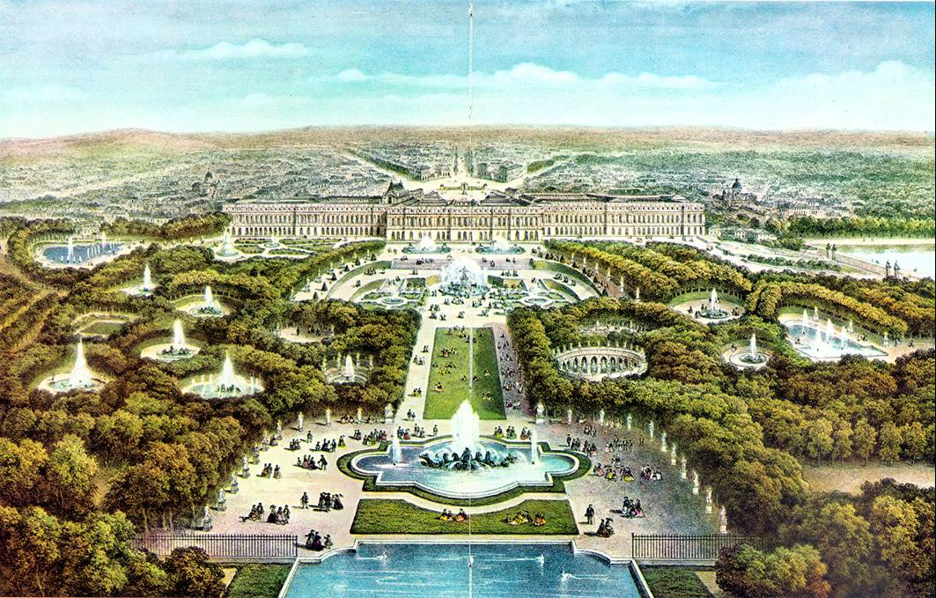

Slide 69
Louis XIV’s Court at Versailles

Slide 70
Frederick II, “The Great” of Prussia r. 1740-1786

Slide 71
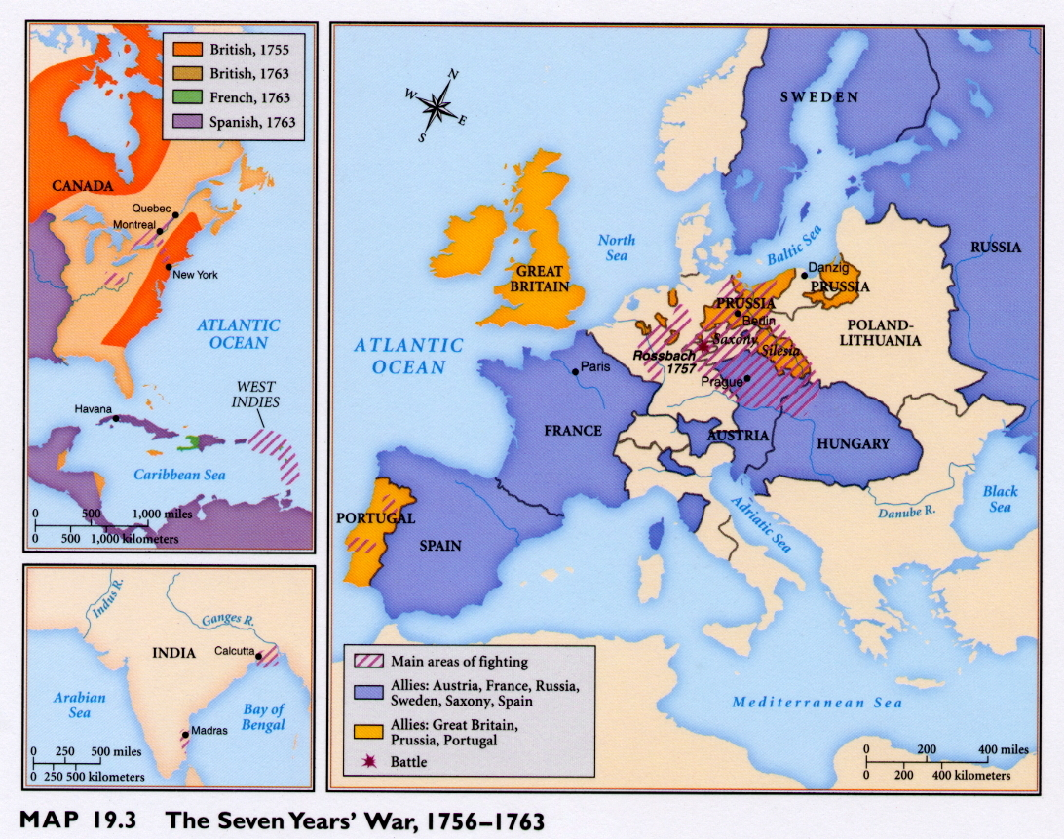
The Seven Years’ War
1756-1763

Slide 72
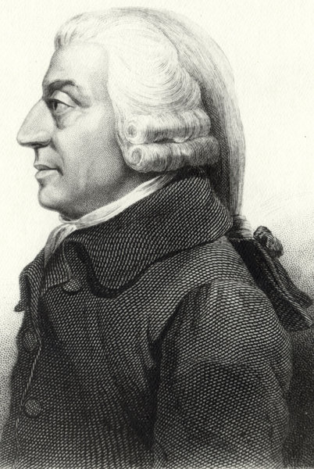
Adam Smith Author of Wealth of Nations

Slide 73
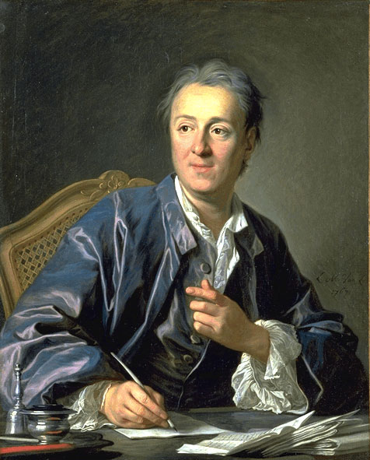
Denis Diderot 1713-1784

Slide 74
The Salon of Madame Geoffrin

Slide 75
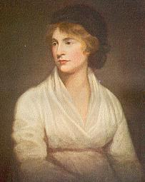
Mary Wollstonecraft 1759-1797

Slide 76
Dutch Waterline

Slide 77
Dutch Dikes

Slide 78
Seed Drill

Slide 79
The Flying Shuttle - 1733

Slide 80
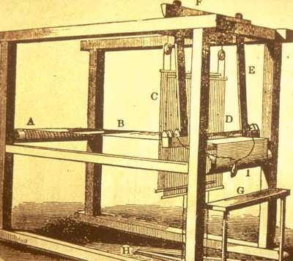
Flying Shuttle Location - I

Slide 81
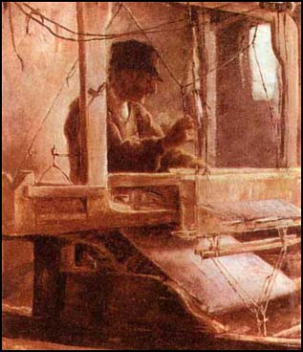
A Weaver using the Flying Shuttle

