Slide 1
APWH Period 3: Regional and Transregional Interactions, c. 600 CE to c. 1450 Textbook Part III: The Postclassical Period, New Faith and New Commerce: 500-1450 C.E. .
Chapter 10: A New Civilization Emerges in Western Europe

Slide 2
Introduction

Slide 3
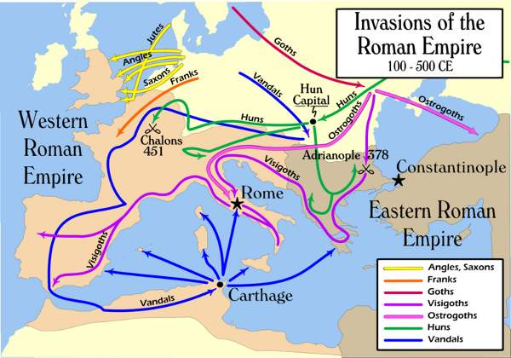

Slide 4
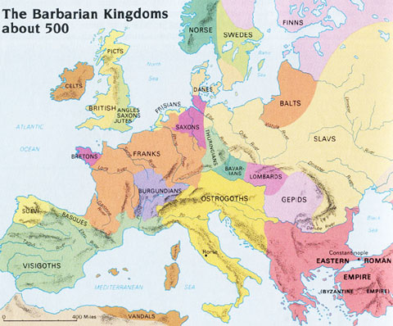

Slide 5
Stages of Postclassical Development

Slide 6
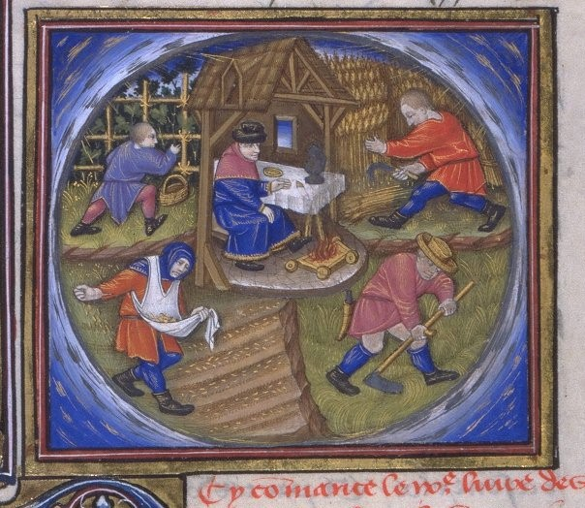
The Four Seasons for a Serf

Slide 7
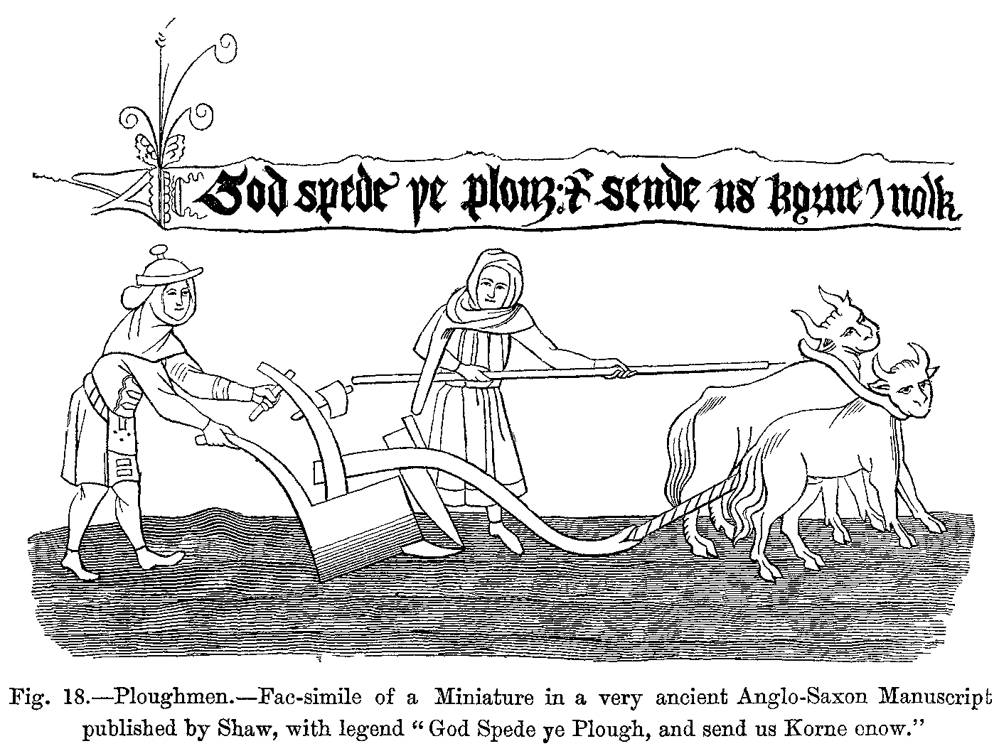
Moldboard

Slide 8
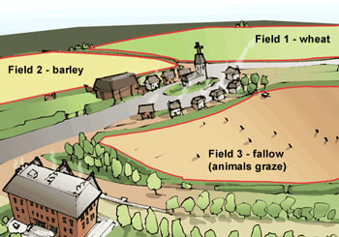
Three-field System

Slide 9
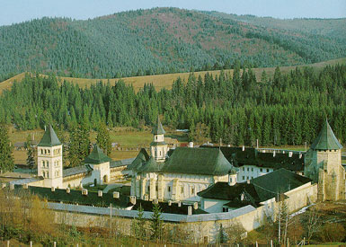
Medieval Monastery

Slide 10
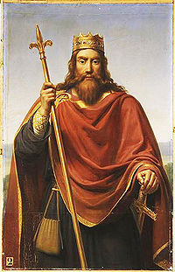
Clovis converted 496

Slide 11
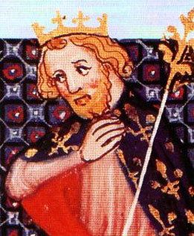
Charles Martel 688-741

Slide 12
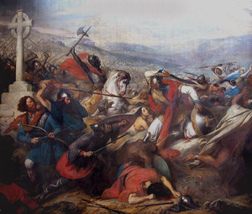
Battle of Tours (Poitiers) 732 CE

Slide 13
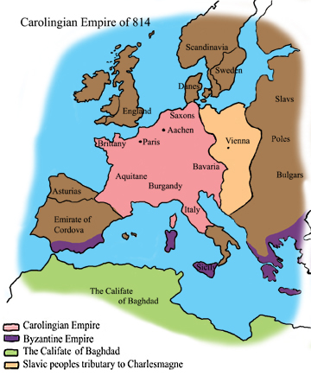
Carolingian Empire at its Height

Slide 14
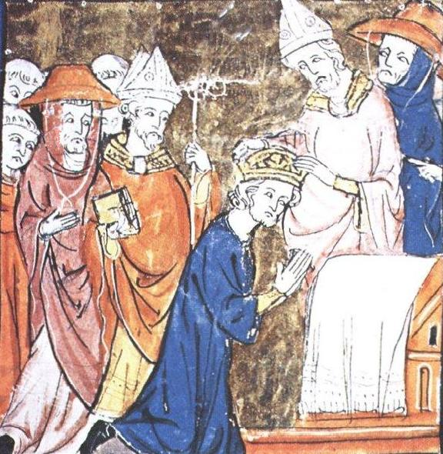
Charlemagne r. 800-814

Slide 15
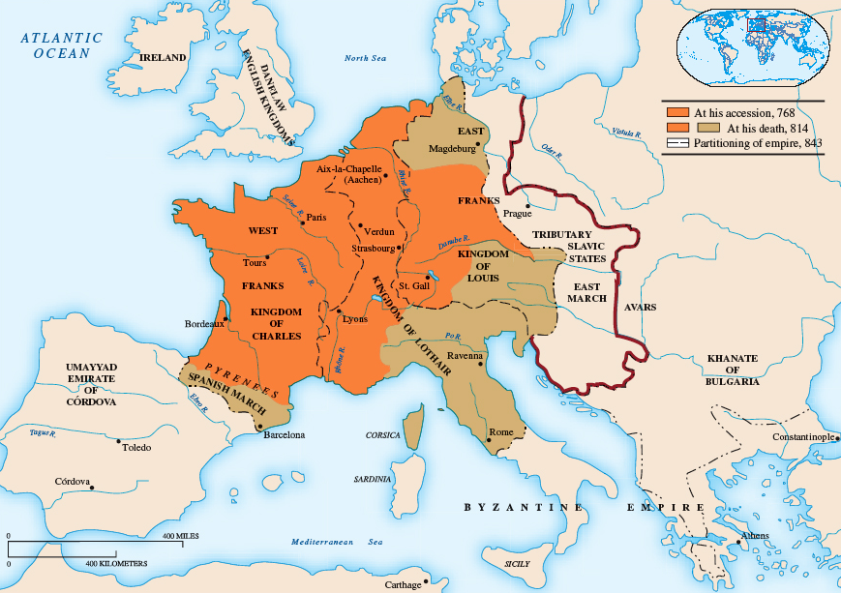

Slide 16
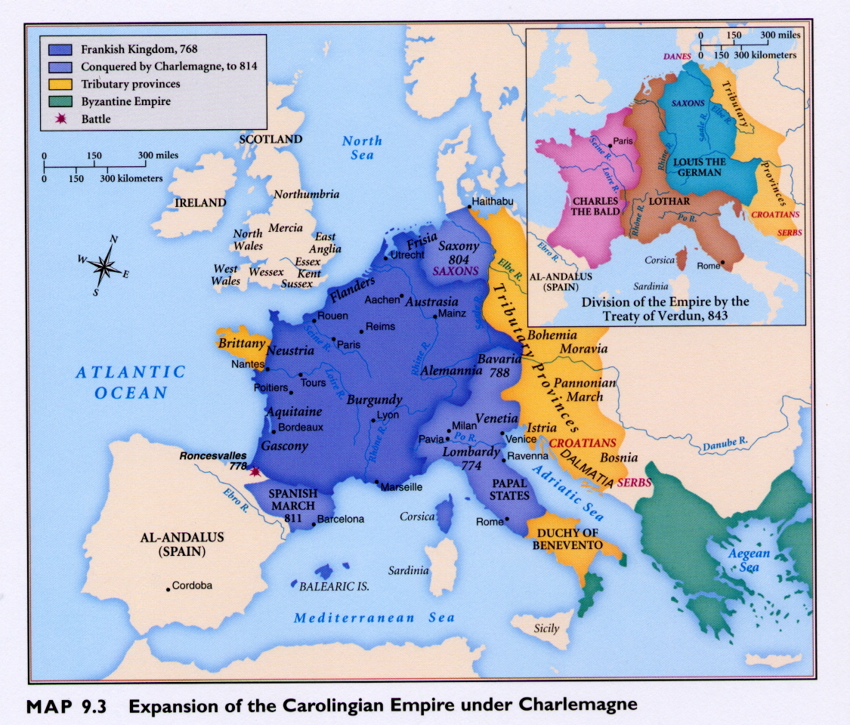

Slide 17
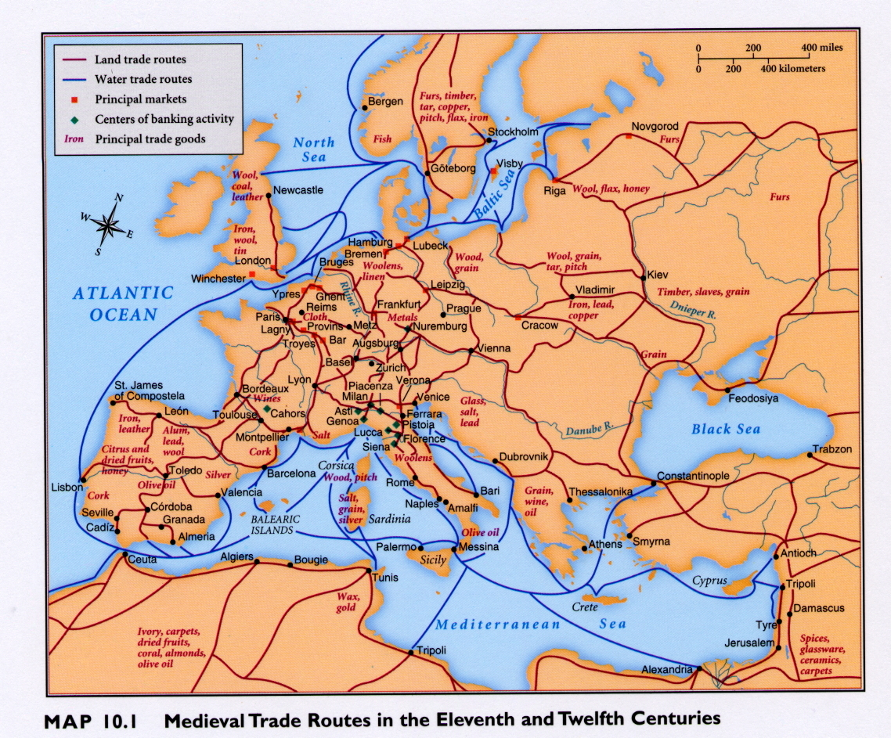

Slide 18
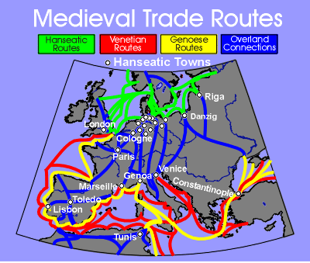

Slide 19
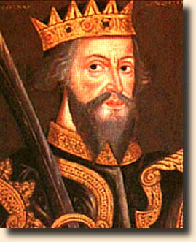
William the Conqueror r. 1066-187

Slide 20
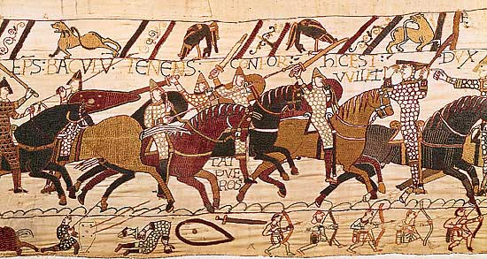
Battle of Hastings – Bayeux Tapestry

Slide 21
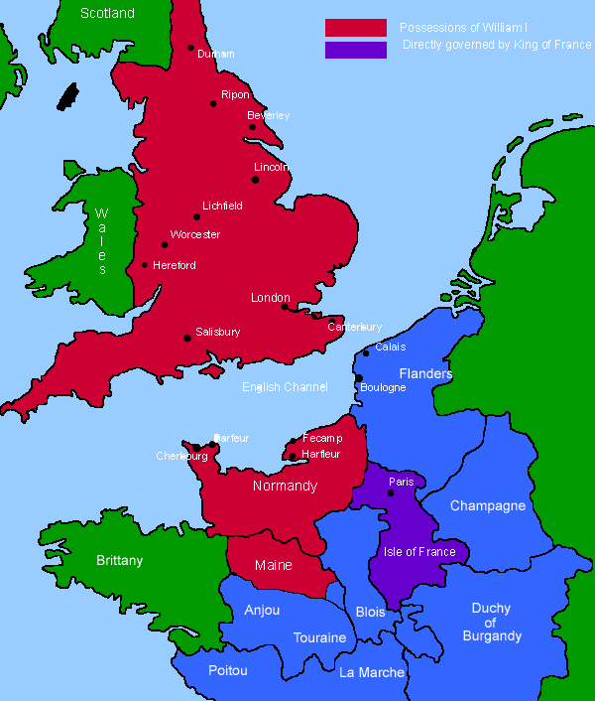
William I’s Kingdom (in red)

Slide 22
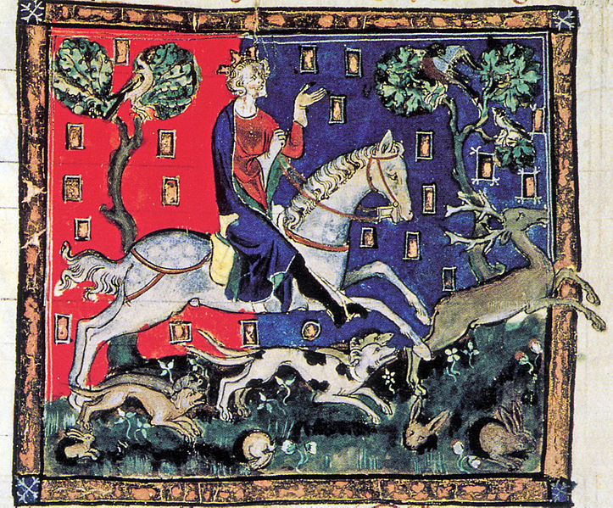
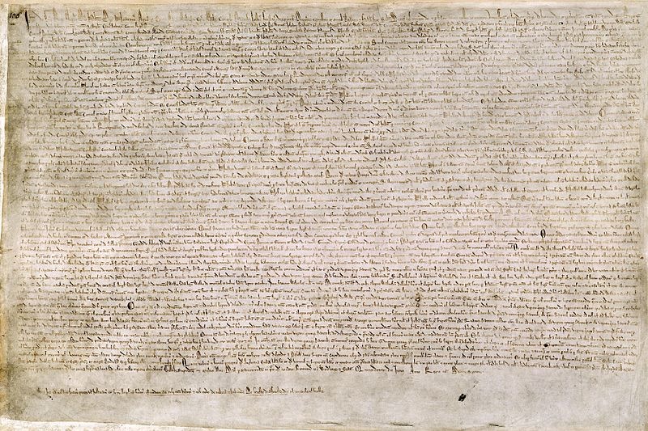
King John and the Magna Carta

Slide 23
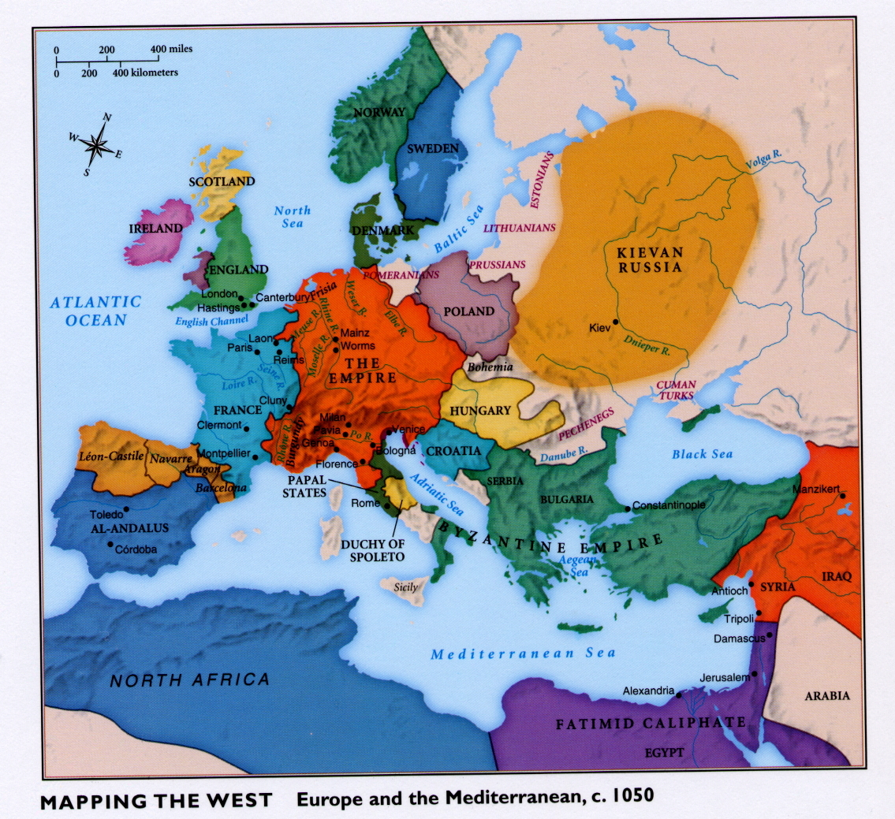

Slide 24
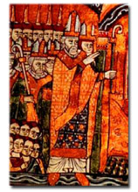
Pope Urban II papacy 1088-1099 Calling the First Crusade

Slide 25
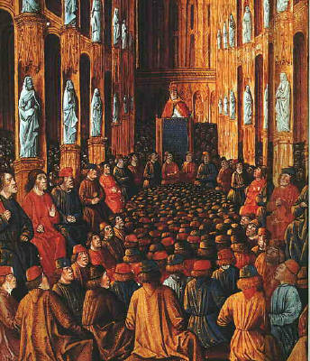

Slide 26
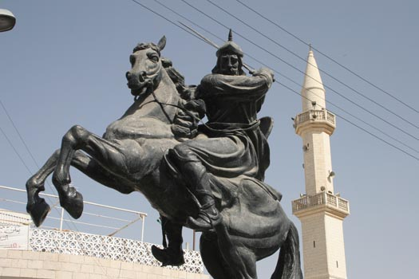
Saladin (Salah al-Din)

Slide 27
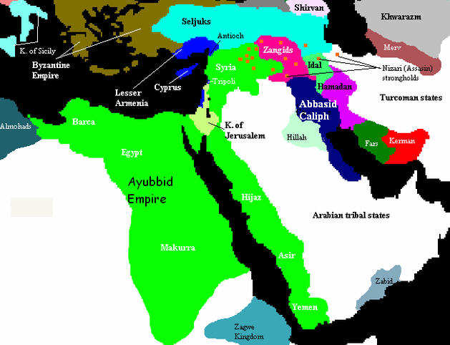
Saladin’s Empire (in the Green)

Slide 28
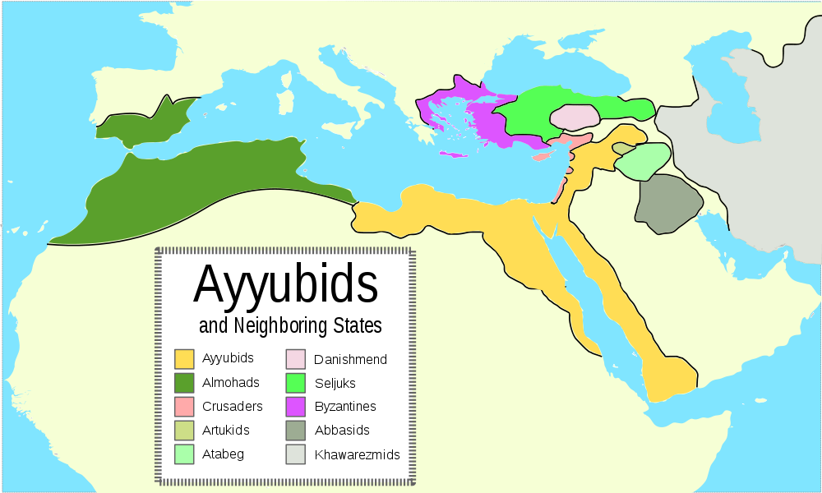

Slide 29
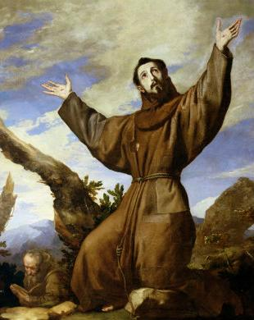
St. Francis of Assisi c. 1181-1226

Slide 30
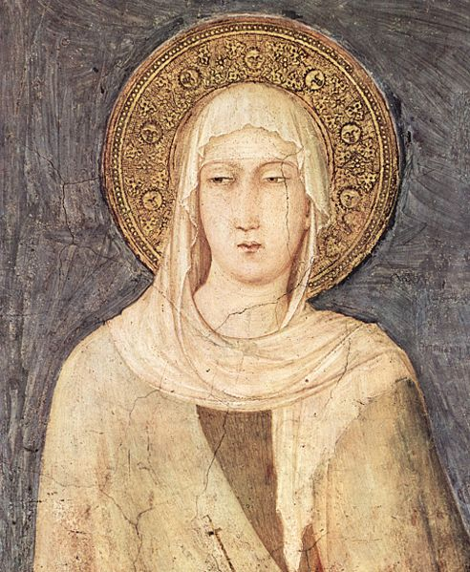
St. Claire of Assisi 1194-1253

Slide 31
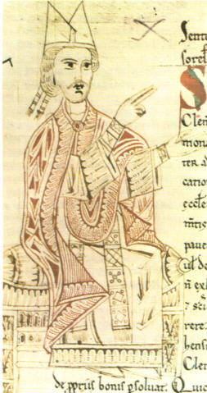
Pope Gregory VII papacy 1073-1085

Slide 32
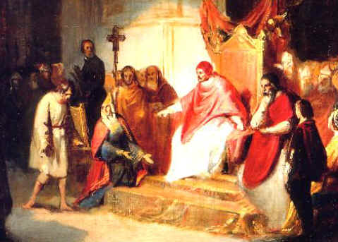
Henry IV, HRE, Begs Forgiveness

Slide 33
Western Culture in the Postclassical Era

Slide 34
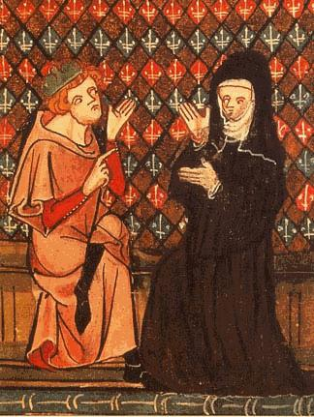
Peter Abelard (w/ Heloise) 1029-1142

Slide 35
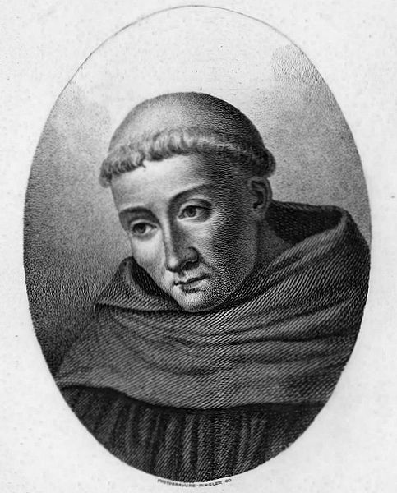
St. Bernard of Clairvaux 1090-1153

Slide 36
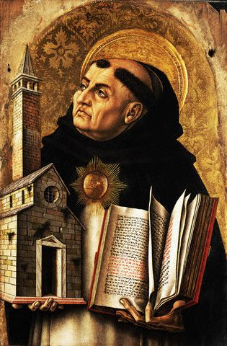
St. Thomas Aquinas 1225-1274

Slide 37
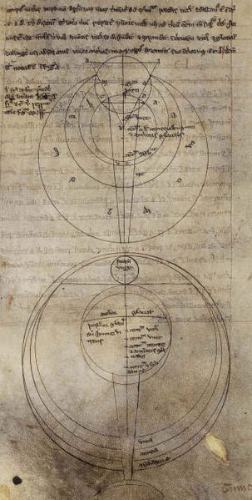
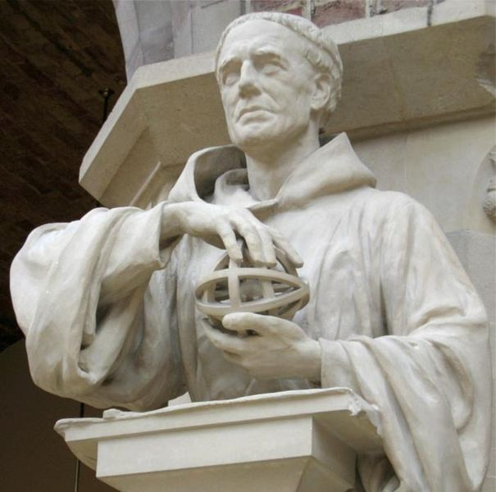
Roger Bacon c. 1214-1294

Slide 38
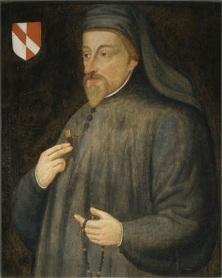
Geoffrey Chaucer

Slide 39
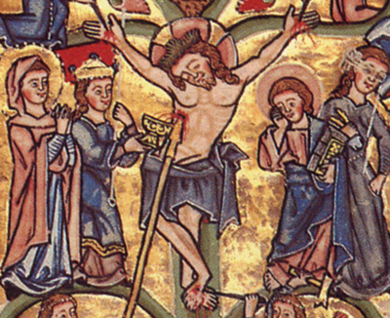
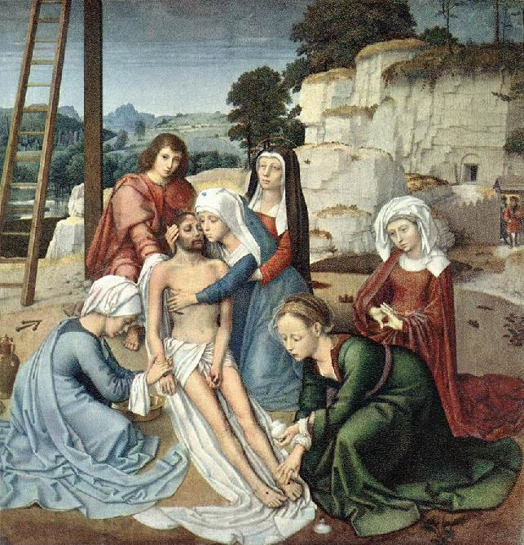
Medieval Art More stylized More Natural

Slide 40
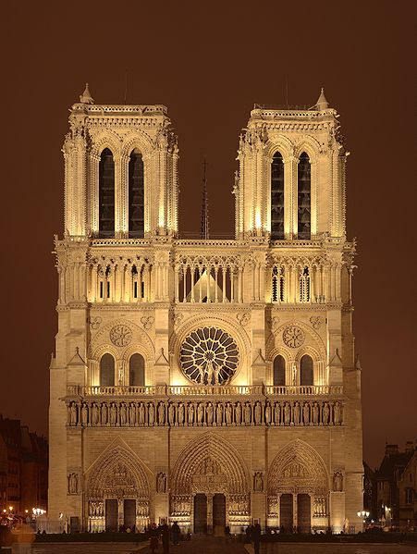
Gothic Architecture

Slide 41
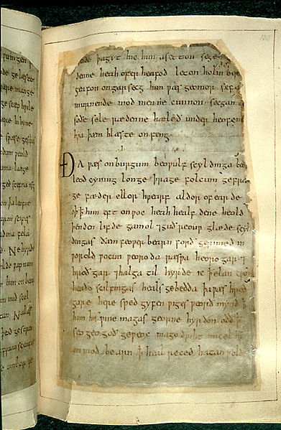
Beowulf

Slide 42
Changing Economic and Social Forms in the Postclassical Era

Slide 44
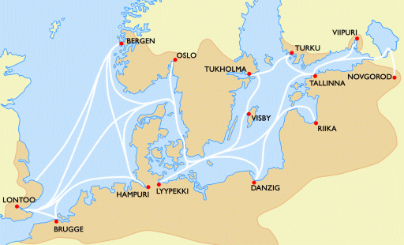
Hanseatic League

Slide 45
The Decline of the Medieval Synthesis

Slide 46
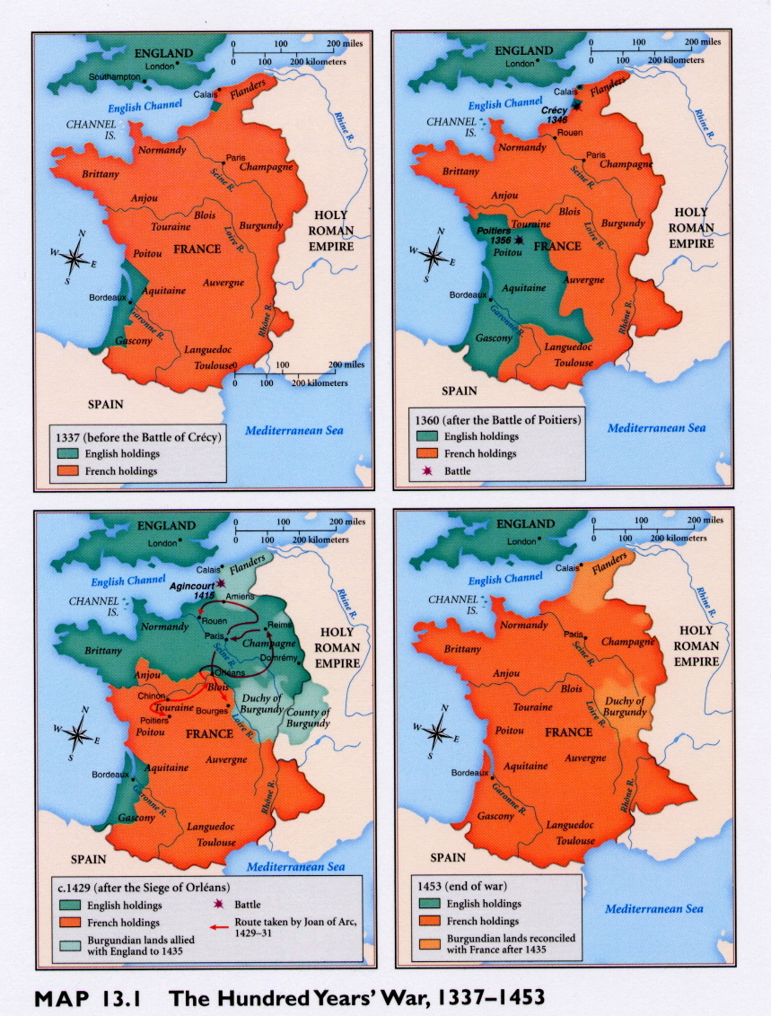
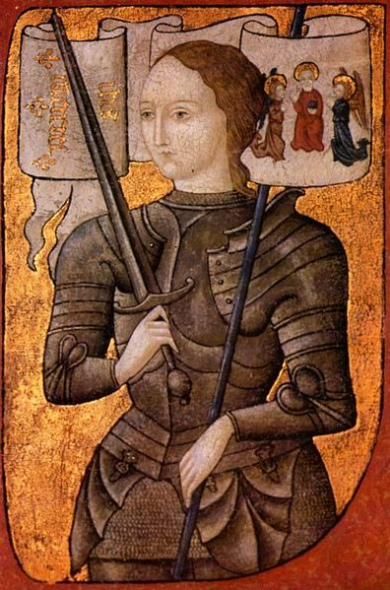
Joan of Arc 1412-1431

Slide 48
