Slide 1
APWH Period 1: Technological and Environmental Transformations to 600 B.C.E. Textbook: Part I: Origins – From Hunting and Gathering to Civilizations, 2.5 Million-1000 B.C.E
Chapter 1: From Human Prehistory to the Early Civilizations

Slide 2
APWH Key Concepts and Themes
Key Concept 1: Technological and Environmental Transformations, to c. 600 B.C.E
1.1 – Big Geography and the Peopling of the Earth
1.2 – The Neolithic Revolution and Early Agricultural
Societies
Themes:
1 – Interaction between Humans & the Environment
(migration/settlement/technology)
2 – Development & Interaction of Cultures (culture defined)
4 – Creation, Expansion & Interaction of Economic Systems
(agricultural/pastoral production)
5 – Development & Transformation of Social Structures
(gender roles & relations/family & kinship)

Slide 3
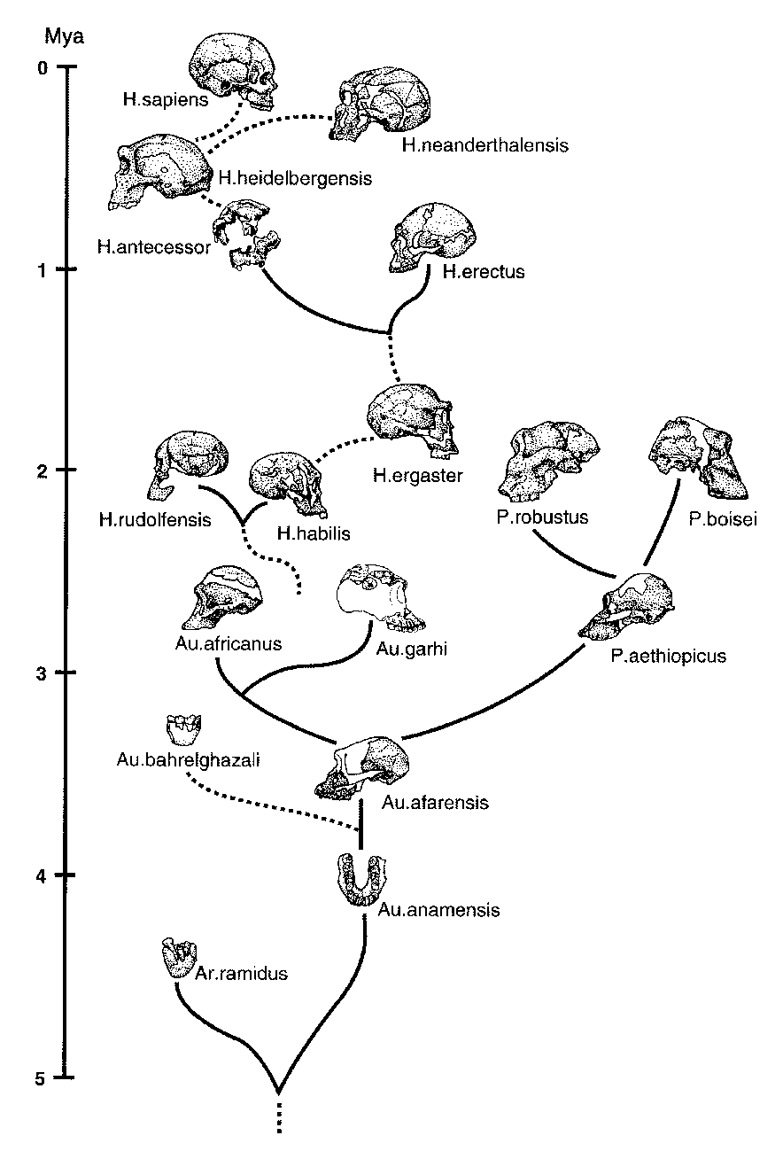
Human Origins

Slide 4
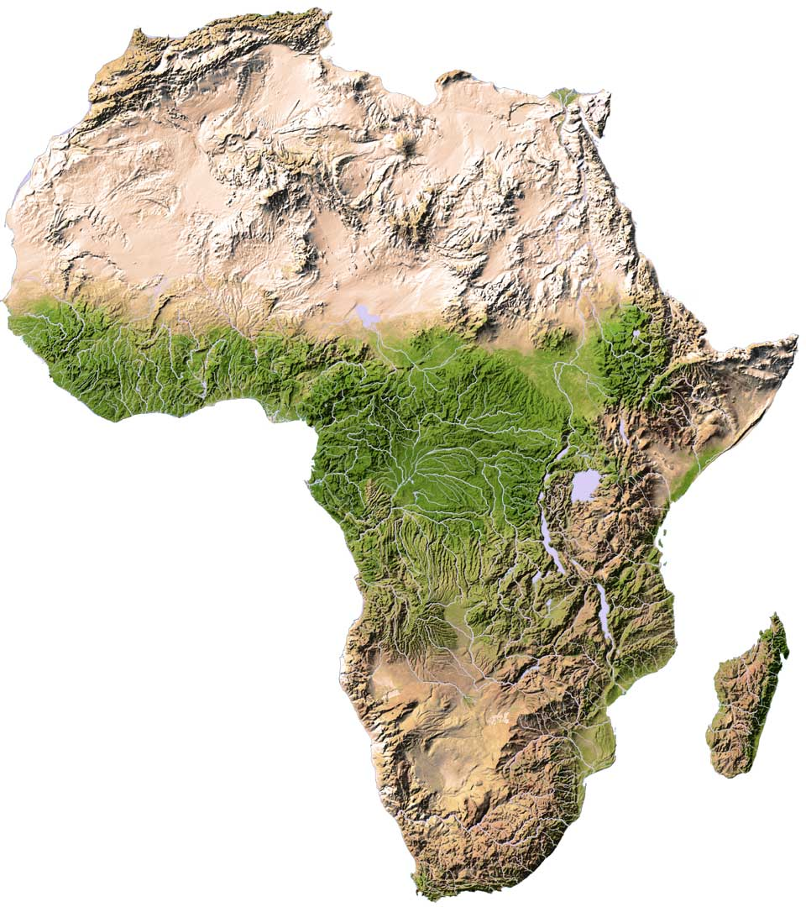
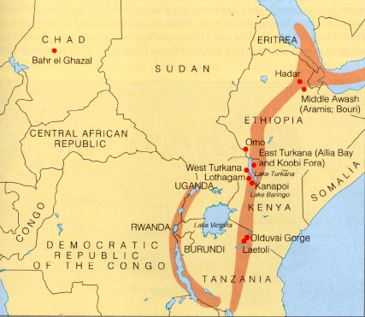
East Africa – Birthplace of Humanity

Slide 5
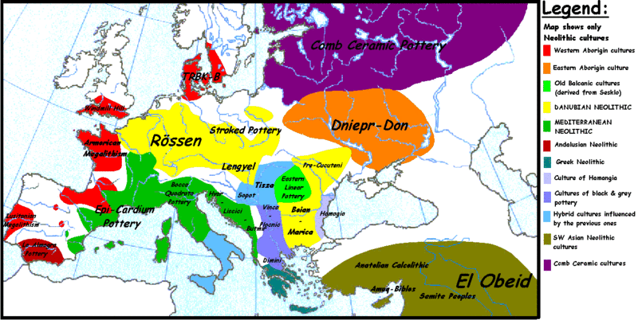
European Neolithic Cultures

Slide 6
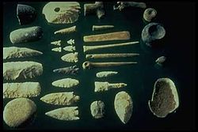
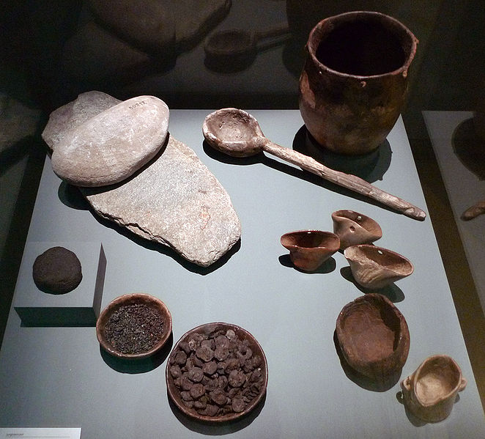
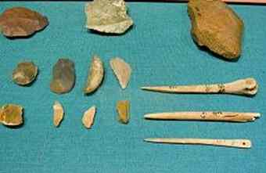
Stone Age Tools and Weapons

Slide 7
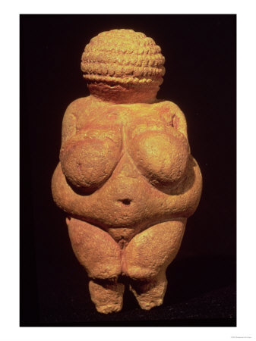
Stone Age Fertility Statue

Slide 8
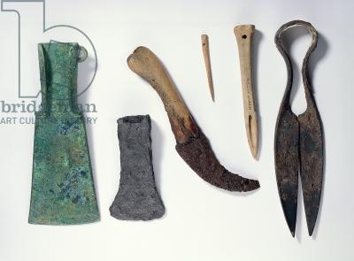
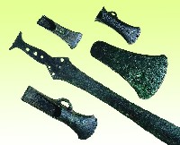
Bronze Age Tools and Weapons

Slide 9
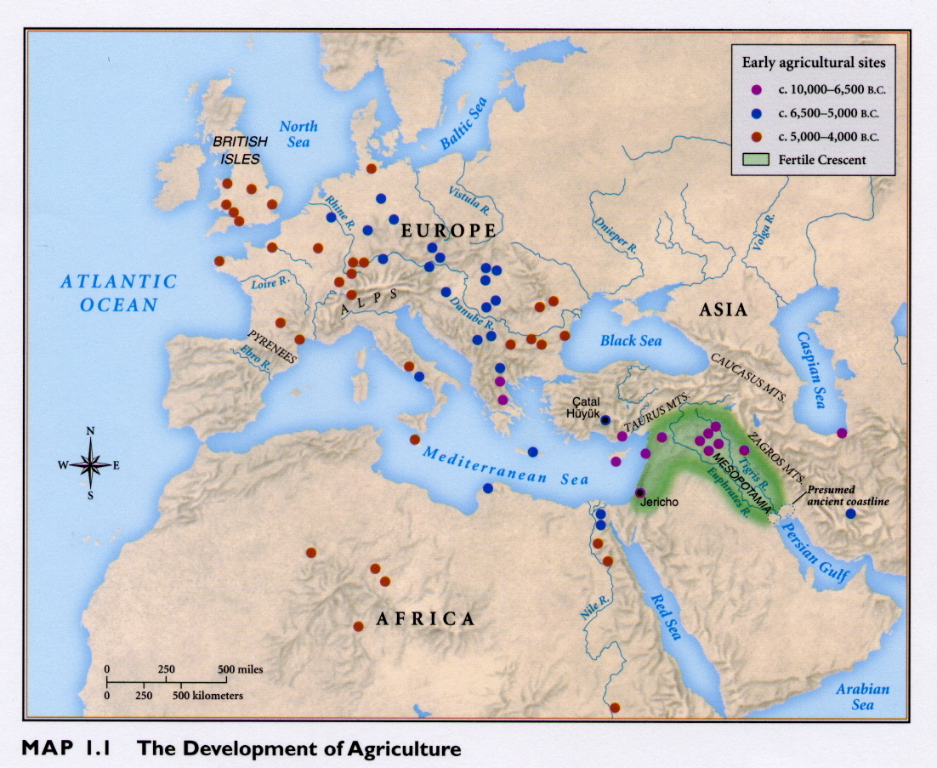

Slide 10
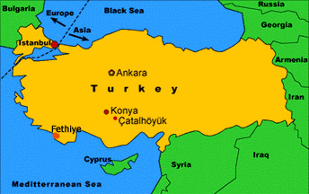
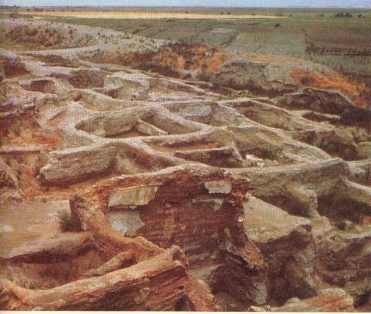
Çatal Hüyük

Slide 11
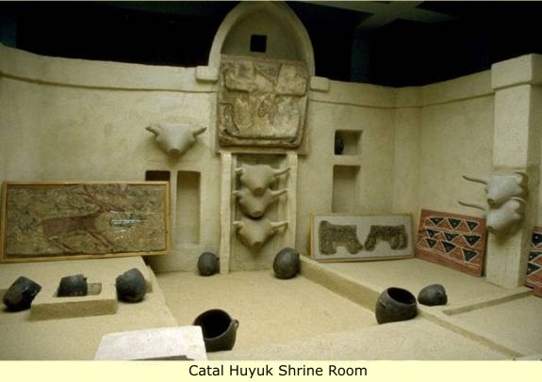
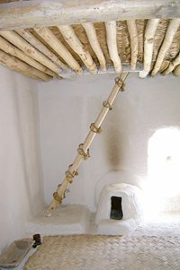

Slide 12
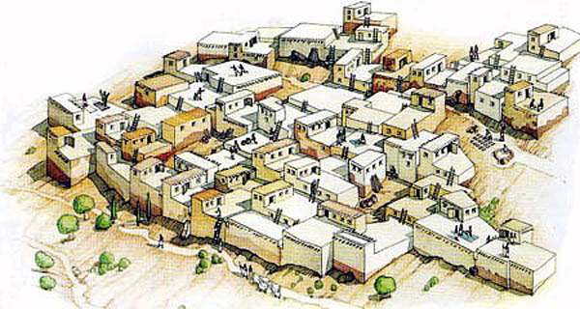
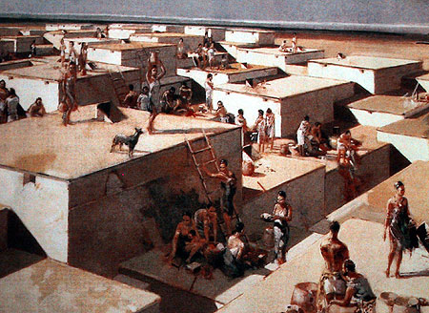

Slide 13
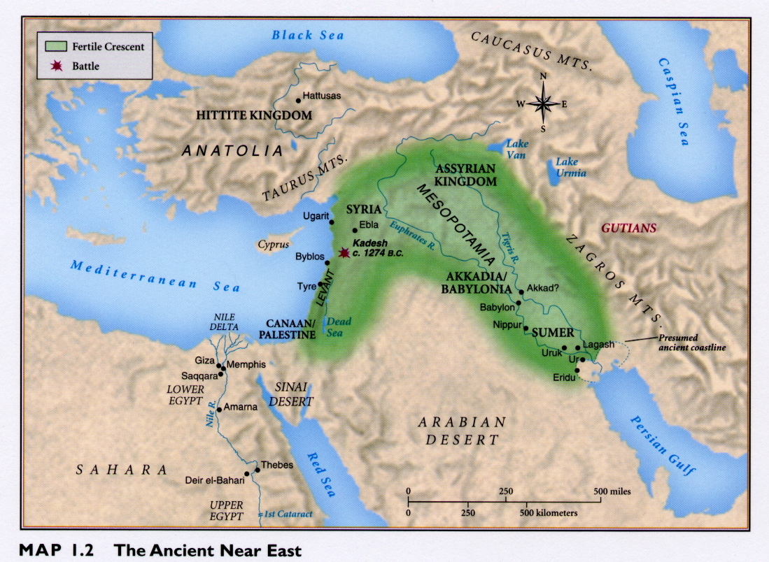

Slide 14
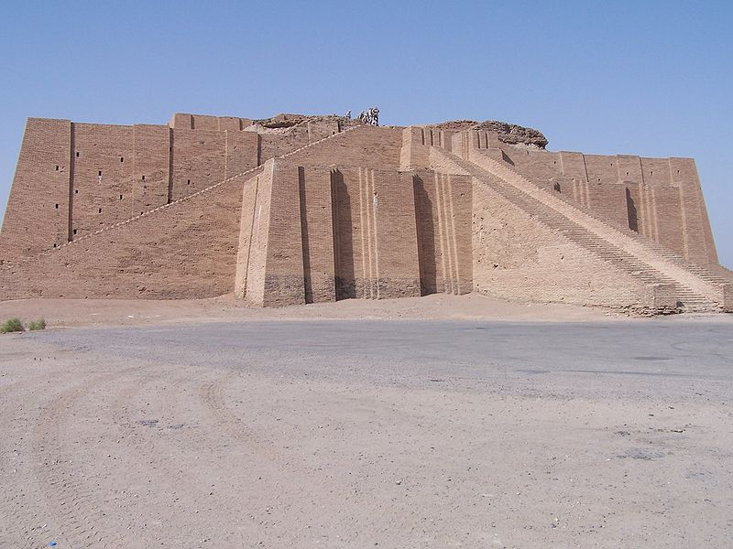
Sumerian Ziggurat at Ur

Slide 15
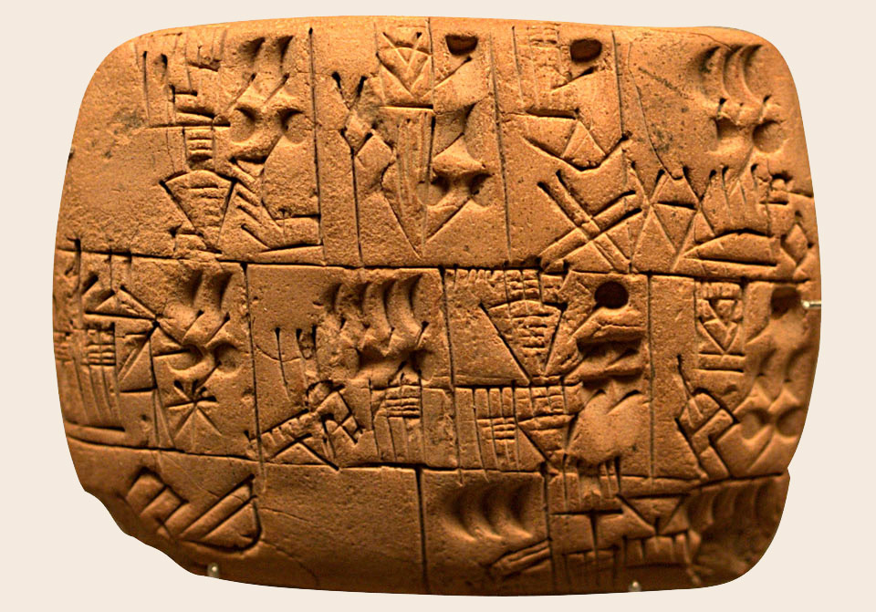
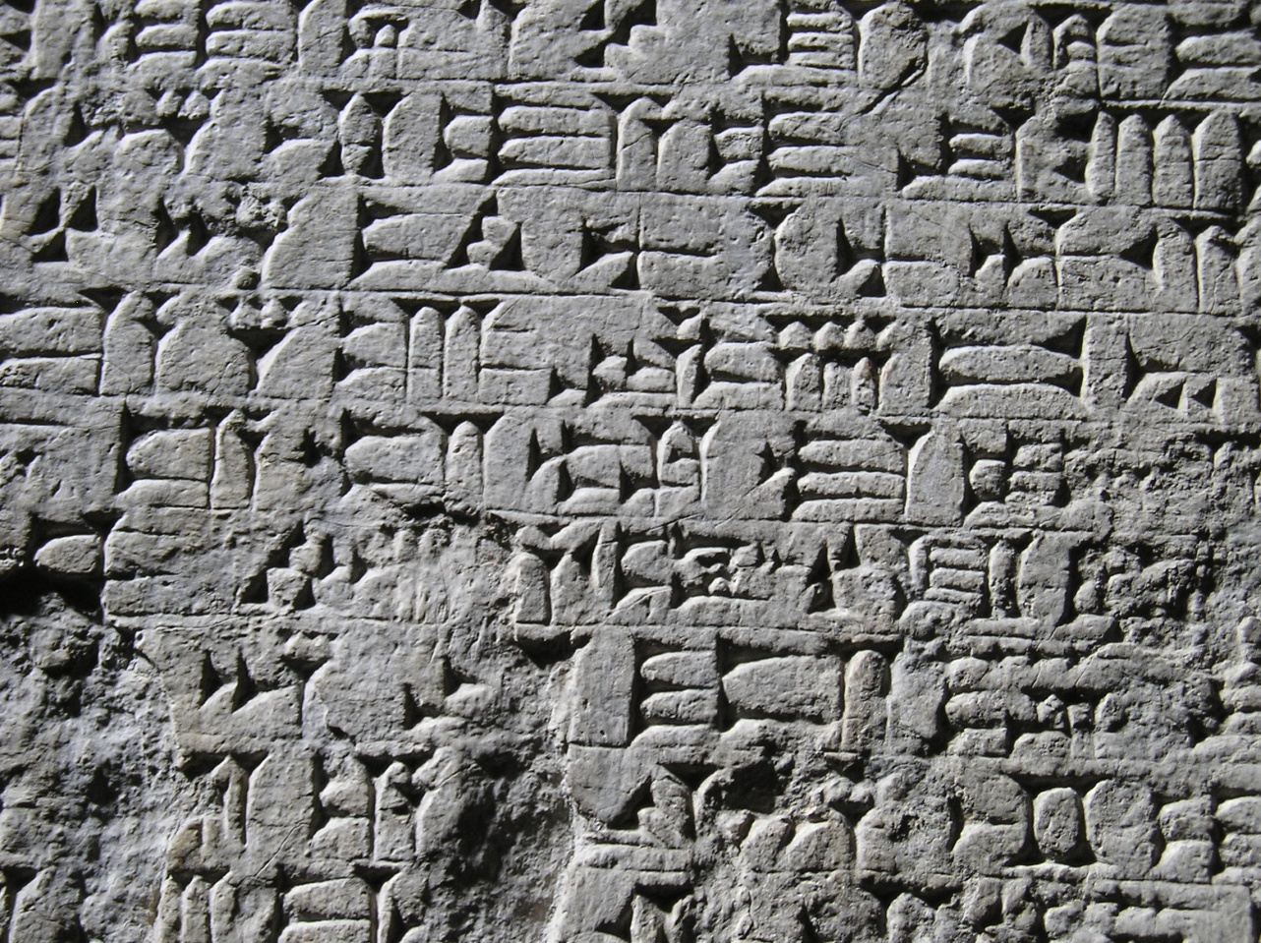
Cuneiform

Slide 16
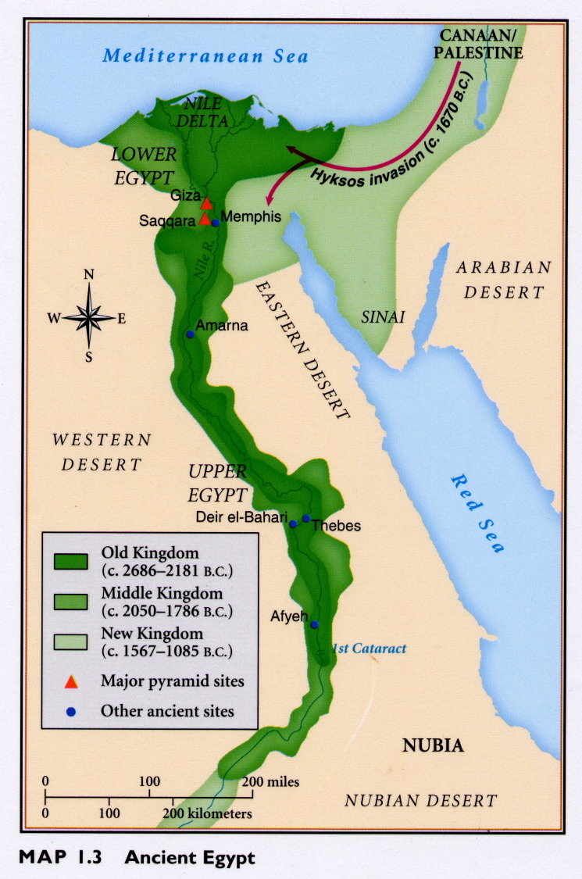

Slide 17
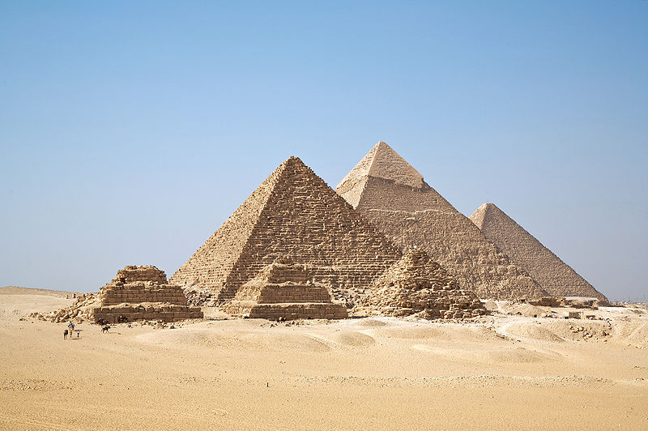
Pyramids of Giza

Slide 18
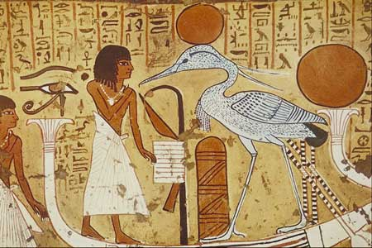
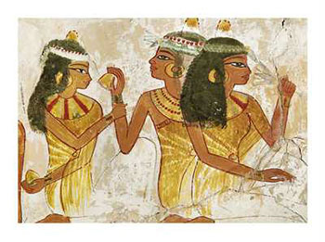
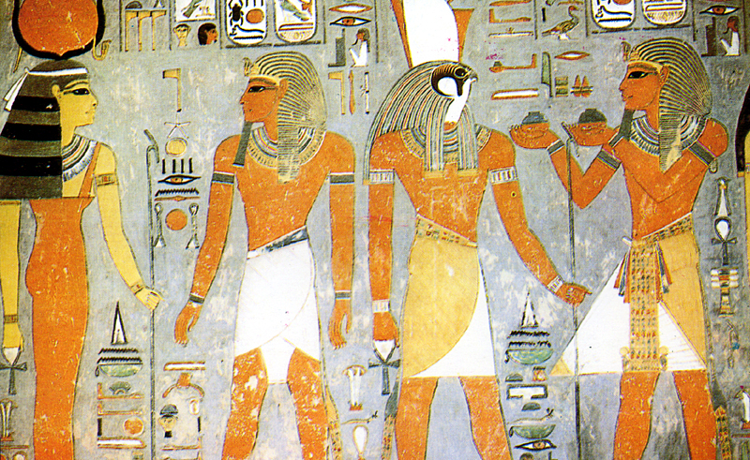

Slide 19
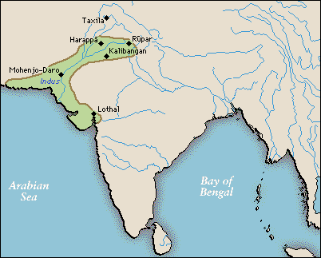

Slide 20
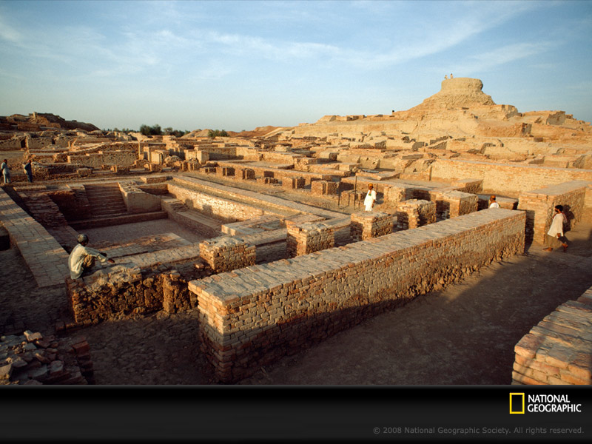
Mohenjo-Daro

Slide 21
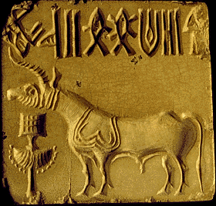
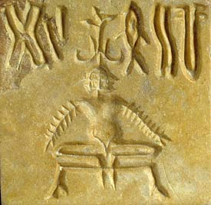
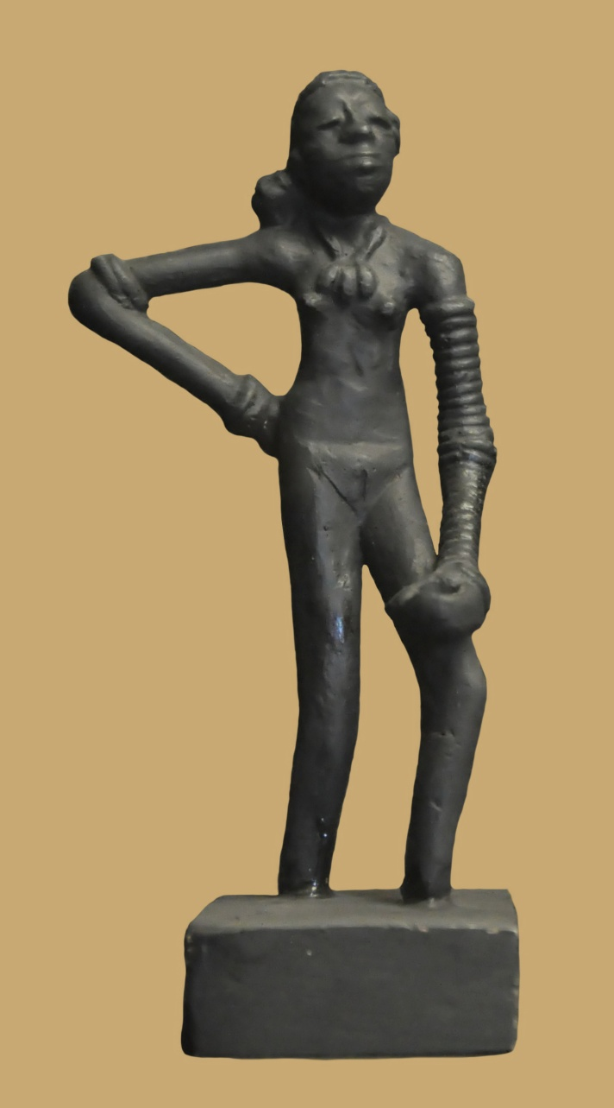
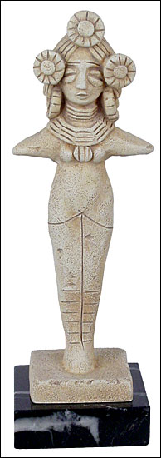
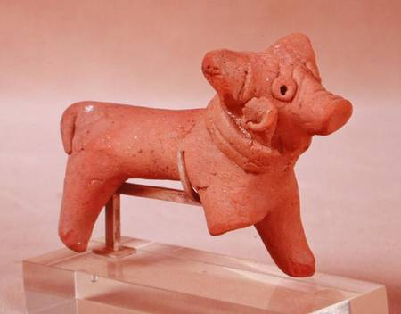
Indus River Valley Culture

Slide 22
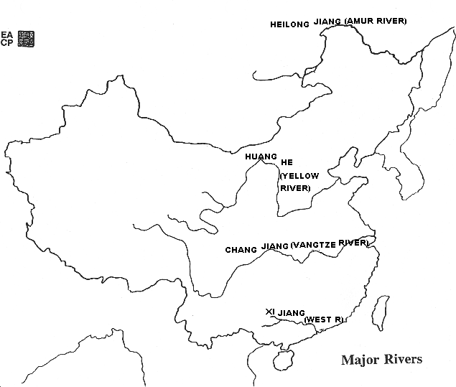

Slide 23
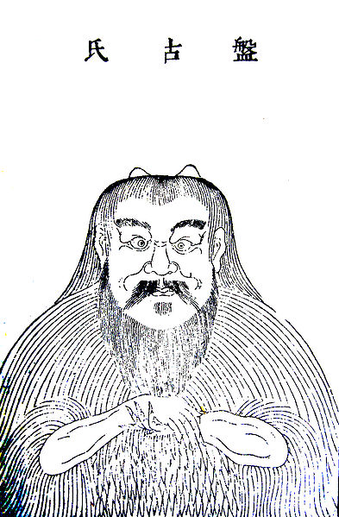
P’an Ku

Slide 24
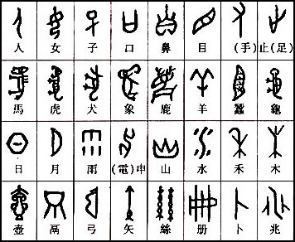
Early Chinese Ideographic Symbols

Slide 25
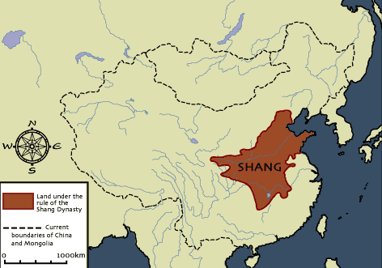

Slide 26
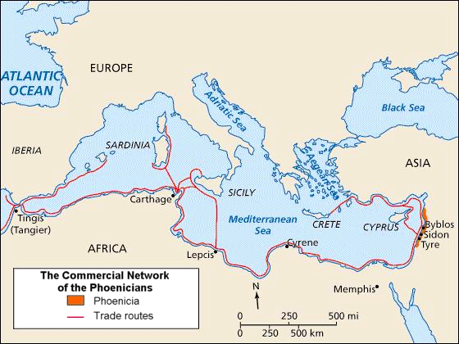

Slide 27
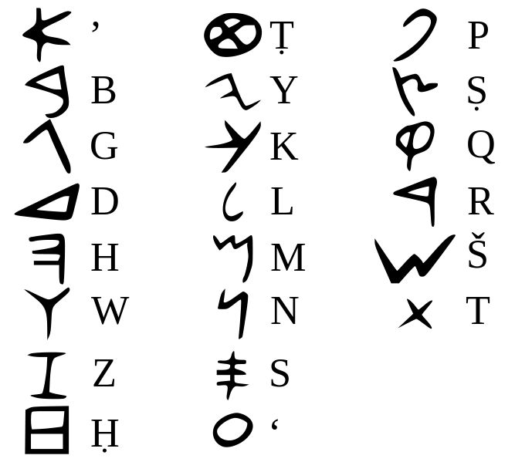
Phoenician Alphabet

Slide 29
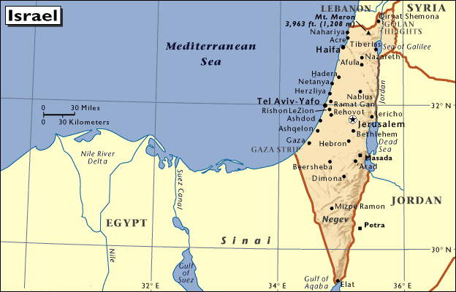

Slide 30
