Slide 1
The Atlantic Slave Trade

Slide 2
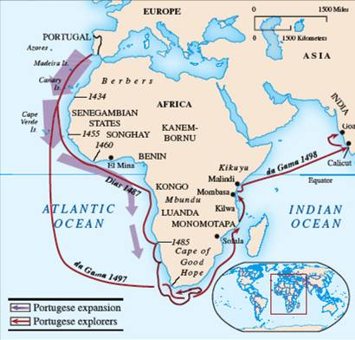

Slide 3
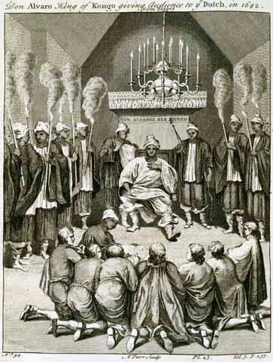
Nzinga Mvemba Portuguese: Alfonso I r. 1509-1542 or 1543

Slide 4
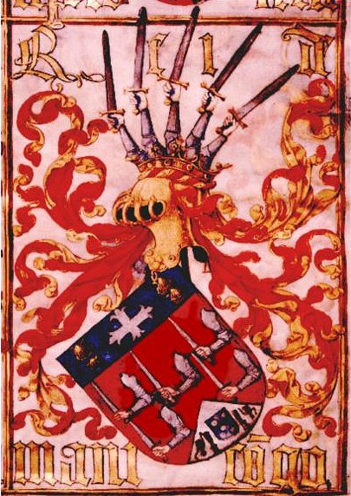
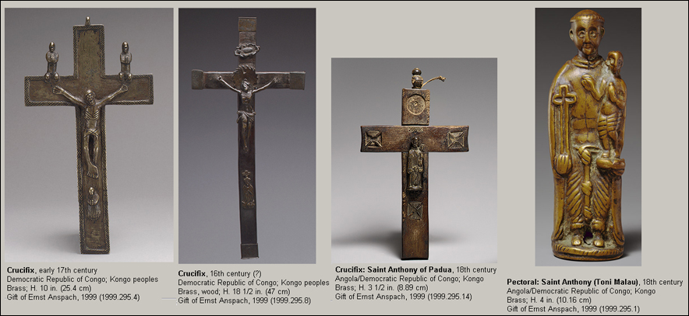
European influences on Kongo

Slide 5
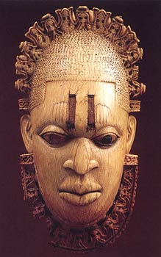
European influence on African Art A Benin monarch w/ European crown and collar

Slide 6
Slave Trade Exports

Slide 7
Slave Transport from Interior Africa

Slide 10
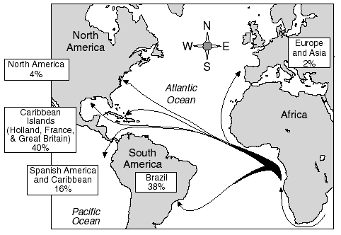

Slide 11
The Slave Trade’s Effects on African Societies

Slide 12
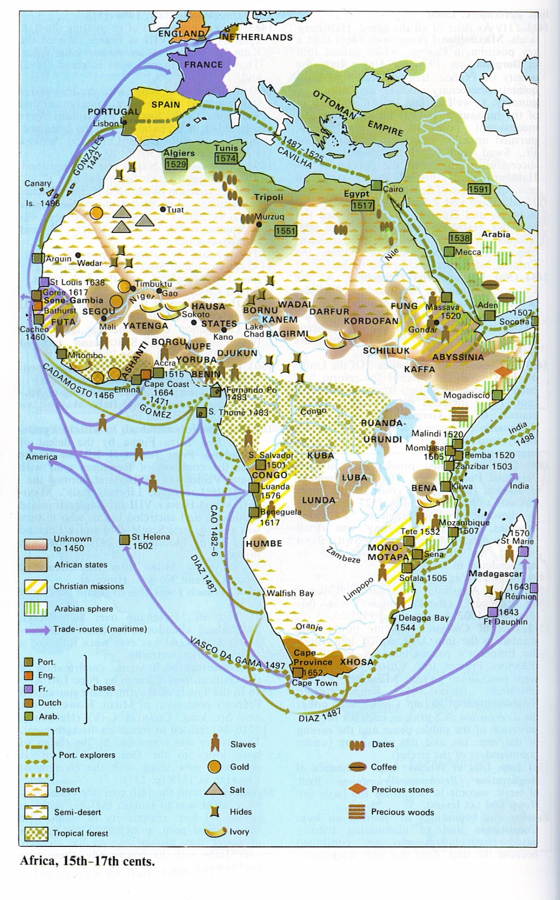
15th-17th Century Africa

Slide 13
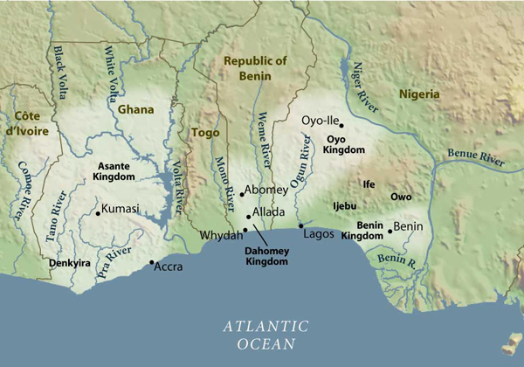

Slide 14
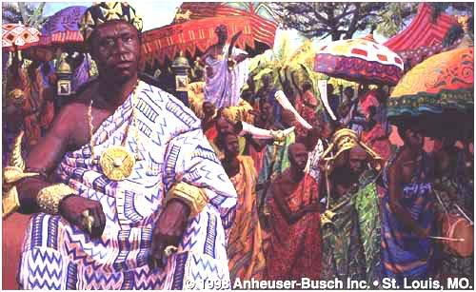
Osei Tutu I r. 1701-1717

Slide 15
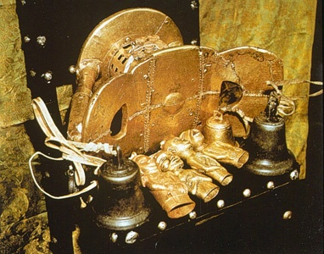
The Golden Stool – Seat of power and believed to be soul of Asante nation, living, dead and yet to be born

Slide 16
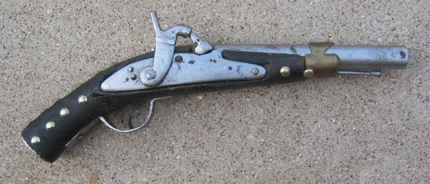
Asante Warrior Pistol

Slide 17
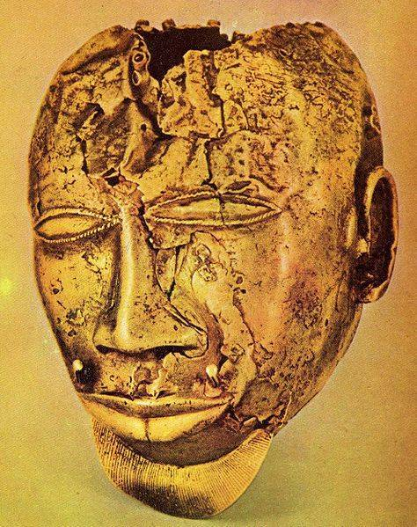
Asante Gold Mask

Slide 18
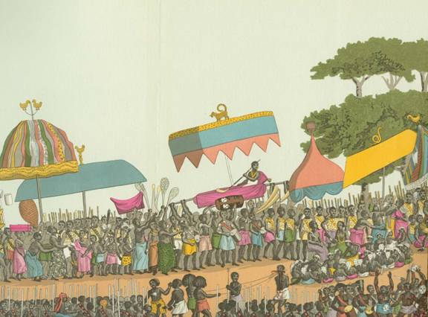
Traditional Asante Yam Harvest Festival as captured by European artists

Slide 20
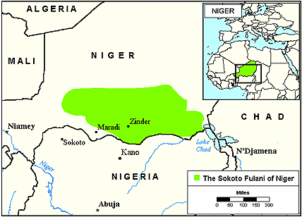
The Fulani Peoples form Sokoto

Slide 21
White Settlers and Africans in Southern Africa

Slide 22
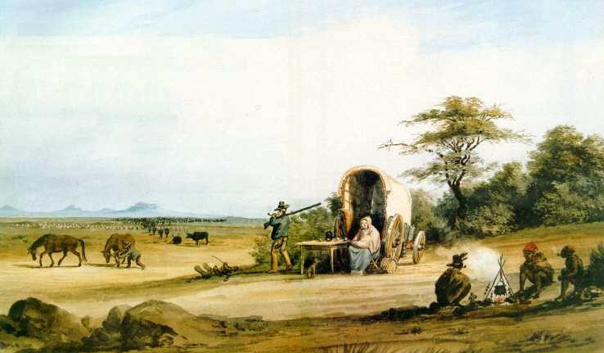
Boer Trekkers

Slide 23
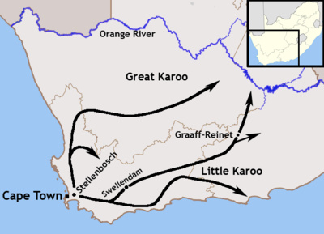
The Great Trek

Slide 24
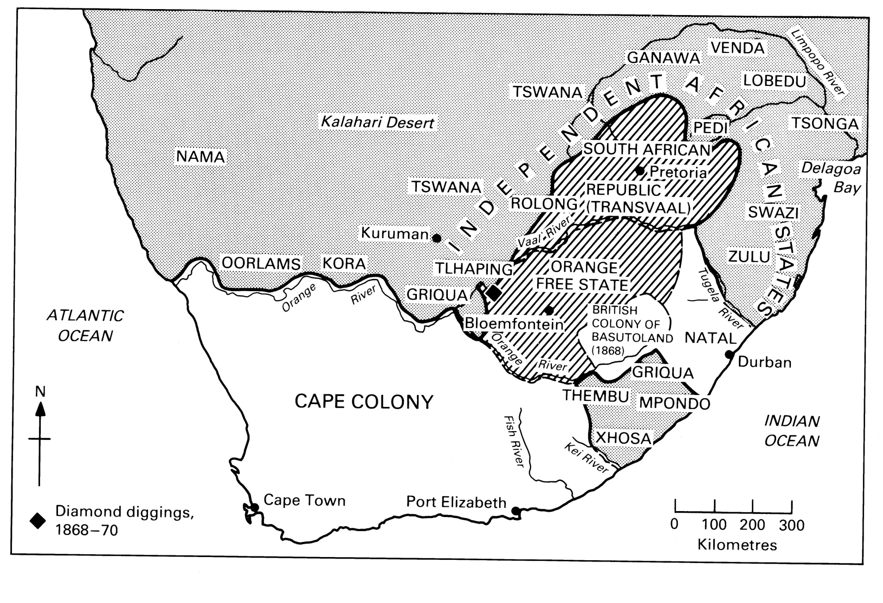
Rise of Zulu Kingdom

Slide 25
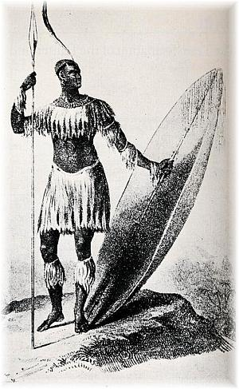
Sketch of Shaka Zulu r.1816-1828

Slide 26
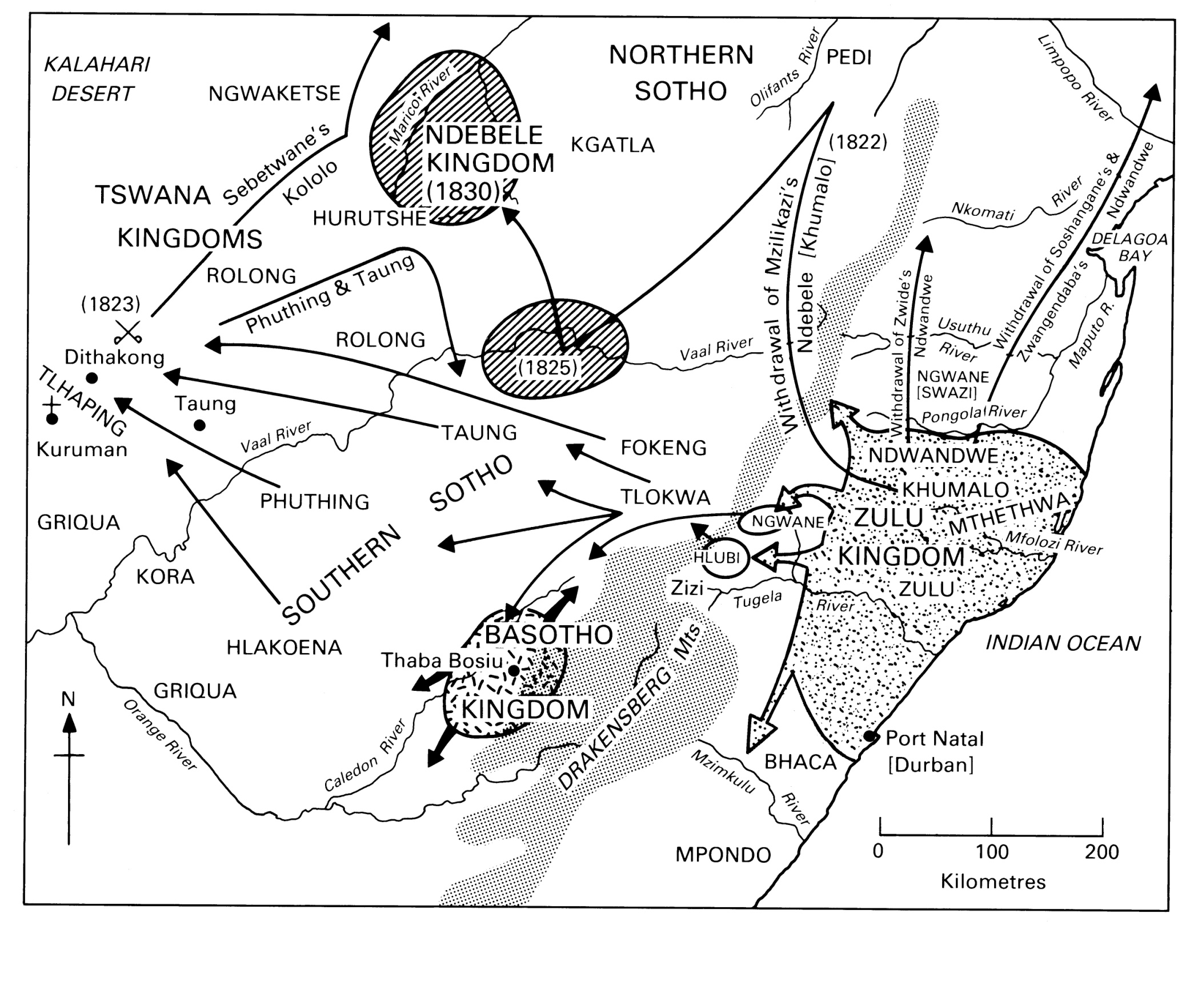

Slide 27
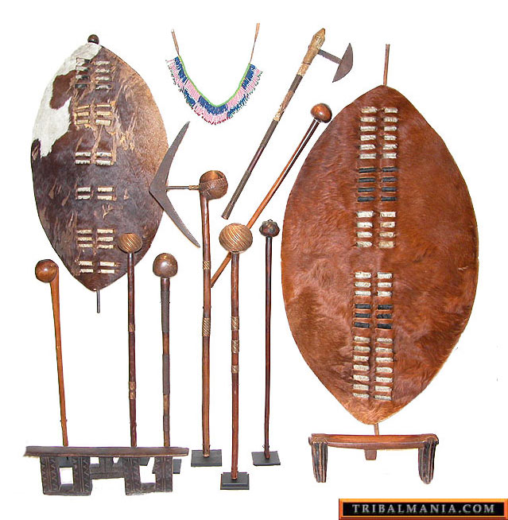
Zulu Weapons

Slide 28
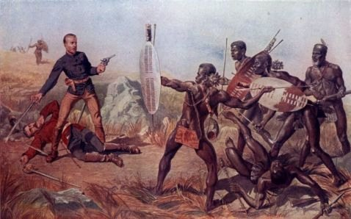
Zulu battles with Europeans

Slide 29
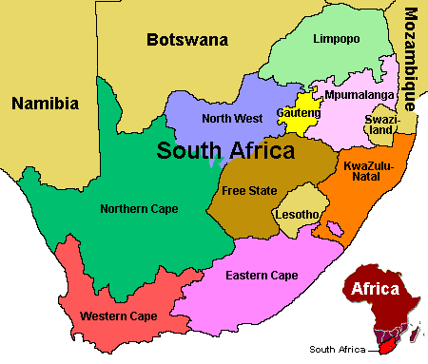
Swazi State and Lesotho

Slide 30
The African Diaspora

Slide 31
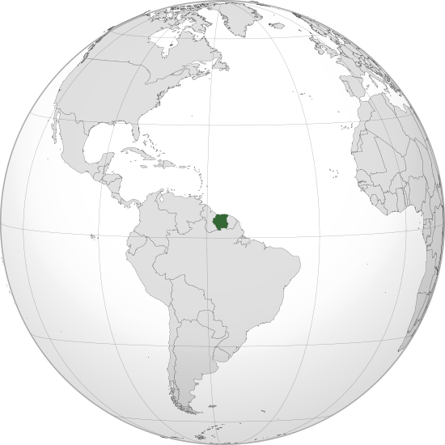
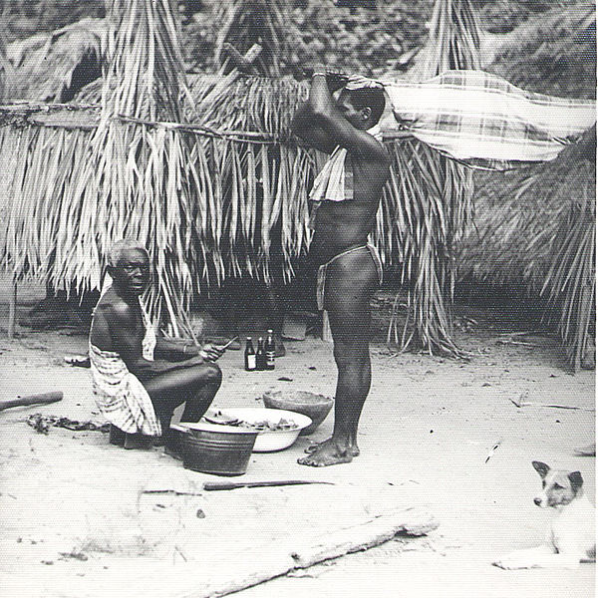
Suriname and Maroons

Slide 32
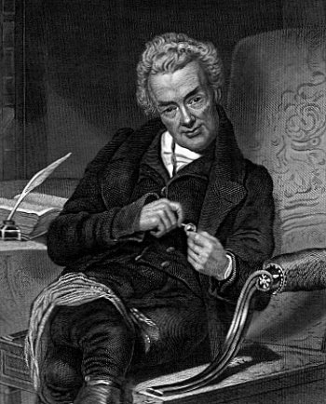
William Wilberforce British Abolitionist

Slide 33
Imperialism in Africa: Mid-Late 1800s

Slide 34
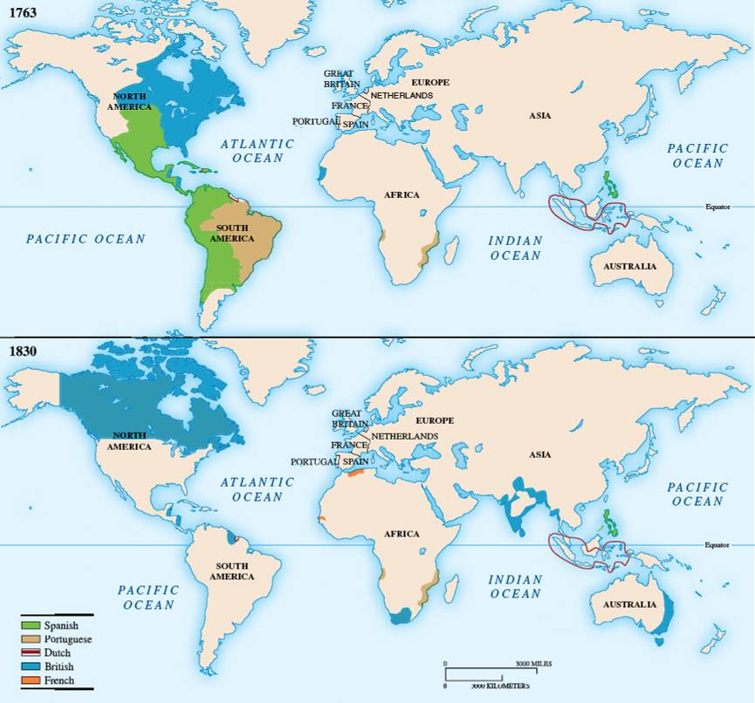
Africa in 1830 – Prior to Imperialism

Slide 35
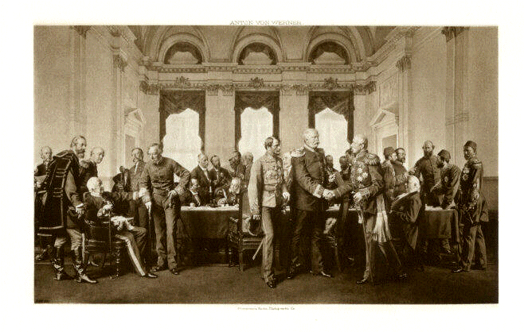
Berlin Conference 1884-1885

Slide 36
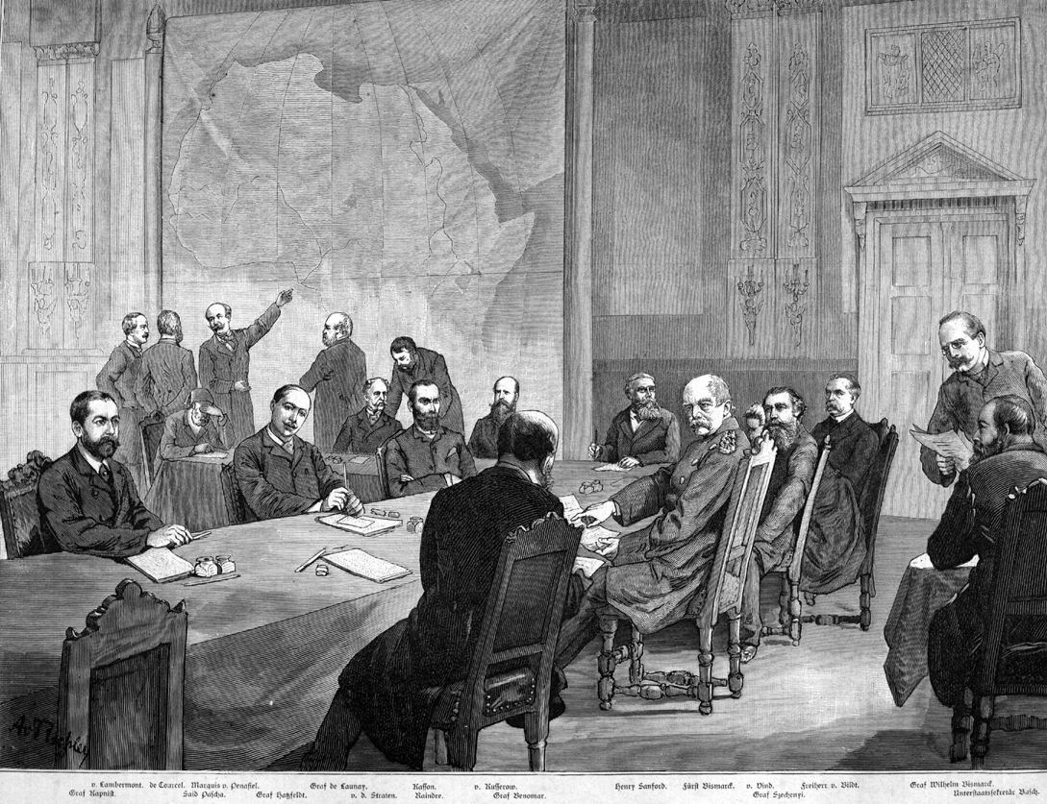

Slide 38
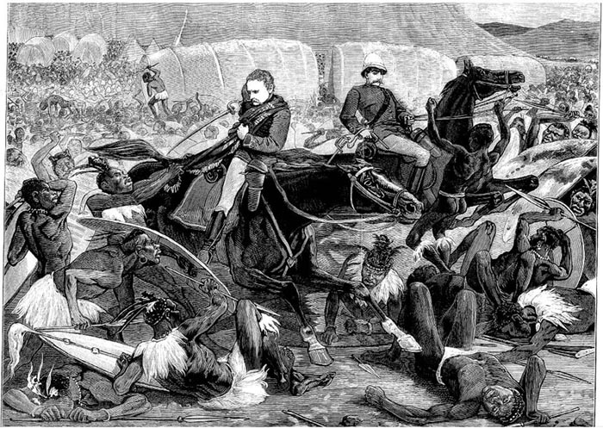
Battle of Isandhlwana

Slide 39
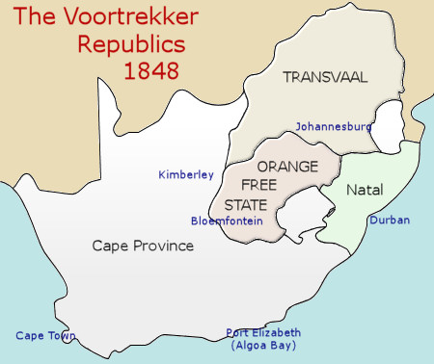
Boer Republics

Slide 40
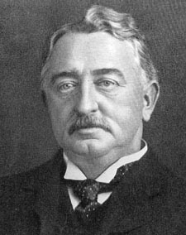
Cecil Rhodes

Slide 41
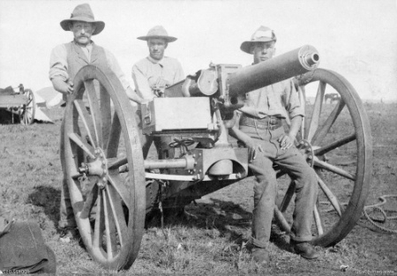
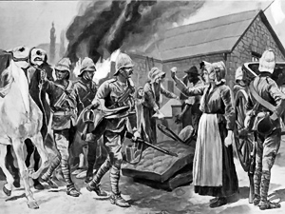
Boer Wars 1899-1902

