Slide 1
Africa
Foundations, Classical, and Postclassical Eras Review

Slide 2
African Geography
Africa so large w/ such diverse geography and societies it’s difficult to generalize about it
These differences contribute to the lack of political unity
Bantu languages (a unifier) spoken throughout sub-Saharan Africa
Geographic regions: Mediterranean zone in far north, then Sahara Desert, then Sahel (great trade zone), then grasslands and jungles throughout middle and south

Slide 3
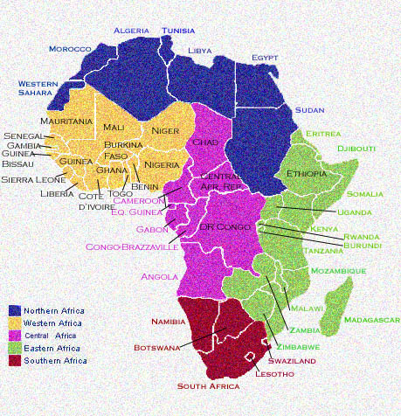

Slide 4
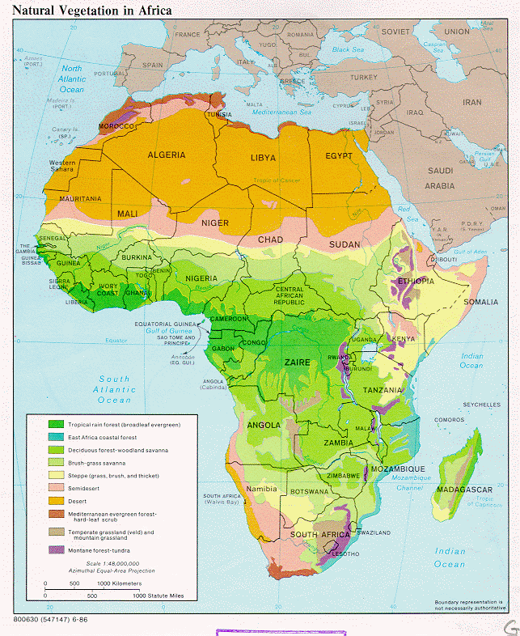

Slide 5
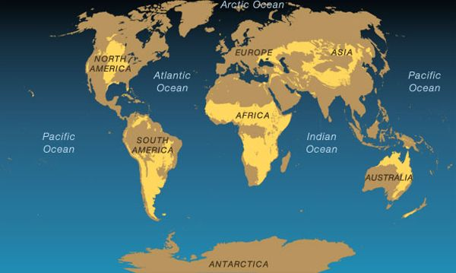
African Grasslands

Slide 6
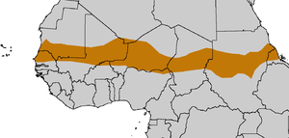
The Sahel

Slide 7
Overview of African Politics and Religion
Much of Africa (pre-contact) characterized by stateless societies – organized around kinship or tribute and lacking concentration of political power and authority associated with states; had councils of elders, no need for taxes, gov’t not a full-time occupation; unable to mobilize for war, organize large building projects, create stable conditions for long distance trade
Other areas had states with a ruler, a court, tax collection
Original religion: animistic with a focus on power of natural forces, ritual and worship (dancing, drumming), divination, sacrifice and witchcraft, cosmology (how universe worked), belief in creator deity, link to deceased ancestors
Had neither universal states nor universal religions until Christianity and Islam arrive, contributing to empires

Slide 8
Foundations Period: 8000 BCE to 600 BCE
East Africa the birthplace for humans
Great Rift Valley the main site
Spread both north and south from there
Bantu migrations start around 2000 BCE, state building 1000 BCE although stateless societies the norm for most during the foundations period

Slide 9
Foundations Period: 8000 BCE to 600 BCE
Important exception: Egypt – description:
Benefitted from Mesopotamian culture (offshoot of it) but developed very differently; easier to defend so more unified and left intact
Politics: dominated by a pharaoh – ultimate ruler with divine right, god-like status; shows blending of religion and politics
Economy: gov’t controlled by pharaohs who used wealth to build pyramids (tombs)
Science/Math: less developed science but more developed math than Mesopotamia (created 24-hr day)
Writing: hieroglyphics – not as advanced as cuneiform
Art: Some of the best in ancient world
Egyptian influence spread to Kush/Nubia and Axum/Ethiopia through trade along rivers

Slide 10
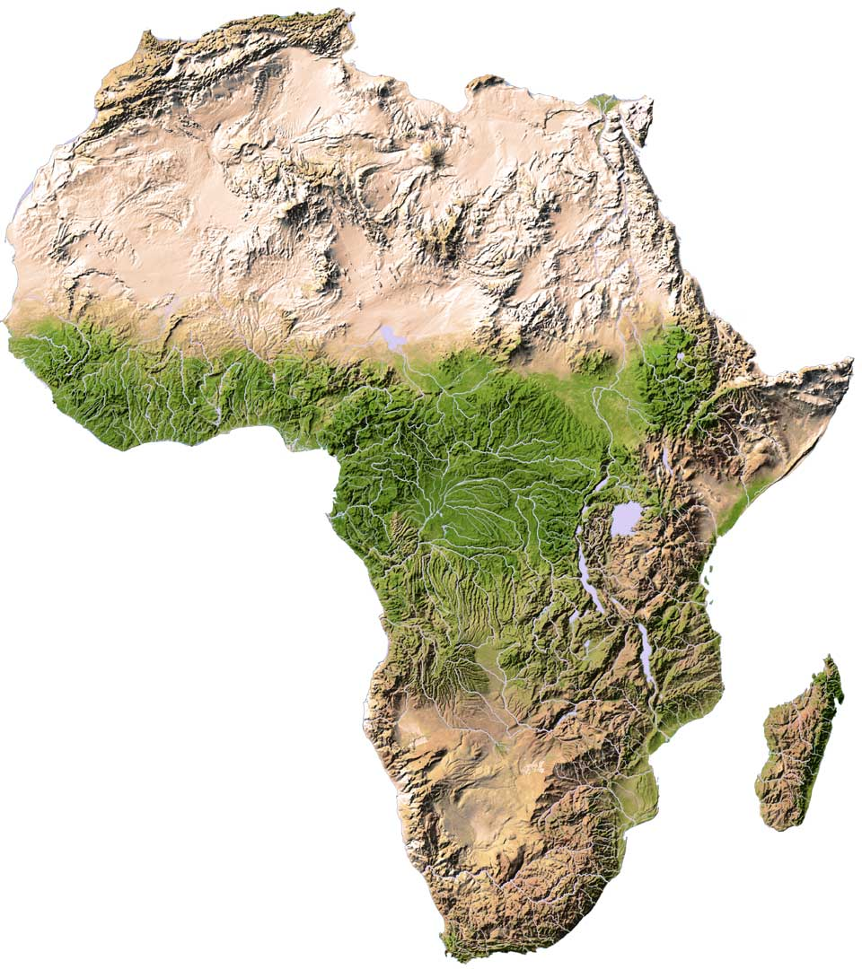
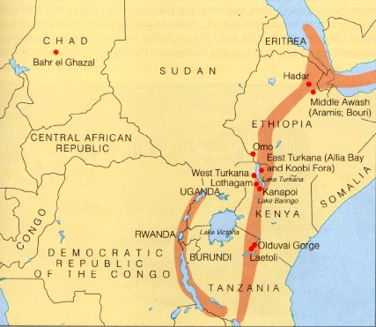
East Africa – Birthplace of Humanity

Slide 11
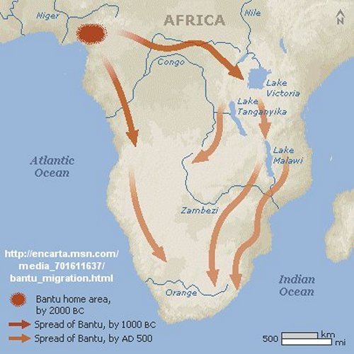
Bantu Migrations

Slide 12
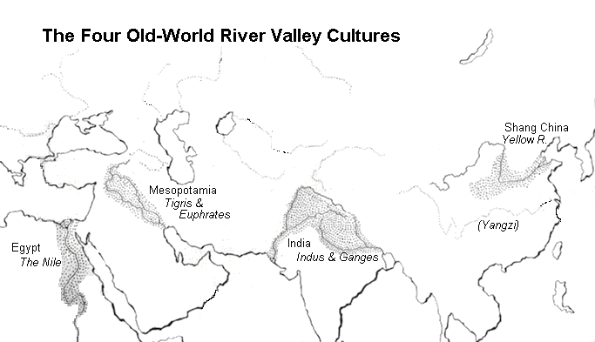

Slide 13
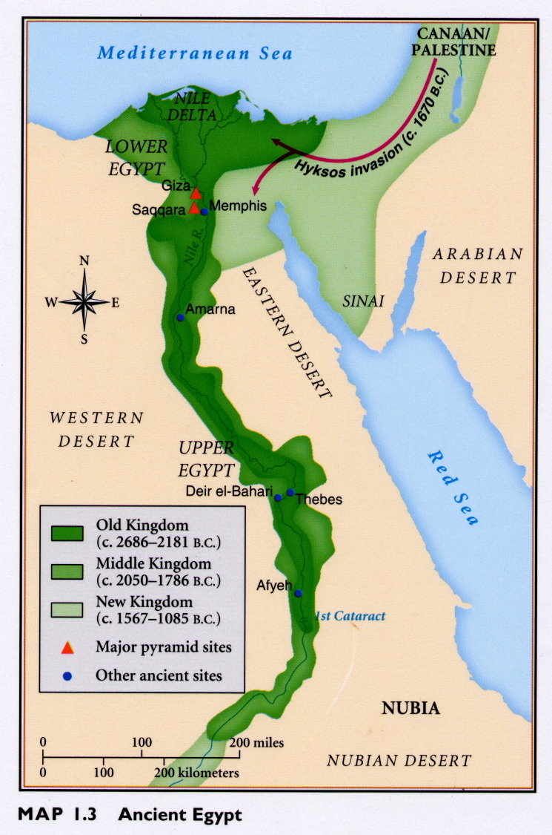

Slide 14
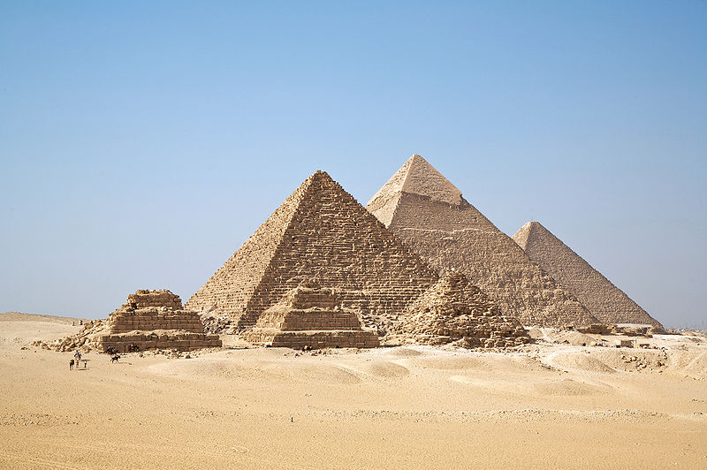
Pyramids of Giza

Slide 15
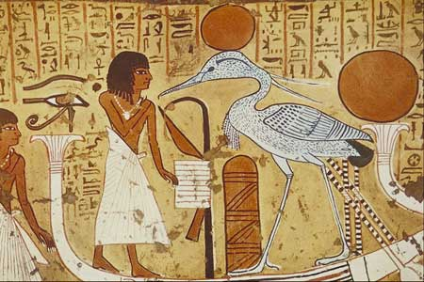
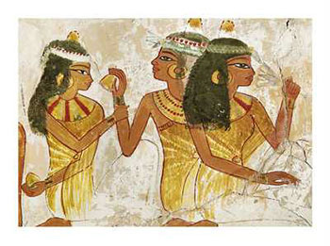
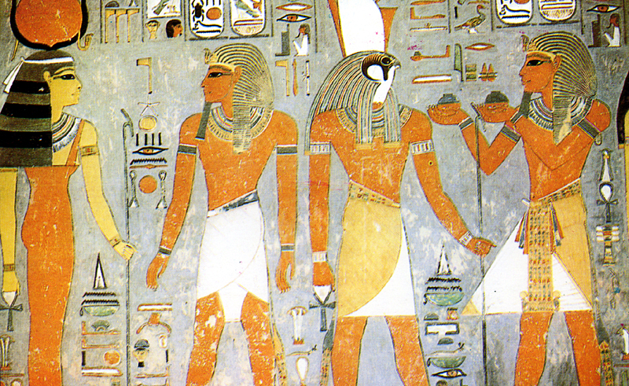

Slide 16
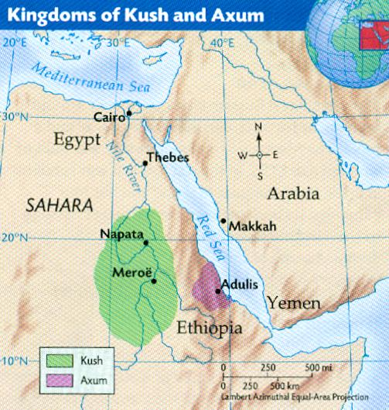

Slide 17
Classical Period: 600 BCE – 600 CE
Stateless societies of Berbers in the north – fully involved in Mediterranean trade by this era; traded throughout Sahara
Important classical -era trade cities: Cyrene and Carthage
Carthage built by sea-trader Phoenicians originally from the Levant (spread their alphabet to Greeks)
Hellenic (Greek) culture spread to north Africa with Alexander the Great’s conquest of Egypt in 332 BCE
Alexandria became a great place of learning, culture
When Christianity arises in 1st century CE, it spreads 1st through Egypt due to Greek contacts, forming Coptic Christianity
Then spreads down into Kush/Nubia , Axum/Ethiopia
Traded with Byzantine Empire in late Classical era & for short time loosely tied to it but eventually split with empire – doctrinal and political issues

Slide 18
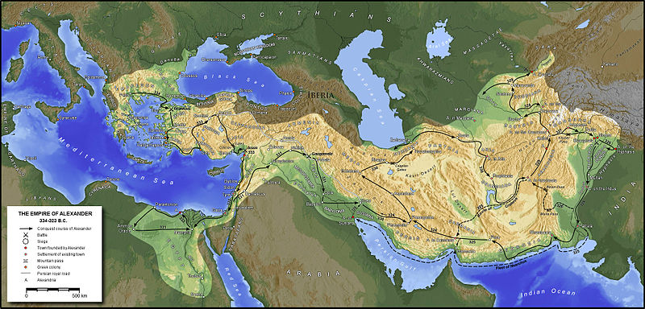
Conquests of Alexander the Great

Slide 19
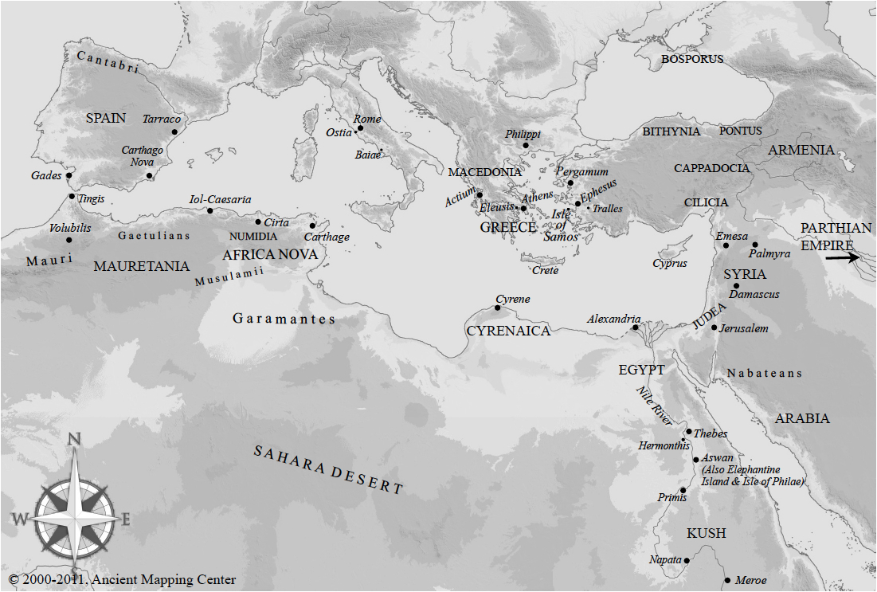
Carthage and Cyrene

Slide 20
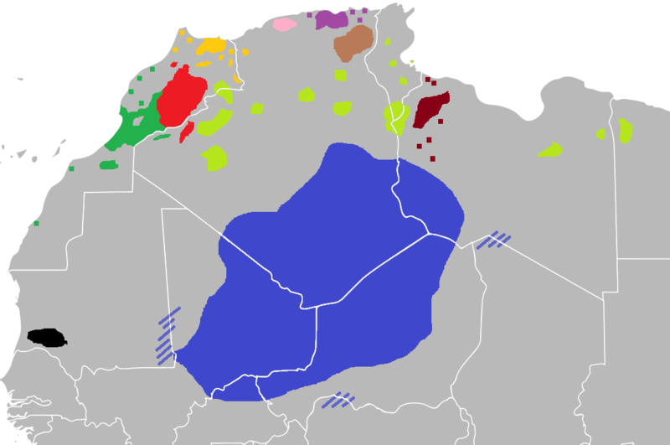
Berber Language Groups Today

Slide 21
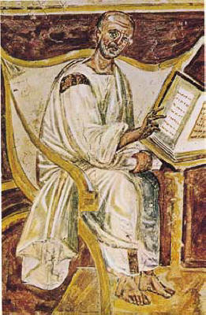
Augustine of Hippo, early Christian leader in Africa

Slide 22
Classical Period: 600 BCE – 600 CE
Axum (Ethiopia) – most important African Christian outpost in Africa
Cut off from Byzantium surrounded by pagans, influenced by Jewish/pagan immigrants -syncretism
Eventually, a dynasty appeared in late 13th, 14th centuries (postclassical)
Built rock sculpture churches
Traced origins to marriage of Solomon and Sheba – Old Testament
Maintained its brand of Christianity – isolated
These will be the “islands of Christianity” left after Muslim conquest

Slide 23
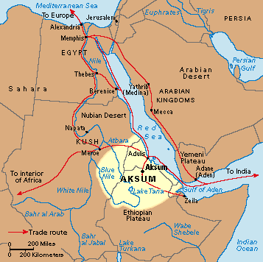
Kush/Nubia and Axum/ Ethiopia

Slide 24
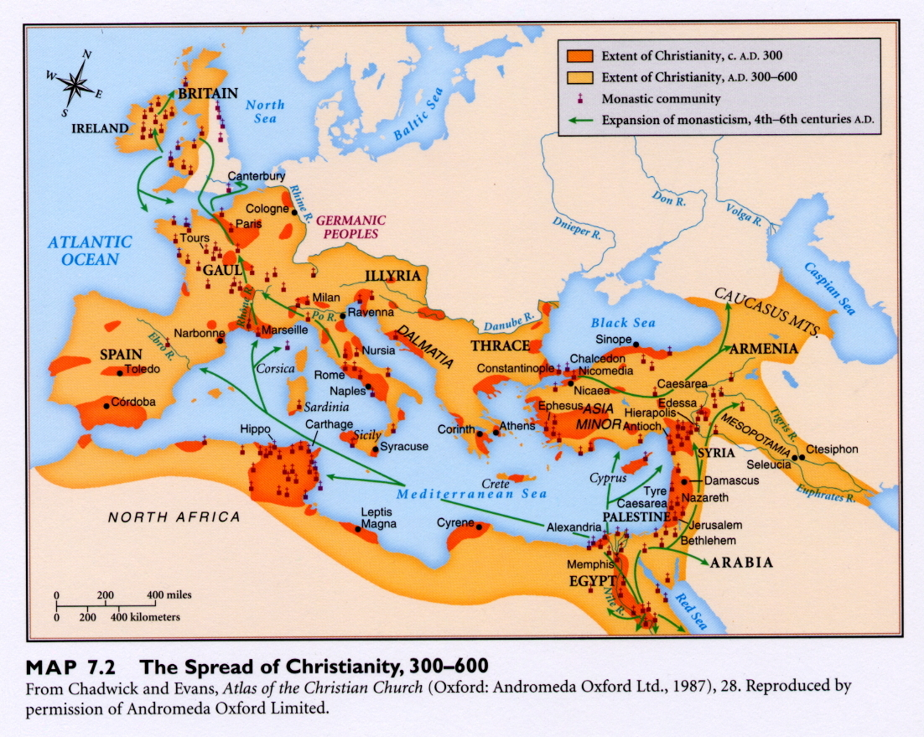

Slide 25
Postclassical Period: 600 CE -1450 CE
Main event of period: arrival/impact of Islam – 1st continent it spread to
Many rulers used it to legitimize their kingship
Often adopted Islam to become Dhimmi (People of the Book)
640-700 CE – Muslim followers spread across Africa under Umayyads and by 670, controlled Ifriqiya (NE Africa) and Maghrib (NW Africa)
Abbasid dynasty continued marching west across Africa and into Spain

Slide 26
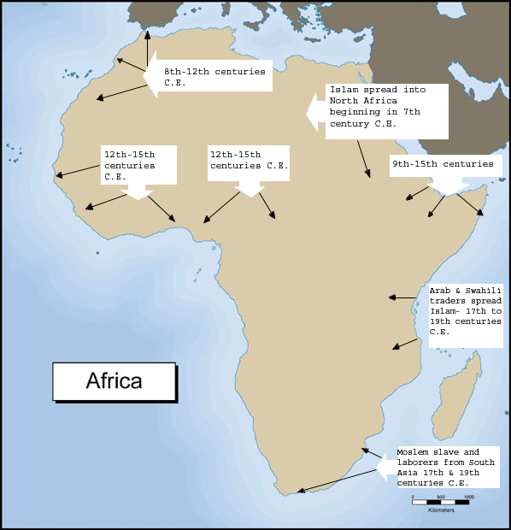
Arrival and spread of Islam

Slide 27
Postclassical Period: 600 CE -1450 CE
When Abbasid dynasty broke up, several competing Arab-led states formed and during 11th - 12th centuries – puritanical reformist groups spread throughout Africa and Spain
Almoravids – ultra-conservative - reformers
launched jihad – holy war to purify, spread, protect faith
Almohadis – also reformers, very similar – overthrew Almoravids
also wanted a return to original teachings of Muhammad
Why Islam was attractive to Berbers/other Africans
Egalitarian teachings – all Muslims are equal
Reinforced African kings authority b/c united people under 1caliph figure
Put Berbers/other Africans on = footing w/Arab invaders(on paper that is)
Still, disparity between law and practice

Slide 28
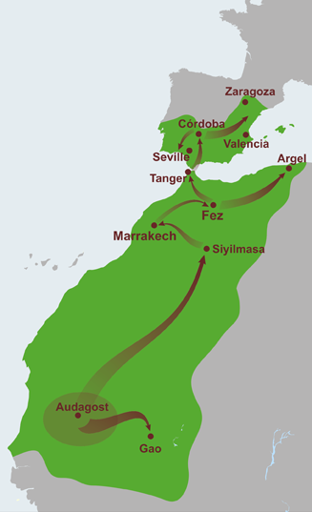
Almoravid Dynasty of 11th-12th centuries

Slide 29
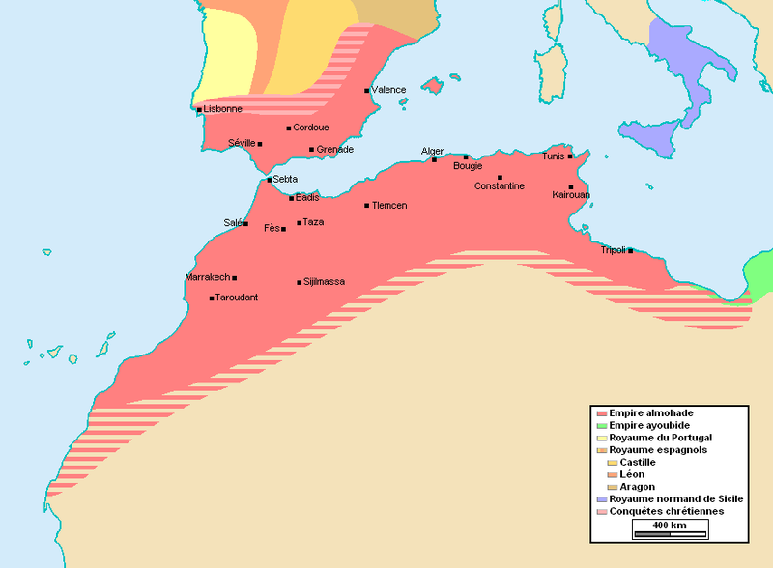
Almohad Dynasty (Almohadis) in 12-13th Centuries

Slide 30
Sudanic States in the Postclassical Period
Islam in the Sudanic States of West Africa:
Before Islam, ruled by patriarch or council of elders with states that could collect taxes, tribute, military support
200s CE Ghana rose to power through taxing salt, gold exchange
Declined in power due to Almoravid armies invasion in 1076
New States then emerge – Mali, Songhay starting in 13th century (1200s)

Slide 31
African states 600-1450

Slide 32
Sudanic States in the Postclassical Period
The Empire of Mali – formed when Malinke people broke from Ghana
Rulers supported Islam – encouraged obedience to ruler
Built mosques, attended public prayers, supported preachers
Juula – traders: small but important group in economy; gold mostly
Griots – professional oral historians b/c Africa preliterate
Sundiata (Sunjata) – leader nicknamed “Lion Prince” who expanded Mali during his reign

Slide 33
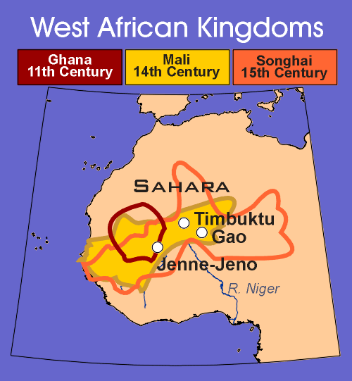

Slide 34
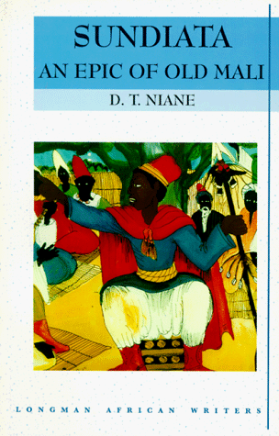
Sundiata

Slide 35
Mali Continued
Ibn Batuta – Arab traveler – noted impressive power of Mali
Mansa Musa – Sundiata’s successor; 1324 trip to Mecca on hajj with luxurious caravan passed out gold , devalued local economies
Had a Muslim Spanish architect design great Mosque of Jenne
Timbuktu becomes important trading city

Slide 36
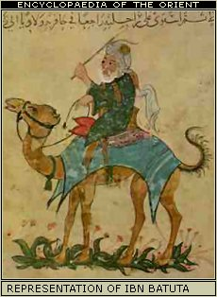
Ibn Batuta

Slide 37
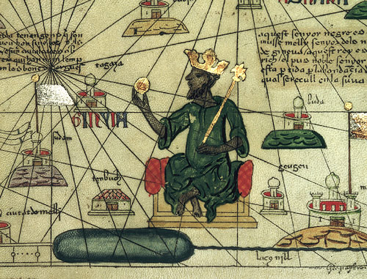
Mansa Musa

Slide 38
Mansa Musa’s Pilgrimage

Slide 39
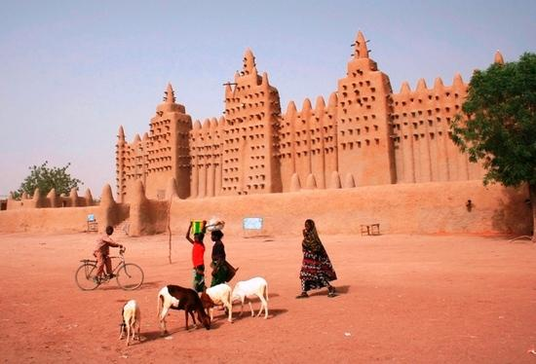
Mosque at Jenne

Slide 40
A Malinke Griot

Slide 41
Sudanic States Continued and Impact of Trans-Saharan Slave Trade
Next big empire: Songhay (Songhai) in 1370 broke from Mali
By Mid-16th century Songhay dominated Sudan under Muhammad the Great
Familiar pattern: unique brand of Islam due to syncretism w/ pagans
Woman mixed freely in public, no veil for example
But… Sharia Law says it must be patrilineal
Many visitors shocked at African women’s equality
Downfall when Muslim army from Morocco came down, led to revolts

Slide 42
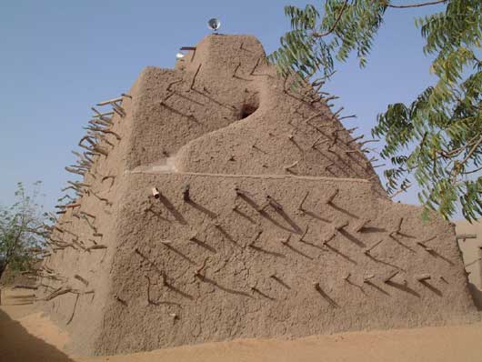
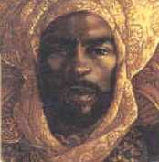
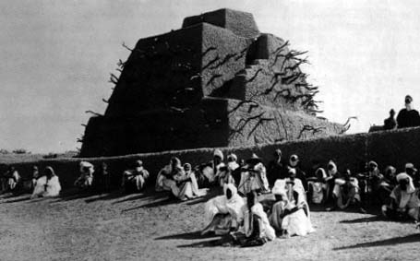
Muhammad the Great of Songhay’s Tomb

Slide 43
Sudanic States Continued and Impact of Trans-Saharan Slave Trade
Impact of slavery: up to 4.8 million traded on Trans-Saharan route
Always existed, Muslims brought it to new heights
Muslims saw slavery as process in conversion
Slaves used as servants, laborers, soldiers, administrators, eunuchs, concubines
Led to desire to enslave women and children
Children of slave mothers freed which creates need for more slaves so cycle continued

Slide 44
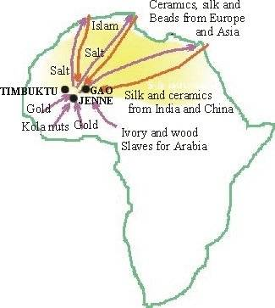
Trans-Saharan Trade Routes Used camels in caravans after Arabs arrive

Slide 45
The Swahili Coast
Bantu settlers arrive in 1st century CE
Islamic merchants settle in coastal villages
Swahili culture emerges by 13th century – blend of Bantu, Arab; Swahili language also a blend of the 2
Plays major role in Asian Sea Trade network
traded w/ Arabs, Persians, Indians, Chinese
Traded raw materials like gold, iron, slaves, exotic animals for Indian, Islamic, & Chinese luxuries such as silks, porcelain

Slide 46
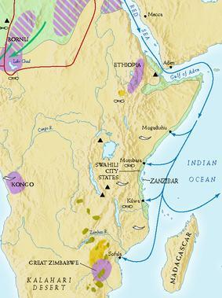

Slide 47
The Swahili Coast
Islam embraced here b/c it had a universal set of ethics which maritime contacts easier
Coastal cities became dominated by ruling Muslim African families
Sofala – beautiful coastal city, furthest southern city that could catch monsoon, key to trading in Indian Ocean
Link to coastal commerce and caravan trade in coastal cities
1500 Portuguese arrive; wanted to control gold trade and established Fort Jesus, but never able to control trade

Slide 48
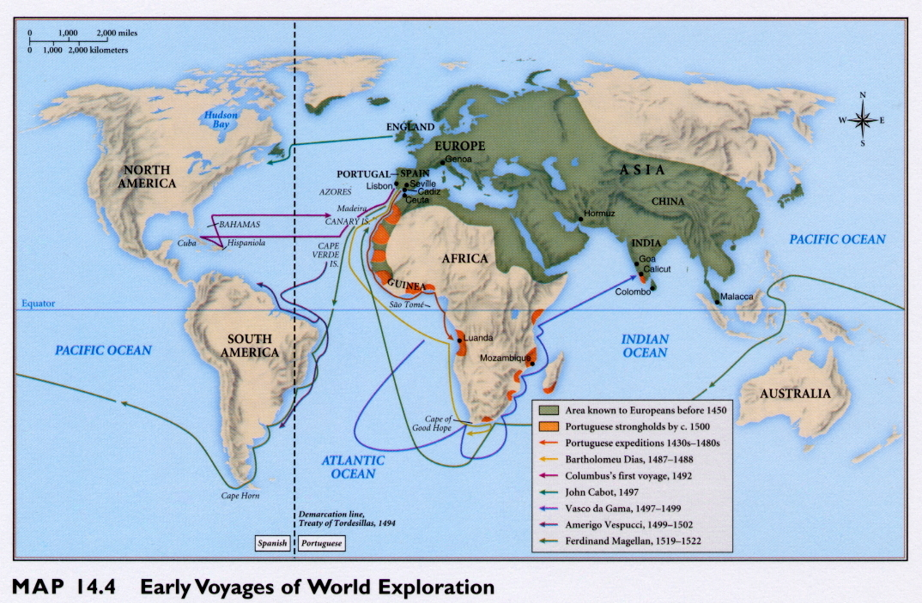
Portuguese Expansion into Indian Ocean

Slide 49
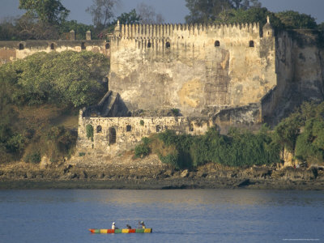
Fort Jesus

Slide 50
Other Postclassical Societies & Global Connections
Great Zimbabwe dominates central Africa 9th-16th centuries
Built massive stone enclosures (zimbabwe)
Supplied gold to the Swahili coast
Declined due to internal divisions by the 16th century
Great Zimbabwe part of Bantu Confederation that dominated region

Slide 51
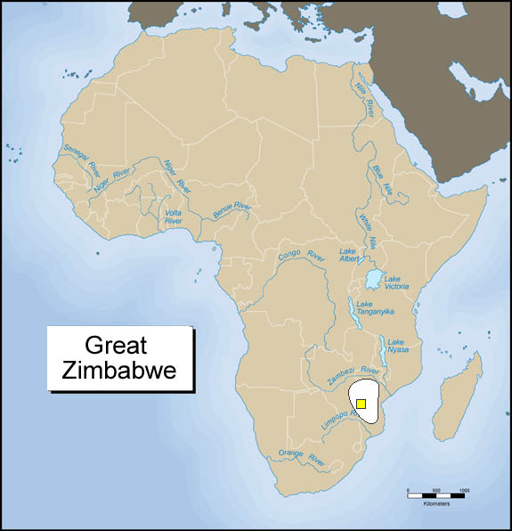

Slide 52
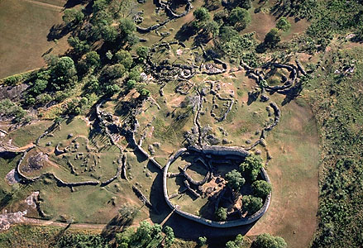
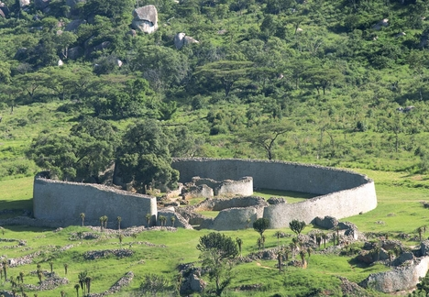

Slide 53
Other Postclassical Societies & Global Connections
Benin established 15th century by the Edo peoples
Known for its bronze and ivory sculptures
Portuguese were impressed by cities and the quality of artwork
Kongo flourishing by late 15th century
kingship hereditary but had confederation style gov’t
Art – weaving, pottery, blacksmithing
population of 60-100K by 16th c.

Slide 54
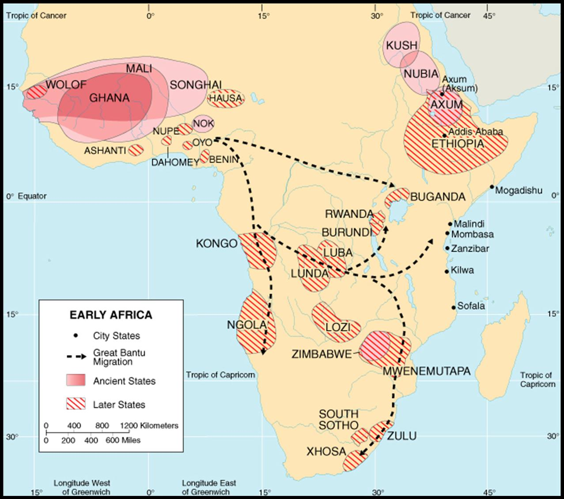
Kingdom of Benin

Slide 55
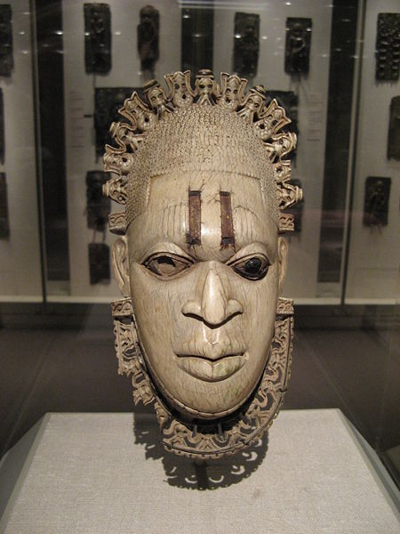
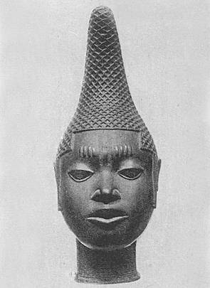
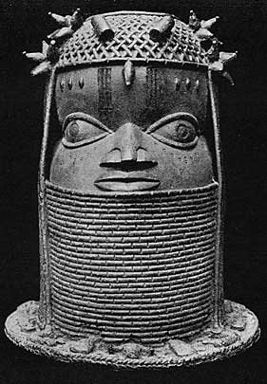
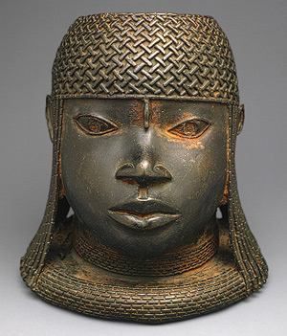
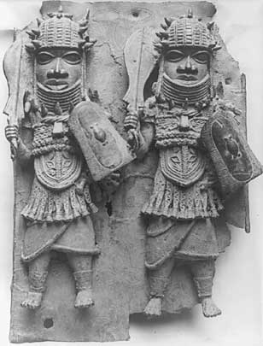

Slide 56
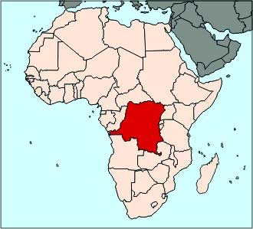
Kongo

Slide 57
Other Postclassical Societies & Global Connections
Global Connections for Classical through Postclassical Eras
More written records in Sudanic states and Swahili coast – due to Islam’s entrenchment
Synthesis of African/Islamic values changed some Africans lives
Portuguese arrived in 15th century causing another important wave of interactions w/ Africans
Muslims and Portuguese intensified trade of ivory, slaves and gold
Widened trade and global relations for Africans
Next big events for Africa in early modern and modern periods: The Atlantic Slave Trade (Triangle Trade) then Imperialism

